Slide 1
Tumor modeling
A hybrid approach in cancer modeling

Slide 2
Several ways to modeling cancer tumor growth
Continuous model: based on a set of differential equations
Discrete model: using cellular automata
Agent based model: https://github.com/petermchale/tumor

Slide 3




Cell population and cell life cycle
Monte-Carlo simulation
Discrete random value: $ζ=\left\{\begin{aligned}\text{Death}, P_{death} \\ \text{Interphase}, P_{rest} \\ \text{Metaphase}, P_{div}\end{aligned}\right.$
Need to guarantee that $P_{death}+P_{rest}+P_{div}=1$
Representation of the life cycle model:
Death
Interphase
Metaphase
$$ζ<P_{death}$$
$$P_{death}<ζ≤1−P_{div}$$
$$ζ>1−P_{div}$$

Slide 4
Cell dynamics
Borrowed some idea from molecular dynamics.
Consider the cell spatial model as a “gas cloud”.
Each single cell’s interaction is determined by 2 type of forces: adhension(attractive) forces and haptotaxis(repulsive) forces.

Slide 5
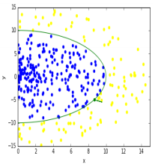
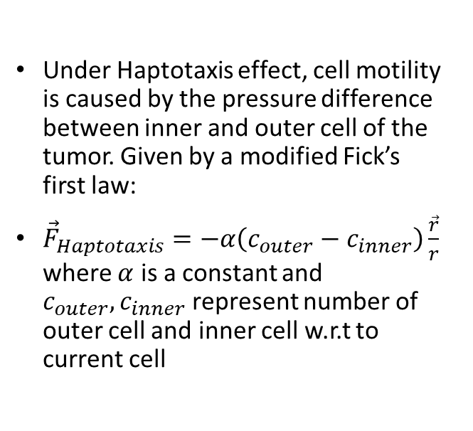
Haptotaxis Force
Under Haptotaxis effect, cell motility is caused by the pressure difference between inner and outer cell of the tumor. Given by a modified Fick’s first law:
${\vec{F}}_{Haptotaxis}=−α\left(c_{outer}−c_{inner}\right)\frac{\vec{r}}{r}$ where $α$ is a constant and $c_{outer},c_{inner}$ represent number of outer cell and inner cell w.r.t to current cell

Slide 6

Adhension Force
Adhesion forces are caused by cell-cell mechanical interaction throw special components of their membranes or skeletons.
The action radius of the adhension force should be short enough.
Given by the following formula with cut-off radius:
${\vec{F}}_{Adhension}=−β\frac{\vec{r}}{r^{3}}e^{−γr}=−β\frac{\vec{r}}{r^{3}}e^{−\frac{r}{R_{cut−off}}}$, where $β$ is a constant, $r$ is the radius of the cell, $\vec{r}$ is the radius vector from another cell to the current cell, and $R_{cut−off}$ is simply the cut-off radius. In this case, we can set the cut-off radius to be $2⋅r+ε$

Slide 7
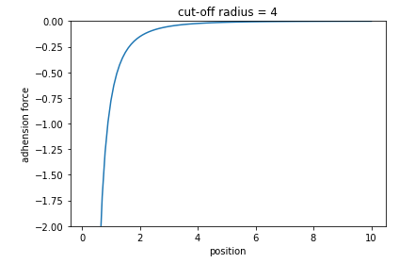
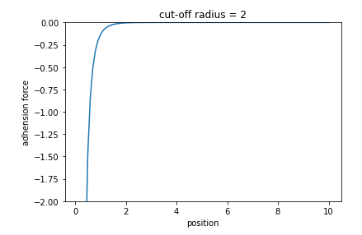

More about cut-off radius
Consider a 1-D case, let the tumor center to be at $x_{center}=0$
Consider 2 cells $c_{1}$, $c_{2}$ in the tumor, $c_{1}$ is at position $x_{1}=1$, $c_{2}$ is a moving cell from position 10 to 1, then we can compare the adhension force of $c_{2}$ given by $c_{1}$ with different cut-off radius.

Slide 8

Cell motion
${\vec{F}}_{Total}^{j}={\vec{F}}_{Haptotaxis}^{j}+{\vec{F}}_{Adhension}^{j}=−α\left(c_{outer}^{j}−c_{inner}^{j}\right)\frac{{\vec{r}}^{j}}{r^{j}}−β\sum_{i≠j}{\frac{{\vec{r}}_{i}^{j}}{{{(r}_{i}^{j}+R_{Banned})}^{3}}e^{−\frac{r_{i}^{j}}{R_{cut−off}}}}$, here $j$ means j-th cell, $R_{Banned}$ is an artificial banned radius.
${\vec{a}}^{j}=\frac{{\vec{F}}_{Total}^{j}}{mass}$, now we can further write out the formula for x-coordinate representations.
$\left\{\begin{aligned}a_{x}^{j}=\frac{dv_{x}^{j}}{dt}=\frac{α\left(c_{outer}^{j}−c_{inner}^{j}\right)\frac{x^{j}}{r^{j}}−β\sum_{i≠j}{\frac{x^{j}−x^{i}}{{{(r}_{i}^{j}+R_{Banned})}^{3}}e^{−\frac{r_{i}^{j}}{R_{cut−off}}}}}{mass} \\ \frac{dx^{j}}{dt}=v_{x}^{j}\end{aligned}\right.$

Slide 9
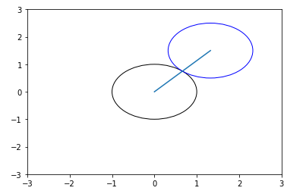
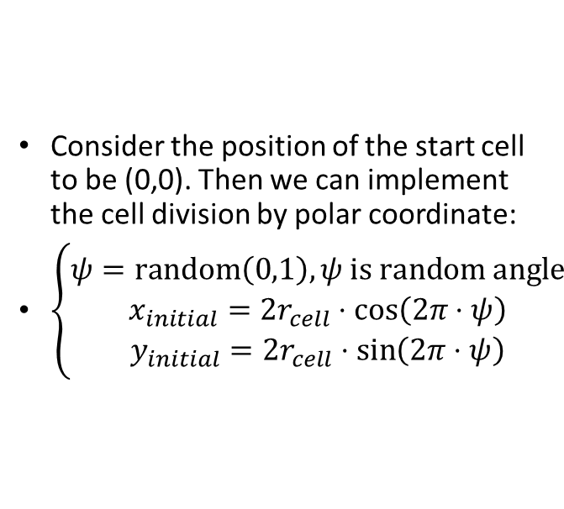
Cell division implementation (2D)
Consider the position of the start cell to be (0,0). Then we can implement the cell division by polar coordinate:
$\left\{\begin{aligned}ψ=\text{random}\left(0,1\right), ψ \text{is} \text{random} \text{angle} \\ x_{initial}=2r_{cell}⋅\cos\left(2π⋅ψ\right) \\ y_{initial}=2r_{cell}⋅\sin\left(2π⋅ψ\right)\end{aligned}\right.$

Slide 10
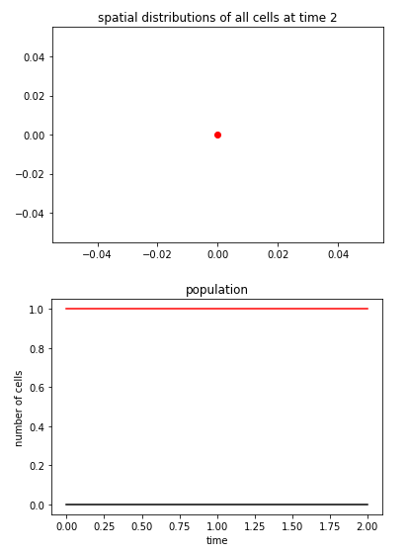
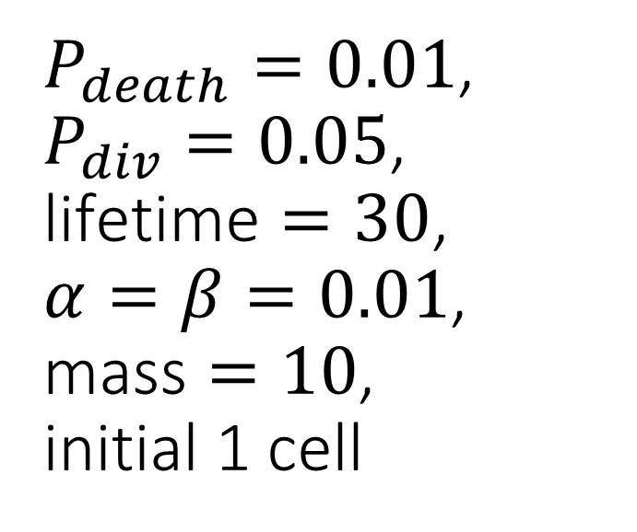
$P_{death}=0.01$, $P_{div}=0.05$, $\text{lifetime}=30$, $α=β=0.01$, $\text{mass}=10$, initial 1 cell

Slide 11
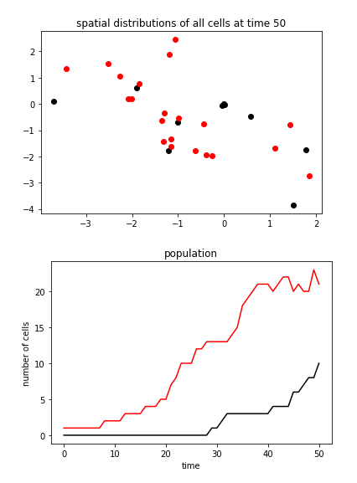
$P_{death}=0.01$, $P_{div}=0.05$, $\text{lifetime}=30$, $α=β=0.01$, $\text{mass}=10$, initial 1 cell

Slide 12
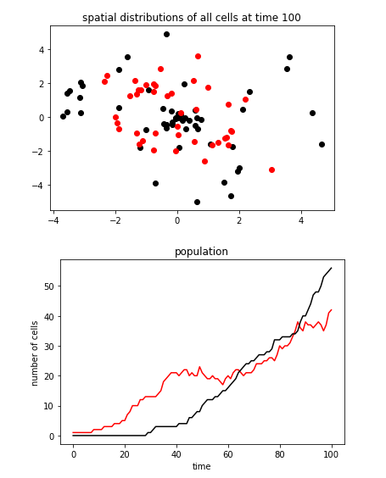
$P_{death}=0.01$, $P_{div}=0.05$, $\text{lifetime}=30$, $α=β=0.01$, $\text{mass}=10$, initial 1 cell

Slide 13
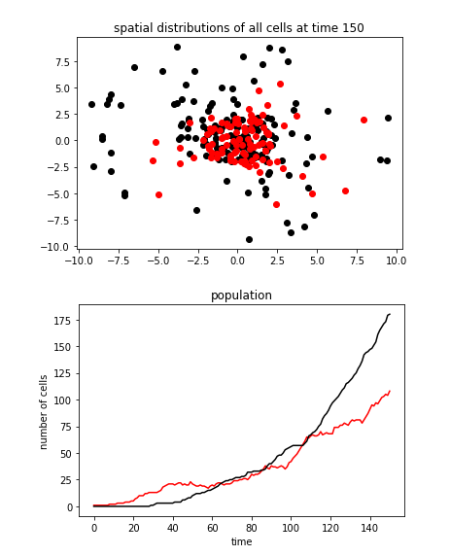
$P_{death}=0.01$, $P_{div}=0.05$, $\text{lifetime}=30$, $α=β=0.01$, $\text{mass}=10$, initial 1 cell

Slide 14
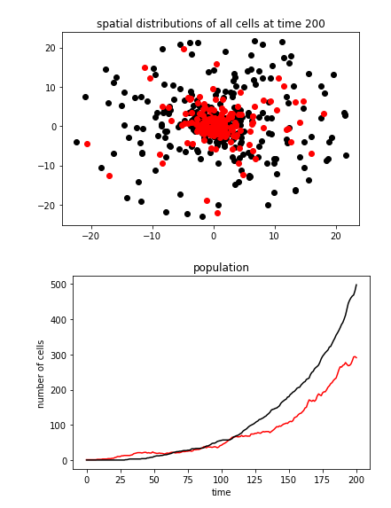
$P_{death}=0.01$, $P_{div}=0.05$, $\text{lifetime}=30$, $α=β=0.01$, $\text{mass}=10$, initial 1 cell

Slide 15
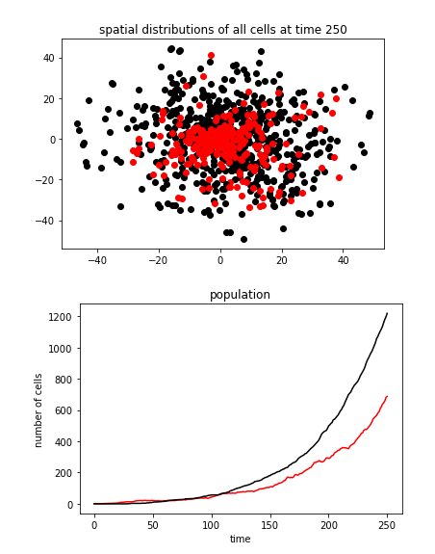
$P_{death}=0.01$, $P_{div}=0.05$, $\text{lifetime}=30$, $α=β=0.01$, $\text{mass}=10$, initial 1 cell

Slide 16
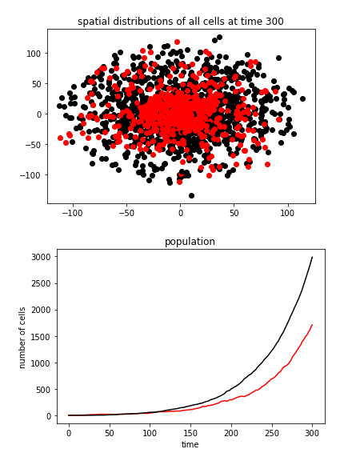
$P_{death}=0.01$, $P_{div}=0.05$, $\text{lifetime}=30$, $α=β=0.01$, $\text{mass}=10$, initial 1 cell

Slide 17
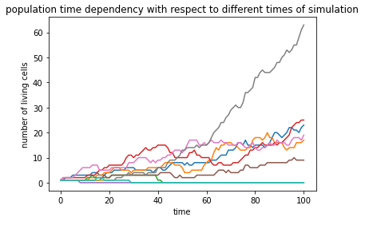
Uncertainty
A character of this hybrid model is uncertainty. Uncertainty is manifested in different results of simulations with the same vector of initial parameters.

Slide 18
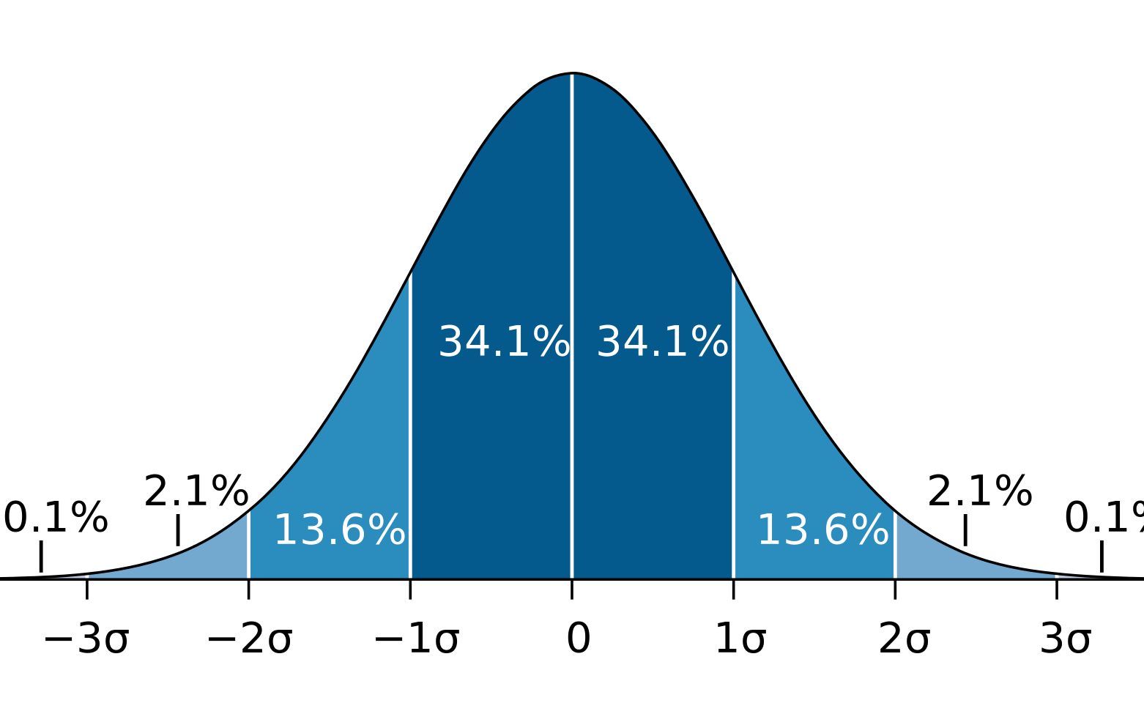

Life cycle modification
In previous model, we predefine the lifetime of each newborn cell to be a fixed value. But in real life, each cell has own lifetime which can be different from other’s one. A simple way to implement it is using normal distributed random value. Here is the gaussian distribution formula for cell’s lifetime:
$f\left(x\right)=\frac{1}{σ\sqrt{2π}}e^{−\frac{1}{2}{\left(\frac{x−μ}{σ}\right)}^{2}}$

Slide 19
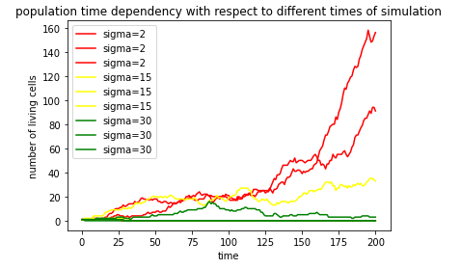

Life cycle modification
Statistically saying, the larger $σ$ gives the smaller growing rate of tumor.

Slide 20

Treatment modeling
In this model, we can also simulate the therapy of both chemical or/and radiation throw changing in lifecycle. The cancer treatment is a process that killing tumor cells. Then we can consider treatment as rising $P_{death}$. Here we select a reasonable treatment function:
$P_{death}=\left\{\begin{aligned}P_{death}^{0}, \text{if} t≤T_{treatment} \\ P_{death}^{0}+P_{s}\left(\sin^{2}\left(\frac{2π}{T_{s}}\left(t−T_{treatment}\right)\right)\right), \text{if} t>T_{treatment}\end{aligned}\right.$

Slide 21
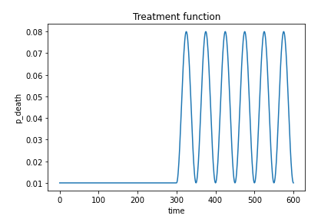
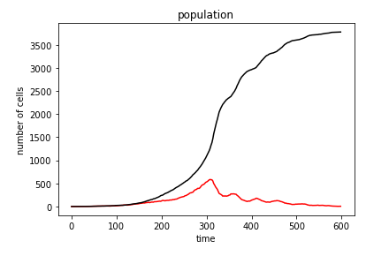
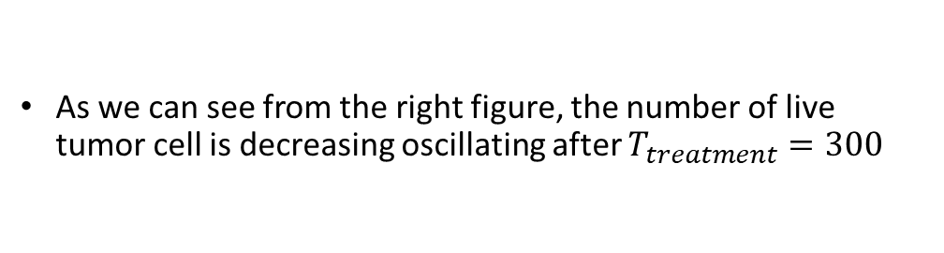
Treatment modeling
As we can see from the right figure, the number of live tumor cell is decreasing oscillating after $T_{treatment}=300$

Slide 22
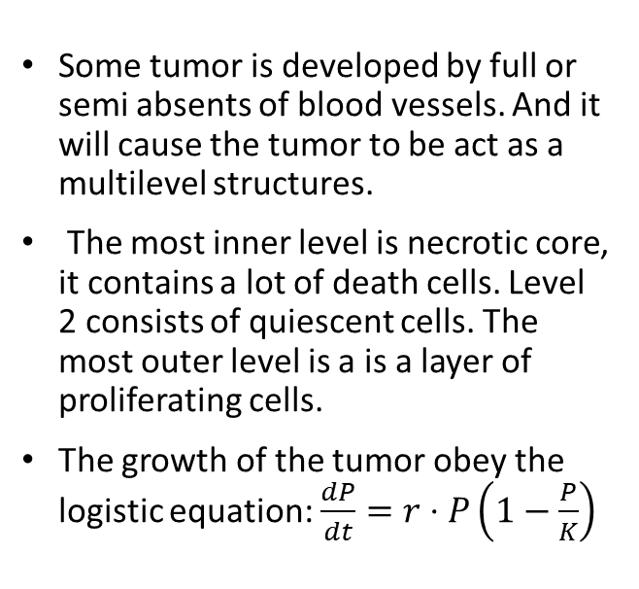
Multilevel structure
Some tumor is developed by full or semi absents of blood vessels. And it will cause the tumor to be act as a multilevel structures.
The most inner level is necrotic core, it contains a lot of death cells. Level 2 consists of quiescent cells. The most outer level is a is a layer of proliferating cells.
The growth of the tumor obey the logistic equation: $\frac{dP}{dt}=r⋅P\left(1−\frac{P}{K}\right)$
3
2
1

Slide 23
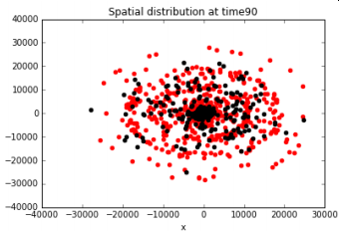
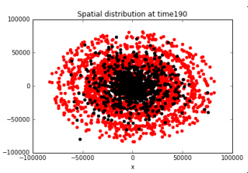
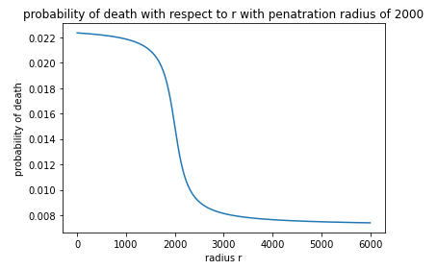
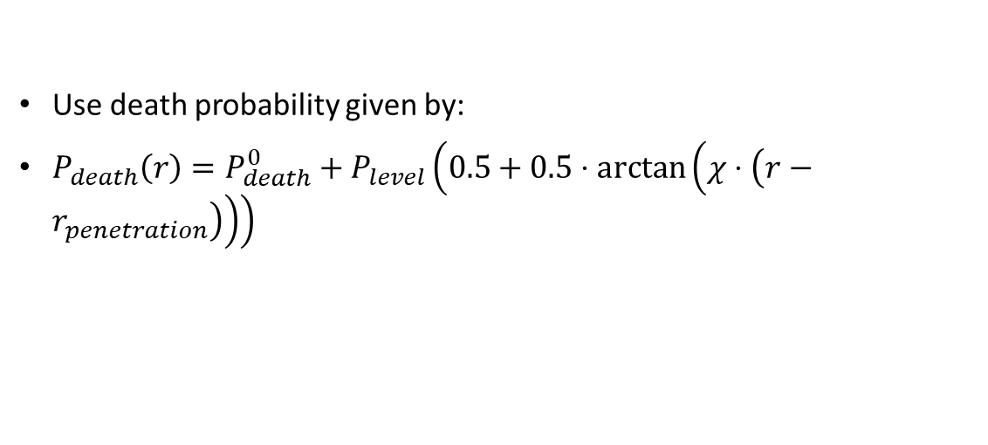
Equation for multilevel structure
Use death probability given by:
$P_{death}\left(r\right)=P_{death}^{0}+P_{level}\left(0.5+0.5⋅\arctan\left(χ⋅\left(r−r_{penetration}\right)\right)\right)$

Slide 24
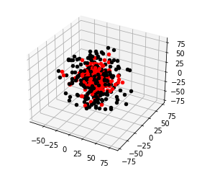

Extends to 3D and visualization
Add a z-coordinate:
$\left\{\begin{aligned}ψ=\text{random}\left(0,1\right), ψ \text{is} \text{random} \text{angle} \\ φ=\text{random}\left(0,1\right), φ \text{is} \text{a} \text{random} \text{angle} \\ x_{initial}=2r_{cell}⋅\cos\left(2π⋅ψ\right)⋅\sin\left(2π⋅φ\right) \\ y_{initial}=2r_{cell}⋅\sin\left(2π⋅ψ\right)⋅\sin\left(2π⋅φ\right) \\ z_{initial}=2r_{cell}⋅\cos\left(2π⋅φ\right)\end{aligned}\right.$

Slide 25
Reference
https://arxiv.org/ftp/arxiv/papers/1705/1705.00666.pdf
https://math.libretexts.org/Bookshelves/Calculus/Book%3A_Calculus_(OpenStax)/08%3A_Introduction_to_Differential_Equations/8.4%3A_The_Logistic_Equation#:~:text=dPdt%3DrP(1%E2%88%92PK,problem%20for%20P(t).&text=If%20r%3E0%2C%20then%20the,grows%20rapidly%2C%20resembling%20exponential%20growth.
https://github.com/petermchale/tumor
https://www.itl.nist.gov/div898/handbook/eda/section3/eda3661.htm

Slide 26

Thank you

