Slide 1
Prediction on Lung Cancer
Machine Learning and Data Analysis
Academic year 2023-2024
Sonia Spinelli
5176304

Slide 2
Dataset
The dataset chosen contains information about 309 individuals.
https://www.kaggle.com/datasets/mysarahmadbhat/lung-cancer/data
There are 16 variables:
GENDER: male = M, female=F .
AGE: Age of the patient
SMOKING: YES=2 , NO=1.
YELLOW FINGERS: YES=2 , NO=1.
ANXIETY: YES=2 , NO=1.
PEER_PRESSURE: YES=2 , NO=1.
CHRONIC DISEASE: YES=2 , NO=1.
FATIGUE: YES=2 , NO=1.
ALLERGY: YES=2 , NO=1.
WHEEZING: YES=2 , NO=1.
COUGHING: YES=2 , NO=1.
ALCOHOL CONSUMING: YES=2 , NO=1.
SHORTNESS OF BREATH: YES=2 , NO=1.
SWALLOWING DIFFICULTY: YES=2 , NO=1.
CHEST PAIN: YES=2 , NO=1.
LUNG_CANCER: YES , NO.
The aim of this project is to predict the occurrence of lung cancer based on variables related to symptoms and potential causes.

Slide 3
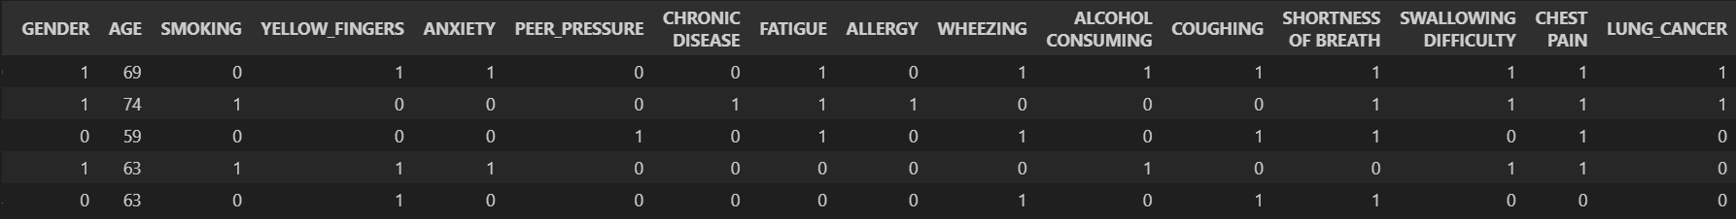
Data Preparation
All the categorical variables have been codified in 0 and 1, in order to facilitate the reading of the statistics. In particular, ‘Male’ is 1 and ‘Female’ is 0, while for other variables ‘Yes’ is 1 and ‘No’ is 0.
There are no missing values, but there are 33 duplicates, that should be deleted.
Some of these variables just describe the patient, such as age and gender, some are plausible symptoms of lung cancer, such as coughing and fatigue, and some might be causes of it, such us smoking and alcohol consuming.

Slide 4
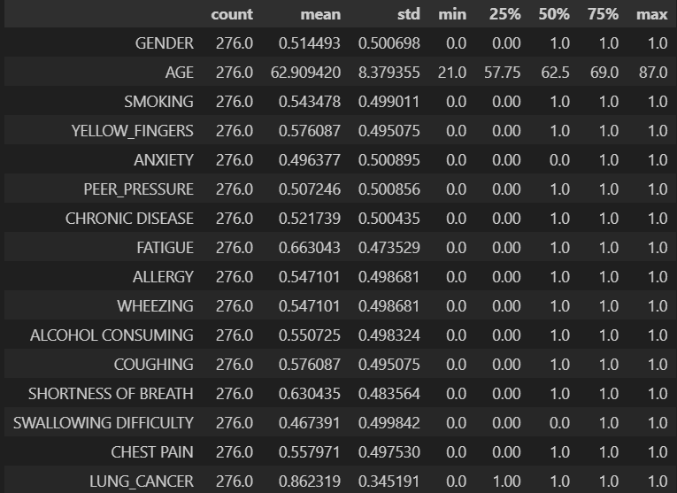
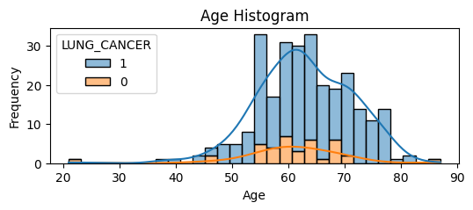
Exploratory Data Analysis
By looking at the statistics, we can assert that because all the means are near 0.5.
So all the variables are equally distributed among the individuals, except for LUNG_CANCER: almost 86% of the population has lung cancer. So the distribution of the variable we want to predict unbalanced.
The only quantitative variable is AGE: our population spans from 21 to 87-year-old people, with an average of 62.

Slide 5
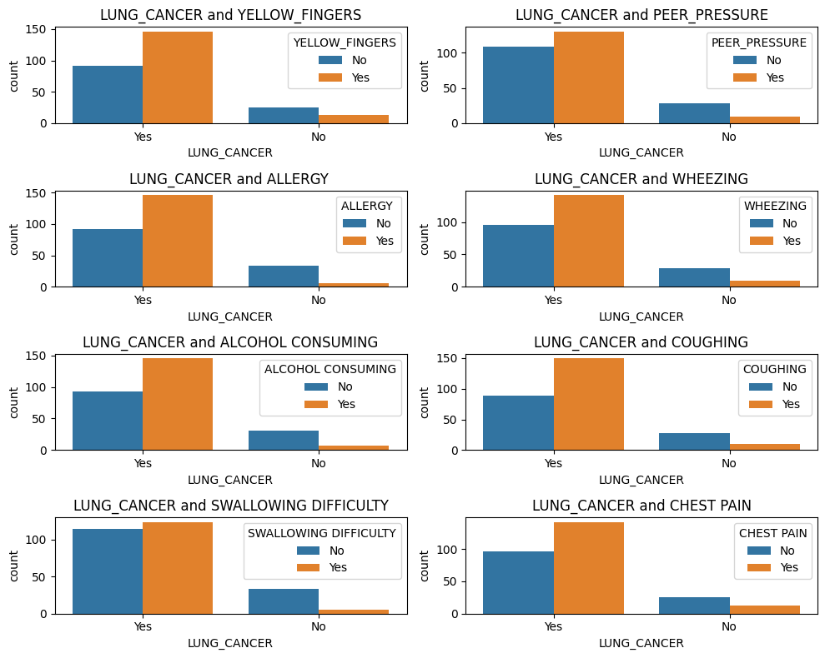
Exploratory Data Analysis
Applying a Chi squared test on correlation with LUNG_CANCER,the variables YELLOW_FINGERS, PEER_PRESSURE, ALLERGY, WHEEZING, ALCOHOL CONSUMING, COUGHING, SWALLOWING DIFFICULTY, CHEST PAIN are the most significant.
Individuals afflicted with cancer are typically assigned 'YES' for the corresponding correlated variable, whereas the majority of individuals without cancer are designated 'NO'.
For instance, individuals with lung cancer commonly exhibit symptoms such as coughing, while a significant portion of cancer-free patients does not experience coughing.

Slide 6
Binary classification problem
The aim of this project is to predict the presence of lung cancer based on the given variables, constituting a binary classification problem.
To assess the model's effectiveness, the confusion matrix is employed, constructed as illustrated in the diagram. From this, some indices are built and they are used to evaluate a model.
These are
the accuracy score
the precision score
the recall score
Using all of these indices results relevant when classes are unbalanced.
Predicted labels
 | NO | YES
NO | True Negative TN | False Positive FP
YES | False Negative FN | True Positive TP
True labels

Slide 7
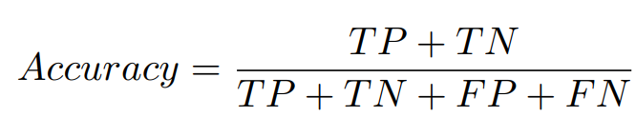
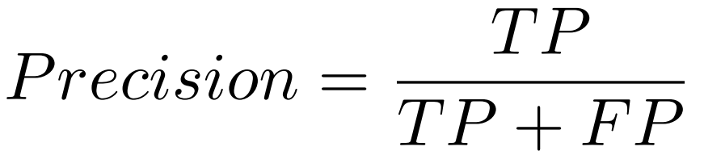
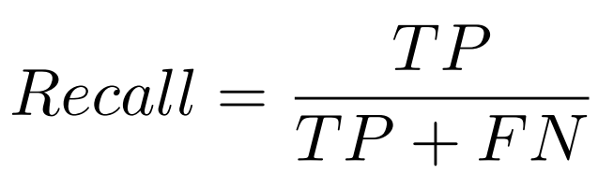
Binary classification problem
The accuracy score shows how often the classification is correct overall:
The precision score shows how often the model is correct when predicting the target class.
The recall score shows whether the model can classify as true the actual true.
Predicted labels
 | NO | YES
NO | True Negative TN | False Positive FP
YES | False Negative FN | True Positive TP
True labels

Slide 8
Support Vector Machine
Moreover, the dataset is split into training, validation, and test sets. Specifically, the test set comprises 25% of the original dataset. With the remaining the 25% is allocated to validation and the remaining portion assigned to the training set.
The SVM algorithms employed include
the Linear Kernel
the Gaussian Kernel
the Polynomial Kernel
The hyperparameters to be selected encompass the complexity term, C, applicable to all three kernels, gamma, which is exclusive to non-linear kernels, and the degree of the polynomials.
The C indicates how complex the model is and represents the trade off between complexity and simplicity. When set too high, the model may overfit the data, when it is too low the model could be too simple and underfit the data.
The gamma parameter defines how far the influence of a single training example reaches, with low values meaning ‘far’ and high values meaning ‘close’.

Slide 9
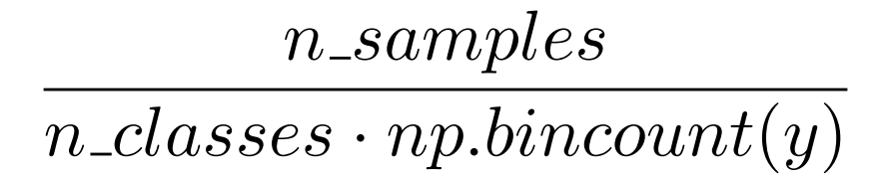
Unbalanced problem
Having a distribution unbalanced, it’s important to be aware of it during training and validation of the model. In this regard, the following command is employed to assign weights to the classes, ensuring a balanced weighting.
class_weight=’balanced’
The “balanced” mode uses the values of y to automatically adjust weights inversely proportional to class frequencies in the input data as

Slide 10
SVM: Linear kernel
Some examples:
Linear kernel C=0.01
Accuracy: 85.5072463768116
Precision: 100.0
Recall: 82.14285714285714
Linear kernel C=1
Accuracy: 85.5072463768116
Precision: 97.91666666666666
Recall: 83.92857142857143
Linear kernel C=10
Accuracy: 85.5072463768116
Precision: 97.91666666666666
Recall: 83.92857142857143
It can be observed that the accuracy remains constant when adjusting the complexity term. However, precision and recall exhibit variations.
A smaller C value corresponds to higher precision, but lower recall, compared to a higher C value, which results in decreased precision and increased recall.
Given a preference for evaluation based on recall, indicating how often the presence of cancer is correctly classified when it exists, a preference is observed for either C=1 or 10. Furthermore, since a C value of 10 implies a more complex model compared to 1, a preference is inclined towards the model with C=1.
13 | 0
10 | 46
12 | 1
9 | 47
12 | 1
9 | 47

Slide 11
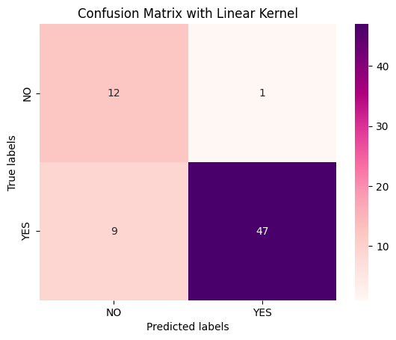
SVM: Linear kernel
Best hyperparameter for linear kernel is C=1
Accuracy: 85.5072463768116
Precision: 97.91666666666666
Recall: 83.92857142857143
Consistent with expectations, the optimal model has complexity term set to 1. The accuracy is pretty high, however it appears that 9 individuals with cancer have been misclassified as lacking the tumor presence.
This is indicated by the relatively low recall.

Slide 12

SVM: Gaussian kernel
Using default gamma which is
let’s change C:
Gaussian kernel C=0.01
Accuracy: 18.84057971014493
Precision: 0.0
Recall: 0.0
Gaussian kernel C=1
Accuracy: 91.30434782608695
Precision: 96.29629629629629
Recall: 92.85714285714286
Gaussian kernel C=10
Accuracy: 89.85507246376811
Precision: 91.52542372881356
Recall: 96.42857142857143
Fixed C=1, let’s see how gamma behaves
Gaussian kernel C=1, gamma=0.001
Accuracy: 73.91304347826086
Precision: 100.0
Recall: 96.42857142857143
Gaussian kernel C=1, gamma=0.01
Accuracy: 91.30434782608695
Precision: 98.07692307692307
Recall: 91.07142857142857
Gaussian kernel C=1, gamma=10
Accuracy: 81.15942028985508
Precision: 81.15942028985508
Recall: 100.0
It seems advisable to select an intermediate value for C and gamma to maintain optimal accuracy, as excessively high or low values of it may lead to a loss of accuracy. However, even if the recall score is high, it doesn’t mean that the model is optimal
13 | 0
18 | 38
13 | 0
56 | 0
12 | 1
5 | 51
0 | 13
0 | 56
11 | 2
4 | 52
8 | 5
2 | 54

Slide 13
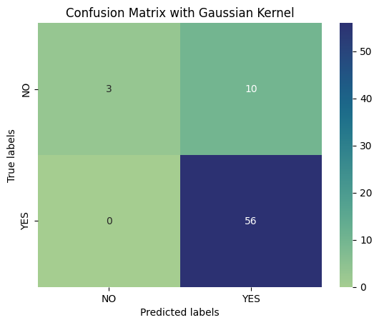
SVM: Gaussian kernel
Best hyperparameters for gaussian kernel are
C=1
gamma=1
Accuracy: 85.5072463768116
Precision: 84.84848484848484
Recall: 100.0
The selected hyperparameters result in a similar accuracy to the linear kernel, but with a loss of precision and an increase of recall.
Compared to the linear kernel, all the people with cancer have been correctly classified, while in 10 cases the presence of cancer has been attributed to healthy individuals.
Given C=1, it is inferred that both accuracy and simplicity are equally weighted in the model. A gamma value of 1 is not considered extreme and ensures a high level of accuracy.

Slide 14
SVM: Polynomial kernel
Using default gamma and degree=3, let's modify the parameter C:
Polynomial kernel C=0.01
Accuracy: 18.84057971014493
Precision: 0.0
Recall: 0.0
Polynomial kernel C=1
Accuracy: 89.85507246376811
Precision: 91.52542372881356
Recall: 96.42857142857143
Polynomial kernel C=10
Accuracy: 89.85507246376811
Precision: 91.52542372881356
Recall: 96.42857142857143
Now, fixed C=1, let’s see how gamma behaves:
Polynomial kernel C=1, gamma=0.001
Accuracy: 18.84057971014493
Precision: 0.0
Recall: 0.0
Polynomial kernel C=1, gamma=0.1
Accuracy: 91.30434782608695
Precision: 91.66666666666666
Recall: 98.21428571428571
Polynomial kernel C=1, gamma=10
Accuracy: 88.40579710144928
Precision: 91.37931034482759
Recall: 94.64285714285714
13 | 0
56 | 0
13 | 0
56 | 0
8 | 5
2 | 54
8 | 5
1 | 55
8 | 5
3 | 53
8 | 5
2 | 54

Slide 15
SVM: Polynomial kernel
Fixed C=1, gamma=0.1, let’s change the degree:
Polynomial kernel C=1, gamma=0.1, degree=1
Accuracy: 84.05797101449275
Precision: 97.87234042553192
Recall: 82.14285714285714
Polynomial kernel C=1, gamma=0.1, degree=3
Accuracy: 91.30434782608695
Precision: 91.66666666666666
Recall: 98.21428571428571
Polynomial kernel C=1, gamma=1, degree=5
Accuracy: 88.40579710144928
Precision: 88.70967741935483
Recall: 98.21428571428571
In summary, it appears that precision decreases and the recall increases with an increase in the degree, although the accuracy remains sensitive in both directions .
A higher value for C is preferable, but beyond a certain point, the results do not exhibit significant changes.
It is advisable to opt for an intermediate value of gamma in order to maintain a high accuracy and recall.
12 | 1
10 | 46
8 | 5
1 | 55
6 | 7
1 | 55

Slide 16
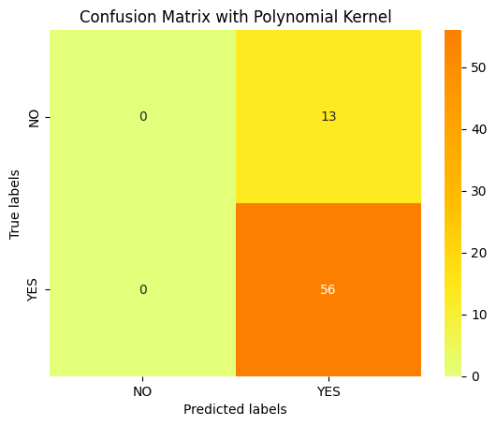
SVM: Polynomial kernel
Best hyperparameters for polynomial kernel are
C=100
gamma=0.01
degree=4
Accuracy: 81.15942028985508
Precision: 81.15942028985508
Recall: 100.0
The selected hyperparameters demonstrate high complexity, a relatively low gamma, and a polynomial degree of 4.
However, despite the high accuracy, the model tends to attribute the presence of cancer to all patients, including those who do not have it. In this way, this might not be a good model.

Slide 17
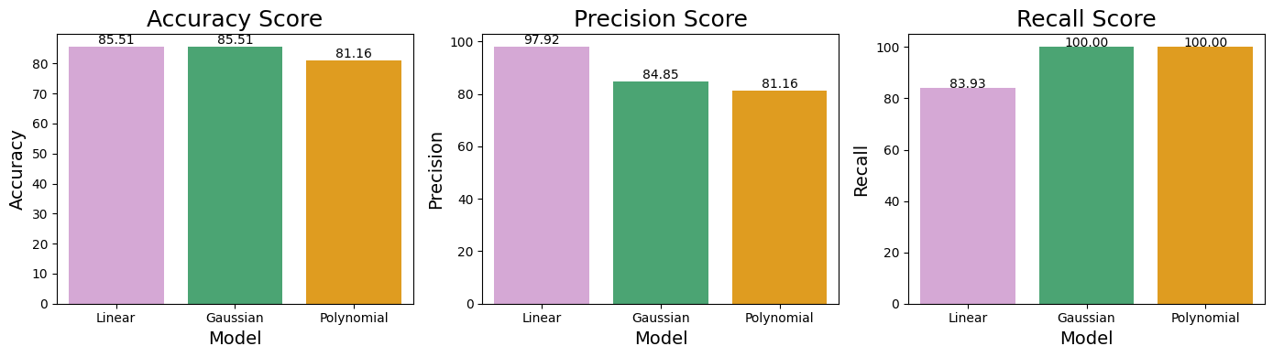
Comparing SVM kernels with the validation set
It appears that the model with a linear kernel exhibits the highest accuracy and precision scores; however, it possesses a relatively low recall score. The Gaussian kernel, on the other hand, shares the same accuracy as the linear model but demonstrates a markedly high recall alongside a lower precision. Meanwhile, the polynomial kernel displays a low accuracy, very low precision, and exceptionally high recall, driven by the classification of all individuals as having cancer.
Given these considerations, it seems that the Gaussian kernel model emerges as the optimal choice.

Slide 18
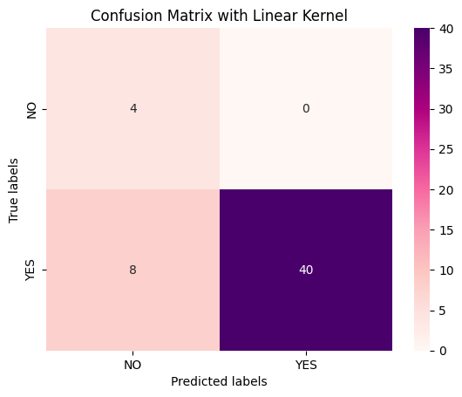
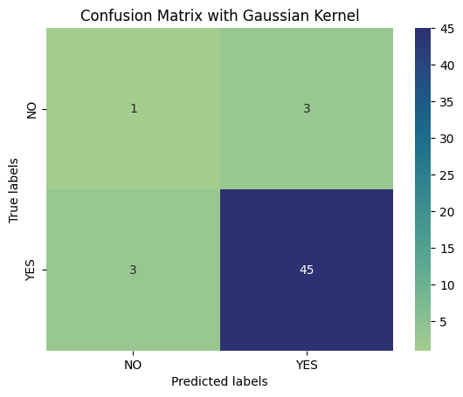
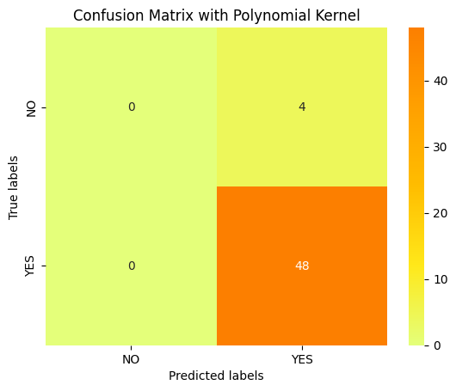
Testing
 | Linear Kernel | Gaussian Kernel | Polynomial Kernel
Accuracy | 84.61538461538461 | 88.46153846153845 | 92.3076923076923
Precision | 100.0 | 93.75 | 100.0
Recall | 83.33333333333334 | 93.75 | 100.0

Slide 19
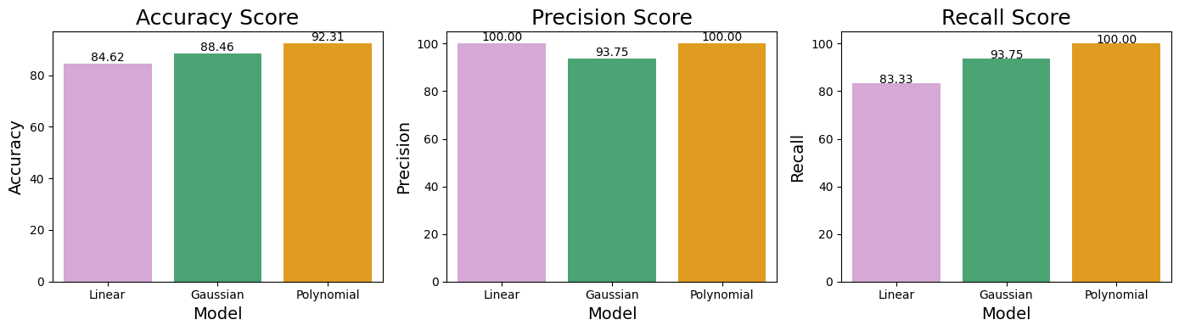
Testing
Additionally, it is noteworthy that the linear kernel demonstrates approximately equivalent accuracy, whereas both polynomial and Gaussian kernels exhibit improvements. Specifically, the linear kernel attains high precision but the lowest recall. Conversely, the Gaussian kernel achieves high values across all three performance indices, yet the polynomial kernel yields the most favorable outcomes. Nevertheless, it is observed that the model tends to classify all individuals as having cancer, which is a detrimental characteristic. In light of these considerations, the Gaussian kernel emerges as the optimal model.

Slide 20
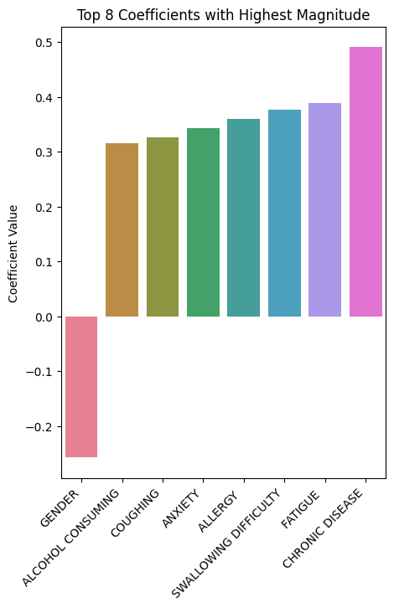
Feature reduction: validation
The highest correlation with LUNG_CANCER has been observed in the variables YELLOW_FINGERS, PEER_PRESSURE, ALLERGY, WHEEZING, ALCOHOL CONSUMING, COUGHING, SWALLOWING DIFFICULTY, CHEST PAIN.
It is notable that these do not match with the top 8 variables with the highest coefficient in the SVM algorithm with linear kernel. The features associated with these coefficients wield significant influence in determining the decision boundary.
Let's determine if the reduction to these 8 variables ensures both high accuracy and simplicity.

Slide 21
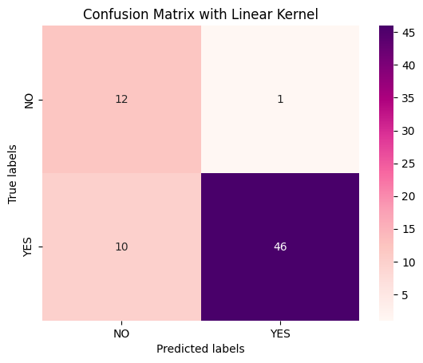
Feature reduction: validation of Linear Kernel
 | Before | After
Hyperparameter | C=1 | C=1
Accuracy | 85.51 | 84.06
Precision | 97.92 | 97.87
Recall | 83.93 | 82.14
Even if the accuracy score isn’t affected by a great loss, we can observe that the recall decreases: that is why the number of False Negative increases.
Considering the aim of this study, the simplicity of the model is not a priority.

Slide 22
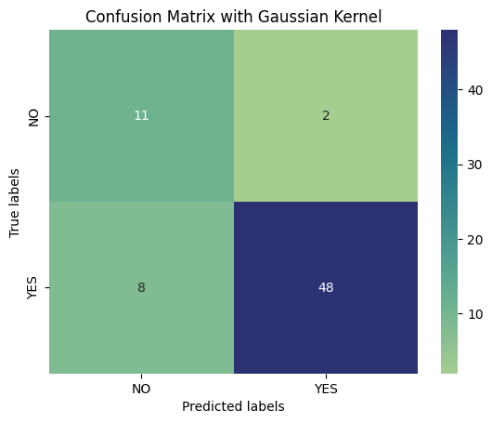
Feature reduction: validation of Gaussian kernel
 | Before | After
Hyperparameter | C=1 gamma=1 | C=1 gamma=0.02
Accuracy | 85.51 | 85.51
Precision | 84.85 | 96.0
Recall | 100.0 | 85.71
With changing the best hyperparameters, the reduced model shows the same accuracy, however the recall score decreases drastically.
Once again, the emphasis lies on the prioritization of accurate classification over feature reduction.

Slide 23
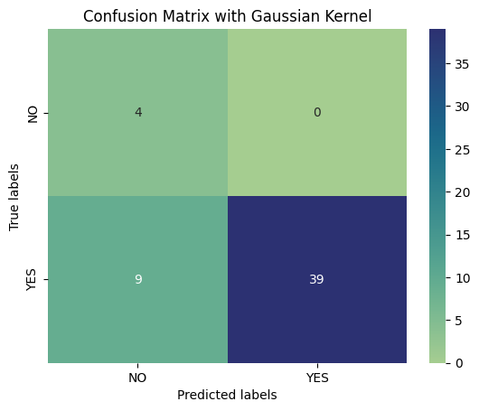
Feature reduction: testing
Accuracy: 84.61538461538461
Precision: 100.0
Recall: 83.33333333333334
Accuracy: 82.6923076923077
Precision: 100.0
Recall: 81.25

Slide 24
Thanks for
your attention

