Slide 1
ReCap
”Capturing, specifying and managing requirements finally made simple.”
Team As.Js
Anders Kofoed, 2120935
Teodora Buzea, 1106566
Johannes Raunio, 2121679

Slide 2
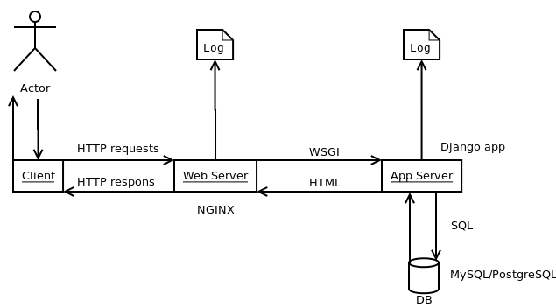
System Architecture

Slide 3
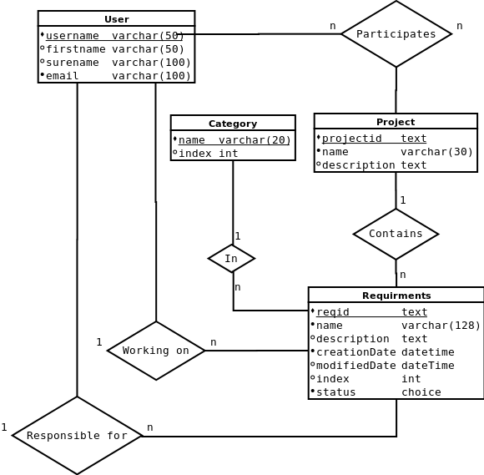
ER-diagram

Slide 4
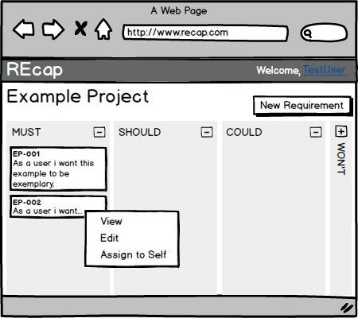
Project page layout
Navigation bar
ReCap-logo -> home
Username -> preferences & logout
Project view
Category column (expanded)
Category column (collapsed)
Requirement box
Requirement quick menu
View -> details page
Edit -> edit page
Assign to self -> quick assignment
New Requirement button
Brings up a dialog
1.
2.
7.
3.
5.
4.
6.

Slide 5
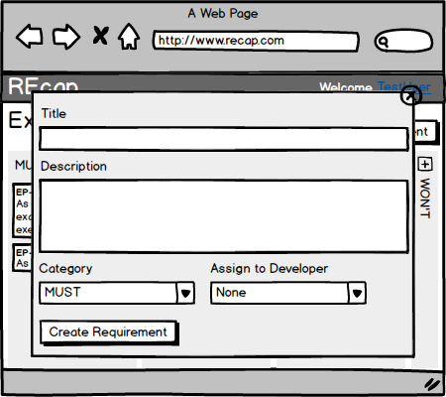
Requirement dialog layout
Title field
Title should contain the one sentence decription of the requirement.
Description text area
Longer description goes here.
Category dropdown
The initial category
Assignment dropdown
Choose on of the project participants or leave empty.
Create requirement button
Sends the form and closes the dialog.
1.
2.
3.
4.
5.

Slide 6
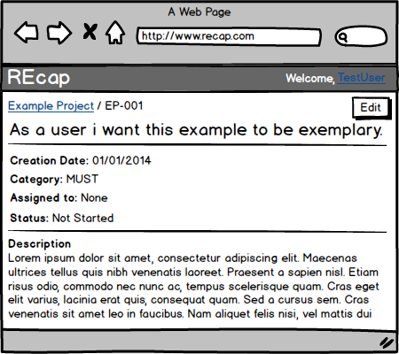
Requirement details layout
Requirement id
Pattern: <ProjectAcronym>-<running_number>
Requirement metadata
Edit button
Redirects to edit page
1.
1.
1.

Slide 7
Stand out features
Flexible category columns (collapse/expand)
Drag and drop functionality in Project view
Manage and keep track of project participants.

Slide 8
Specifications
MUST
As a developer…
I want to be able to add new developers to the project.
I want to have a page that shows an overview of the list of projects that I'm working on.
I want to have a project page where I can see the list of requirements already taken, and add other requirements.
I want to be able to add a short description to a requirement.
I want to be able to indicate that I'm working on a spesific requirement.
I want to be able to mark a requirement completed.
As a product owner…
I want to be able to register, and create a project.
I want to be able to group requirements into different categories (must/should, could would like), and order them by priority.

Slide 9
Specifications
SHOULD
As a product owner, I want to be able to drag requirements between categories and order them by priority.
COULD
As a developer, I want to have a way to track or mark versions so that it can be possible to view previous versions and how the projects have been iterated.
As a product owner, I want to be able to modify the existing categories and add new ones.
As a user, I want to be able to reset a forgtten password.
As a product owner, I want to be able to assign a project to a organization.
As a product owner, I want to be able to add sub requirements to existing requirements.
WON’T
As a multinational company employee, I want to be able to change the language of the UI.
As a product owner, I want to be able to generate progress reports for management.

Slide 10
User personas
The Product Owner
Sally Brown, 35
A Bachelors Degree in Computer Science and Psychology
7 years of work experience: 4 as developer and 3 as product owner
Married, 2 children
Responsibilities:
Gathering, specifying and prioritisation of requirements
Planning the release schedule and scope
Reporting to management
Motivations:
Having a clear overall picture of the process all the time.
Being able to make quick decisions
Devices:
Main: a Windows Laptop
Secondary: Android smartphone
The Developer
William Cottier, 27
A Masters degree in Computer Science
Three years of work experience as web developer
Not married
Responsibilities:
Developing the requirement with highest priority
Keeping PO up to date of the progress
Motivations:
Not doing duplicate work
Always having clear idea, what to do next
Devices:
Main: A Mac OSX Laptop

Slide 11
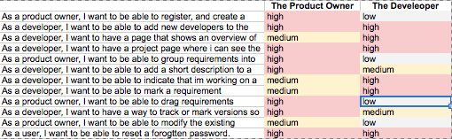
User needs matrix

Slide 12
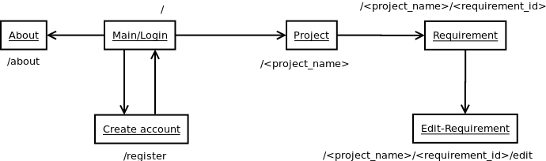
Site map

Slide 13
Implemented features
Feature | Comments
As a product owner, I want to be able to register, and create a project. | We decided to skip the project roles since the difference between project owner and developer turned out to be none existing.
As a developer, I want to be able to add new developers to the project. | Done using a slide in panel with a list of praticipants, and a "add new" feature.
As a developer, I want to have a page that shows an overview of the list of projects that I'm working on.
As a developer, I want to have a project page where I can see the list of requirements already taken, and add other requirements. | Create new requriement popup for using jQuery
As a product owner, I want to be able to group requirements into different categories (must/should, could would like), and order them by priority. | Collapsable categorie collumns
As a developer, I want to be able to add a short description to a requirement.
As a developer, I want to be able to indicate that I'm working on a spesific requirement. | "Assign to self" in context menu of requirements
As a developer, I want to be able to mark a requirement completed. | "Set status" in context menu of requirement
As a product owner, I want to be able to drag requirements between categories and order them by priority. | Using ajax to update the DB when dragging between categories and when reordering.

