Slide 2
goo.gl/vRSxix
Kubernetes, Jenkins, Docker

Slide 3

goo.gl/vRSxix
About Me
Senior Operations Engineer – SpinDance
Passionate about infrastructure automation
Fascinated about by the DevOps movement
6 years at SpinDance
Love spending time with my family and friends

Slide 4
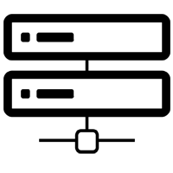

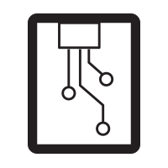

goo.gl/vRSxix
SPINDANCE
Systems engineering, software development, and solution hosting,
focused on creating and delivering connected smart products.
HOSTING
MOBILE
SYSTEMS
EMBEDDED
CLOUD
Notes:
Founded in 2000
Offices in Holland and Grand Rapids
Supporting everything from funded start ups to Fortune 500 companies
Specializing in consumer facing products
Capable of everything from full system design, development and solution hosting
With deep expertise in embedded, cloud, web and mobile software development

Slide 5
goo.gl/vRSxix
Docker
An open platform for distributed applications for developers and sysadmins – docker.com
Allows you to put everything for your app in a container
Run anywhere that docker engine is
Immutable infrastructure

Slide 6
goo.gl/vRSxix
Jenkins
Open source build server
Swiss army knife
Supports continuous delivery model
Pluggable and extendible
Rich Ecosystem

Slide 7
goo.gl/vRSxix
Kubernetes
Google open source project
Kubernetes is an open-source system for automating deployment, operations and scaling of containerized operations. – kubernetes.io
huh?
Allows you to dictate how your container infrastructure behaves
Means – helmsman or pilot

Slide 8
goo.gl/vRSxix
Kubernetes - Architecture
Node (Minon)
Docker
Pulling images
Starting containers
Kubelet
Manages pods
Kube-proxy
Network Proxy and Load balancer
Services

Slide 9
goo.gl/vRSxix
Kubernetes - Architecture
Master Node (Control Plane)
Currently One node, changing soon
Multiple components
Etcd
Master state
API Server
Interaction
Scheduler
Schedule pods to nodes
Controller Manager Server
Cluster level functions

Slide 10
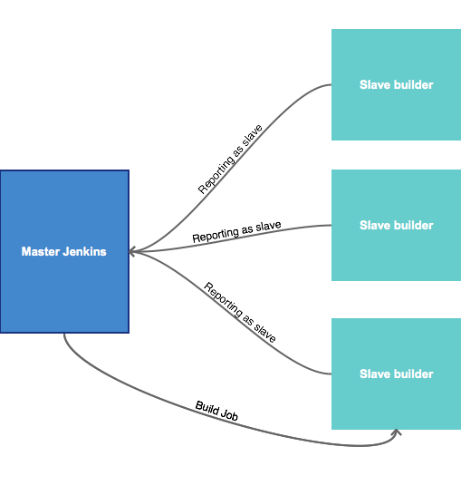
goo.gl/vRSxix
Problem
So why use all of this?
Jenkins Master / Slave configuration
Usually based on VMs
Results on wasted resources

Slide 11
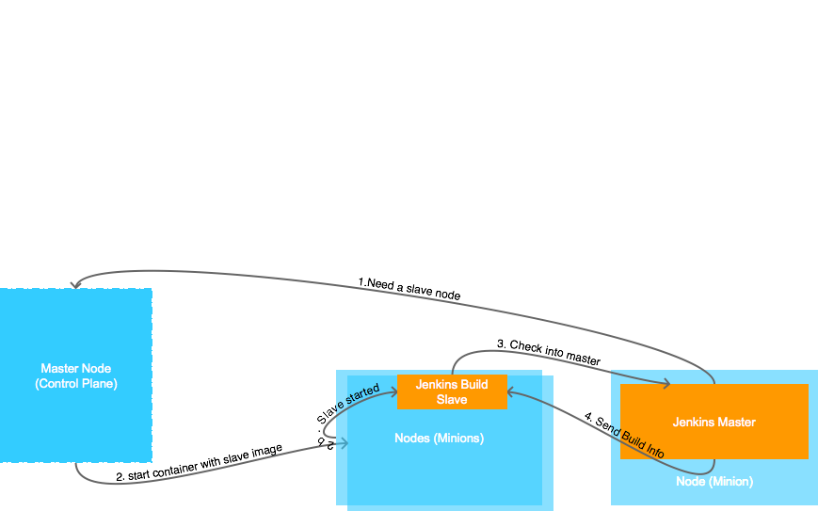
goo.gl/vRSxix
Solution

Slide 12
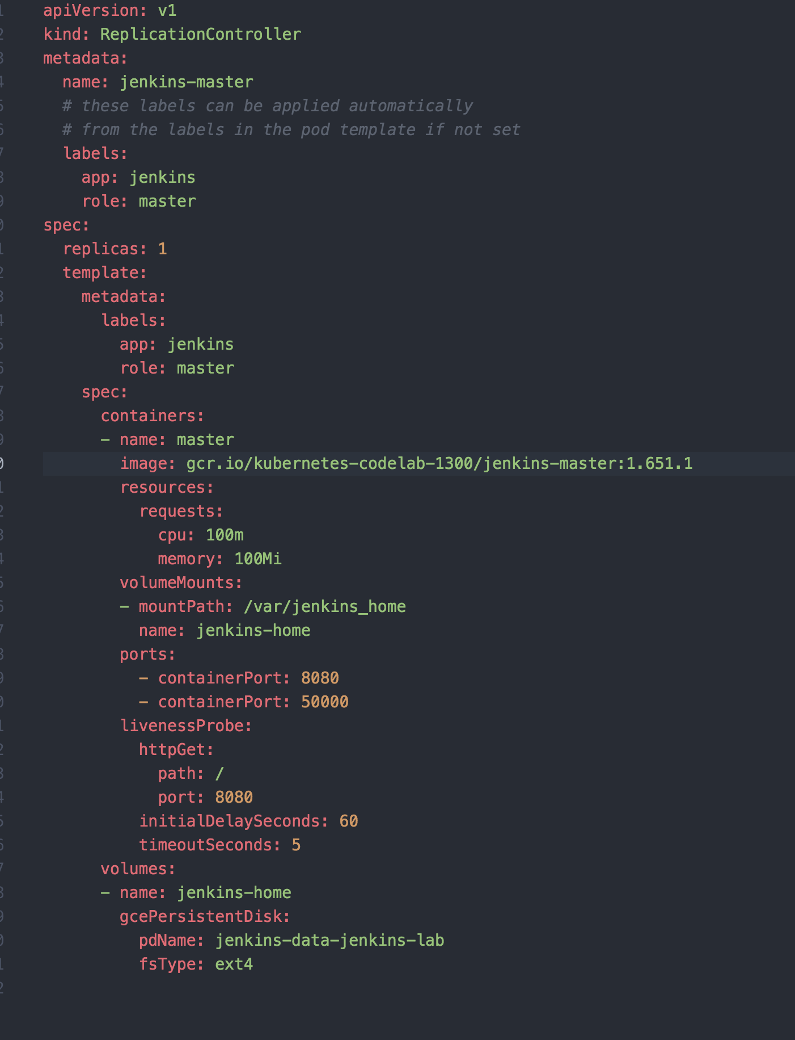
goo.gl/vRSxix
Lab

Slide 13
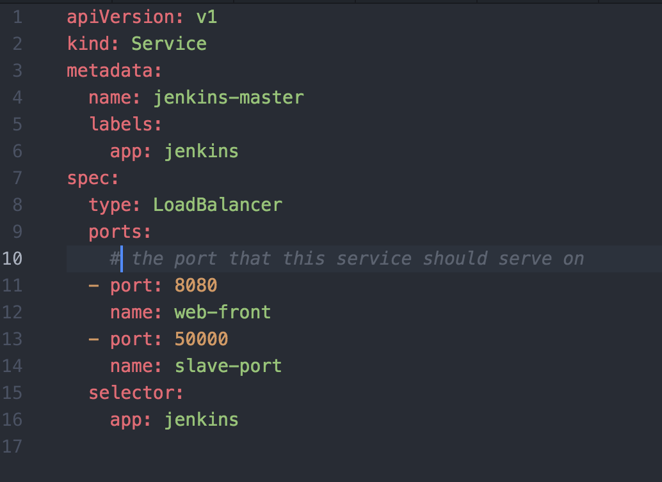
goo.gl/vRSxix
Lab

Slide 14
goo.gl/vRSxix
Issues
Testing with embedded hardware would be challenging in this environment
Multiple builders of the same type seems to be missing from plugin (workaround)
Windows not supported (https://github.com/kubernetes/kubernetes/issues/22623)
Permission issue with volumes (https://github.com/kubernetes/kubernetes/issues/2630)

Slide 15
goo.gl/vRSxix
Questions?
https://github.com/spindance/kubernetes-jenkins-lab
goo.gl/vRSxix
@rodrigdav

