Slide 1
Foodtrackr
Clinical nutrition tracking for nursing & exercise-science students
Taylor Kloss . D301 Software Engineering . UCOL 2026

Slide 2
What is Foodtrackr?
A clinical nutrition tool that turns a patient's daily food intake into actionable insight. Clinicians-in-training build profiles, log meals from official NZ data, and instantly see how intake measures up to recommended dietary intakes.
Create patient profiles
Manage the people in their care
Log from NZ FOODfiles
Official NZ food-composition data
Analyse against NZ RDIs
Flags deficiencies and excesses

Slide 3
Architecture
MAUI app
HTTPS . JWT
ASP.NET Core API
EF Core
PostgreSQL
(Android)
(Render)
(database)
The app never touches the database directly - every request goes through the API.

Slide 4
Technology
.NET MAUI 9
ASP.NET Core
PostgreSQL
Cross-platform app (C#)
Web API back-end
Hosted on Render (SQLite for dev)
Identity + JWT
Entity Framework Core
xUnit
Authentication & tokens
Database ORM
39 automated tests

Slide 5
Key features
• User registration & login
• Patient profile management
• Live food search (NZ FOODfiles)
• Food logging - portions & meals
• Daily nutrition totals & macros
• RDI compliance flags
• Date navigation

Slide 6
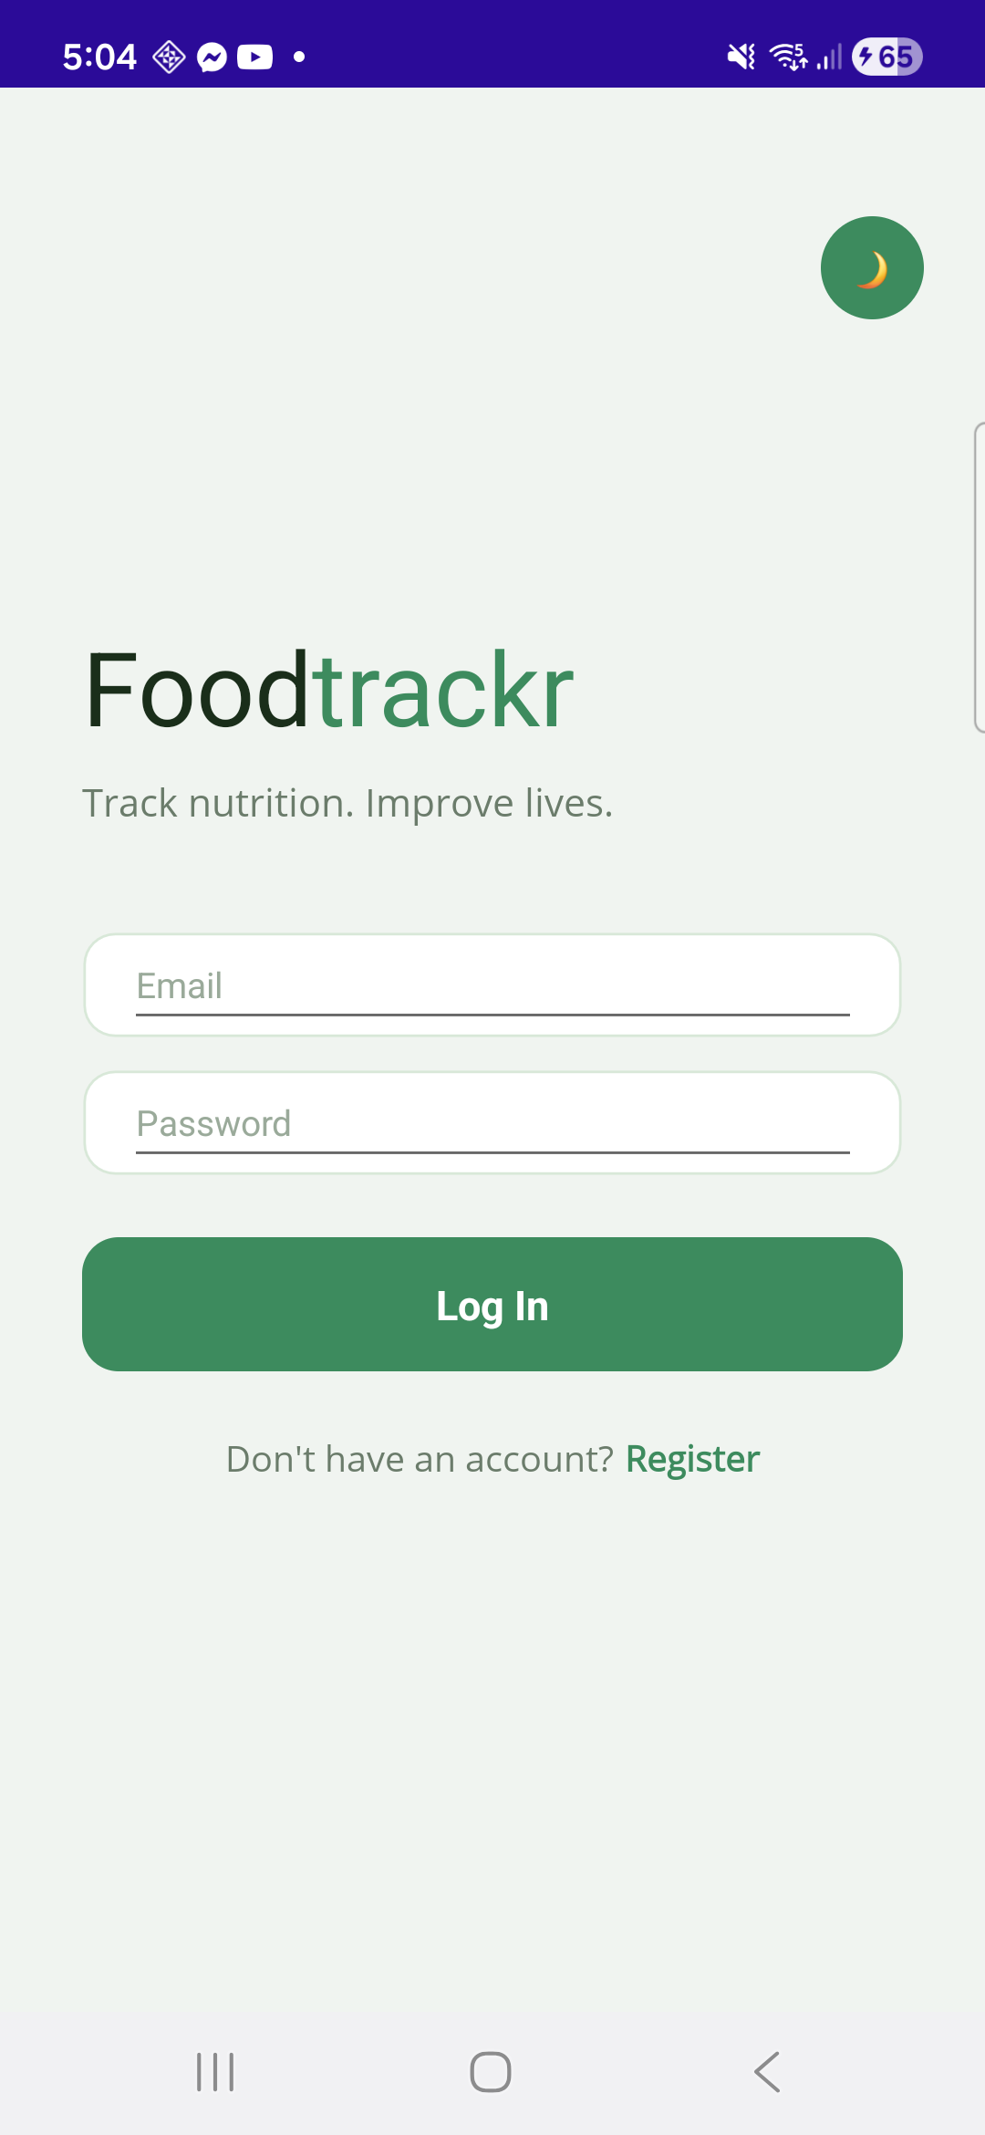
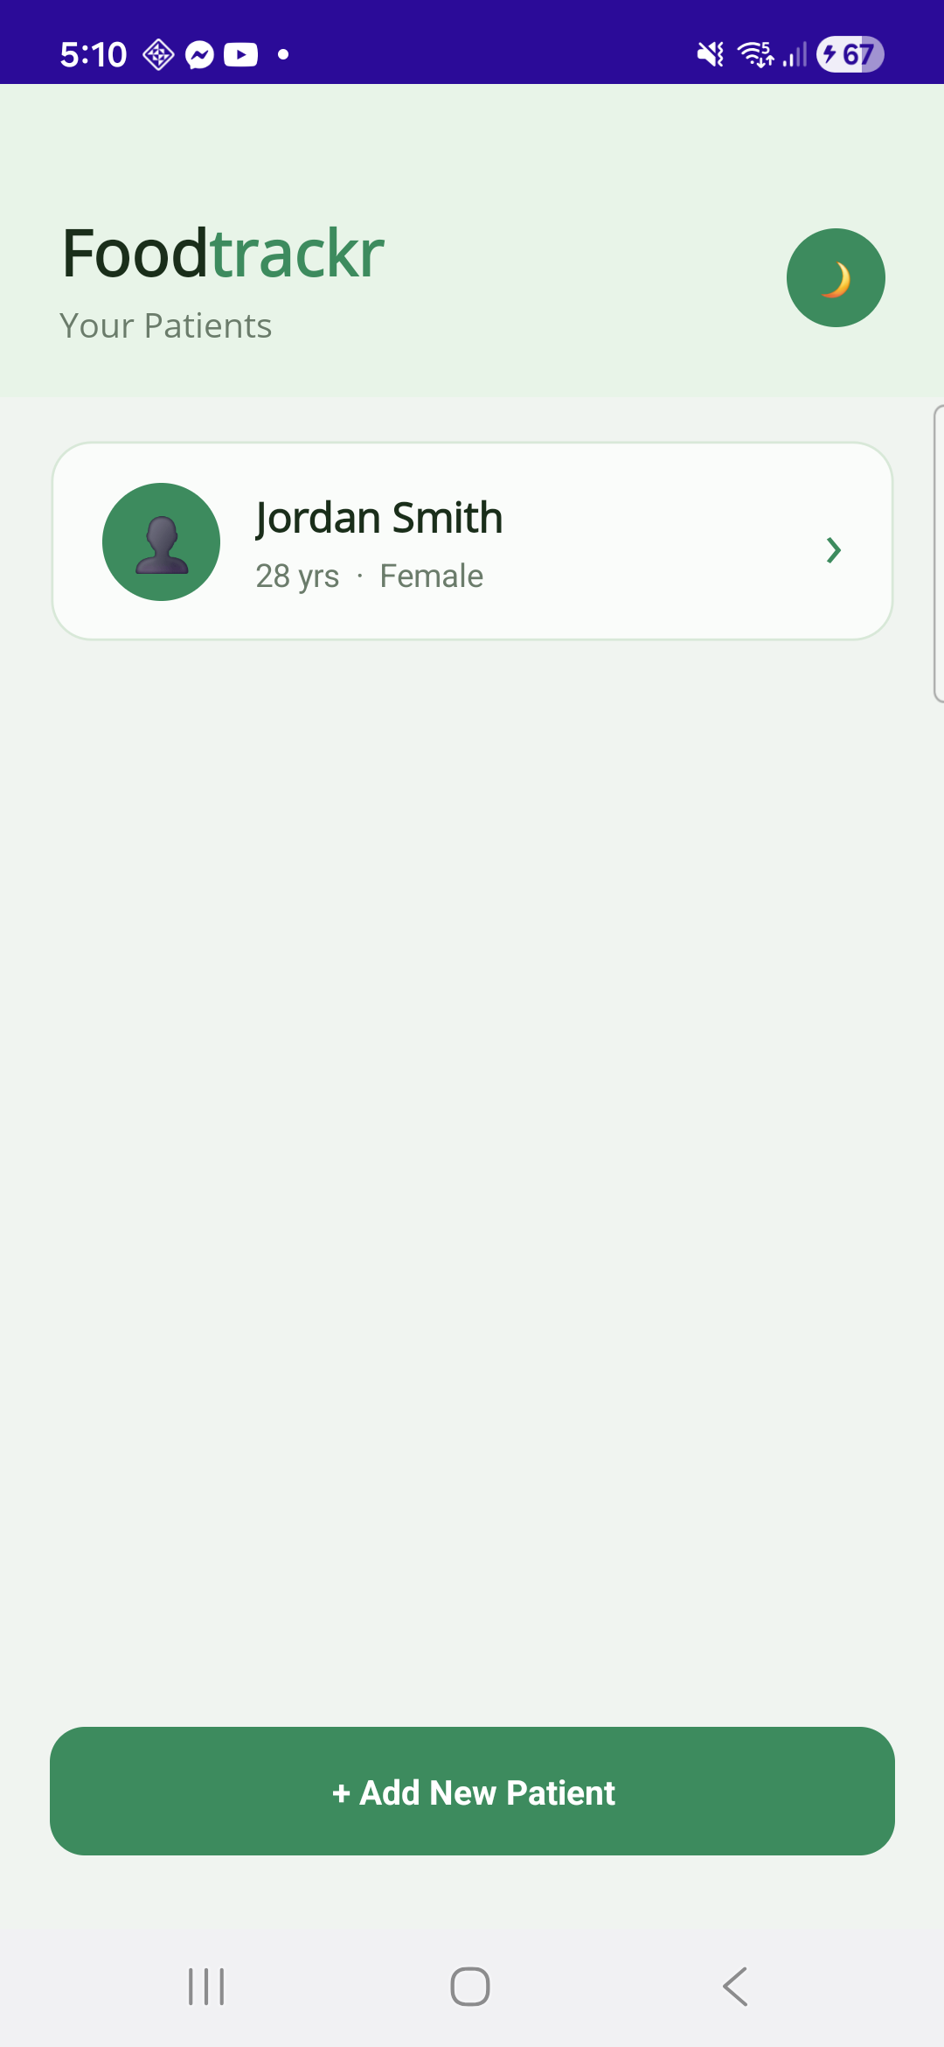
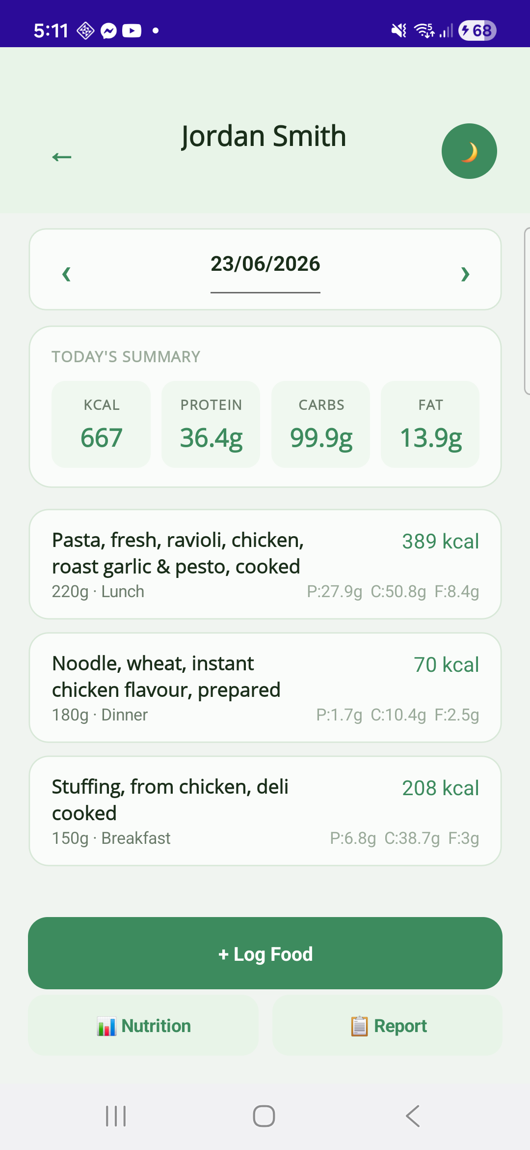
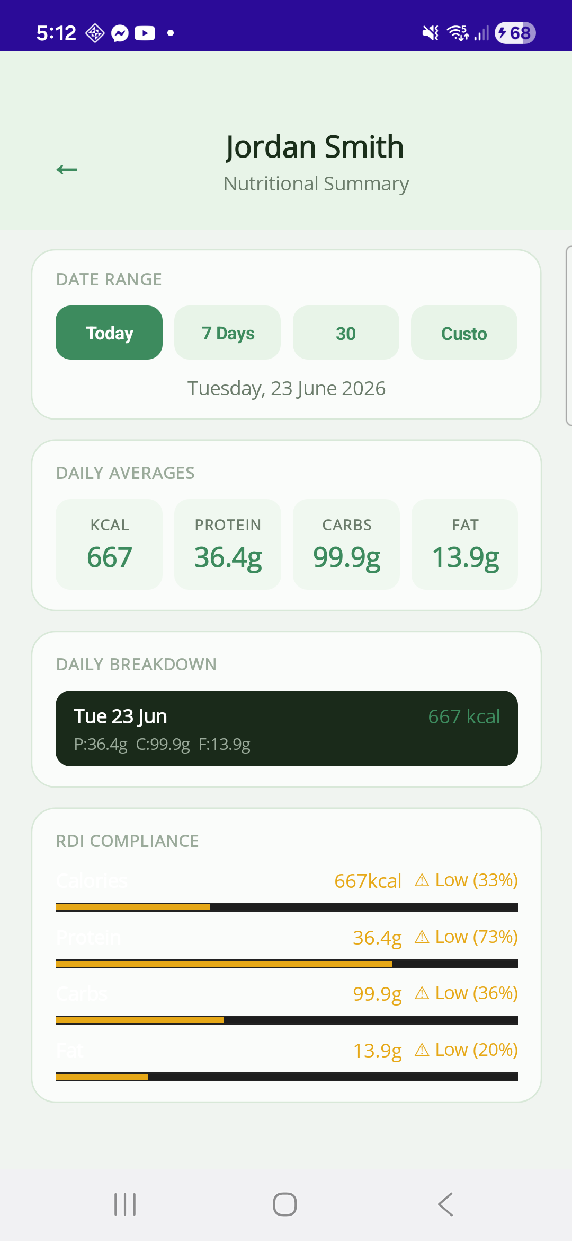
Inside the app
Sign in
Patients
Daily log
RDI report

Slide 7
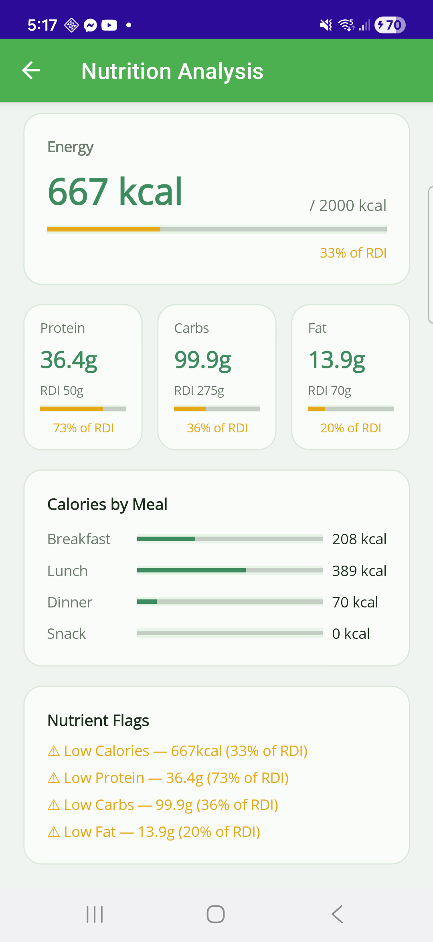
Nutritional analysis
Converting rwa food data into a professional clinical assessment.
Energy vs RDI
667 of 2000 kcal, with a live progress bar
Macros vs RDI
protein, carbs & fat as a % of target
Calories by meal
breakfast, lunch, dinner & snack split
Nutrient flags
automatic deficiency / excess warnings

Slide 8
Authentication & data security
Authentication (JWT)
Per-user data isolation
• Login verifies a hashed password
• API returns a signed token (JWT)
• App sends it as a Bearer header on every request
• [Authorize] rejects missing/invalid tokens (401)
• Token carries the user's id
• Every query filters by that id
• Another user's record -> 404 Not Found
• Proven by automated isolation tests

Slide 9
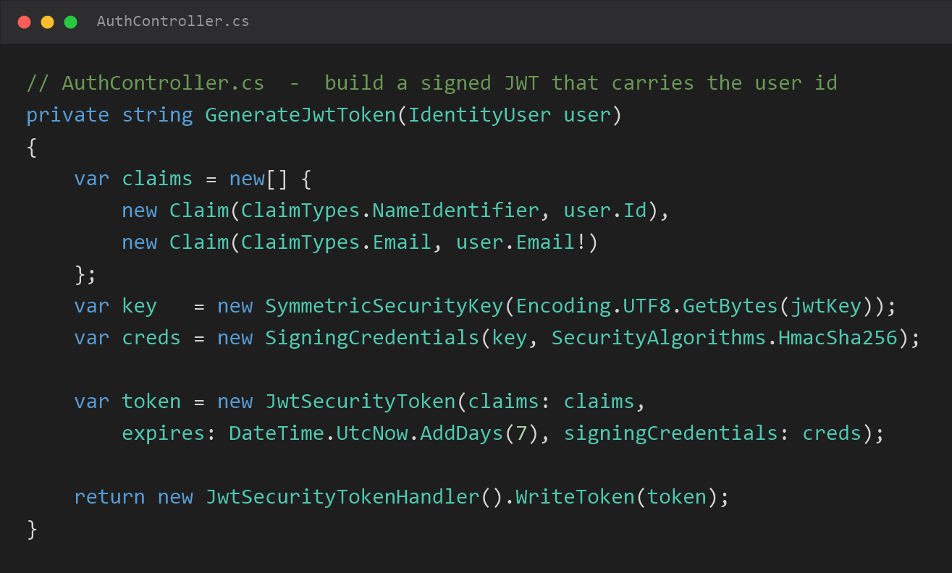
Implementation: authentication (JWT)

Slide 10
Design spotlight: a timezone bug
Symptom
Root cause
The fix
Food logged successfully - the app said 'Success!' - but it never appeared on the daily view. Totals showed 0 kcal.
Timestamps are stored in UTC (required by PostgreSQL's timestamptz), but the daily view filtered by the local date. NZ is UTC+12, so entries near midnight landed on the wrong day.
Convert each timestamp to local time when grouping by day. Storage stays UTC; the day is judged locally. Store the instant in UTC, display in local.

Slide 11
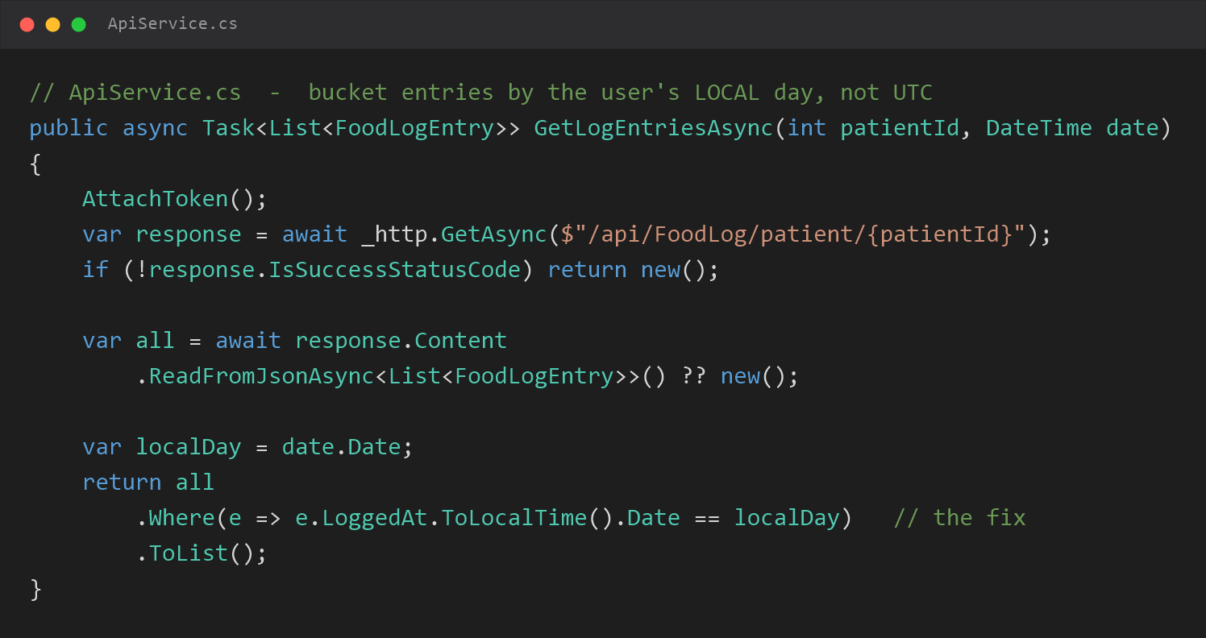
Implementation: the timezone fix

Slide 12
Testing & quality assurance
39
Unit tests
Pure logic - RDI targets, calorie scaling
Controller tests
In-memory DB - CRUD, auth, data isolation
passing tests
Integration tests
run live with: dotnet test
WebApplicationFactory - full HTTP flow
xUnit . EF Core InMemory . isolated from production

Slide 13
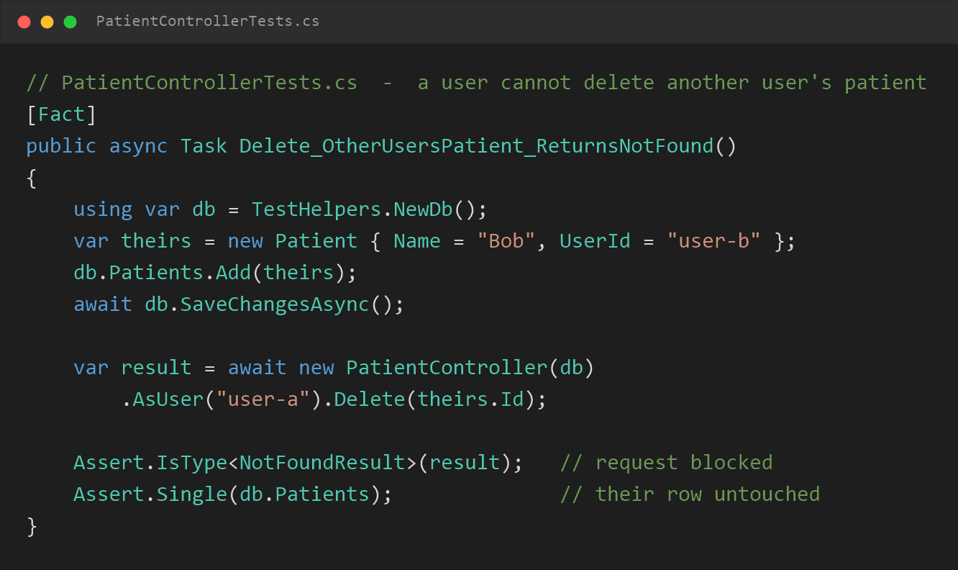
Implementation: a data-isolation test

Slide 14
Project management
• Commit history - migrations, fixes, then tests
• Work tracked as GitHub issues (#40-#45 testing)
• Branching used for feature work
• README documents the stack, setup & how to test
Repository
github.com/spindo44/Foodtrackr
Live API on Render

Slide 15
What I'd improve
• Move secrets (JWT key, DB string) to env vars & rotate
• Offline support / local caching
• Keep-alive to avoid Render cold starts
• Refactor duplicated models; optimise report queries
• Add UI tests for the MAUI pages

Slide 16
Live demo
Thank you
foodtrackr.onrender.com . Taylor Kloss

