Slide 1
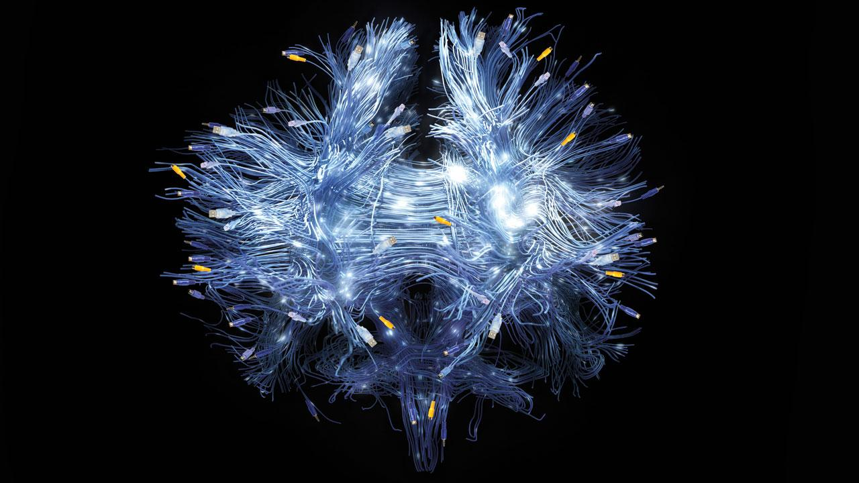
Summer School
Neural Networks with Text
28.09.18, Johanna Binnewitt, Valmir Etemi, Julia Kappes

Slide 3
Wrap up

Slide 4
Wrap up
Illustration of the basic model
„H“
all possible chars
 | H | A | L | O | . | ``
H | 1 | 0 | 0 | 0 | 0 | 0
A | 0 | 1 | 0 | 0 | 0 | 0
Sequence
…
„ “
Input Layer
Hidden Layer
Output Layer

Slide 5
Wrap up
Illustration of the basic model
len(chars)
„H“
len(chars)
 | H | A | L | O | . | ``
H | 1 | 0 | 0 | 0 | 0 | 0
A | 0 | 1 | 0 | 0 | 0 | 0
seqlen
…
„ “
Input Layer
Hidden Layer
Output Layer

Slide 6
Domains of Machine Learning

Slide 7

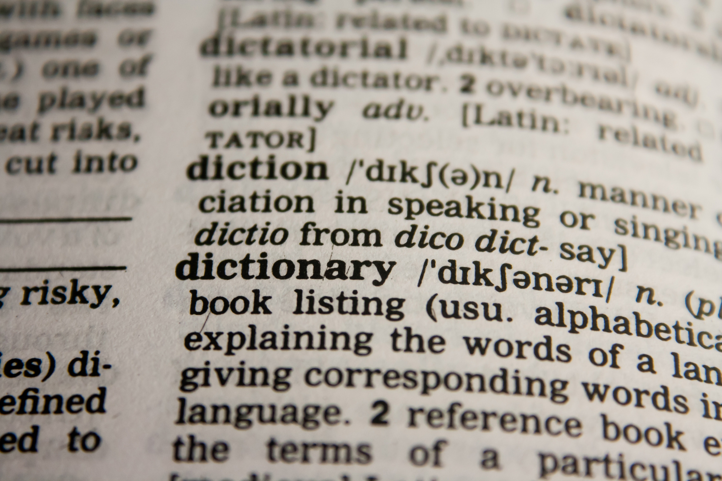

Domains of Machine Learning

Slide 8
Hyperparameter Configuration

Slide 9
Hyperparameter Configuration

Slide 10
Discussion

Slide 11
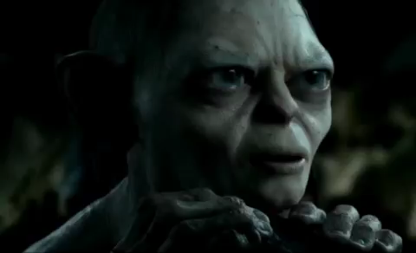
Discussion
Any Questions?

