Slide 1



SPINFF Technopark Private Limited

Slide 2

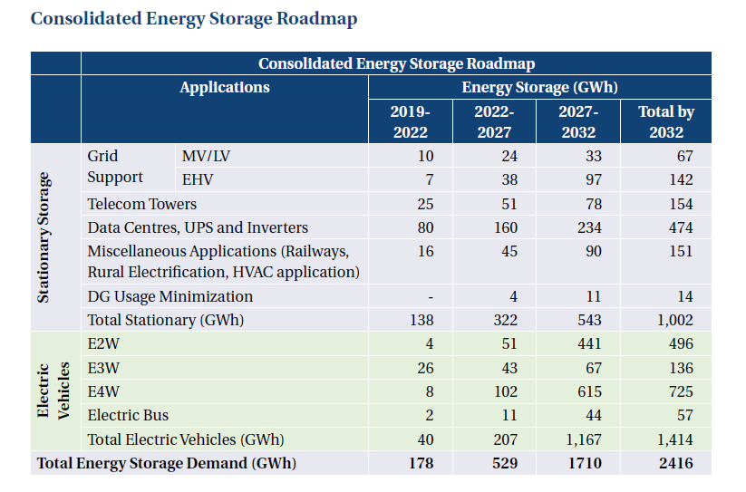

ESS Demand Forecast by Applications 2032
Stationary Storage systems by 2032:
1002 GWh ( 41.5% ) of total Energy storage demand
EVs would contribution by 2032:
1414 GWh ( 48.5%) of total energy storage demand.
Data centre, UPS & Inverter will contribute to 474 GWh ( 47.3% of Stationary & 19.61% of Total Energy storage demand.)
Source : ISGF-Report-on-Energy-Storage-System-(ESS)-Roadmap-for-India

Slide 3
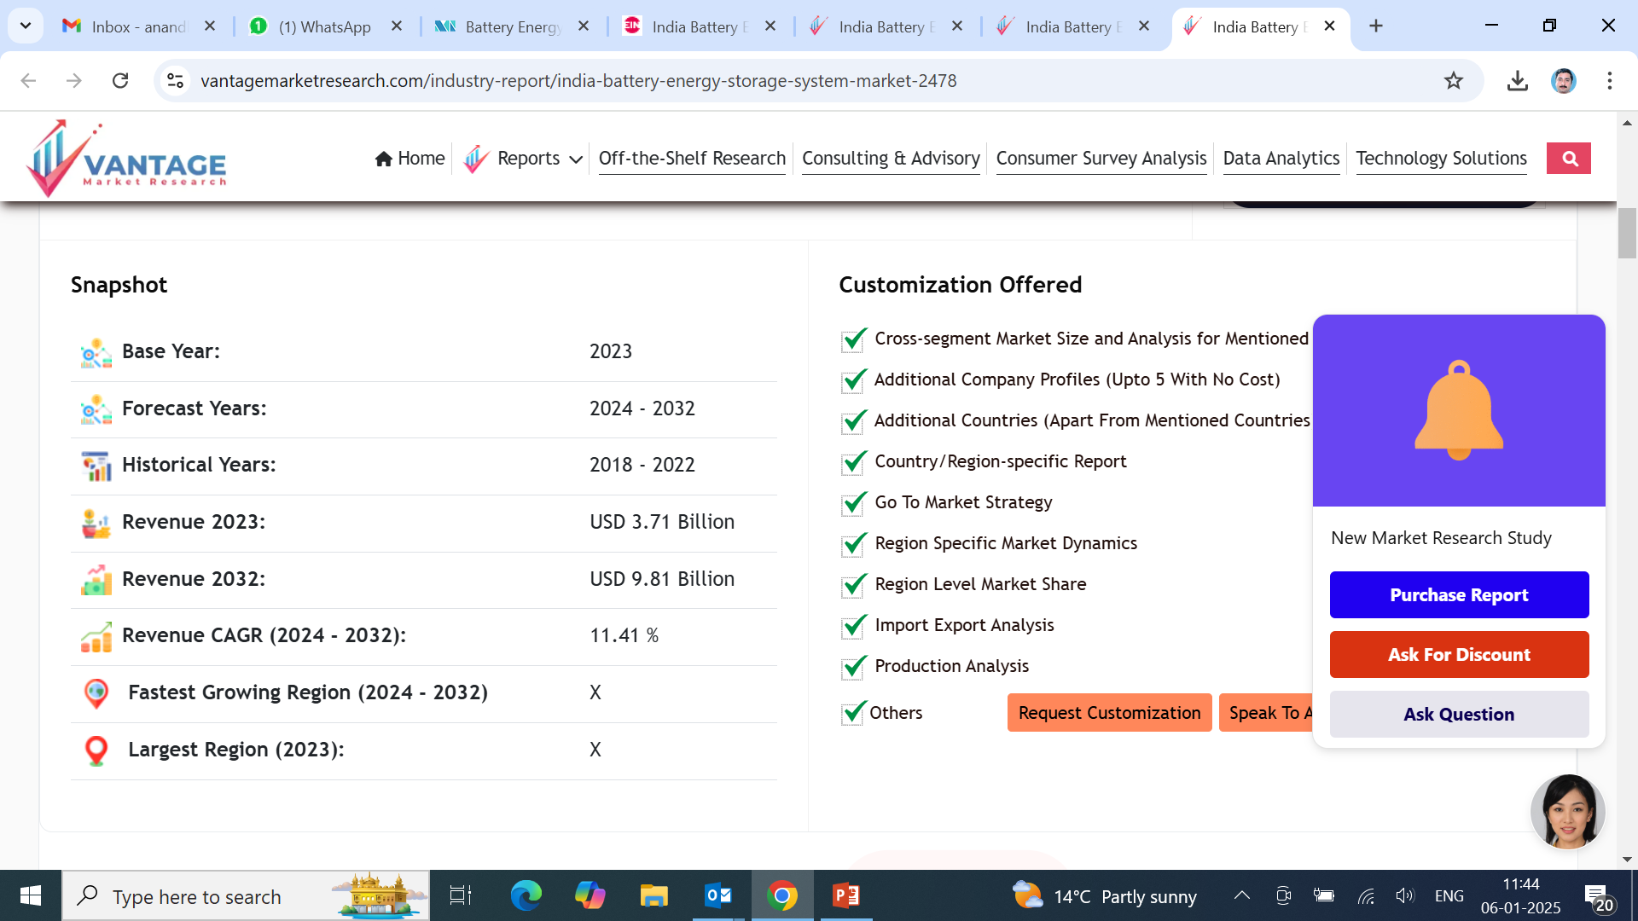
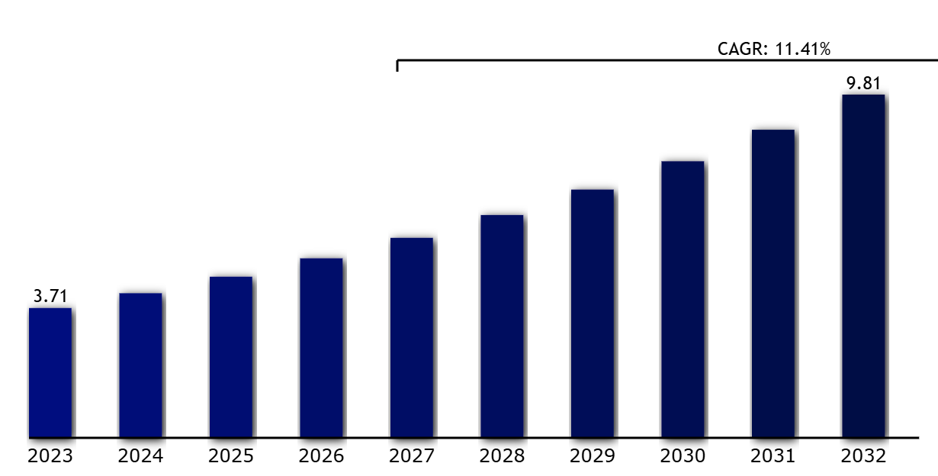
ESS & BESS Market size in India
India Battery Storage systems Market size ,2023 to 2032 ( USD Billion)
Technological advancements in new battery technologies to store energy and India's target to reach around 500 GW plus of renewable capacity by 2032 will likely create lucrative growth opportunities for the India BESS market during the forecast period.
*Source: Vantage Market research

Slide 4
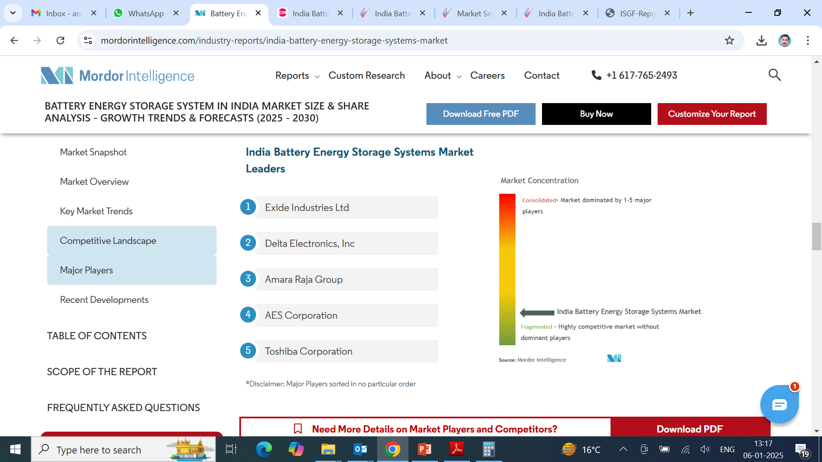
Market Leaders in BESS In India
Growth Drivers BESS Market
Significant growth potential in the renewable energy sector driving the BESS market.
• Increasing adoption of lithium-ion batteries due to their superior efficiency and declining costs.
• Government initiatives and policies promoting clean energy and energy storage systems.
• Rise of hybrid energy storage systems combining multiple battery types.
• Integration of AI and ML technologies in battery management systems.
• Growth in decentralized energy systems and micro grid projects.
• High initial investment costs and technological complexities as major challenges.
• Opportunities in expanding smart grid technologies and electric vehicle infrastructure.
India's battery energy storage systems market is moderately fragmented.
Some of the major players in the market (in no particular order) include Toshiba Corporation, AES Corporation, Exide Industries Ltd, Delta Electronics Inc., and Amara Raja Group, Panasonic & Tata Power.

Slide 5
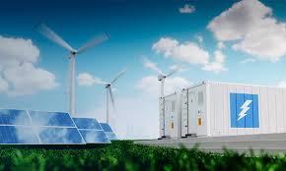
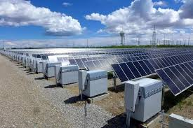
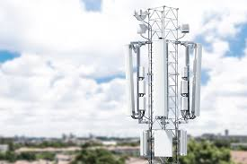
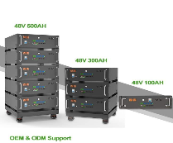
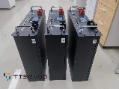
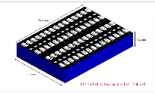
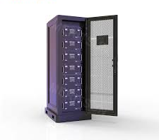
BESS Solution at Spinoff Technopark
BESS Packs for Industrial & Commercial applications in Solar, Wind & other renewable sources from 48V to 1000 V with 100 KW to 500 KW range

