Slide 1
Applying Privacy Controls to Data from Connected Vehicles
Aditya S Mishra

Slide 2

Background and Problem
Use of Computers. Software, and Sensors in Vehicles
Infotainment and internet connection.
Mobile device connection Sync’d contacts, messages, and and stored in the car.
Hundreds of sensors like the GPS, camera, touch sensor, and pressure sensors are monitoring and generating data.
Car manufacturers collect data from cars and upload it to their storage server
Driver’s ignorant
No control for owners
Data compromise
Data shared with 3rd parties or service providers like insurance
How can car owners protect their personally identifiable information?

Slide 3


Objective
Study mechanisms that build trust between car owners and the car manufacturers with respect to data owned by the car owner.
Privatize the personal data stored in the connected vehicle that is sent to external sources such as the car manufacturer and associated partners.
Keeping data utility intact.
Devise mechanisms to enforce privacy compliance.

Slide 4



Design
The data is taken from a connected vehicle via the TorqueFiles app.
Quasi-identifiers within dataset are de-identified via anonymization techniques - hashing, generalization, and data masking.
For the purposes of this project, the data columns that were tested were the Longitude and Latitude columns, as those are the most significant quasi-identifiers.
The privacy of the data was verified using K-Anonymity algorithms

Slide 5
Implementation
Libraries used:
Pandas, MatPlotLib, NumPy, os, Geopy.Geocoders, HashLib
Convert data to Dataframes
Use SHA256 hashing for pseudo-anonymization
Generalization of quasi-identifiers
Data Masking for quasi-identifiers
Verify using K-Anonymity
Notes:
The data was read from data files uploaded to google drive, and converted to dataframes
The data was placed into temporary dataframes so that the values could be edited and tested on without changing the original data for further use
The reverse geocode method in the Geocoder library allowed me to input the latitude and longitude coordinate data and retrieve a global address with city, state, etc. This address was then used to generalize the location data to a city, state, or country

Slide 6
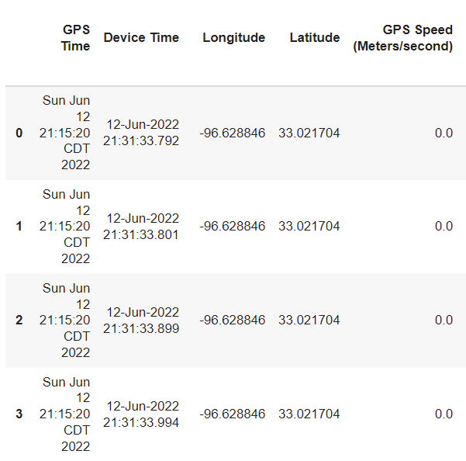
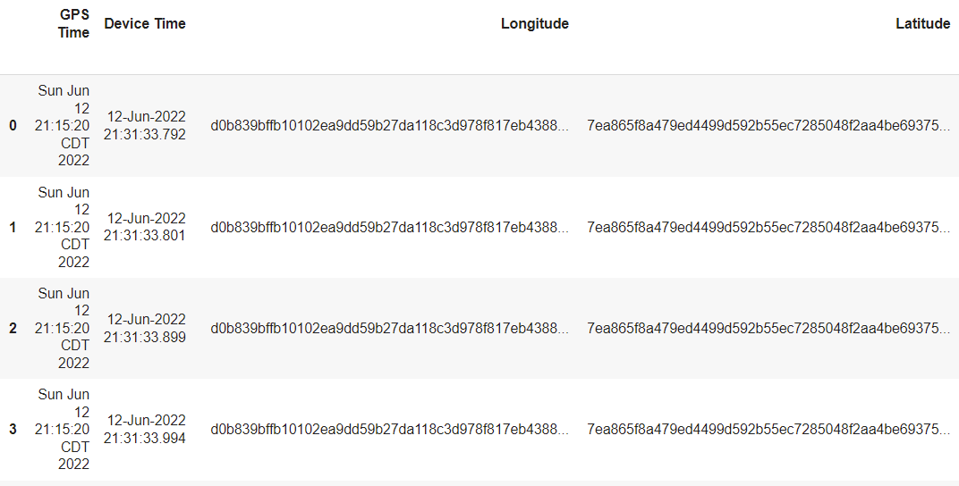
Anonymization Demo
Original
Hashing

Slide 7
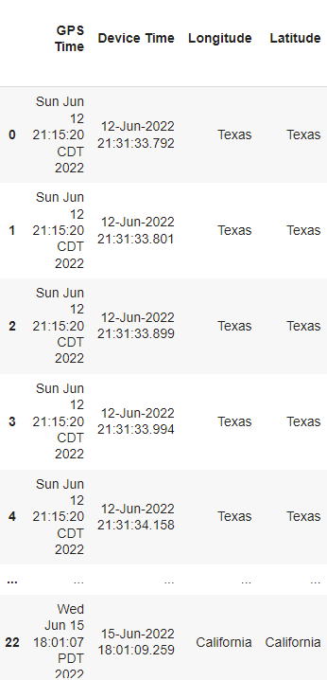
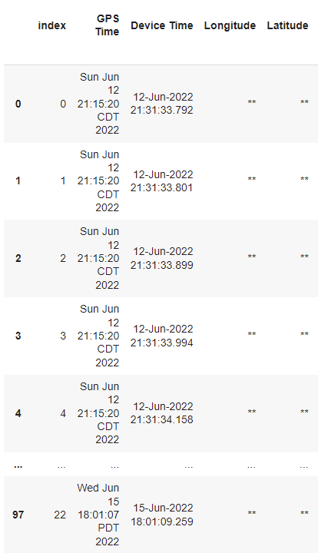
Anonymization Demo
Generalization
Data Masking

Slide 8
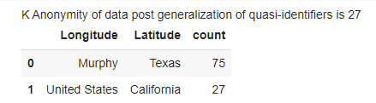
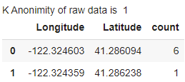

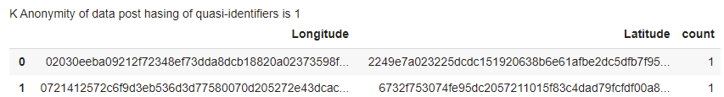
K-Anonymity
Original
Generalization
Masking
Hashing

Slide 9



Challenges
K-anonymity
Understanding and learning the topics
Hashing
Data Masking
Working with Dataframes
Certain functions that should have been necessary did not exist
Certain rows of the data did not have values and would return an error.
Geocoordinate data sometimes resulted in exception
Notes:
The initial challenge was with Understanding and learning the topics, especially how to code them. Some of them had built in functions from libraries, others required algorithms to be written.
working with DataFrames, as certain functions that should have been necessary did not exist (index for the Series, a simple way to copy Series onto other DataFrames, etc).
Certain rows of the data did not have a value, such as location or speed, and trying to access that part of the dataset would return an error.
Geocoordinate data sometimes did not return a city or other part of real-world location, resulting in an error.

Slide 10



Future Directions
Integrating the anonymization techniques with the car before data is uploaded to car manufacturer’s storage
Extension of the program to anonymize datasets of other smart devices
Learn and implement additional disclosure metrics

Slide 11
References
https://www.researchgate.net/figure/System-architecture-of-in-vehicle-data-management_fig18_304090501
Emerging Data Privacy Regulation Brings OEMs and Consumers Closer Together Than Ever Before (upstream.auto)
Can Your Car Be Hacked? - Feature - Car and Driver
Three landmark UN vehicle regulations enter into force | UNECE
A New Era of Automotive Data Compliance is Coming | Consumer Privacy World
Opinion | Your Car Knows When You Gain Weight - The New York Times (nytimes.com)
https://www.geeksforgeeks.org/sha-in-python/
https://www.geeksforgeeks.org/how-to-create-an-empty-dataframe-and-append-rows-columns-to-it-in-pandas/
https://stackoverflow.com/questions/41763997/how-to-append-item-to-list-of-different-column-in-pandas
https://www.geeksforgeeks.org/get-a-specific-row-in-a-given-pandas-dataframe/
https://pandas.pydata.org/docs/reference/api/pandas.DataFrame.replace.html
https://pandas.pydata.org/docs/reference/api/pandas.DataFrame.insert.html

