Slide 1
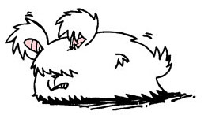
Angora: Efficient Fuzzing by Principled Search
Peng Chen
ShanghaiTech University
Hao Chen
University of California, Davis
The image of angora is designed by Frederic Mur.

Slide 2
Fuzzing
Fuzzing
Popular dynamic analysis techniques to find bugs.
Creates different inputs to trigger bugs in the program.
Challenges
Exploration: How to cover more parts of the program?

Slide 3
Coverage-based fuzzing (e.g. AFL)
Instrumentation
Instruments the program slightly to track branch coverage.
Fuzzing loop
Mutates seed inputs by heuristics.
Keeps inputs that explore new path as seeds.

Slide 4


Fuzzing vs. symbolic execution
Angora
Fuzzing
Scalable and low overhead.
Uses only heuristics. Random mutation is unproductive.
Symbolic execution
Creates quality inputs by solving path constraints.
Slow and cannot solve many types of constraints efﬁciently.

Slide 5
Motivating example
1
2
3
4
5
6
7
8
9
10
11
12
13
14
15
16
void foo(int i, int j) {
if (i * i - j * 2 > 0) {
// some code
} else {
// some code
}
}
int main() {
char buf[1024];
int i = 0, j = 0;
if (fread(buf, sizeof(char), 1024, fp) < 1024) return(1);
if (fread(&i, sizeof(int), 1, fp) < 1) return(1);
if (fread(&j, sizeof(int), 1, fp) < 1) return(1);
foo(i, j);
}
fread(…) < 1024
F
T
fread(…) < 1
return(1)
F
T
fread(…) < 1
return(1)
F
T
i * i – j * 2 > 0
return(1)
F
T
Line 5
Line 3

Slide 6
Which input bytes flow into this predicate?
1
2
3
4
5
6
7
8
9
10
11
12
13
14
15
16
void foo(int i, int j) {
if (i * i - j * 2 > 0) {
// some code
} else {
// some code
}
}
int main() {
char buf[1024];
int i = 0, j = 0;
if (fread(buf, sizeof(char), 1024, fp) < 1024) return(1);
if (fread(&i, sizeof(int), 1, fp) < 1) return(1);
if (fread(&j, sizeof(int), 1, fp) < 1) return(1);
foo(i, j);
}
Input
… |  |  |  |  |  |  |  |  | …
1024..1027
1028..1031
i * i - j * 2 > 0

Slide 7
How to solve this path constraint efficiently?
1
2
3
4
5
6
7
8
9
10
11
12
13
14
15
16
void foo(int i, int j) {
if (i * i - j * 2 > 0) {
// some code
} else {
// some code
}
}
int main() {
char buf[1024];
int i = 0, j = 0;
if (fread(buf, sizeof(char), 1024, fp) < 1024) return(1);
if (fread(&i, sizeof(int), 1, fp) < 1) return(1);
if (fread(&j, sizeof(int), 1, fp) < 1) return(1);
foo(i, j);
}
Input
… | 0 | 0 | 0 | 0 | 0 | 0 | 0 | 0 | …
1024..1027
1028..1031
… | ? | ? | ? | ? | ? | ? | ? | ? | …
1024..1027
1028..1031

Slide 8
How are input bytes combined into values and their types?
1
2
3
4
5
6
7
8
9
10
11
12
13
14
15
16
void foo(int i, int j) {
if (i * i - j * 2 > 0) {
// some code
} else {
// some code
}
}
int main() {
char buf[1024];
int i = 0, j = 0;
if (fread(buf, sizeof(char), 1024, fp) < 1024) return(1);
if (fread(&i, sizeof(int), 1, fp) < 1) return(1);
if (fread(&j, sizeof(int), 1, fp) < 1) return(1);
foo(i, j);
}
Input
…
1024..1027
1028..1031
int
int

Slide 9


What is the minimum input length to reach here?
void foo(int i, int j) {
if (i * i - j * 2 > 0) {
// some code
} else {
// some code
}
}
int main() {
char buf[1024];
int i = 0, j = 0;
if (fread(buf, sizeof(char), 1024, fp) < 1024) return(1);
if (fread(&i, sizeof(int), 1, fp) < 1) return(1);
if (fread(&j, sizeof(int), 1, fp) < 1) return(1);
foo(i, j);
}
Input
… |  |  |  |  | …
Length $<$ 1032
… |  |  |  |  |  |  |  |  | …
Length $≥$ 1032

Slide 10
Overview of Angora
(1) Taint tracking
(2) Shape and
type inference
(3) Gradient
descent
byte 0
byte 1
byte 2
byte 3
byte 4
…
byte N – 2
byte N – 1
byte 0
byte 1
Mutated
Input
x0: u16
x1: u16
byte 3
byte 4
Input
Run program
Finish
Satisfy
constraints?
Output
byte N
(4) Input length
exploration

Slide 11
Search based on gradient descent
Question
How to mutate the input to solve path constraints?
Solution
View fuzzing as a search problem.
Solve the constraint using optimization techniques, such as gradient descent.

Slide 12
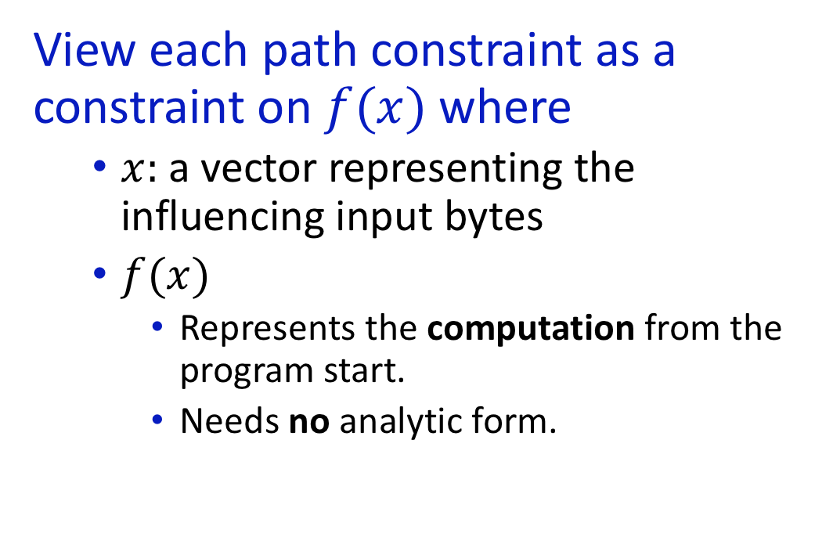



View path constraint as function over input
View each path constraint as a constraint on $f(x)$ where
$x:$a vector representing the influencing input bytes
$f(x)$
Represents the computation from the program start.
Needs no analytic form.
Input
… |  |  |  |  |  |  |  |  | …
int
int
$$x←[int, int]$$
Program
entry
…
if (i * i – j *2 > 0)
…
$$f(x)$$
$$− \left(i∗i−j∗2\right)≤0$$

Slide 13
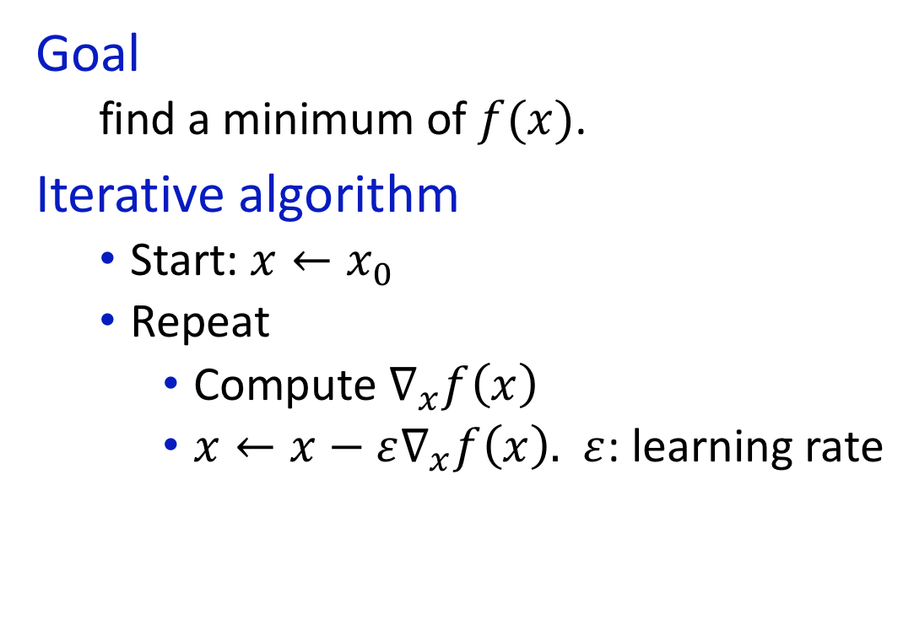




Gradient descent
Goal
find a minimum of $f(x)$.
Iterative algorithm
Start: $x←x_{0}$
Repeat
Compute $∇_{x}f\left(x\right)$
$x←x−ε∇_{x}f\left(x\right).$ $ε$: learning rate
$$f$$
$$x_{0}$$
Gradient
$$x_{t}$$
0
$$x$$
Local minimum
Global minimum

Slide 14
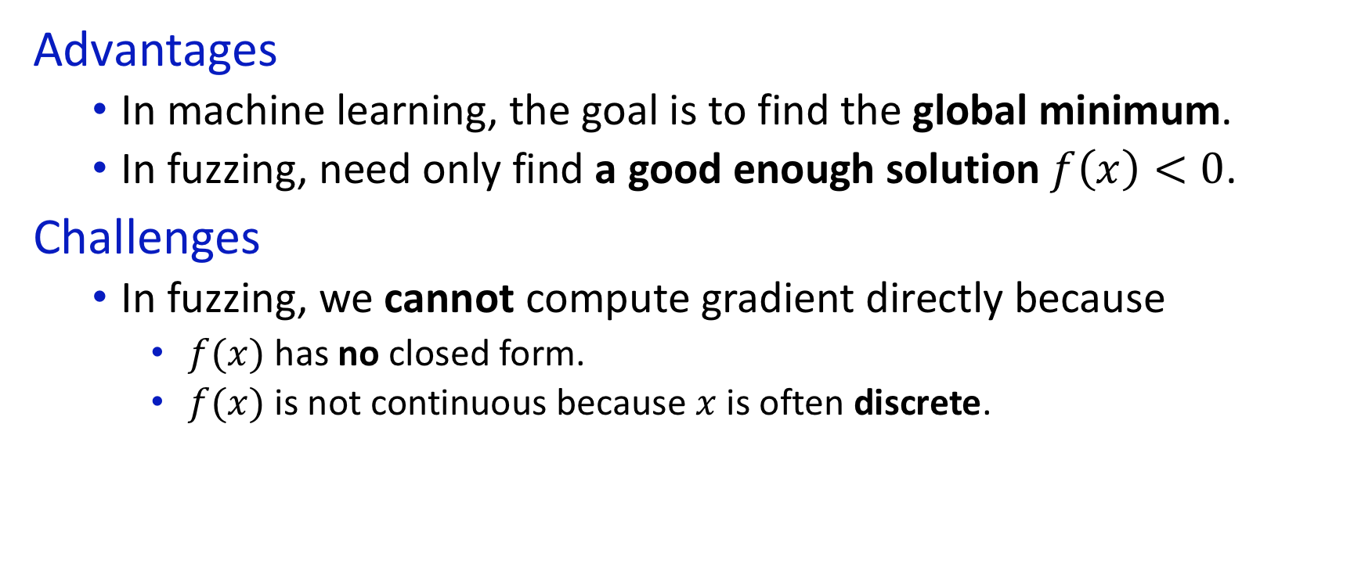



Apply gradient descent to solving path constraints
Advantages
In machine learning, the goal is to find the global minimum.
In fuzzing, need only find a good enough solution $f\left(x\right)<0$.
Challenges
In fuzzing, we cannot compute gradient directly because
$f(x)$ has no closed form.
$f(x)$ is not continuous because $x$ is often discrete.
$$f$$
$$x_{t}$$
0
$$x$$
Local minimum
Global minimum

Slide 15



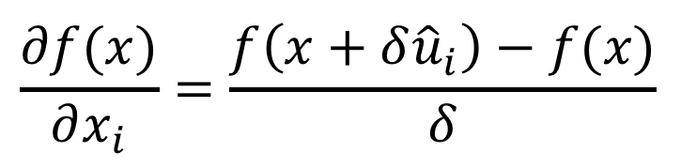


Numerically approximate directional derivative
Mathematical foundation
$δ$ is a small value.
${\hat{u}}_{i}$ is a unit vector in the i-th dimension.
Input
… |  |  |  |  |  |  |  |  | …
$$\frac{∂f(x)}{∂x_{i}}=\frac{f\left(x+δ{\hat{u}}_{i}\right)−f(x)}{δ}$$
int
int
$$x+δ{\hat{u}}_{i}$$
$$x$$
Program
entry
…
if (i * i – j *2 > 0)
…
$$f(x+δ{\hat{u}}_{i})$$
$$f(x)$$

Slide 16
Implementation
Instrumentation
Instrument LLVM Pass.
Extend DFSAN with byte-level taint tracking.
Fuzzing loop
Implemented by Rust.

Slide 17
Bugs in LAVA-M found by each fuzzer
LAVA-M: Ground-truth corpora with injected realistic bugs.
Dolan-Gavitt, Brendan, et al. "Lava: Large-scale automated vulnerability addition." Security and Privacy (SP), 2016 IEEE Symposium on. IEEE, 2016.
Program | Listed bugs | Angora | AFL | FUZZER | SES | VUzzer | Steelix
uniq | 28 | 29 | 9 | 7 | 0 | 27 | 7
base64 | 44 | 48 | 0 | 7 | 9 | 17 | 43
md5sum | 57 | 57 | 0 | 2 | 0 | Fail | 28
who | 2136 | 1541 | 1 | 0 | 18 | 50 | 194

Slide 18
Bugs in LAVA-M found by Angora
Programs | Listed bugs | Found bugs |  | Time(min)
 |  | Listed | Unlisted
uniq | 28 | 28 | 1 | 10
base64 | 44 | 44 | 4 | 10
md5sum | 57 | 57 | 0 | 10
who | 2136 | 1443 | 98 | 45

Slide 19
Angora vs. AFL on real world applications
Line Coverage
Program | Line coverage |  |  | Branch coverage |  |  | Unique crashes
 | AFL | Angora | Increase | AFL | Angora | Increase | AFL | Angora
file | 2070 | 2535 | 21.2% | 1462 | 1899 | 29.9% | 0 | 6
jhead | 347 | 789 | 127.4% | 218 | 532 | 144.0% | 19 | 52
xmlwf | 1980 | 2025 | 2.3% | 2905 | 3158 | 8.7% | 0 | 0
djpeg | 5401 | 5509 | 2.0% | 1677 | 1782 | 6.3% | 0 | 0
readpng | 1592 | 1799 | 13.0% | 872 | 1007 | 15.5% | 0 | 0
nm | 6372 | 7721 | 21.2% | 4105 | 4693 | 14.3% | 12 | 29
objdump | 3448 | 6216 | 80.3% | 2071 | 3393 | 63.8% | 4 | 40
size | 2839 | 4832 | 70.2% | 1792 | 2727 | 52.2% | 6 | 48

Slide 20
Cumulative line coverage on file

Slide 21
Angora vs. AFL on real world applications

Slide 22
Solved path constraints
Program | Random | Magic bytes + random | Gradient descent
file | 63.5% | 76.0% | 87.1%
jhead | 86.9% | 87.1% | 97.6%
xmlwf | 77.4% | 81.4% | 97.0%
djpeg | 66.1% | 73.6% | 78.3%
readpng | 19.9% | 23.7% | 24.5%
nm | 57.5% | 66.4% | 80.2%
objdump | 47.0% | 54.9% | 56.3%
size | 44.1% | 52.4% | 54.3%

Slide 23
Conclusion
Key techniques
Efficient byte-level taint analysis
Search algorithm based on gradient descent
Shape and type inference
Input length exploration
Principled approach brings impressive performance.

Slide 24
Backup slides

Slide 25
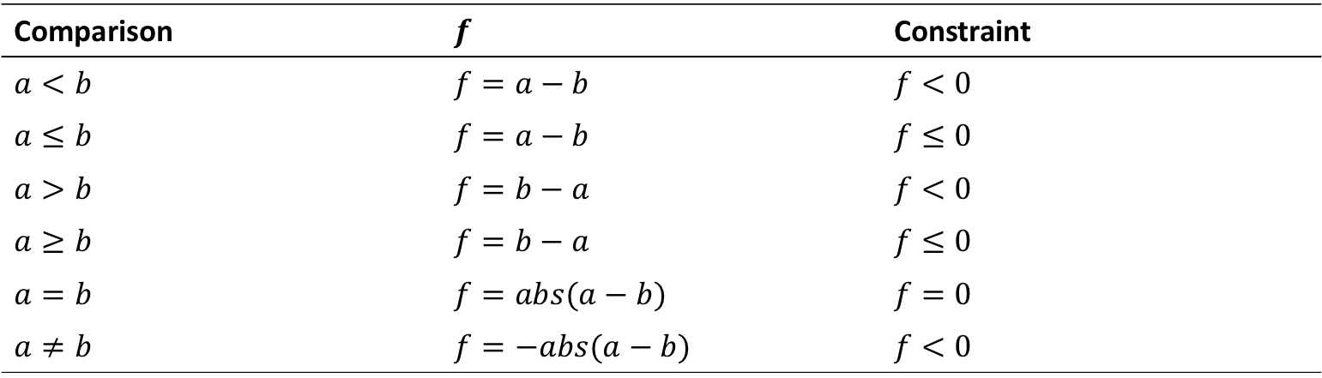
From predicates to constraints
Comparison | $$f$$ | Constraint
$$a<b$$ | $$f=a−b$$ | $$f<0$$
$$a≤b$$ | $$f=a−b$$ | $$f≤0$$
$$a>b$$ | $$f=b−a$$ | $$f<0$$
$$a≥b$$ | $$f=b−a$$ | $$f≤0$$
$$a=b$$ | $$f=abs(a−b)$$ | $$f=0$$
$$a≠b$$ | $$f=−abs(a−b)$$ | $$f<0$$

Slide 26
Inputs tested per second
Program | AFL | Angora
file | 971.17 | 791.73
jhead | 2684.45 | 2648.91
xmlwf | 2225.07 | 2206.24
djpeg | 1439.94 | 1185.52
readpng | 3374.43 | 2881.72
nm | 1633.72 | 1045.35
objedump | 1882.05 | 1192.04
size | 1671.95 | 1174.55

Slide 27
Byte-level taint tracking
Question: Which input bytes flow into each path constraint?
Challenges: Taint tracking is expensive, more so at byte-level.

Slide 28
Run taint tracking once on each seed input
Observation
Taint tracking is unnecessary while mutating the input.
Solution
Run taint tracking once on each seed input.
Mutate the seed many times and run without taint tracking.
Benefit: amortize the cost of taint tracking over many mutations.

Slide 29
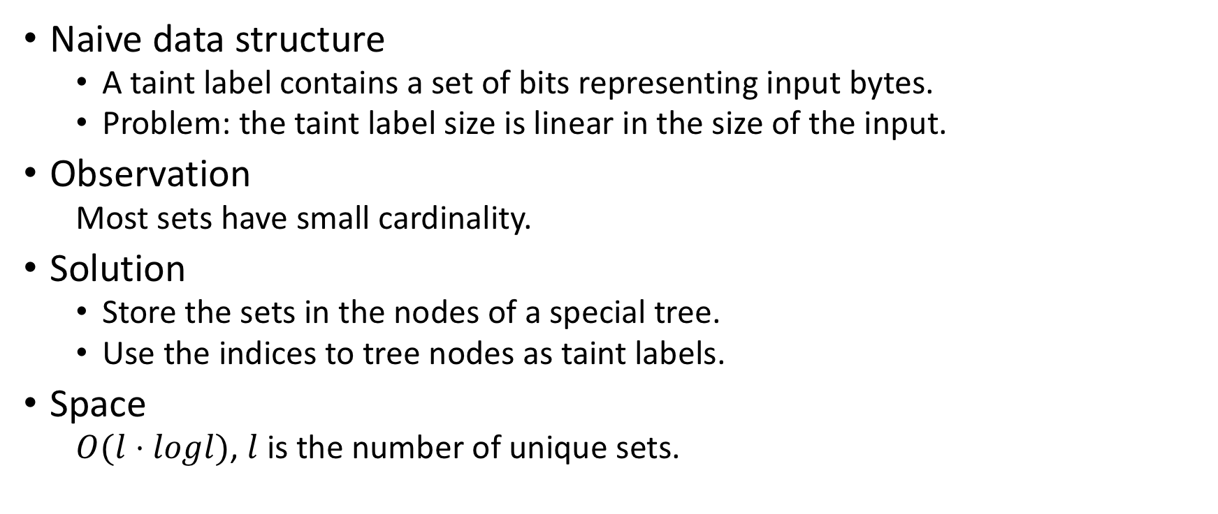
Efficient data structure for byte-level taint tracking
Naive data structure
A taint label contains a set of bits representing input bytes.
Problem: the taint label size is linear in the size of the input.
Observation
Most sets have small cardinality.
Solution
Store the sets in the nodes of a special tree.
Use the indices to tree nodes as taint labels.
Space
$O(l⋅logl)$, $l$ is the number of unique sets.

Slide 30
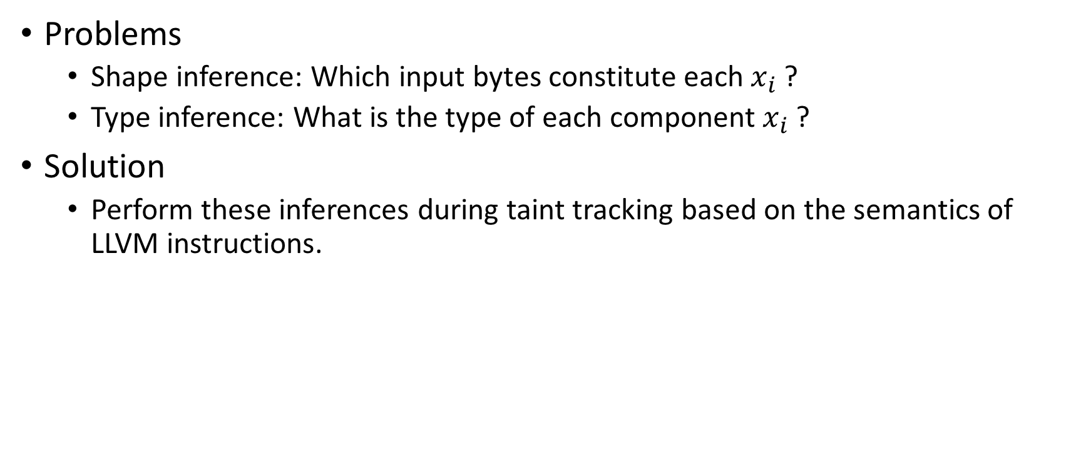
Shape and type inference
Problems
Shape inference: Which input bytes constitute each $x_{i}$ ?
Type inference: What is the type of each component $x_{i}$ ?
Solution
Perform these inferences during taint tracking based on the semantics of LLVM instructions.

Slide 31
Input length exploration
Problem: How long should be the input?
If too short, may not explore certain branches.
If too long, may waste time and memory (or cause OOM).
Solution
Criterion: Extend input only when it might explore new branches.
Approach: Instrument functions that return values that depend on the file size, e.g., read(), stat().

Slide 32
Input length exploration
Program | Longer inputs |  |  |  | Average length
 | Random |  | Angora |  | Random | Angora
 | Useful | Total | Useful | Total
file | 185 | 79k | 251 | 3342 | 889.9 | 399.0
jhead | 0 | 66k | 0 | 26 | 0.0 | 0.0
xmlwf | 277 | 143k | 588 | 2196 | 190.3 | 128.9
djpeg | 32 | 106k | 474 | 3476 | 846.6 | 283.6
readpng | 46 | 35k | 43 | 152 | 2242.7 | 363.1
nm | 17 | 170k | 19 | 872 | 771.7 | 248.0
objedump | 44 | 214k | 60 | 1614 | 1271.6 | 496.0
size | 27 | 197k | 33 | 1482 | 1584.5 | 949.7

