Slide 1
Funix Swap A decentralized exchange for swapping tokens
Hoàng Tử Vinh – HE140292

Slide 2
Table of contents
01
02
03
04
05
06
Overview
Functions
Metamask
Brief about Funix Swap
What do Funix Swap do?
Import and View wallet information
Swapping Token
Transfer Token
Conclusions
You can describe the topic of the section here
You can describe the topic of the section here
You can describe the topic of the section here

Slide 3
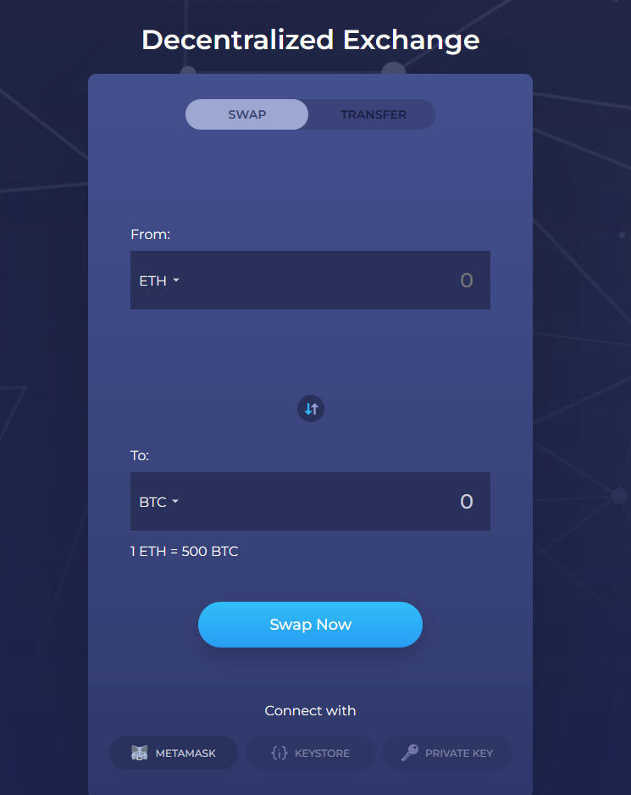
01
Overview
FunixSwap performs as an trader to exchange ETH to tokens, and between two distinct types of tokens.
FunixSwap can also transfering tokens, ETH from an account to another account or to a contract

Slide 4
Hypotheses
1
Import and view wallet information
Implementing import user wallet using Metamask.
After import, token balance and address will display on interface.
2
Swapping tokens
Support exchange between token and ETH and between 2 tokens.
3
Transfer tokens
Support transfer token and ETH from user’s wallet to specific address.

Slide 5
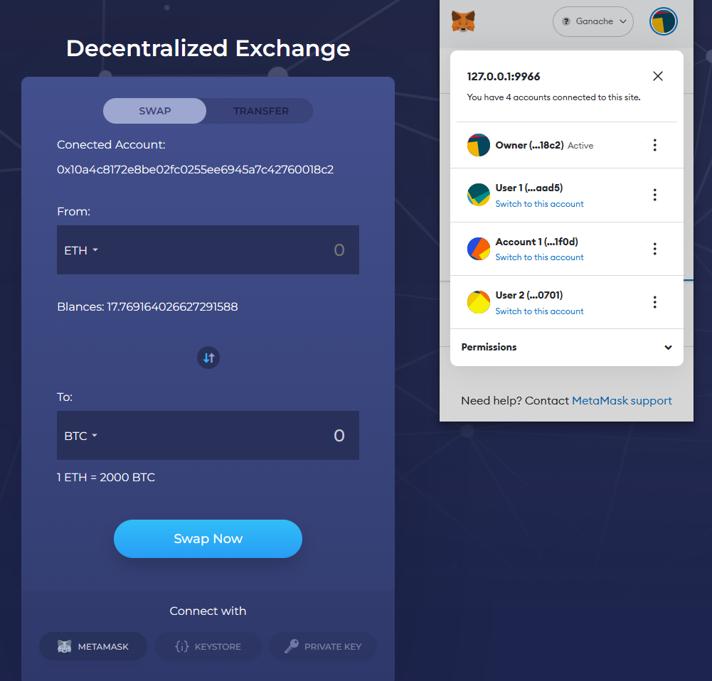
Import and view wallet information
- Implementing import user wallet using Metamask.
- Showing current imported wallet address and its balance of selected token in dropdown list.
- A background job running for fetching user balances in an interval of 10s.

Slide 6


Main functions
Swapping Tokens
Transferring Tokens
Swapping between ETH and other tokens. Exchange fast, easy and secure
Transfer token between other address

Slide 7
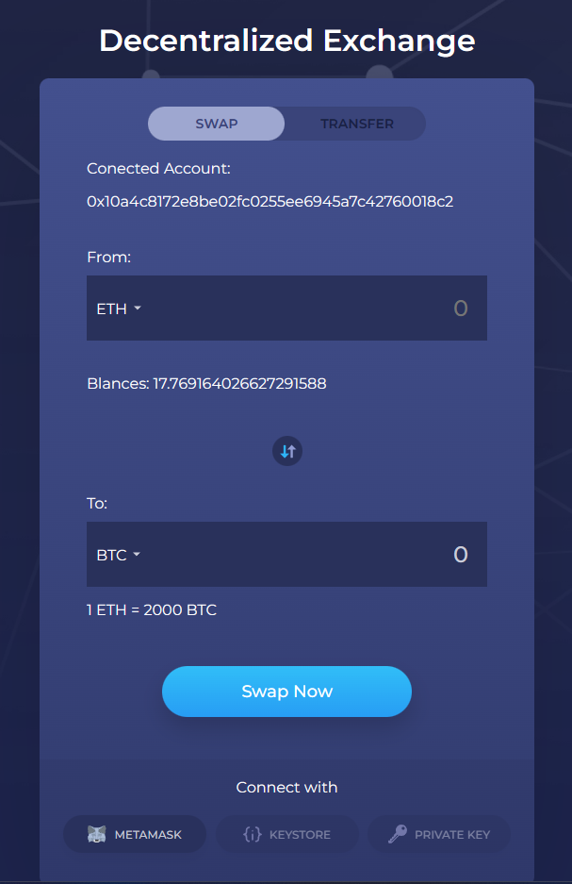
Swapping Tokens
- Showing current market rate of selected token pair, also expected amount of destination token.
- A background job running for fetching market rate of selected token pair in an interval of 10s.
- On click, Swap Now showing a confirmation modal with all the information selected before and estimated transaction fee to execute the transaction.

Slide 8
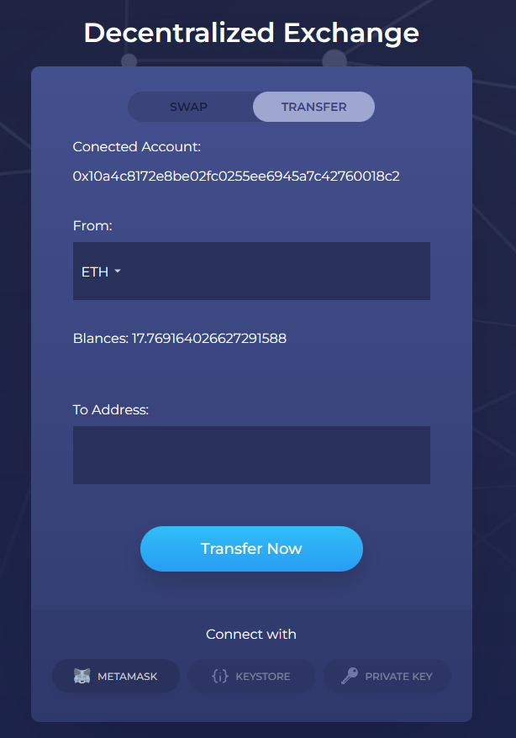
Transferring Tokens
- Support transfer token and ETH from user’s wallet to specific address.
- Verify provided address.
- On click, Swap Now showing a confirmation modal with all the information selected before and estimated transaction fee to execute the transaction.

Slide 9
Thanks!
Do you have any questions?
vinhht14@gmail.com
+84 94349156
yourwebsite.com

