Slide 1
Introduction to the Shiny Framework
Jim Hughes
Email: jim.hughes@mymail.unisa.edu.au
26th July 2017
Acknowledgements: Jessica Wojciechowski

Slide 2
Overview
Demonstration of Shiny application
What is Shiny?
The Shiny framework
Hands on
What can Shiny do for me?
2
Notes:
Today I will provide an introduction to R. This presentation contains:
A demonstration of basic examples developed using R and the Shiny package
Information on how Shiny works
How the Shiny package interacts with R scripts
A hands-on section demonstrating the building of applications
What you can get out of using Shiny

Slide 3
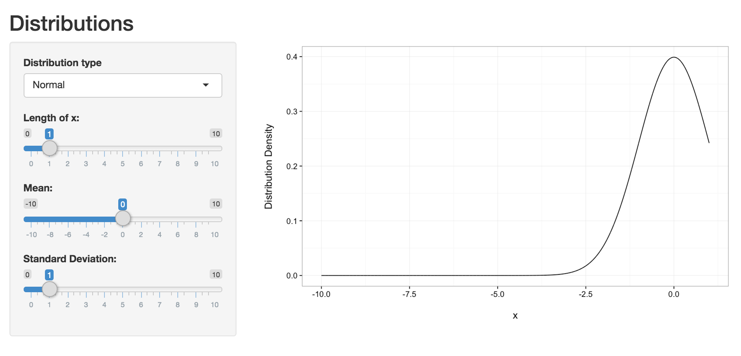
3
Notes:
I thought I would start with a simple example application.
This is an application that explores a few different distributions and allows the user to visualise distribution densities and shapes when parameter values are changed.
The application opens up with a normal distribution with a mean of zero and standard deviation of 1. The sliders on the left-hand side allow the user to manipulate the distribution. As I change these sliders values, the plot updates automatically. For example, when changing the mean value, the distribution automatically makes a shift along the x-axis.
Using this drop down box, I can also look at other distributions such as a:
Log-normal distribution
Or Inverse-gamma, etc.
You can see, as I selected the inverse-gamma distribution, the sliders on the left-hand slide updated to reflect the parameters in an inverse-gamma distribution as it is not parameterised in terms of mean and standard deviation like a normal distribution.
You can see here with using a Shiny application I am able to explore different values for parameters and instantaneously see the updated plot. If I was doing this with a standard R script I would have to either re-run it multiple times with different values for each parameter and save each static plot and compare them later, or plot all of the different scenarios based on different parameter values on the same plot which could get messy.
It is the automatic updating of output when input changes which is the key feature of the Shiny application compared to standard R scripts.

Slide 4
Shiny for R
Interactively show output for R scripts
Code controls:
Appearance of application user-interface
Generated output
Application can be used without needing:
R installation
Files containing R code
4
Notes:
So what is Shiny? Shiny is an open-source package by RStudio for R that allows…
R programmers to interactively show the output for their R programs.
You are able to have control in coding the elements of the application’s user-interface and their position without knowing HTML, Css or Javascript.
Just like when you write an R script, with Shiny you still have control in generating your output:
Such as control in the appearance of plots using the ggplot2 package
As well the structure of tables and text
Whilst I won’t go into too much detail about this today, Shiny applications can be shared and viewed in web-browsers via the Internet and accessed by a URL. This is particularly useful when you want to share your application with someone who is not familiar with R and probably does not have an existing installation of R on their computer.

Slide 5
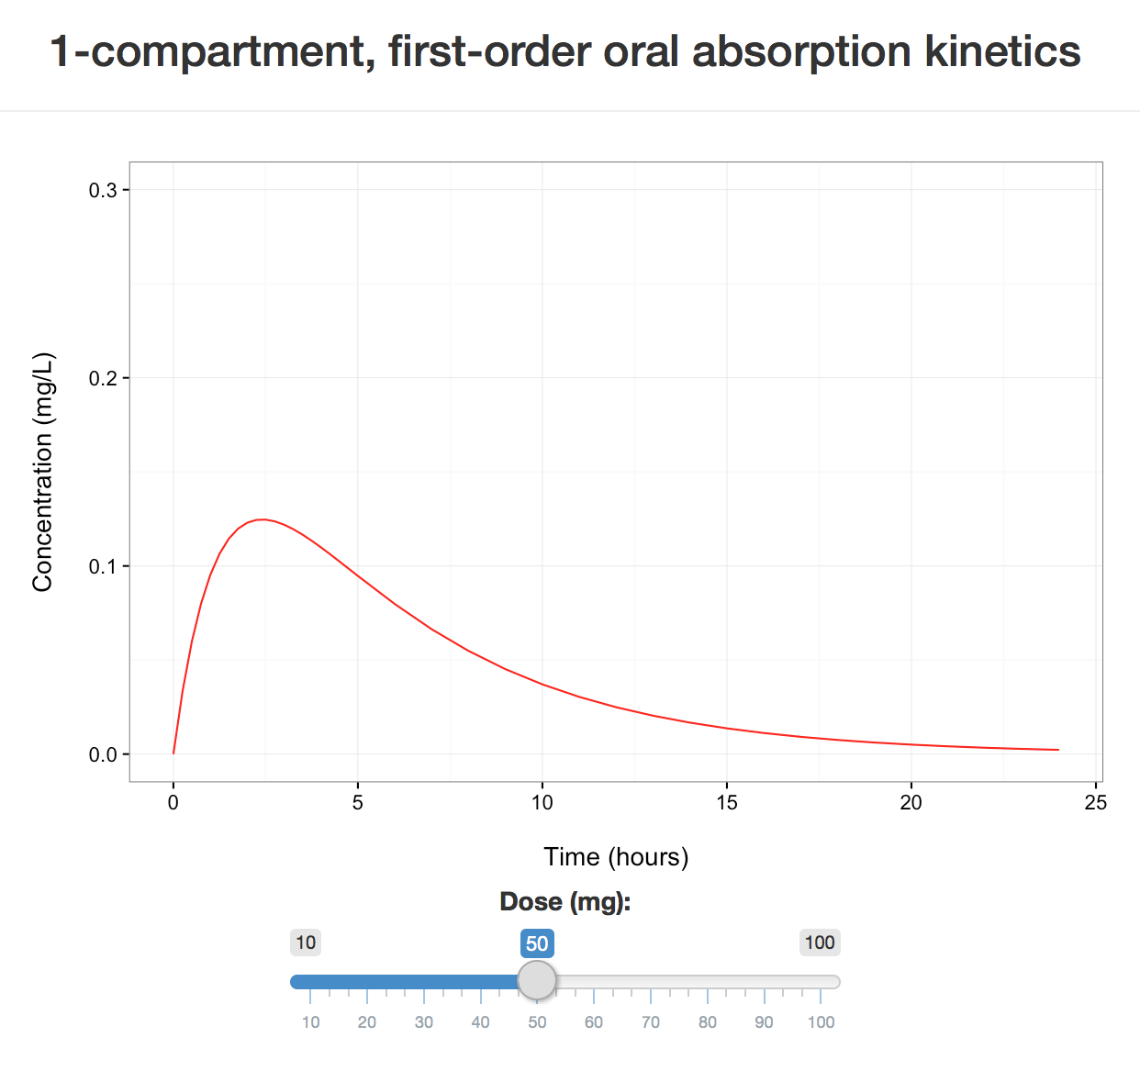
Example Application
5
Notes:
The example that I want to work through today is an application that simulates a 1-compartment, first-order oral absorption concentration-time profile that updates when we change the dose slider.
Here, I have fixed parameter values of the model such as clearance, volume and the absorption constant. The application has a pre-defined time sequence for which it will calculate concentrations.
Therefore, the only input from the user-interface that can be changed by the user is dose and this is done so by this slider. On application initiation, the dose is set to 50 mg. If I move the slider to 100 mg we can see the concentrations have doubled.

Slide 6
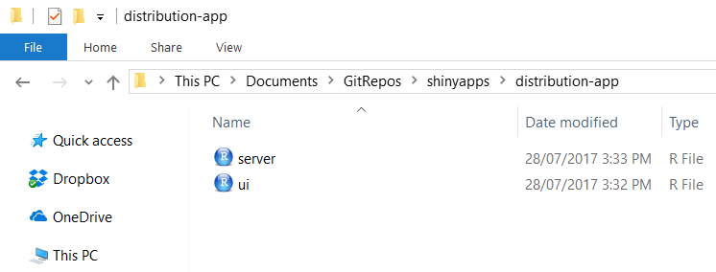
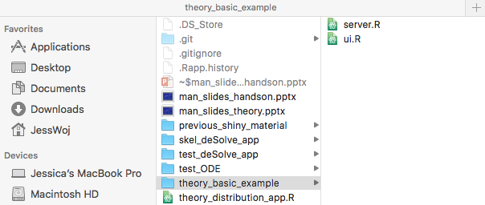
Structure of a Shiny Application
ui.R
Application’s graphical user-interface
server.R
Instructions for turning input into output to be displayed in the user-interface
Need to be saved in the same folder
6
Notes:
So what is required to make such an application?
Shiny applications are built using two R scripts that communicate with each other.
A user-interface script, named ui.R, which controls layout and the application’s appearance.
And a server script, named server.R, incorporating instructions for user-input, processing data and output by utilising the R language and functions from user-installed packages.
These two scripts need to be named as so and saved in the same folder so that R knows that the two combined form one application.

Slide 7
ui.R: Creating a user-interface
Variety of customisable layouts and pre-built widgets
Three levels for creating an interface:
Layout function
fluidPage, fixedPage, sidebarLayout
Positioning function
fluidRow, fixedRow, column
Element
Widget functions
Reactive output functions
Headings, line breaks, images
7
Notes:
Creating a user-interface for your application is easy when you understand the general structure for the code.
For the next couple of slides I’ll describe some of the functions that are used for creating a user-interface and then we’ll work through the code for the example application.
The Shiny package comes with a suite of customisable layouts and pre-built widget functions that are highly intuitive that you can use.
Layout function:
Creates a layout for the entire page.
All other functions need to be within the brackets of the layout function.
Positioning function:
Places the elements for the UI into specific areas of the page.
Each of these functions take their own specific arguments.
Element:
These are functions for coding widgets, output such as plots that change with widget input, headings, line breaks and images.
They are placed within the brackets of a positioning function.
As you can see, it follows a hierarchical structure where element functions such as input widgets and output are placed within positioning functions which are within layout function.
Multiple elements can be written in the same positioning function or layout function, and they are simply separated by a comma.

Slide 8
ui.R: Shiny Widgets
Interactive elements
Allow users to explore different values of categories of parameters and variables
Store values chosen by the user
Which are involved in a cascade of functions in server.R to produce the displayed output
Changing a widget, changes the resulting output object
8
Notes:
The widgets are what makes the application interactive and need to be written into the user-interface code.
They allow the user to explore different values or categories for variables.
They then store that value chosen by the user which is then involved in a cascade of functions in the server.R script leading to an output object which is dependent on the widget’s value.
So changing a widget will then change the resulting output object.
Examples of these widgets, which we’ve already seen in the examples shown earlier are…

Slide 9
ui.R: Displaying Reactive Output
Output functions call R objects in server.R to the UI
Examples
plotOutput
tableOutput
textOutput
Specific for the object in server.R
i.e. ggplot2 object called by plotOutput
9
Notes:
The output that changes with widget input also needs to be placed somewhere in the user-interface.
There are a series of functions that call R objects from server.R (remember this is our script containing application instructions) into the user-interface.
These functions are specific for that type of object.
For example, a ggplot2 object written in server.R needs to be called into the user-interface using the plotOutput function.
So let’s look at how this code for a user-interface looks!

Slide 10
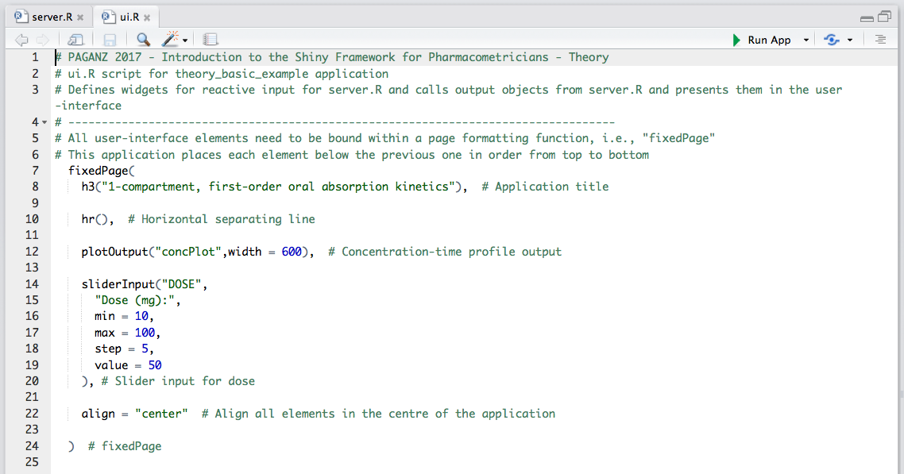
10
Notes:
Beginning from the top we have:
fixedPage – our layout function. Creates a page that aligns elements, such as input control widgets or output plots and text, in rows and columns in a fixed width such that when you change the size of your web-browser, everything stays in the same position.
Everything within fixedPage is now an element.
h3 function creates a heading. A function adopted from HTML.
hr creates a horizontal line between the heading and the next element.
plotOutput positions our output plot which is created in the server.R script and called concPlot. The plot will have a fixed width of 600 pixels.
sliderInput is the function for creating a slider. It needs a “NAME” where whatever value for the slider is selected it can be called in server.R, and then a “LABEL” which will be seen in the user-interface.
Min and max assign numerical constraints to the slider
Step is the incremental values on the slider
Value is the starting value for the slider on application initiation
Don’t forget to close parentheses!

Slide 11
server.R: Application Instructions
Controls the processing of widget input to display output to the UI
Can use your favourite R packages and functions
Structure of server.R code plays an important role:
Minimising redundant computation
Maximising application speed
11
Notes:
The server.R script can be a little bit more complicated depending on how complicated your program is or how much output you want the application to show.
However, for those experienced with the R language, writing server.R consists of using the same packages, functions and arguments to process information as previously in a standard R script.
The only difference is where some of this code needs to placed within the script.
Shiny re-runs parts of the server.R code every time the value for a widget changes.
Therefore, you don’t want computationally intense code that does not change when a widget changes to be re-run every time because it will slow down your application update time.
You need to think about which parts of your code are reactive and what is non-reactive.

Slide 12
server.R: Non-Reactive versus Reactive
“Non-reactive” objects are packages, constants and datasets
Objects dependent on widget input are “reactive”
Reactive objects need to be within the shinyServer function
They are called from ui.R to server.R by the widget’s name:
DOSE in ui.R = input$DOSE in server.R
Reactive objects update every time input from a widget changes
Code in shinyServer re-executes with every widget change
Code outside shinyServer is run once on application initiation
12
Notes:
“Non-reactive” objects have values that are not dependent on input from widgets.
For example; your loaded package libraries, constant expressions such as one creating a time sequence, or if you choose to pre-load a dataset into the application.
Therefore, objects that are called “reactive,” are dependent on widget input.
These reactive objects need to be coded within the function called shinyServer.
And it is this code in shinyServer that is re-run on every widget change.
Code outside of shinyServer, but still within server.R, is run only once when the application is run for the first time.
The most basic reactive object is the value from the widget itself. In server.R this value is represented using the widget’s name that was described in ui.R.

Slide 13
server.R: Sending Reactive Output to the UI
Functions that create reactive output to be sent to ui.R
renderPlot
renderTable
renderText
Can contain code for the reactive object and code processing widget input
Code within shinyServer
Specific for the object type
Define plot with ggplot2 within renderPlot in server.R
Matches with corresponding plotOutput in ui.R
13
Notes:
Therefore, any output object such as a plot, table or text that is in some way dependent on widget input also needs to be placed within shinyServer.
The code creating that object also needs to be within a render function.
This object is given the name that is then used in the ui.R script for positioning it in the application.
Just like how plotOutput called a plot object from server.R to the user-interface script in ui.R, renderPlot creates the reactive plot object in server.R to be sent to the user-interface.
So let’s have a look at what the code for server.R looks like.

Slide 14
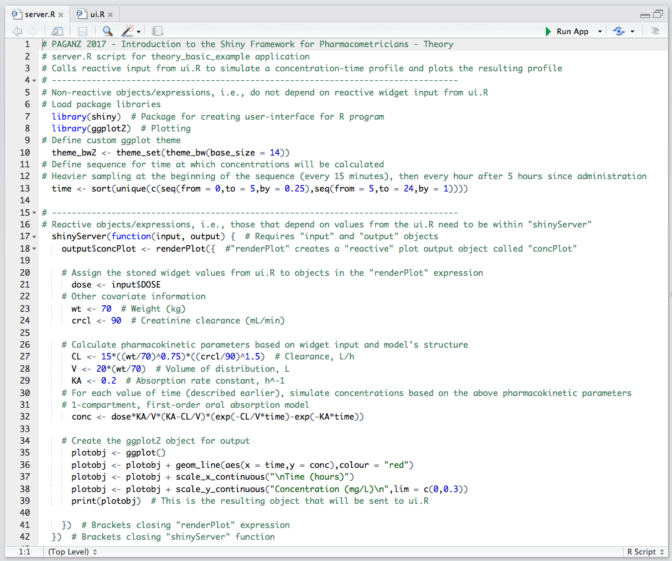
“Non-reactive”
“Reactive”
14
Notes:
Starting from the top again:
We have our “non-reactive” section for code that is not dependent on widget-input such as the package libraries, code amending the ggplot2 theme, and a TIME sequence from 0 to 24 hours at variable increments.
Then underneath:
Is our “reactive” section beginning with the opening curly parentheses for the shinyServer function.
concPlot is defined as an “output” object and then code defining concPlot is within the renderPlot function for creating a reactive plot.
Each of the widget values are then called in as input – in this case the only input is DOSE.
And then their values are used to calculate the concentration-time profile over a 24 hour period.
A ggplot2 object is created using time and concentration.
What if we don’t want a slider for dose and only wanted 2 options for dose? How do we do this?
selectInput(“DOSE”,”Dose (mg):”,choices = list(“50 mg” = 1, “100 mg” = 2),selected = 1)
What if we wanted to allometrically scale clearance and volume? How do we add input for weight?
sliderInput(“WT”,”Weight (kg):”,min = 40,max = 100,value = 70)

Slide 15
Demonstration: Adding/Changing UI Elements
Change sliderInput for DOSE to selectInput
Only choices are 50 and 100mg
Add sliderInput for weight (WT)
Add numericInput for creatinine clearance
Add checkboxInput to plot concentrations on a log-scale
Change the positioning of UI elements using fluidPage and sidebarLayout
15

Slide 16
server.R: Using Reactive Objects
Redundant computation occurs when code is re-executed without change in output
Avoided by splitting objects into smaller objects
Objects that aren’t an output are made using reactive
Still use render* functions for output
i.e. renderPlot
input
i.e. sliderInput
object
i.e. reactive
output
i.e. renderPlot
16
Notes:
An application can have as much interaction as you want, however none of that interaction is useful if the application does not run quickly. A responsive application is crucial for a good user experience. This is why non-reactive objects, such as libraries, constants and datasets are defined once outside of the server. If a large dataset had to be read into R every time the user made a change, then you can guarantee they wouldn’t enjoy using it.
When a dataset in an application is created according to user input, we can no longer make the dataset a non-reactive object. Therefore, we need to ensure that we recreate that dataset only when necessary. Sometimes this requires intermediary reactive objects that take input values from the UI (and potentially other reactive objects in the server) to create a new reactive value which can then be sent to an output function i.e. renderPlot.
In the flow diagram you can see a simple example of a reactive object in use. It takes the input from the UI and provides an object that can be used by an output function. In this example flow diagram, there doesn’t seem to be much need for this intermediary object because of it’s simplicity, but making server scripts like this when first designing a Shiny app can save you time later when your application becomes more complicated.

Slide 17
Example: Using Reactive Objects
Inefficient
Efficient
input1
(affects data)
object
(data)
input1
(affects data)
output
output
(plot)
input2
(affects plot)
input2
(affects plot)
output1 (plot)
object
(data)
output1 (plot)
input
(affects data)
input
(affects data)
output2 (table)
output2 (table)
17
Notes:
Here are some more complicated examples of applications.
The first row shows an application that has an input that creates the dataset and an input that affects the resulting plot. The code responsible for creating the plotted dataset and plotting the data are all within the same output object. Therefore, whenever input2 is updated, the code for creating the plotted dataset re-executes, despite there being no changes made to it! It is more efficient for the data to be a reactive object, with each of the inputs now affecting different parts of the server as shown on the right.
The second row shows an application where an input creates a dataset, which is then used to create two outputs: a plot and a table. The left diagram represents the data being created within each of the output objects, before being used to make the final output. But both output objects contain the same code for creating the data! Instead of running that code twice, it could be placed in a reactive object and then used in each of the output objects.

Slide 18
Example: Using Reactive Objects
Use reactive for objects and render* for outputs
reactive function is assigned to a name like an object in an R script
reactive_object <- reactive({ dnorm(x_axis, input$mean, input$sd) })
Value of reactive function is like a function with no arguments when used inside another reactive object
ggplot() + geom_line(aes(x = x_axis, y = reactive_object()))
18
Notes:
The reactive function works similarly to the render* functions, with all code being contained within the reactive function, however, the final line is not sent to the UI. Instead it can be used elsewhere in the server. Additionally, instead of being assigned to an output (i.e. output$concPlot) it is assigned to a object name, much like a regular object in an R script.
To use your reactive object within another reactive function or within a render* function, it must be named as a function with no arguments (i.e. reactive_object() ).

Slide 19
Demonstration: Using Reactive Objects
Identify the redundant computation in the demo app
Split the renderPlot code into two reactive objects
A reactive object containing the data
A renderPlot object containing the plot
Update the variable name for the data
Originally named conc, use reactive object instead
Remember naming conventions i.e. reactive_object()
19

Slide 20
Shiny for Pharmacometricians
The R language allows any of our models to be coded
With the addition of Shiny we can:
Rapidly test dosing scenarios through simulation
Exploring the impact of a model’s covariate effects
Identify initial parameter estimates prior to population modelling
Demonstrate properties of the model itself to a collaborating clinician
Teaching pharmacokinetic and pharmacodynamic principles to students
Share your work with others not familiar with or do not have an installation of R on their computer
Develop a prototype prior to formal web-app development
But… how will you use Shiny?
20

Slide 21
Useful Shiny Resources
Shiny by RStudio
Shiny developers provide a tutorial series built with exercises, videos and discussion boards
http://shiny.rstudio.com/
Stack Overflow
http://stackoverflow.com/questions/tagged/shiny
GitHub
https://github.com/rstudio/shiny
Shiny Google mailing list
https://groups.google.com/d/forum/shiny-discuss
Commercially available book, “Web Application Development with R using Shiny” by Chris Beeley
21
Notes:
There are some useful Shiny resources for those who are keen to develop their own applications…
I would recommend beginning with the RStudio tutorials! They have done a really great job!

Slide 22
More Shiny Resources
Shiny Tutorial paper in CPT:PSP
Wojciechowski J, Hopkins AM, Upton RN. Interactive Pharmacometric Applications Using R and the Shiny Package. CPT: pharmacometrics & systems pharmacology. 2015;4(3):1-14.
Shiny Tutorial from ACoP6
Building Pharmacometric Applications using R: R Shiny Tutorial. American Conference of Pharmacometrics (ACoP6) Annual Conference, October 2015: Arlington, VA, USA.
Available online: http://discuss.go-isop.org/t/building-pharmacometric-applications-using-r-an-online-r-shiny-tutorial/57
Public Shiny app example repository
https://github.com/jhhughes256/shinyapps
22
Notes:
For more pharmacometrics and Shiny there is a tutorial paper in CPT: Pharmacometrics and Systems Pharmacology with supplementary code, and there was also the Shiny tutorial from ACoP last year in which it’s materials are posted on the discuss-isop website.
I also know that there are a lot of people in pharmacometrics who have been exploring Shiny who also have material posted online or you may know them personally!

