Slide 1

Course Paper –Topic Selection Report
A Research on College Students’ Characteristics of
Behavior in Playing Online Games
大学生网络游戏行为特征研究
Student：Huang Hao
Supervisor：Zhang Mei
Assistant：Zeng Yuting
Sept. 28, 2022

Slide 2
Content
1
Reasons for the Research
2
Introduction of Research Method
3
Results of the Research

Slide 3
1
Reasons for the Research

Slide 4
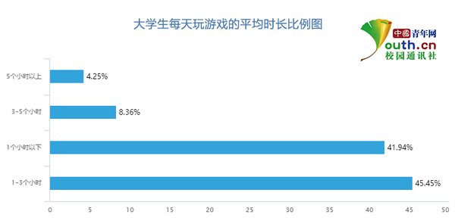

Reasons for the Research
Importance
Necessity
Purpose
Popularity of online games
The majority of college students play online games
Indulgence in online games
Controversy about online games
Overall characterization
Advice on playing online games
Notes:
大学生群体大多玩过（这里可以互动）

Slide 5
2
Introduction of Research Method

Slide 6


Introduction of Research Method
Research methods: questionnaire survey
Participants: college students
Research steps:
List the outline
Write drafts
Trial test
Revise drafts
Draw conclusions
Data analysis
Organize data
Formal survey

Slide 7
3
Results of the Research

Slide 8
Results of the Research
Data
Original data of college students about playing online games
1
Analysis
2
Data analysis about the data collected
Advice
Advice towards college students about playing online games
3

Slide 9
Thank you!

