Slide 1

串讲计组 -- 体系结构分支预测实验
此次实验的主题：在计组实验4中，beq指令的实现方式是缩短延迟法，此次体系结构实验的内容就是用动态分支预测来实现beq指令
1. 此次实验基础：计算机组成原理四次实验
2. 此次实验内容：动态分支预测

Slide 2
计算机组成原理实验
目的是实现一个CPU。内容就是添加了十几条比较基础的指令，然后采用的是五级流水结构，要求通过简单的测试。
什么是CPU: center process unit; 由计算单元，存储单元以及控制单元组成
为什么是这三个单元呢？因为计算机最大的需求就是计算数据，然后由此衍生出来的存储计算的数据跟控制如何计算。

Slide 3
计算机组成原理实验
CPU结构
CPU的结构依托于指令集架构
指令的概念：为了控制CPU计算数据跟存储数据，我们通过（汇编）指令来控制CPU，也就是机器语言。
这儿有不同的机器语言，例如公司代表：intel，arm。我们根据不同的机器语言来设计对应的CPU。比如我们的手机用的就是arm架构，arm这种机器语言，对应的就是什么高通晓龙处理器。电脑的话一般就是x86机器语言，对应的就是intel或者amd处理器
然后我们实验使用的就是mips指令集架构，所以我们的实验要做的就是设计对应的CPU。

Slide 4
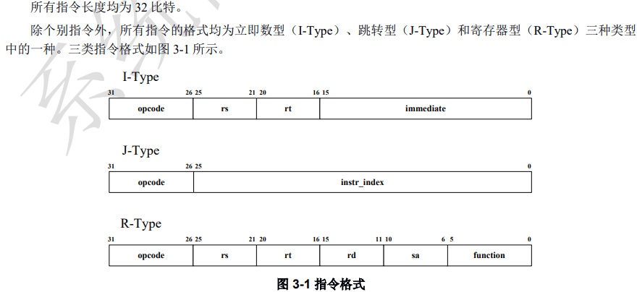
计算机组成原理实验
MIPS指令集架构
mips指令系统
我们计算机组成原理实验的内容就是根据MIPS指令来设计一个CPU

Slide 5
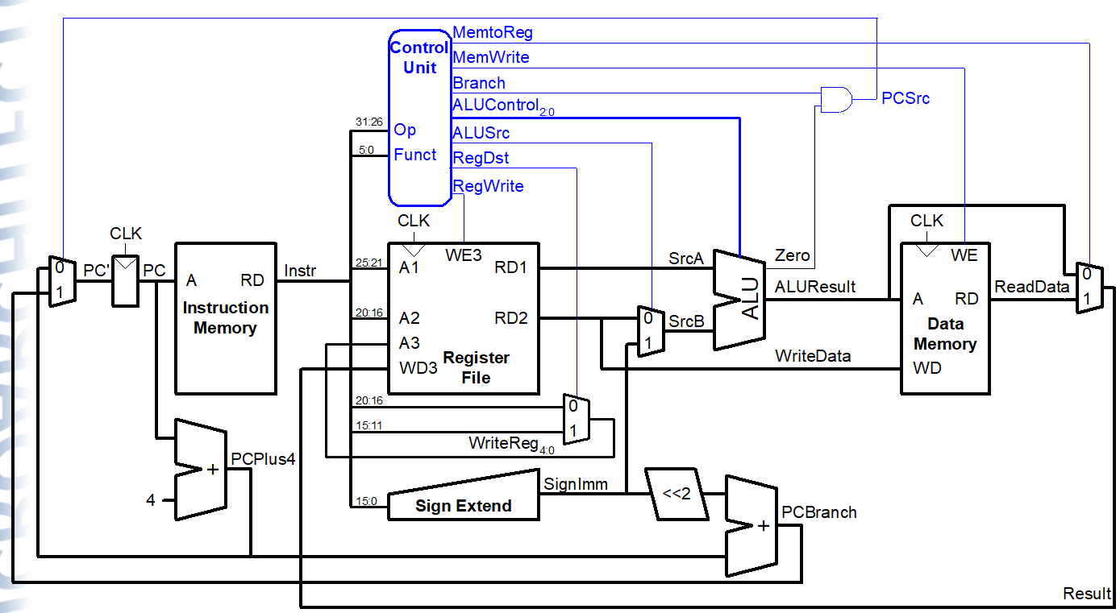
实验基础
我们可以将CPU执行指令分解为5个动作：取指，译码，执行，访存，写回；
以lw指令为例进行讲解；

Slide 6
Single-Cycle vs. Pipelined

Slide 7
Pipelined Processor Abstraction

Slide 8
Single-Cycle & Pipelined Datapath

Slide 9
Pipeline Hazards
When an instruction depends on result from instruction that hasn’t completed
Types:
Data hazard: register value not yet written back to register file
Control hazard: next instruction not decided yet (caused by branches)

Slide 10
Data Hazard

Slide 11
Handling Data Hazards
Insert nops in code at compile time
Rearrange code at compile time
Forward data at run time
Stall the processor at run time

Slide 12
Compile-Time Hazard Elimination
Insert enough nops for result to be ready
Or move independent useful instructions forward

Slide 13
Data Forwarding

Slide 14
Data Forwarding

Slide 15
Stalling

Slide 16
Stalling

Slide 17
Stalling Hardware

Slide 18
Stalling Logic
lwstall =
((rsD==rtE) OR (rtD==rtE)) AND MemtoRegE
StallF = StallD = FlushE = lwstall

Slide 19
Control Hazards
beq:
branch not determined until 4th stage of pipeline
Instructions after branch fetched before branch occurs
These instructions must be flushed if branch happens
Branch misprediction penalty
number of instruction flushed when branch is taken
May be reduced by determining branch earlier

Slide 20
Control Hazards: Original Pipeline

Slide 21
Control Hazards

Slide 22
Early Branch Resolution

Slide 23
Handling Data & Control Hazards

Slide 24
Control Forwarding & Stalling Logic
Forwarding logic:
ForwardAD = (rsD !=0) AND (rsD == WriteRegM) AND RegWriteM
ForwardBD = (rtD !=0) AND (rtD == WriteRegM) AND RegWriteM
Stalling logic:
branchstall = BranchD AND RegWriteE AND
(WriteRegE == rsD OR WriteRegE == rtD)
OR
BranchD AND MemtoRegM AND
(WriteRegM == rsD OR WriteRegM == rtD)
StallF = StallD = FlushE = lwstall OR branchstall

Slide 25
Branch Prediction
Guess whether branch will be taken
Backward branches are usually taken (loops)
Consider history to improve guess
Good prediction reduces fraction of branches requiring a flush

Slide 26
总体框架

