Slide 1



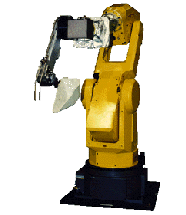

Research Activities of
MSC Group in the
Mechatronics Lab
2 1 6 8 E t c h e v e r r y H a l l
Erwin Satrya Budiman
August 2, 1999

Slide 2
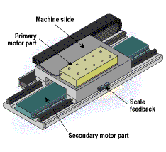
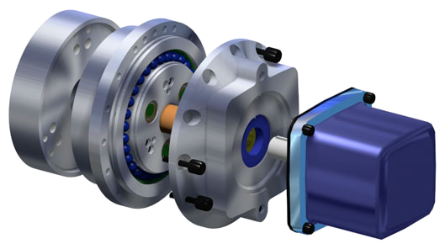
Projects
Motion Control of a Linear Motor Table
  Dong-Jun Lee
Motion & Force Control of an Indirect Drive Robot
  Erwin S Budiman

Slide 3
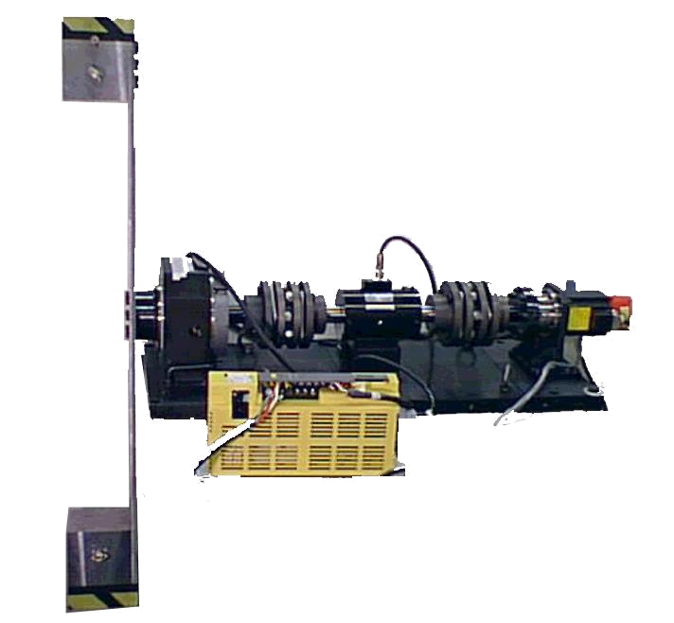
Motion and Force Control of an Indirect Drive Robot
This research is funded by a grant from FANUC LTD, Japan

Slide 4
Background
Direct-Drive (DD) Actuated Robot and Indirect-Drive (ID) Actuated Robot
  DD: “Simple” dynamics, larger actuator, high rigidity
  ID: “Complex” dynamics, smaller actuator, low rigidity
Motivation
Construct a system with large bandwidth and compact actuator
Goal
Use HD (or RV reducer) and joint torque sensor to achieve the same level of performance as a DD unit

Slide 5
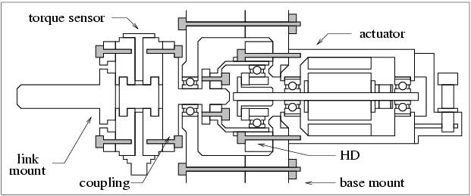
System

Slide 6
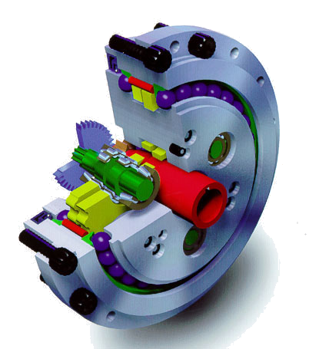
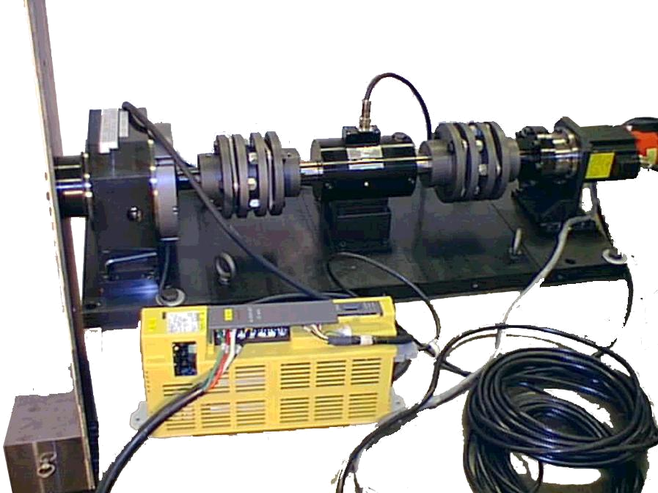
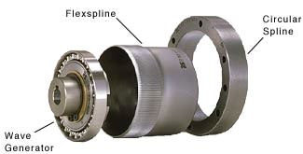
System

Slide 7
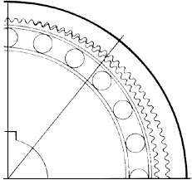
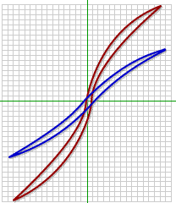
Main Issues
Nonlinear friction
Nonlinear compliance
Backlash (RV)
Research Activities
Directional Coulomb Friction Observer
Disturbance Observer-Based Tip Force Estimation
Position/Force Control Coordination

Slide 8
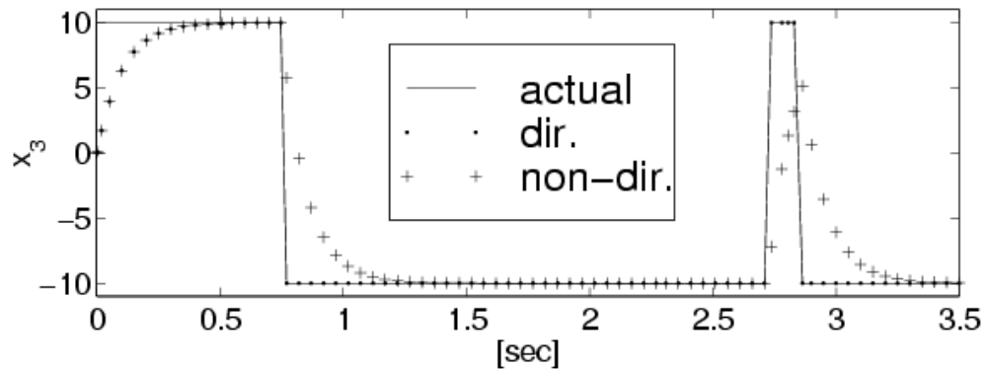
Research Activity:
Directional Coulomb Friction Observer
Use a simple friction model for the observer-based estimator.
The observer uses rotor velocity to separate the directionality from the scalar magnitude of the Coulomb friction.

Slide 9
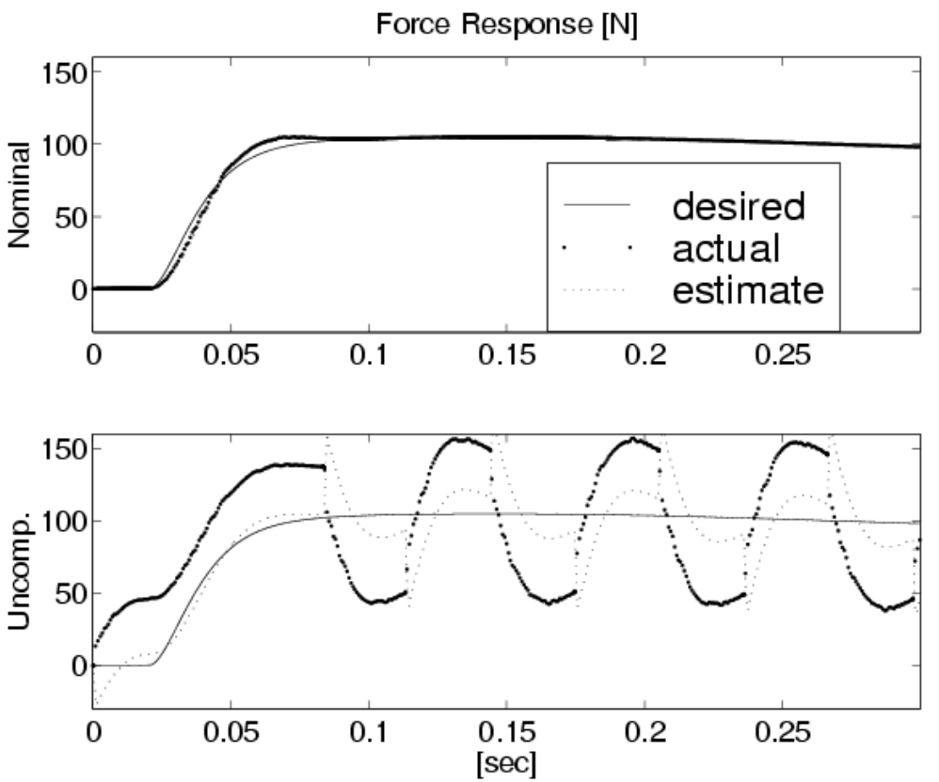
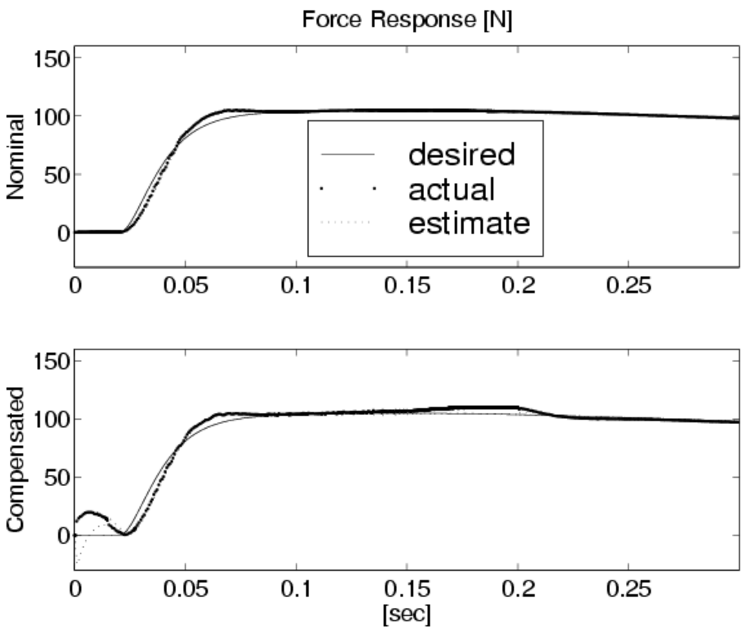
Research Activity:
Disturbance Observer-Based Tip Force Estimation
Estimate tip force subject to unknown contact-no-contact state and unknown environment stiffness.
The Disturbance Observer-based structure does not require any adaptation of the unknown environment stiffness for its estimation model.

Slide 10
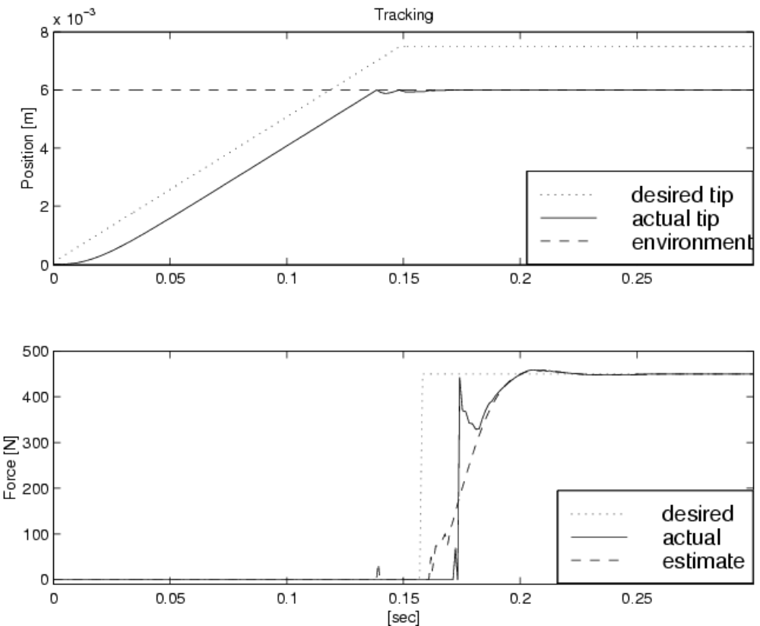
Research Activity:
Position/Force Control Coordination
Use the Accomodation principle ^{[Whitney]} for a position/force control structure.
The coordination of position control in free motion and force control in constrained motion uses no switch mechanism
This structure allows for automatic task transition

Slide 11
publications
      Budiman and Tomizuka, "Disturbance Observer-Based Compliant Environment Estimator for Torque Controlled System", 1998 Japan-USA Symposium on Flexible Automation, Otsu, Japan, July 1998
      Budiman and Tomizuka, “Position/Force Control with a Frequency-Based Switch for Robots Interacting with a Compliant Environment”, to be presented at the 1999 IEEE/ASME International Conference on Advanced Intelligent Mechatronics, Atlanta, Georgia, USA,
      September 1999

