Slide 1

Applied Financial Analytics for Strategic Decisions and Value Creation
Group 1: Dashboard for Lindt
Proudly presented by:
Michele Senkal
Shaoxi Liu
Gianmarco Murgida
Matthew Aylward
Grégoire Prétat
Yidan Chen
Ying Fan
Alexander Zingrich

Slide 2
Introduction
Our BI solution is a combination of several Financial Analytics:
1) Sales performance, growth analytics(by region and country), and forecast
3) Simulation tool: simulate production costs (COGS) based on changes in the underlying raw materials prices.
2) Predictive analytics COGS, Expenses, and correlation analysis of historical prices for raw materials (cocoa, sugar, milk)

Slide 3
Introduction
We developed a Business Inteligence prototype to enable the end-user to explore and understand the multidimensional financials data in PowerBI.
1st Dashboard
Sales Performance/region
Growth/region
2nd Dashboard
COGS (forecast up to 2024)
P&O expenses (forecast up to 2024)
3rd Dashboard
Simulation of 4 different chocolate products and commodity prices
Growth/country
Switch ingredients % composition

Slide 4
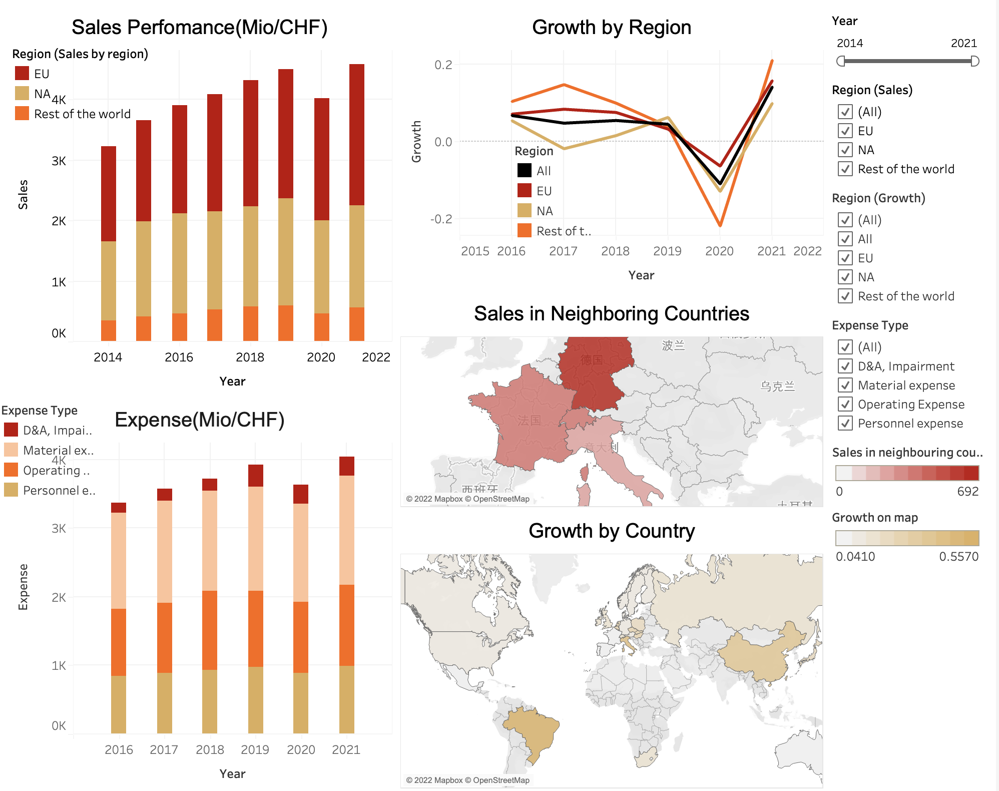
Dashboard Overview

Slide 5
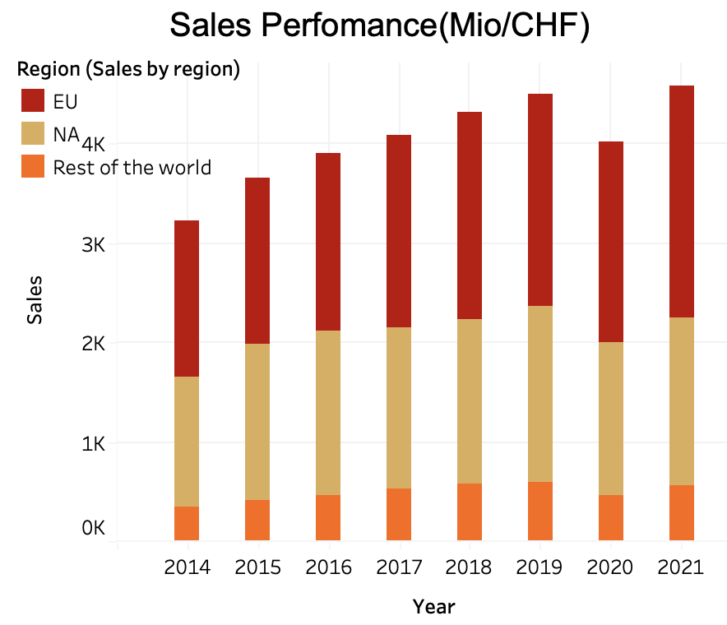
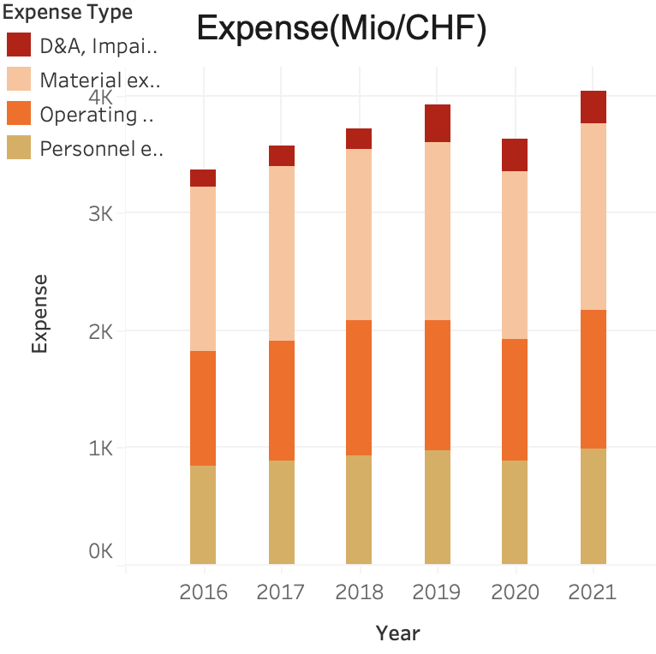
Dashboard Overview

Slide 6
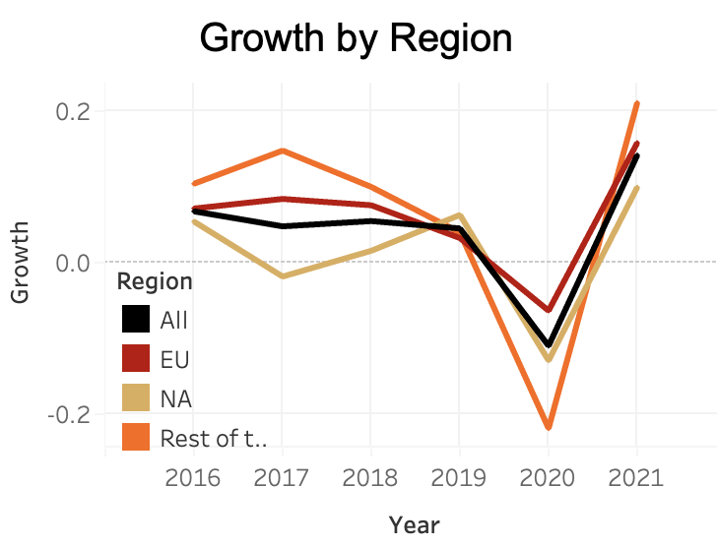
Dashboard Overview
Forecast of Sales (Mio/CHF):
2022: 4862.79 (6.05%)
2023: 5129.31 (5.48%)
2024: 5402.94 (5.33%)

Slide 7
Expense Model Explanation
Product | Sale Price | Cocoa | Sugar | Milk | Weights in Sales
Lindt 70% Cocoa 100g | 2.75$ | 70% | 30% | 0% | 20%
LINDOR Tafelschokolade Weiss 100g | 2.4$ | 51% | 42% | 7% | 40%
LINDOR balls Milk Christmas 200g | 8.95$ | 32% | 47% | 21% | 30%
Lindt MINI Pralines Assorted 100g | 6.95$ | 30% | 47% | 23% | 10%
Expense
Cost of Goods Sold
Operational Cost
Personal Cost
Cost of Goods Sold
Commodity Cost
Wrapper Cost | 0.35$/piece
Tariff | 2.5% Cocoa
Freight-in Cost | 54.45$/kg Cocoa
Commodity Cost
Cocoa
Sugar
Milk

Slide 8
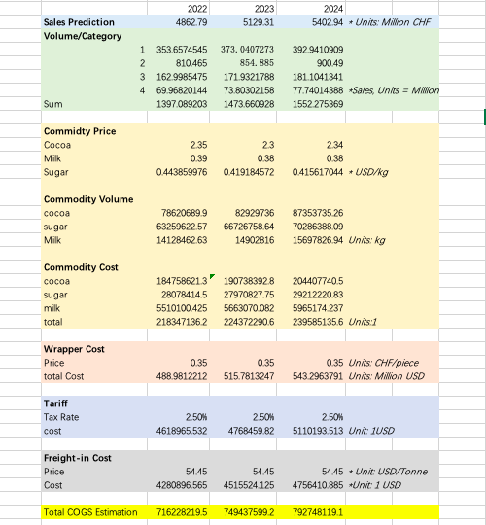
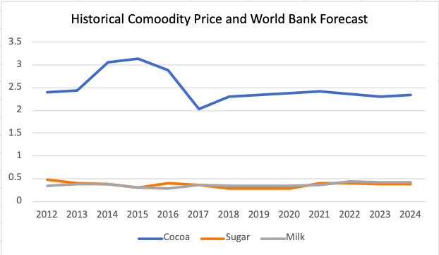
Expense Model Explanation

Slide 9
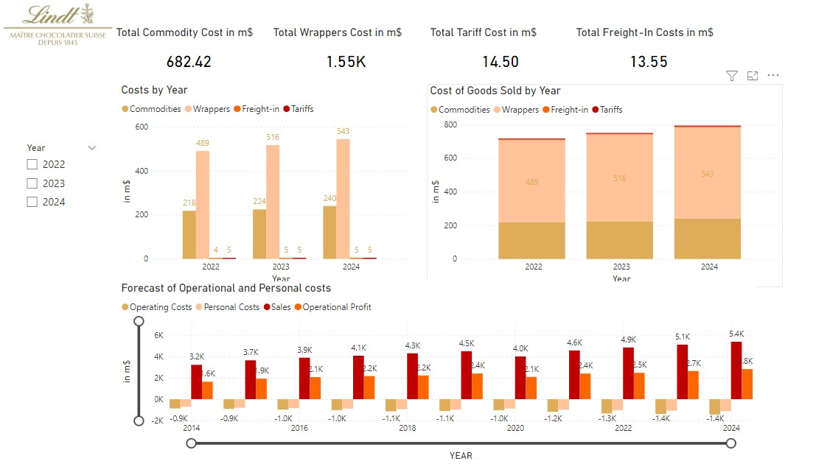
Forecast of COGS and Operational, Personal Costs

Slide 10
Forecast of COGS and Operational, Personal Costs

Slide 11
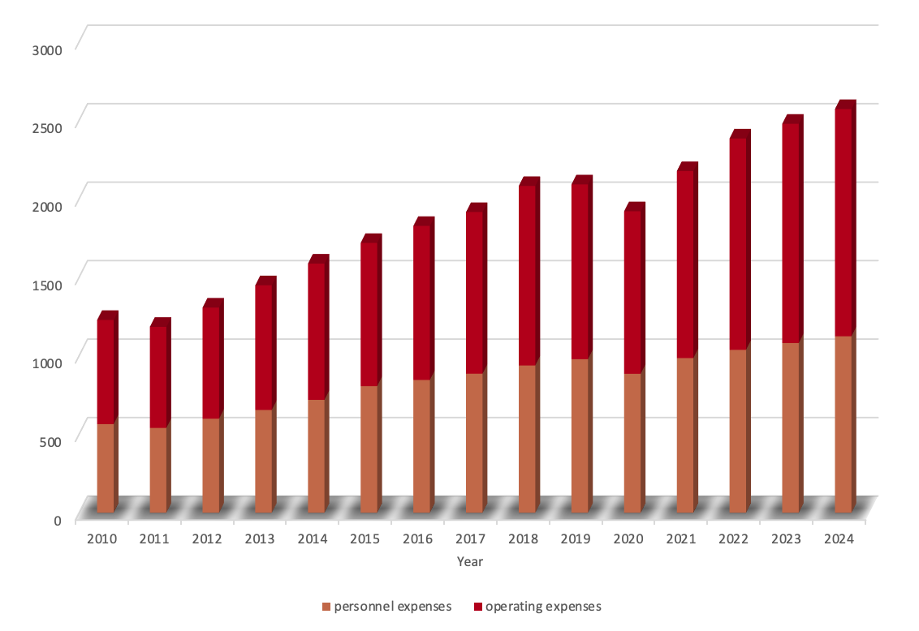
Operating & Personnel expenses

Slide 12
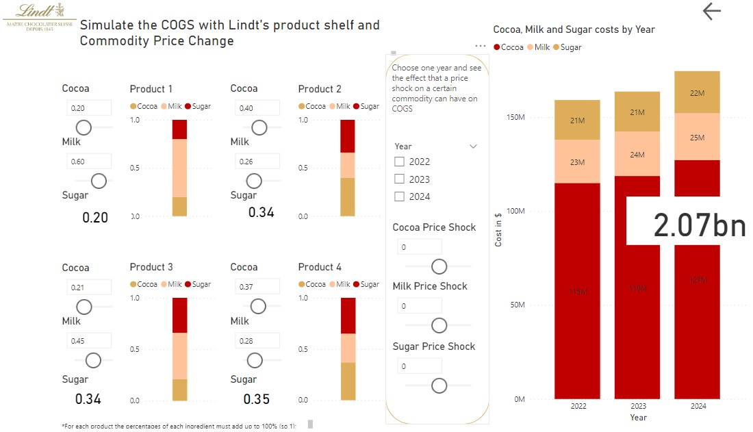
New Product Shelf

Slide 13
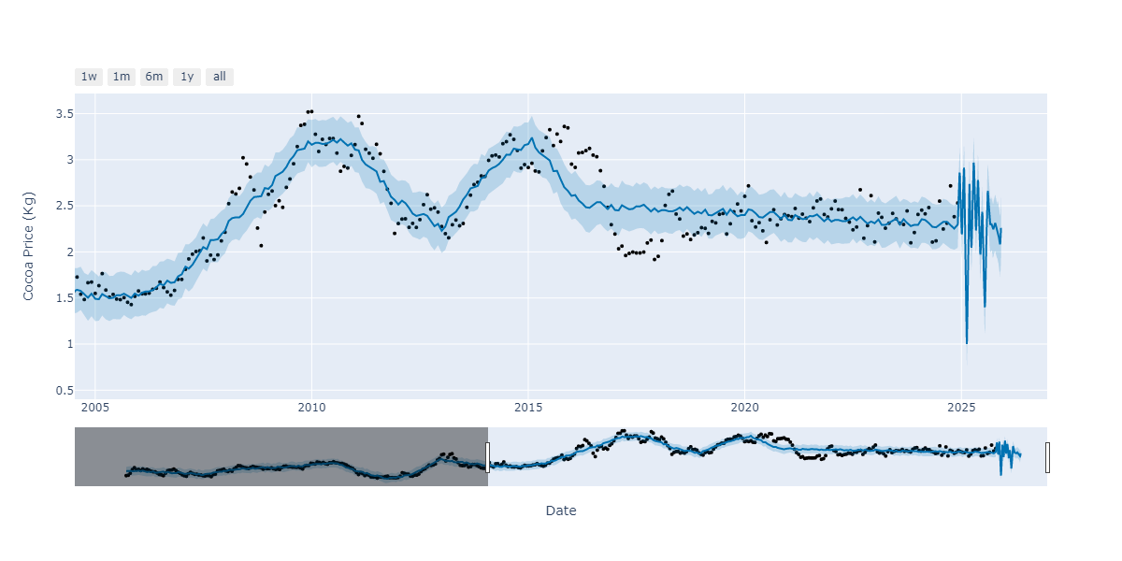
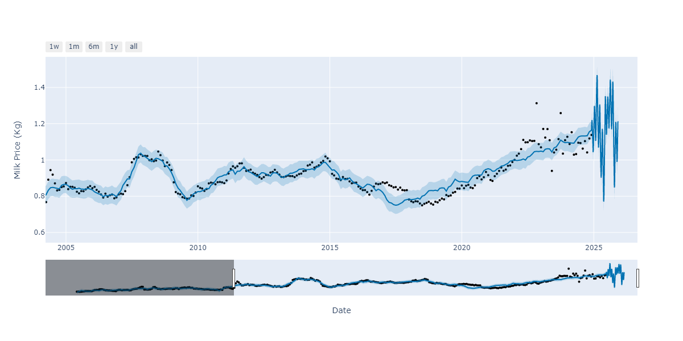
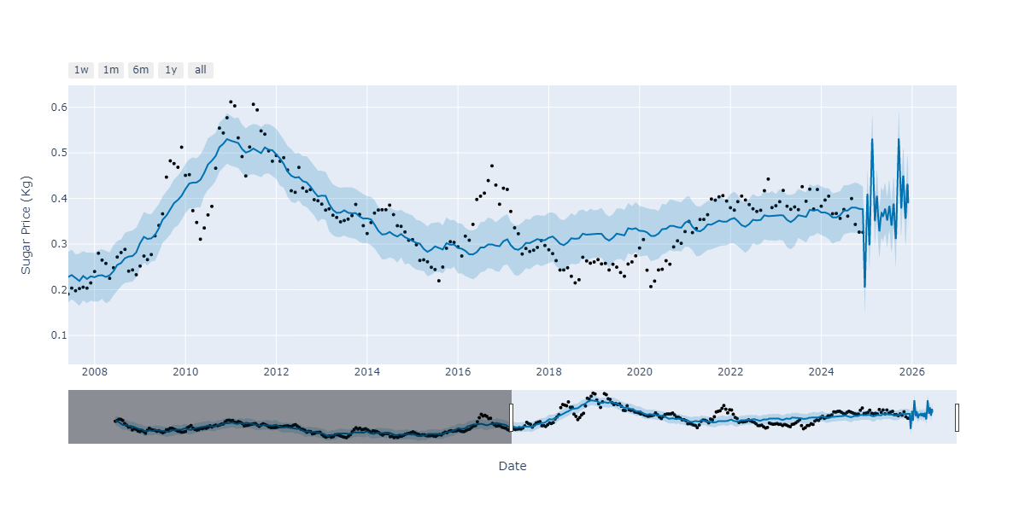
Predictive Prices of Commodities
We used Fakebook’s Time-Series Predictive Tool Prophet to Analyze the Future price of:
Cocoa
Milk
Sugar

Slide 14
Conclusion
As Lindt is one of Switzerland’s most beloved brands we are confident in the Business intelligence we have provided.
Our PowerBi Dashboards & Prediction Algorithm give us a range of prediction capabilities
We can predict future Sales
Estimate the impact of changes in commodity prices
Calculate the expected profits if we modify the recipe
Apply our Solution to similar products

