Slide 1
Computer Network

Slide 2
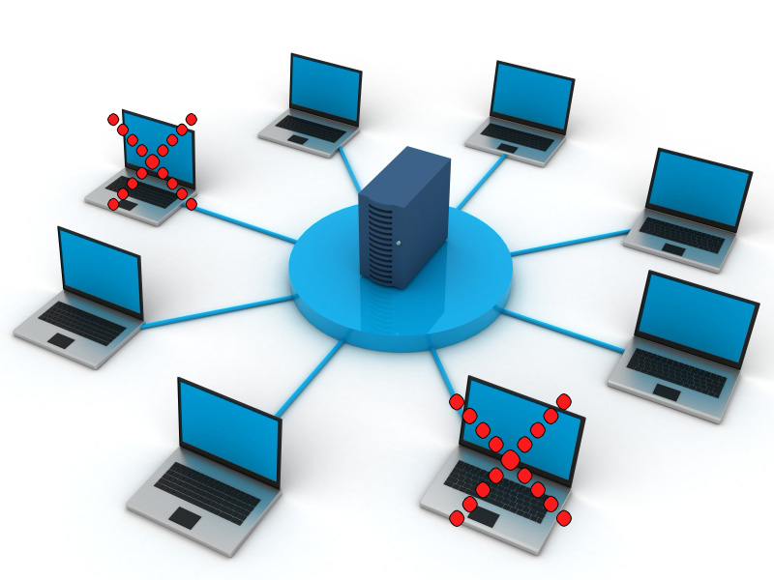
Simple Computer Network

Slide 3
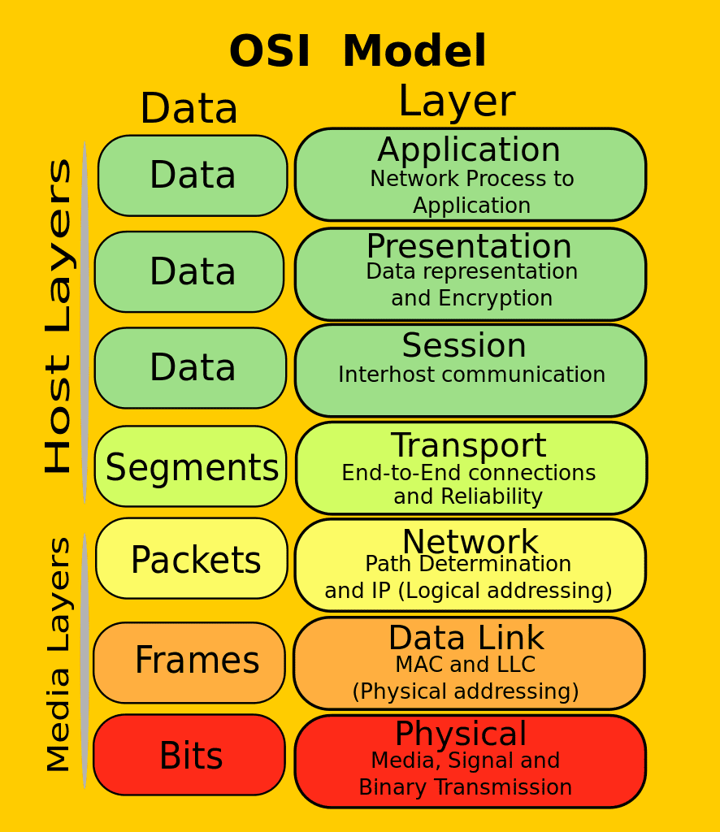

Slide 4
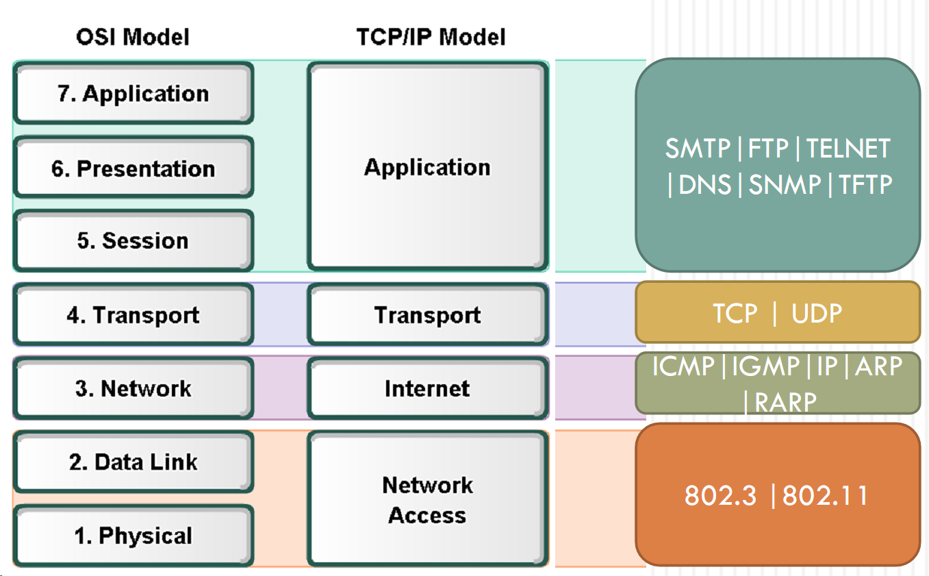

Slide 5
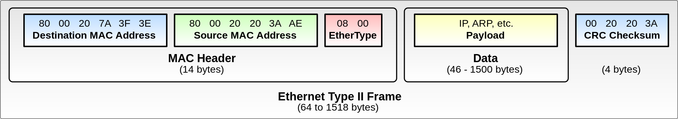
Ethernet protocol Frame

Slide 6
Thank you!

