Slide 1
LIFE PROCESSES
NUTRITION

Slide 2
CRITERIA TO DECIDE WHETHER SOMETHING IS ALIVE
MOVEMENT :
All living organisms move without the help of any external help
Some movements are easily visible, like movements of body parts
Some are not easily visible, like molecular movements
The molecular movements in cells and tissues is necessary for all life processes

Slide 3
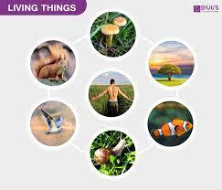

Slide 4
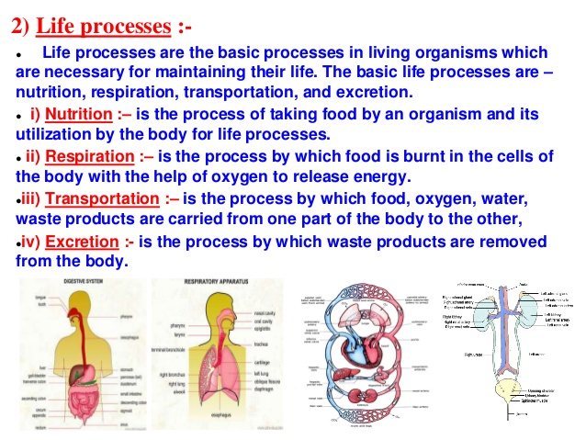

Slide 5
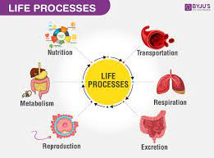

Slide 6
NUTRITION

Slide 7
NUTRITION
Nutrition is the biochemical and physiological process by which an organism uses food to support its life
Nutrition is mainly of 2 types
Autotrophic
Heterotrophic

Slide 8
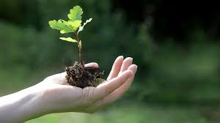
Autotrophic Nutrition
Some organisms use simple food material obtained from inorganic sources in the form of carbon dioxide and water
These organisms are autotrophs and the type of nutrition is autotrophic nutrition
Eg : green plants and some bacteria

Slide 9
Carbon and energy requirements of the autotrophic organism are fulfilled by photosynthesis
It is the process by which autotrophs take in substances from the outside and convert them into stored forms of energy
This material is taken in the form of carbon dioxide and water which is converted into carbohydrates in the presence of sunlight and chlorophyll
Carbohydrates are utilised for providing energy to the plant
The carbohydrates which are not used immediately are stored in the form of starch, which serves as the internal energy reserve to be used as and when required by the plant

Slide 10
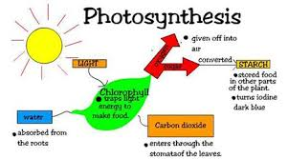

Slide 11
Events occur during photosynthesis
Absorption of light energy by chlorophyll
Conversion of light energy to chemical energy and splitting of water molecules into hydrogen and oxygen
Reduction of carbon dioxide to carbohydrates
Chlorophyll is a green pigment found in cell organelles called chloroplasts, which traps light energy for photosynthesis

Slide 12
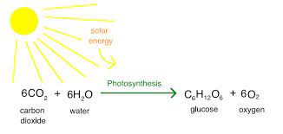
EQUATION

Slide 13
How plants obtain CO2
Massive amounts of gaseous exchange takes place in the leaves through stomata for the purpose of photosynthesis
Stomata are the tiny pores present on the surface of the leaves
Plant closes these pores when it does not need carbon dioxide for photosynthesis, because large amounts of water can also be lost through these stomata
The opening and closing of the pore is a function of the guard cells
The guard cells swell when water flows into them, causing the stomatal pore to open. Similarly the pore closes if the guard cells shrink

Slide 14
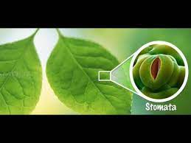
STOMATA

Slide 15
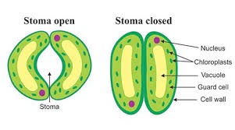
STOMATA - OPENING & CLOSING

Slide 16
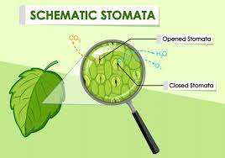

Slide 17
Water used in photosynthesis is taken up from the soil by the roots in terrestrial plants
Other materials like nitrogen, phosphorus, iron and magnesium are taken up from the soil
Nitrogen is an essential element used in the synthesis of proteins and other compounds

Slide 18
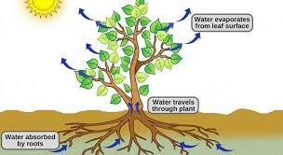

Slide 19
Why is diffusion insufficient to meet the oxygen requirements of multicellular organisms like humans?
In the case of a single-celled organism, no specific organs for taking in food, exchange of gases or removal of wastes may be needed because the entire surface of the organism is in contact with the environment
But In multi-cellular organisms, all the cells may not be in direct contact with the surrounding environment. Thus, simple diffusion will not meet the requirements of all the cells

