Slide 1
LIFE PROCESSES
HETEROTROPHIC NUTRITION

Slide 2
HETEROTROPHIC NUTRITION
In this type, organisms cannot make their own food utilising inorganic materials, instead they directly or indirectly depends on autotrophs for their food need
EG : all animals , bacteria , fungi
It is of 3 types :
1. Saprophytic
2. Parasitic
3. Holozoic

Slide 3
SAPROPHYTIC NUTRITION
Sapro = rotten
Nutrition in which organism obtains its food from dead and decaying organic matter
Such organisms are called saprophytes
Eg : Fungi like Bread moulds, Yeast , Mushrooms

Slide 4
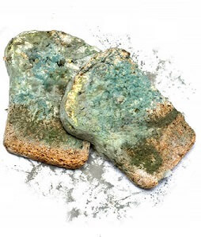
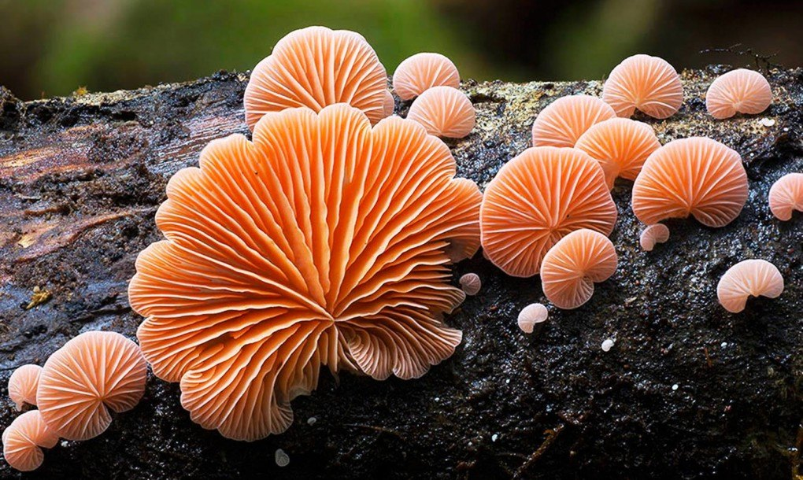

Slide 5
PARASITIC NUTRITION
Nutrition in which organisms derives its food from the body of another living organisms, called its host
Organisms which obtains food = parasite
Organisms from whose body food is obtained = host
Eg : Leeches, Tape worms, Lice, Cuscuta

Slide 6
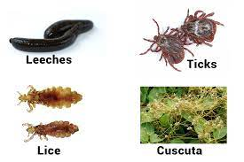

Slide 7
HOLOZOIC NUTRITION
Nutrition in which an organism takes complex organic food materials into its body by the process of ingestion, which is then digested and absorbed
Eg : Humans, Frogs, Amoeba

Slide 8
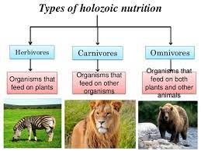

Slide 9
NUTRITION IN AMOEBA
Amoeba is a unicellular animal which feeds on microscopic plants and animals that floats in water body
Mode of nutrition in amoeba = holozoic
Amoeba takes in food using temporary finger-like extensions of the cell surface called pseudopodia, which fuse over the food particle forming a food-vacuole (engulfing)
Inside the food vacuole, complex substances are broken down into simpler ones which then diffuse into the cytoplasm
The remaining undigested material is moved to the surface of the cell and thrown out
This process is known as phagocytosis

Slide 10
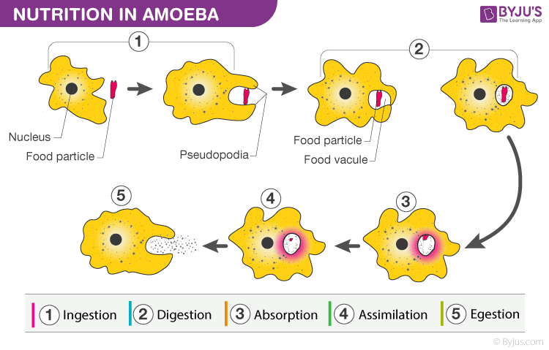

Slide 11
NUTRITION IN HUMANS
Humans are heterotrophic, omnivorous organisms
They obtain their food from plants and animals by holozoic mode of nutrition
Possess well advanced digestive system consisting alimentary canal and associated glands

Slide 12
ALIMENTARY CANAL
The alimentary canal is basically a long tube extending from the mouth to the anus
MOUTH
BUCCAL CAVITY
PHARYNX
OESOPHAGUS
STOMACH
SMALL INTESTINE
LARGE INTESTINE
RECTUM
ANUS

Slide 13
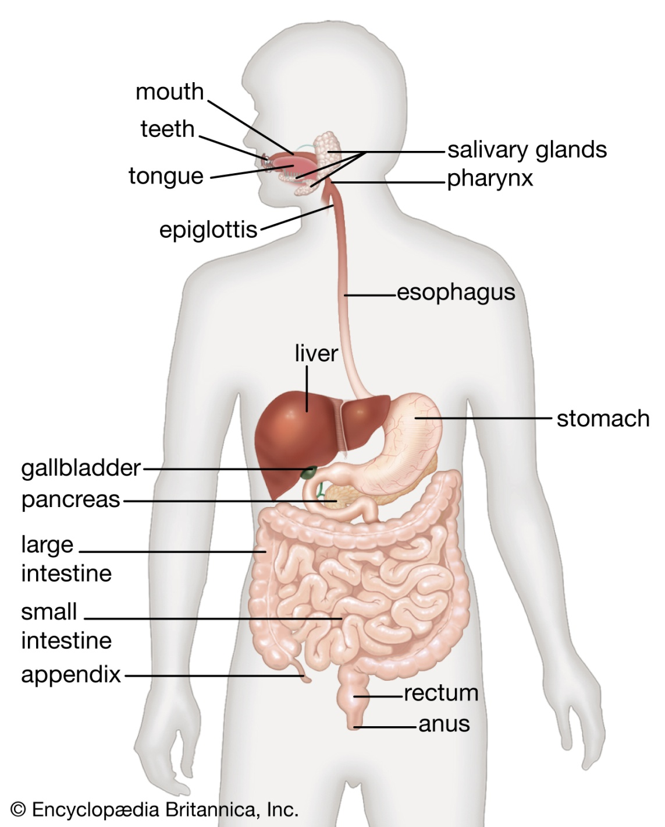

Slide 14
MOUTH
It is the uppermost opening of the digestive system which is guarded by two soft movable lips
Mouth leads to buccal cavity

Slide 15
BUCCAL CAVITY
It is the large space bounded by upper and lower jaws
Bears a soft muscular tongue and four types of teeth – incisors , canines, molars, pre-molars
Has three pairs of salivary glands (parotid, sublingual and sub maxillary) which secretes saliva through their ducts
Saliva contains water, mucus and salivary enzymes
Food is crushed by teeth and tongue
The enzyme salivary amylase breaks down the starch and glycogen into maltose
Partial digestion of carbohydrates occurs

