Slide 1
LIFE PROCESSES
NUTRITION IN HUMAN

Slide 2
NUTRITION IN HUMAN
Humans are heterotrophic, omnivorous organisms
They obtain their food from plants and animals by holozoic mode of nutrition
Possess well advanced digestive system consisting alimentary canal and associated glands

Slide 3
ALIMENTARY CANAL
The alimentary canal is basically a long tube extending from the mouth to the anus
MOUTH
BUCCAL CAVITY
PHARYNX
OESOPHAGUS
STOMACH
SMALL INTESTINE
LARGE INTESTINE
RECTUM
ANUS

Slide 4
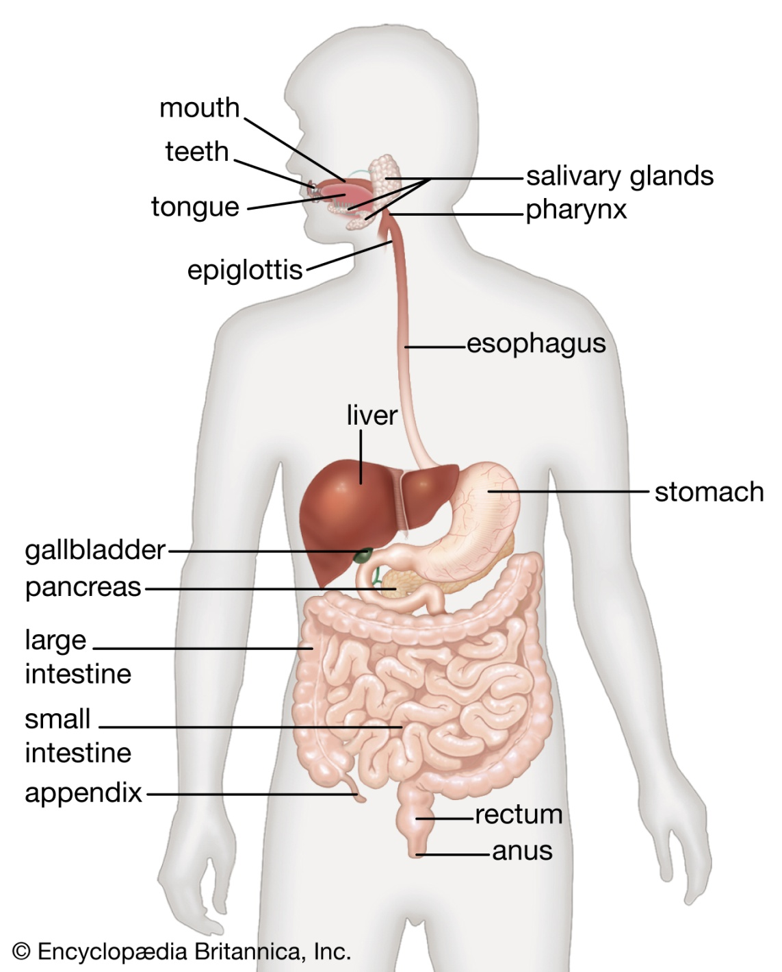

Slide 5
MOUTH
It is the uppermost opening of the digestive system which is guarded by two soft movable lips
Mouth leads to buccal cavity

Slide 6
BUCCAL CAVITY
It is the large space bounded by upper and lower jaws
Bears a soft muscular tongue and four types of teeth – incisors , canines, molars, pre-molars
Has three pairs of salivary glands (parotid, sublingual and sub maxillary) which secretes saliva through their ducts
Saliva contains water, mucus and salivary enzymes
Food is crushed by teeth and tongue
The enzyme salivary amylase breaks down the starch and glycogen into maltose
Partial digestion of carbohydrates occurs

Slide 7
PHARYNX
Pharynx serves as a passage way for food from buccal cavity to oesophagus
Also serves as a passage way for air from nasal cavity to trachea

Slide 8
OESOPHAGUS (FOOD PIPE)
It is a long tubular structure which serves to carry the food from pharynx to stomach by peristaltic movement
PERISTALSIS : The involuntary constriction and relaxation of the muscles of the oesophagus (or alimentary canal), creating wave-like movements that push the contents of the canal forward

Slide 9
STOMACH
The stomach is a large muscular sac like organ which expands when food enters it
Entry of food in stomach is guarded by cardiac sphincter
The muscular walls of the stomach possess gastric glands which secrete gastric juice
Churning mechanism of stomach help in mixing the food thoroughly with more gastric juices
Gastric juice contains 3 components :
a. Hydrochloric acid
b. A protein digesting enzyme called pepsin, and c. Mucus

Slide 10
HCl
- It creates an acidic medium which facilitates the action of the enzyme pepsin
- Kills microbes entered through food
Mucus
- It protects the inner lining of the stomach from the action of the acid under normal conditions
Pepsin
- Partially digests protein

Slide 11
SMALL INTESTINE
From the stomach, the food now enters the small intestine which is regulated by a sphincter muscle
Small intestine is the longest part of the alimentary canal which is fitted into a compact space because of extensive coiling
The length of the small intestine differs in various animals depending on the food they eat
Herbivores eating grass need a longer small intestine to allow the cellulose to be digested
Meat is easier to digest, hence carnivores like tigers have a shorter small intestine

Slide 12
The small intestine is the site of the complete digestion of carbohydrates, proteins and fats
It receives bile juice from liver , pancreatic juice from pancreas and intestinal juice from intestinal glands for this purpose
The food coming from the stomach is acidic and has to be made alkaline for the pancreatic enzymes to act

Slide 13
Bile juice converts acidic food into alkaline so pancreatic enzymes can act on it
Fats are present in the intestine in the form of large globules which makes it difficult for enzymes to act on them
Bile salts break them down into smaller globules increasing the efficiency of enzyme action. This process is called emulsification of fats

Slide 14
Pancreatic juice contains enzymes like trypsin for digesting proteins and lipase for breaking down emulsified fats
The intestinal enzymes finally convert the proteins to amino acids, complex carbohydrates into glucose and fats into fatty acids and glycerol , that is into their simplest forms

Slide 15
The digested food is taken up by the walls of the intestine
The inner lining of the small intestine has numerous finger-like projections called villi which increase the surface area for absorption
The villi are richly supplied with blood vessels which take the absorbed food to each and every cell of the body, where it is utilised for obtaining energy, building up new tissues and the repair of old tissues

Slide 16
LARGE INTESTINE
The unabsorbed food is sent into the large intestine where more villi absorb water from this material

Slide 17
RECTUM
Undigested and unabsorbed food is temporarily stored in rectum

Slide 18
ANUS
Undigested food material is removed from rectum via the anus, and the process is called egestion or defaecation
The exit of this waste material is regulated by the anal sphincter

Slide 19
TEST 1 – NUTRITION @ MARKS : 10
Name the digestive enzyme found in saliva (1)
Name the products of fat digestion (1)
Give the equation for photosynthesis (2)
List out the events occurring in the photosynthesis (3)
Write the components of gastric juice and its functions (3)

