Slide 1
Life Processes
Transportation in Human Beings

Slide 2
Transportation system or circulation system of Human consists of :
Blood – The medium of transport
Blood vessles - Network of tubes to reach all the tissues
Heart – Muscular pumping organ which pumps blood around the body

Slide 3
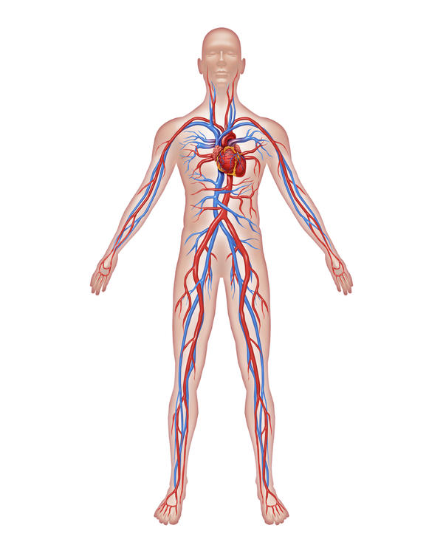

Slide 4
BLOOD
Blood is a red coloured fluid connective tissue
It consists of a fluid medium called plasma (55%) in which the cells (45%) are suspended

Slide 5
Blood corpuscles are of three types :
Red blood corpuscles (RBC) or Erythrocytes
White blood corpuscles (WBC) or Leucocytes
Blood platelets or Thrombocytes

Slide 6
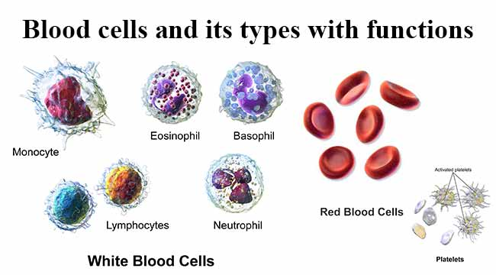

Slide 7
FUNCTIONS OF BLOOD
Transport of respiratory gases
- Oxygen by RBCs
- CO2 through plasma in dissolved form
Transport of digested food materials to the different body cells
Transport of hormones
Transport of nitrogenous wastes

Slide 8
Involved in defense against diseases
It regulates of pH and body temperature
It maintains proper water balance in the body

Slide 9
HEART
The heart is a muscular organ which is as big as our fist
Heart has 4 chambers to prevent the mixing of oxygen-rich blood with carbon dioxide – rich blood
2 atria – left and right – small, thin walled upper chambers
2 ventricles – left and right – large, thick walled lower chambers

Slide 10
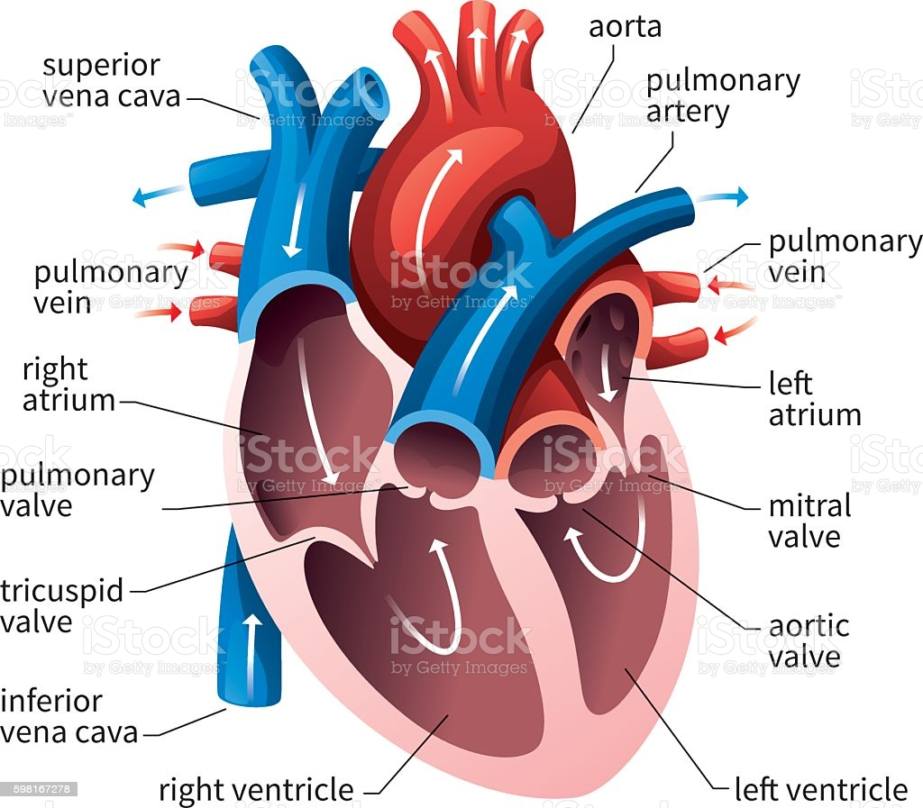

Slide 11
The carbon dioxide-rich blood has to reach the lungs to remove carbon dioxide
Oxygenated blood from the lungs has to be brought back to the heart
This oxygen-rich blood is then pumped to the rest of the body

Slide 12
We can follow this process step by step
Oxygen-rich blood from the lungs comes to left atrium through pulmonary vein
The left atrium relaxes when it is collecting this blood
It then contracts, and transfers blood to the left ventricle, which expands while receiving blood

Slide 13
When the muscular left ventricle contracts, the blood is pumped out of heart through aorta to the body parts
De-oxygenated blood comes from the body to the right atrium, as it expands

Slide 14
As the right atrium contracts, the corresponding lower chamber, the right ventricle, dilates
This transfers blood to the right ventricle
During contraction of right ventricle, blood pumps to the lungs for oxygenation through pulmonary artery
Since ventricles have to pump blood into various organs, they have thicker muscular walls than the atria do
Valves ensure that blood does not flow backwards when the atria or ventricles contract

Slide 15
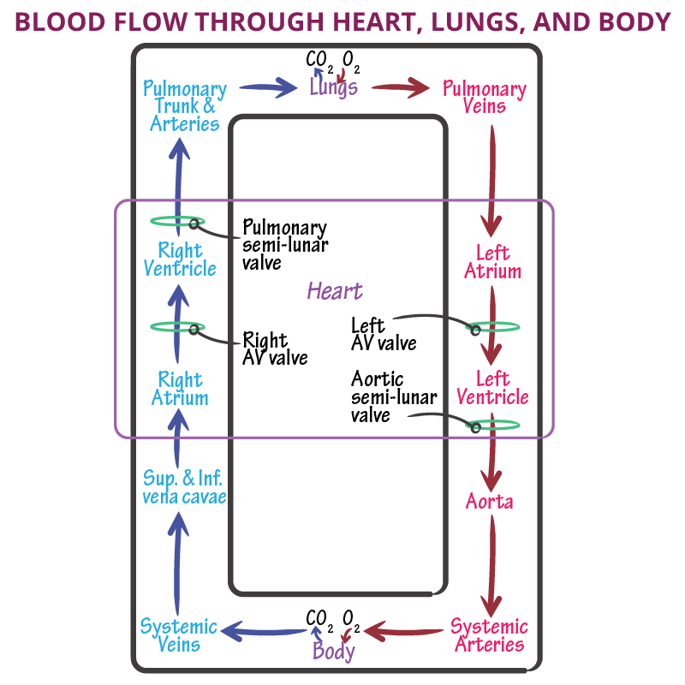

Slide 16
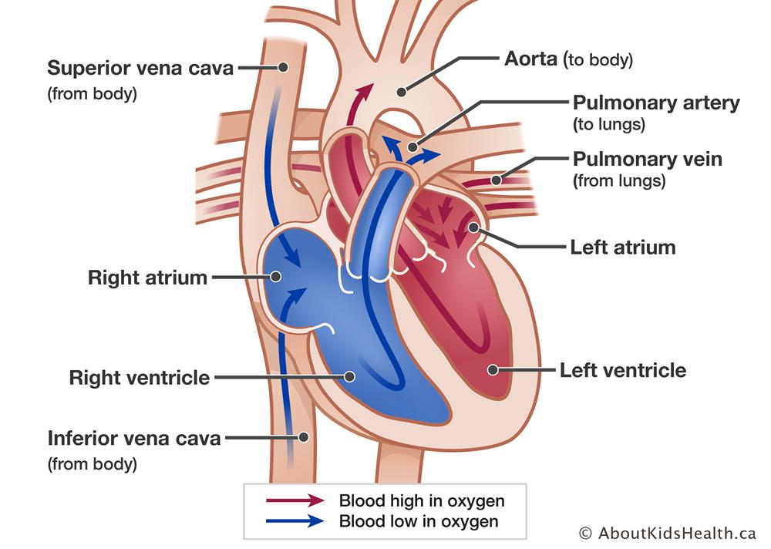

Slide 17
Oxygen enters the blood in the lungs
The separation of the right side and the left side of the heart is useful to keep oxygenated and de-oxygenated blood from mixing
Such separation allows a highly efficient supply of oxygen to the body
This is useful in animals that have high energy needs, such as birds and mammals, which constantly use energy to maintain their body temperature

Slide 18
In animals that do not use energy for this purpose, the body temperature depends on the temperature in the environment
Such animals, like amphibians or many reptiles have three-chambered hearts, and tolerate some mixing of the oxygenated and de-oxygenated blood streams

Slide 19
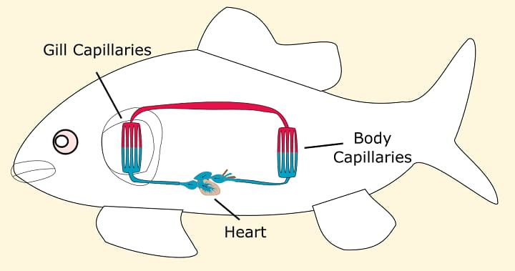
Fishes have only two chambers in their hearts, and the blood is pumped to the gills, which is oxygenated there, and passes directly to the rest of the body
Thus, blood goes only once through the heart in the fish during one cycle of passage through the body
On the other hand, it goes through the heart twice during each cycle in other vertebrates. This is known as double circulation

Slide 20
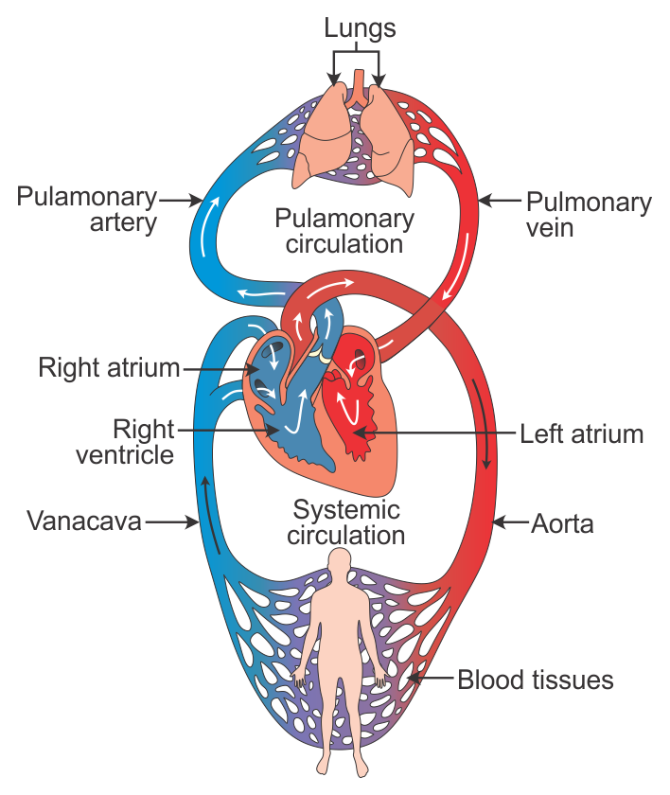
DOUBLE CIRCULATION

Slide 21
THE TUBES – BLOOD VESSELS
ARTERY :
Arteries are the vessels which carry blood away from the heart to various organs of the body
Since the blood emerges from the heart under high pressure, the arteries have thick, elastic walls

Slide 22
VEIN :
Veins collect the blood from different organs and bring it to the heart
They do not need thick walls because the blood is no longer under pressure
Instead they have valves that prevents backward flow of blood and ensure that the blood flows only in one direction

Slide 23
CAPILLARY :
Artery when reaching an organ or tissue, divides into smaller and smaller vessels to bring the blood in contact with all the individual cells
The smallest vessels have walls which are one-cell thick and are called capillaries

Slide 24
Exchange of material between the blood and surrounding cells takes place across this thin capillary wall
The capillaries then join together to form veins that convey the blood away from the organ or tissue

Slide 25
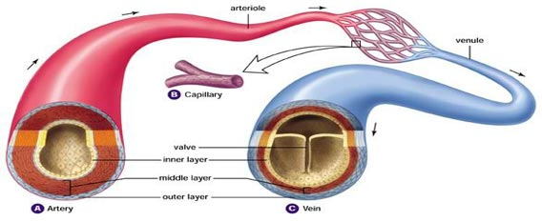

Slide 26
MAINTENANCE BY PLATELETS
When we are injured and start bleeding, there is loss of blood from the system through the injury
In addition, leakage would lead to a loss of pressure which would reduce the efficiency of pumping system
To avoid this, the blood has platelet cells which circulate around the body and plug these leaks by helping to clot the blood at these points of injury

Slide 27
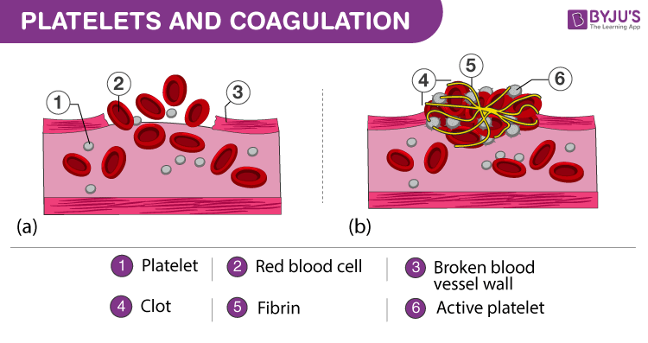

Slide 28
LYMPH
Lymph or tissue fluid is another type of fluid involved in transportation
Through the pores present in the walls of capillaries some amount of plasma, proteins and blood cells escape into intercellular spaces in the tissues to form the tissue fluid or lymph
It is similar to the plasma of blood but colourless due to absence of RBCs and contains less protein

Slide 29
Lymph drains into lymphatic capillaries from the intercellular spaces, which join to form large lymph vessels that finally open into larger veins
Lymph carries digested and absorbed fat from intestine and drains excess fluid from extra cellular space back into the blood

Slide 30
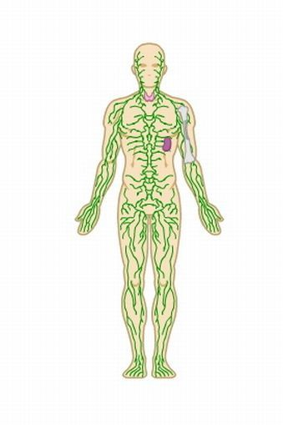

Slide 31
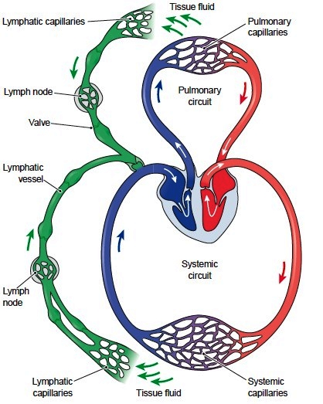

Slide 32
BLOOD PRESSURE
The force that blood exerts against the wall of a vessel is called blood pressure
This pressure is much greater in arteries than in veins
The pressure of blood inside the artery during ventricular systole (contraction) is called systolic pressure
Pressure in artery during ventricular diastole (relaxation) is called diastolic pressure

Slide 33
The normal systolic pressure is about 120 mm of Hg and diastolic pressure is 80 mm of Hg
Blood pressure is measured with an instrument called sphygmomanometer
High blood pressure is also called hypertension
- Caused by the constriction of arterioles, which results in increased resistance to blood flow
It can lead to the rupture of an artery and internal bleeding

