Slide 1
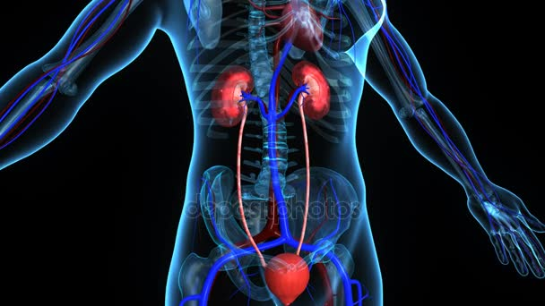
….
HUMAN EXCRETION

Slide 2
L.O
L.OBJS
To explain the process of excretion in human .

Slide 3
EE
EXCRETION
Excretion is the process by which the waste products produced during metabolic activities is removed from the body.
In unicellular organism the waste products are removed from the cells into the surroundings by diffusion.
In multicellular organisms the waste products are removed through specialized organs.
HUMAN EXCRETORY SYSTEM
The excretory system consists of a pair of kidneys , a pair of ureters, urinary bladder and urethra.
Each kidney has a number of excretory units called nephrons.

Slide 4
Kidney-located on the either sides of abdomen ,bean shaped structure.
Ureter-a tube which brings urine from kidney to urinary bladder.
Urinary bladder-Muscular organ which stores urine.It is under nervous control.
Urethra-The opening through which urine passes out which is called micturition.

Slide 5
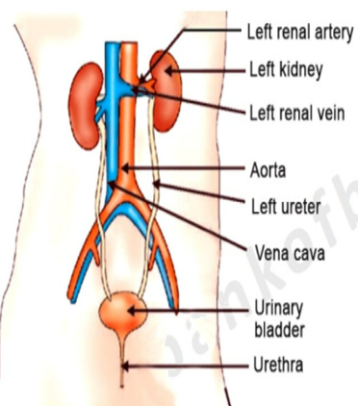
H
HW-SKETCH THE STRUCTURE OF HUMAN EXCRETORY SYSTEM

Slide 6
L
L.OBJ
To recognize the role of nephron in urine formation.

Slide 7
Structure of Nephron
Each nephron has a cup like structure called Bowman’s capsule containing a bundle of capillaries called glomerulus.
The Bowman’s capsule leads into a tubular structure which joins into a collecting duct.
The renal artery brings the nitrogenous waste like ammonia, urea, uric acid (urine) along with excess water, salts etc. into the nephron. It filters the nitrogenous waste, water and salts which passes through the tubular structure into the collecting duct.
The waste then passes through the ureters into the urinary bladder and is then sent out through the urethra as urine.
The useful products like amino acids, glucose, salts etc. are reabsorbed by the capillaries around the tubular structure and goes into the real vein.

Slide 8
Describe the method of urine formation
URINE FORMATION
Urine formed in the kidney by 3 processes.
1.Glomerular filtration –Blood with impurities will reach the Bowmans capsule.Glomerulus filtrate the blood.
2.Tubular reabsorption-Some useful products like amino acids ,salts etc reabsorbed back to the blood.If this tubular part not function well ,all these useful materials and more water eliminated from the blood.
3.Tubular secretion-Some ions are secreted in the blood which help to balance the p H of urine.Then the urine will go through the collecting duct ,to the ureter-urinary baldder and urethra.

Slide 9
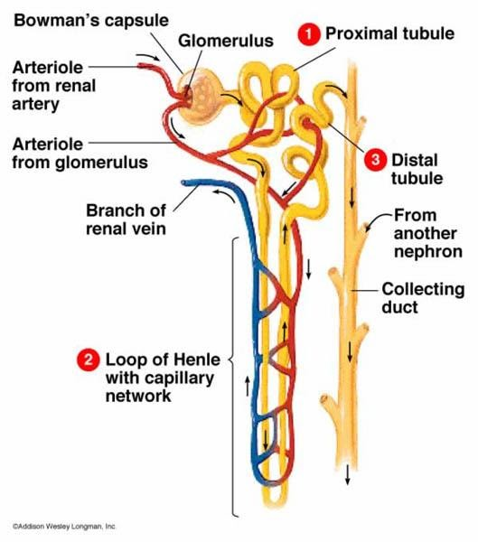
STRUCTURE OF NEPHRON-refer text book for diagram

Slide 10
l
L.Objs
To explain about dialysis
To describe the excretion in plants

Slide 11
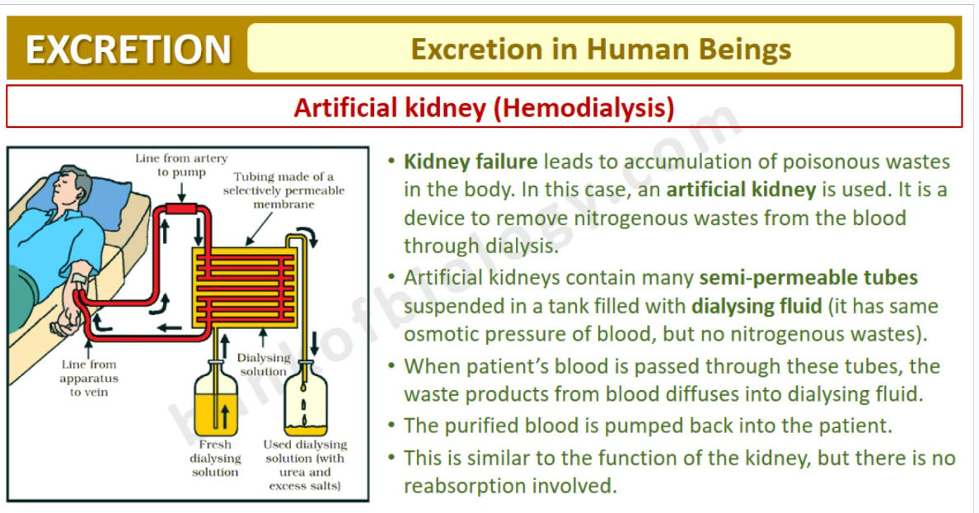

Slide 12
EXCRETION IN PLANTS :-
In plants the gaseous waste products produced during respiration (CO₂) and photosynthesis (O₂) are removed through the stomata. Excess water is removed through the stomata. This process is called transpiration.
Some waste products are stored in the leaves and removed when the leaves dry and fall off. Some waste products are stored in vacuoles. Some waste products like gums and resins are stored in the old xylem cells. Some waste products are removed through the roots.

