Slide 1
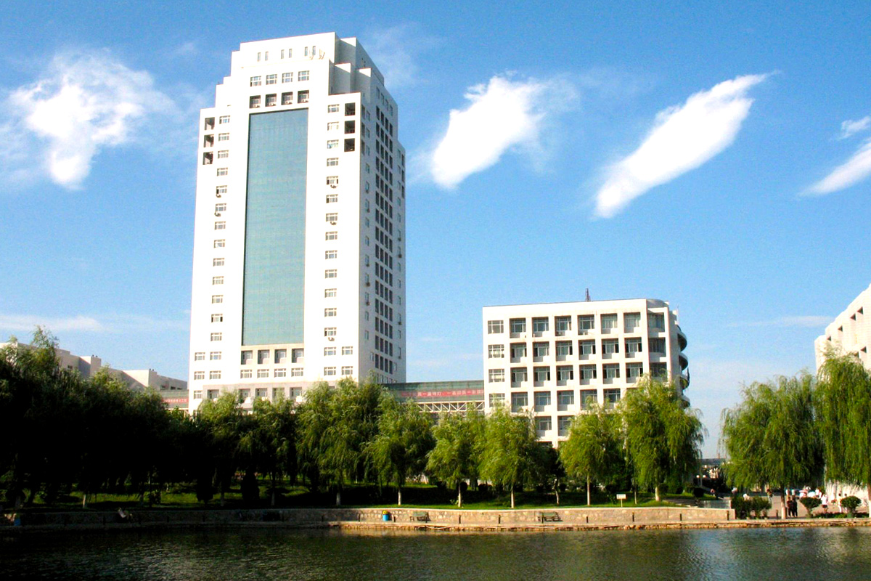


Slide 2
一、SOR迭代格式
SOR是 Succesive Over Relaxation（逐次超松弛）的缩写。SOR 迭代法是解大型稀疏矩阵方程组的有效方法之一。它可以看作是Gauss-Seidel 迭代法 的加速，Gauss-Seidel迭代法是SOR 迭代的一种特殊形式。

Slide 4
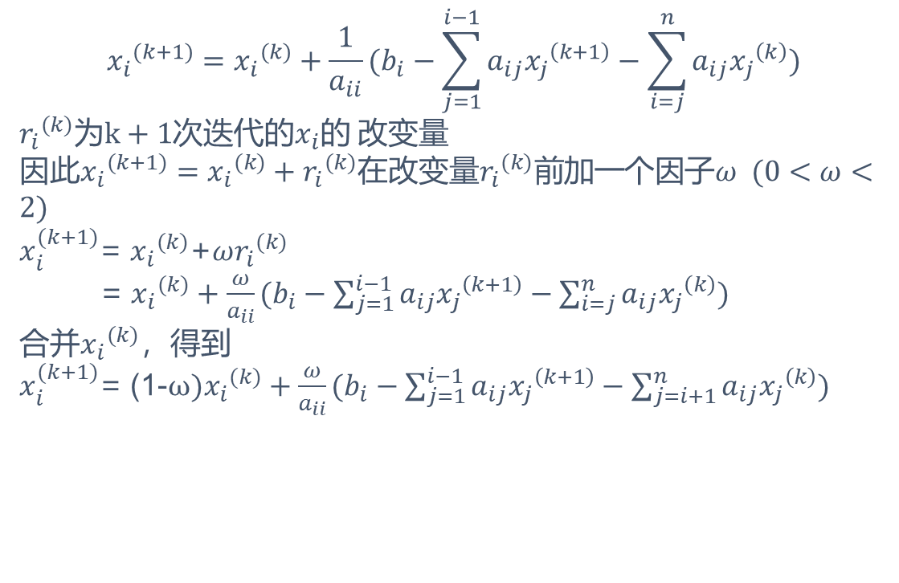
$${x_{i}}^{(k+1)}={x_{i}}^{(k)}+\frac{1}{a_{ii}}(b_{i}−\sum_{j=1}^{i−1}{a_{ij}{x_{j}}^{\left(k+1\right)}}−\sum_{i=j}^{n}{a_{ij}{x_{j}}^{\left(k\right)})}$$
${r_{i}}^{(k)}$为$k+1$次迭代的$x_{i}的$ 改变量
因此${x_{i}}^{(k+1)}={x_{i}}^{(k)}+{r_{i}}^{(k)}$在改变量${r_{i}}^{(k)}$前加一个因子$ω (0<ω<2)$
$x_{i}^{(k+1)}$= ${x_{i}}^{(k)}$+$ω{r_{i}}^{(k)}$
= ${x_{i}}^{(k)}+\frac{ω}{a_{ii}}(b_{i}−\sum_{j=1}^{i−1}{a_{ij}{x_{j}}^{\left(k+1\right)}}−\sum_{i=j}^{n}{a_{ij}{x_{j}}^{\left(k\right)})}$
合并${x_{i}}^{(k)}$，得到
$x_{i}^{(k+1)}$= (1-$ω){x_{i}}^{(k)}+\frac{ω}{a_{ii}}(b_{i}−\sum_{j=1}^{i−1}{a_{ij}{x_{j}}^{\left(k+1\right)}}−\sum_{j=i+1}^{n}{a_{ij}{x_{j}}^{\left(k\right)})}$

Slide 5
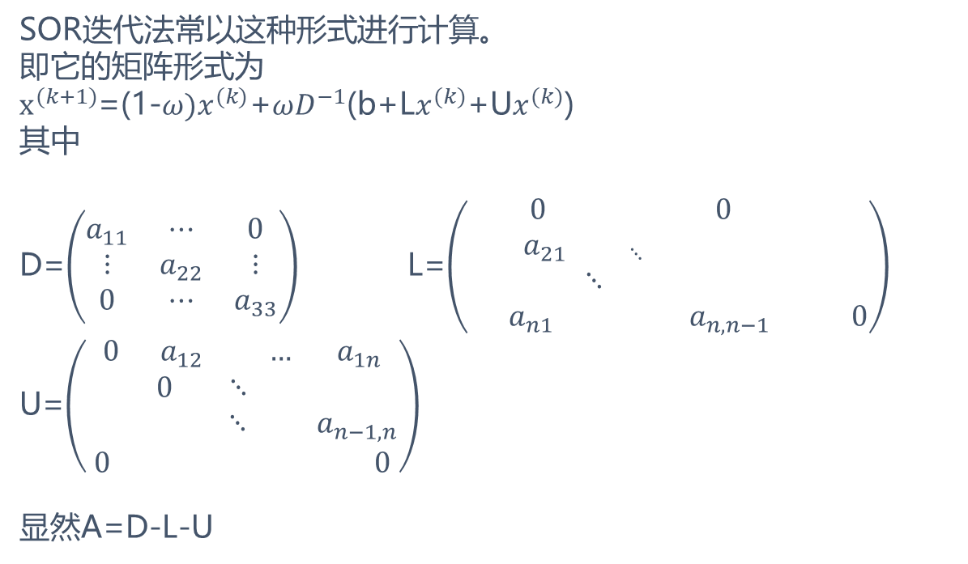
SOR迭代法常以这种形式进行计算。
即它的矩阵形式为
$x^{(k+1)}$=(1-$ω)x^{(k)}$+$ωD^{−1}$(b+L$x^{(k)}$+U$x^{(k)}$)
其中
D=$\left(\begin{matrix}a_{11} & ⋯ & 0 \\ ⋮ & a_{22} & ⋮ \\ 0 & ⋯ & a_{33}\end{matrix}\right)$ L=$\left(\begin{aligned}0 0 \\ a_{21 ⋱ } \\ ⋱ \\ a_{n1} a_{n,n−1} 0\end{aligned}\right)$
U=$\left(\begin{aligned}0 a_{12} … a_{1n} \\ 0 ⋱ \\ ⋱ a_{n−1,n} \\ 0 0\end{aligned}\right)$
显然A=D-L-U

Slide 6
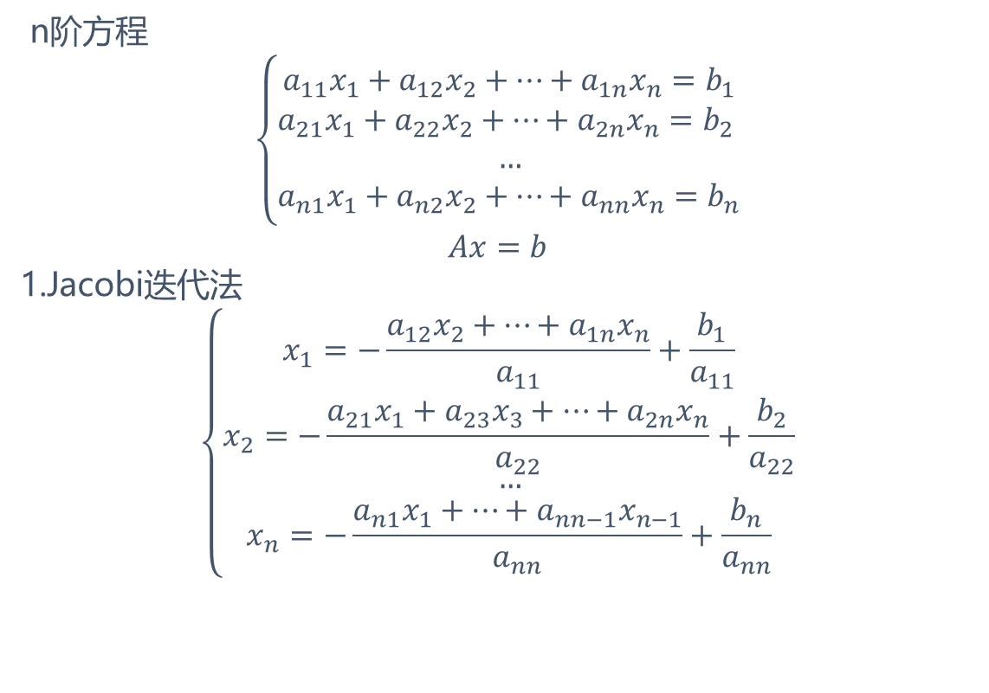
古典迭代法
n阶方程
$$\left\{\begin{aligned}a_{11}x_{1}+a_{12}x_{2}+…+a_{1n}x_{n}=b_{1} \\ a_{21}x_{1}+a_{22}x_{2}+…+a_{2n}x_{n}=b_{2} \\ … \\ a_{n1}x_{1}+a_{n2}x_{2}+…+a_{nn}x_{n}=b_{n}\end{aligned}\right.$$
$$Ax=b$$
1.Jacobi迭代法
$$\left\{\begin{aligned}x_{1}=−\frac{a_{12}x_{2}+…+a_{1n}x_{n}}{a_{11}}+\frac{b_{1}}{a_{11}} \\ x_{2}=−\frac{a_{21}x_{1}+a_{23}x_{3}+…+a_{2n}x_{n}}{a_{22}}+\frac{b_{2}}{a_{22}} \\ … \\ x_{n}=−\frac{a_{n1}x_{1}+…+a_{nn−1}x_{n−1}}{a_{nn}}+\frac{b_{n}}{a_{nn}}\end{aligned}\right.$$

Slide 7
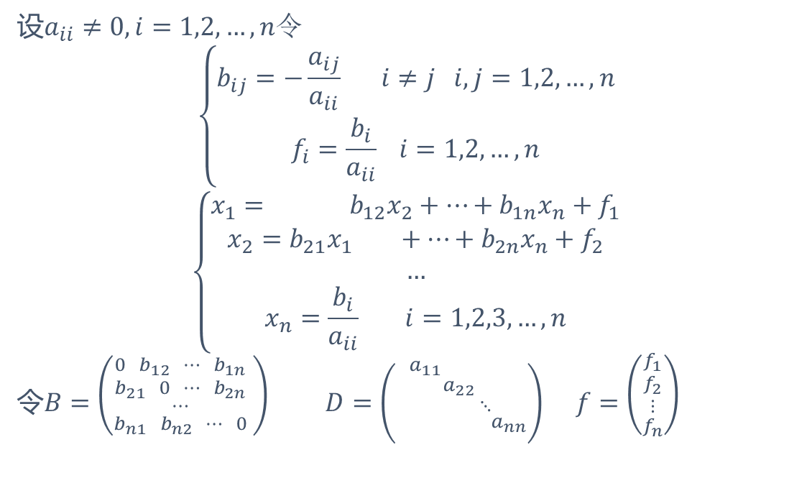
设$a_{ii}≠0,i=1,2,…,n令$
$$\left\{\begin{aligned}b_{ij}=−\frac{a_{ij}}{a_{ii}} i≠j i,j=1,2,…,n \\ f_{i}=\frac{b_{i}}{a_{ii}} i=1,2,…,n\end{aligned}\right.$$
$$\left\{\begin{aligned}x_{1}= b_{12}x_{2}+…+b_{1n}x_{n}+f_{1} \\ x_{2}=b_{21}x_{1} +…+b_{2n}x_{n}+f_{2} \\ … \\ x_{n}=\frac{b_{i}}{a_{ii}} i=1,2,3,…,n\end{aligned}\right.$$
令$B=\left({\begin{aligned}0 b_{12} ⋯ b_{1n} \\ b_{21} 0 ⋯ b_{2n} \\ ⋯\end{aligned} \atop b_{n1} b_{n2} ⋯ 0} \right)$ $D=\left({\begin{aligned}a_{11} \\ a_{22} \\ ⋱\end{aligned} \atop { a}_{nn}}\right)$ $f=\left({\begin{aligned}f_{1} \\ f_{2} \\ ⋮\end{aligned} \atop f_{n}}\right)$

Slide 8
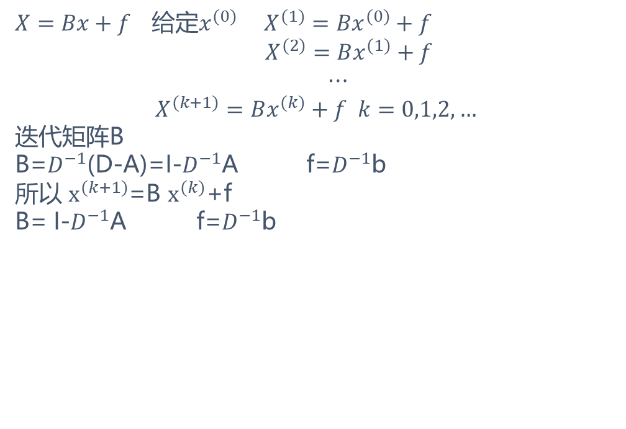
$X=Bx+f$ 给定$x^{(0)}$ $X^{(1)}=Bx^{(0)}+f$
$X^{(2)}=Bx^{(1)}+f$
$⋯$
$$X^{(k+1)}=Bx^{(k)}+f k=0,1,2,…$$
迭代矩阵B
B=$D^{−1}$(D-A)=I-$D^{−1}$A f=$D^{−1}$b
所以 $x^{(k+1)}$=B $x^{(k)}$+f
B= I-$D^{−1}$A f=$D^{−1}$b

Slide 9
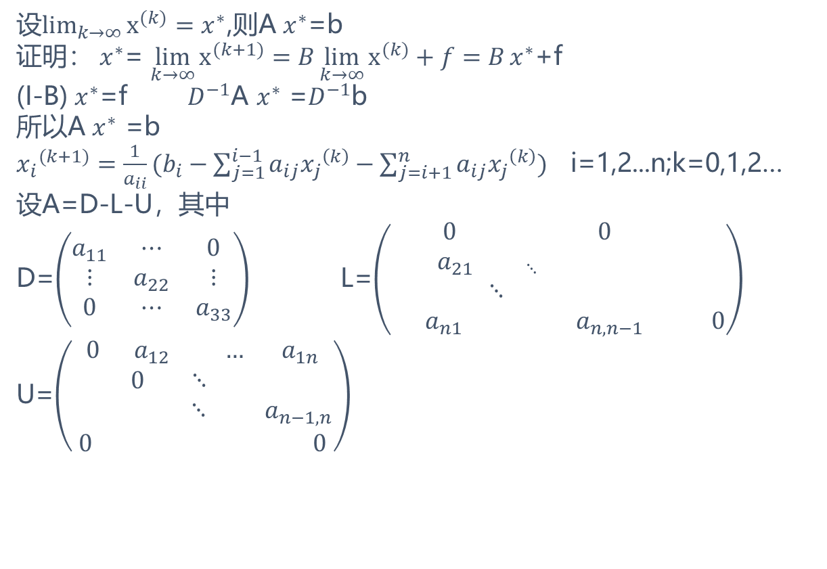
设$\lim_{k→∞}{x^{(k)}=x^{∗}}$,则A $x^{∗}$=b
证明： $x^{∗}$= $\lim_{k→∞}{x^{(k+1)}=B\lim_{k→∞}{x^{(k)}+f=B}x^{∗}}$+f
(I-B) $x^{∗}$=f $D^{−1}$A $x^{∗}$ =$D^{−1}$b
所以A $x^{∗}$ =b
${x_{i}}^{(k+1)}=\frac{1}{a_{ii}}(b_{i}−\sum_{j=1}^{i−1}{a_{ij}{x_{j}}^{\left(k\right)}}−\sum_{j=i+1}^{n}{a_{ij}{x_{j}}^{\left(k\right)})}$ i=1,2...n;k=0,1,2…
设A=D-L-U，其中
D=$\left(\begin{matrix}a_{11} & ⋯ & 0 \\ ⋮ & a_{22} & ⋮ \\ 0 & ⋯ & a_{33}\end{matrix}\right)$ L=$\left(\begin{aligned}0 0 \\ a_{21 ⋱ } \\ ⋱ \\ a_{n1} a_{n,n−1} 0\end{aligned}\right)$
U=$\left(\begin{aligned}0 a_{12} … a_{1n} \\ 0 ⋱ \\ ⋱ a_{n−1,n} \\ 0 0\end{aligned}\right)$
Notes:
引导学员思考经销商管理的方面，注重框架性思维的培训

Slide 10
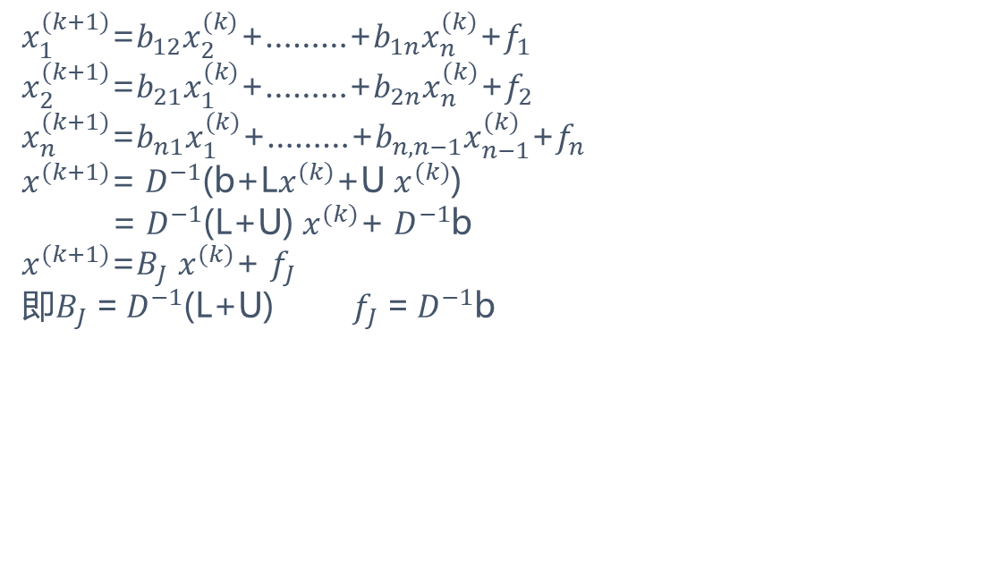
$x_{1}^{(k+1)}$=$b_{12}x_{2}^{(k)}$+………+$b_{1n}x_{n}^{(k)}$+$f_{1}$
$x_{2}^{(k+1)}$=$b_{21}x_{1}^{(k)}$+………+$b_{2n}x_{n}^{(k)}$+$f_{2}$
$x_{n}^{(k+1)}$=$b_{n1}x_{1}^{(k)}$+………+$b_{n,n−1}x_{n−1}^{(k)}$+$f_{n}$
$x^{(k+1)}$= $D^{−1}$(b+L$x^{(k)}$+U $x^{(k)}$)
= $D^{−1}$(L+U) $x^{(k)}$+ $D^{−1}$b
$x^{(k+1)}$=$B_{J}$ $x^{(k)}$+ $f_{J}$
即$B_{J}$ = $D^{−1}$(L+U) $f_{J}$ = $D^{−1}$b

Slide 11
用 Givens变换对上Hessenberg阵作QR分解

