Slide 1
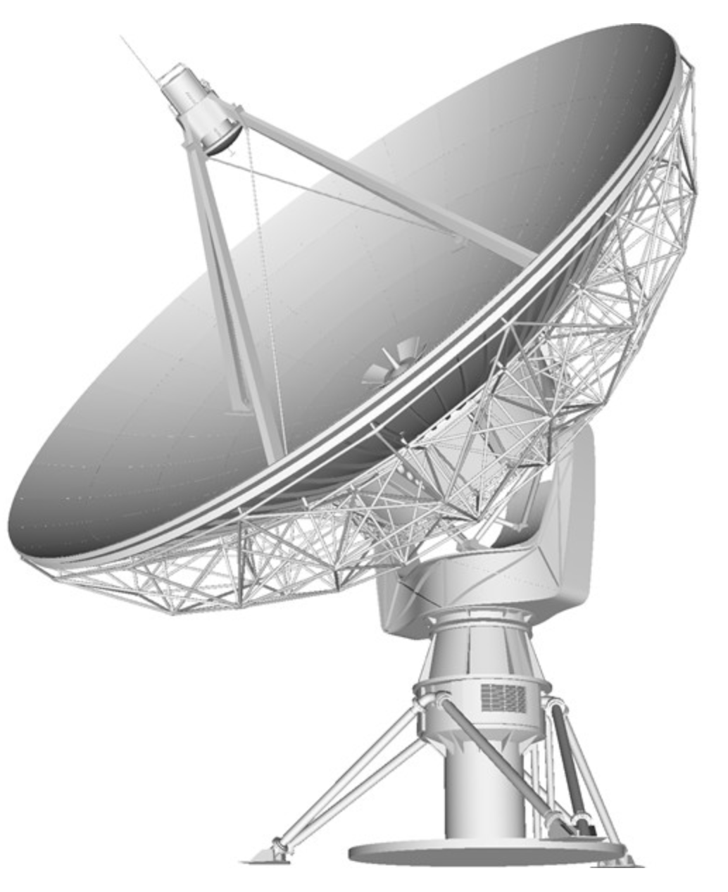
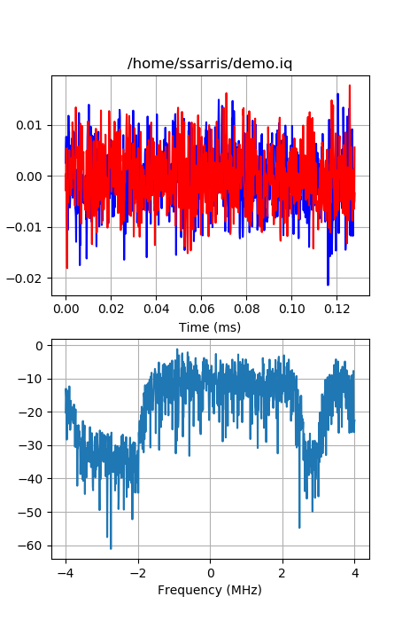
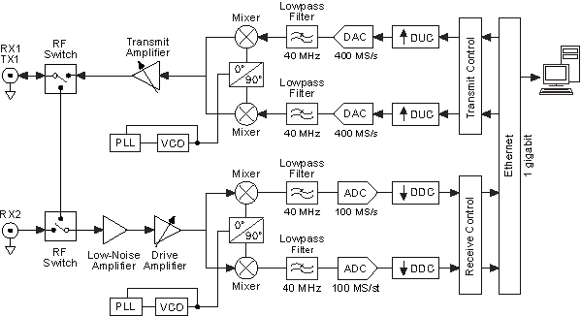

RF Quadrature (IQ) Signals
Math Model
Implementation in Hardware
Structure of Digital Data
Implementation in Software
Spiro Sarris. 01 /2019

Slide 2
Outline
Amplitude, phase. Why is it interesting?
Euler’s formula
Mathematical model of signal
Implementation of model in receiver hardware
Analog to digital conversion (ADC)
Convenience in software programming languages
Implementation of model in software
Tradeoffs between I/Q sampling and real-value sampling
Python demonstration

Slide 3
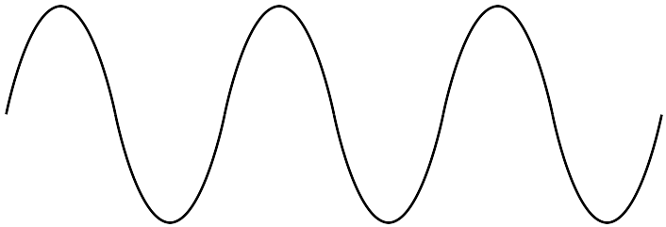

1. Amplitude, Phase
Amplitude, A
time
Phase, Φ
ΔΦ = 2π
ΔΦ = 2π radians for 1 cycle in time and for 1 wavelength (λ) [m] in space
Angular frequency (ω) [radians/sec] is the rate of change of phase vs. time
Temporal frequency (f) [Hz] is the number of cycles per second

Slide 4

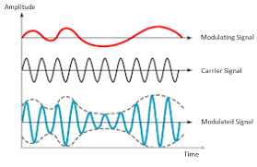
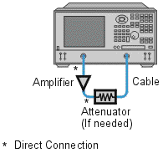
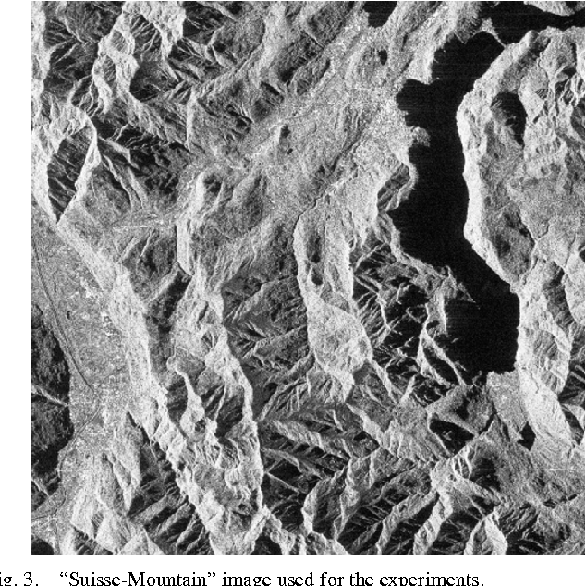
1. Amplitude
RSSI – Received Signal Strength Indicator
Communication Modulation
Component Gain / Loss
Synthetic Aperture Radar Image

Slide 5
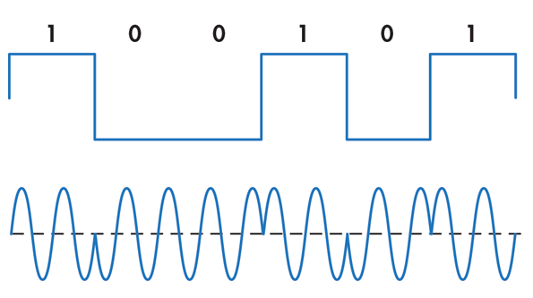
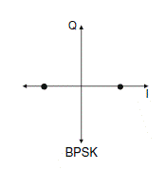
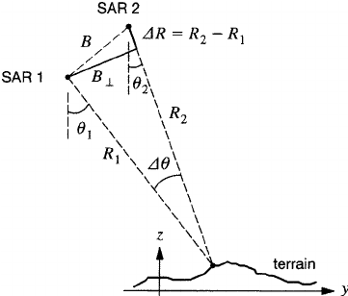
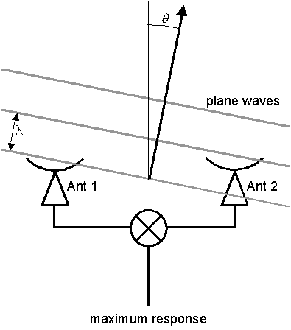
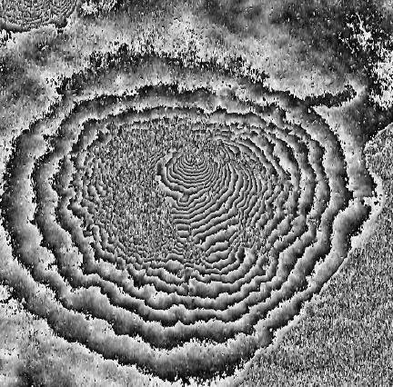
1. Phase
Length / Distance Measurement
Data Communication Modulation
Synthetic Aperture Radar Interferometer
Radio Interferometer

Slide 6

2. Euler’s Formula
Year 1748 - Mathematician Leonhard Euler published that periodic functions such as cosine and sine can be represented as complex exponentials of instantaneous phase (phasors)
This model simplifies math related to amplitude and phase

Slide 7
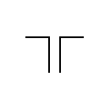

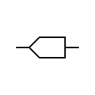
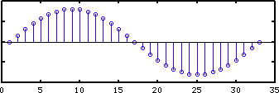
3. Mathematical Model of Signal
Antenna
Balun
t in continuous time
n is integer index for discrete time
At any location in space, we can measure real-valued voltage and record with ADC. Recorded data includes only instantaneous amplitude. How do we find the phase information?

Slide 8
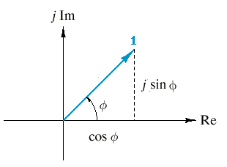

3. Mathematical Model of Signal
Real-value cosine
Euler’s model of complex phasor
?
Receiver
How can we translate real-value voltage signal model (easy to understand in the physical world) to quadrature I/Q signal model (easy to process using DSP software)?

Slide 9
4.Implementation of Model in Hardware
I/Q Downconverter Receiver (example from Ettus USRP N210 + WBX)

Slide 10
4. I/Q Downconverter Receiver
2
4
Use trig identity – product to sum
1
Lowpass filter removes
90 degree
phase delay
3
5
Lowpass filter removes

Slide 11
5. Analog to Digital Conversion
2 ADCs with same sample clock and same length of cable / PCB trace
4
Assume 8-bit ADC
Channel I “in phase”
Channel Q “quadrature phase”
(delay by π/2 radians = λ / 4)
How to combine … ?
5
NOTE: ‘I’ and ‘Q’ in this context are for 1 polarization. Not related to Stokes parameters {I, Q, U, V}

Slide 12
5. Analog to Digital Conversion

Slide 13
6. Convenience in Software
Programming languages include support for complex/imaginary numbers and exponential function.
Many libraries of software are available to process data in this format
Language
Python | 1j | numpy.exp(x)
Matlab | J, j, I, i | exp(x)
C | <complex.h> I | <complex.h> cexp(x)
Octave | J, j, I, i | exp(x)

Slide 14
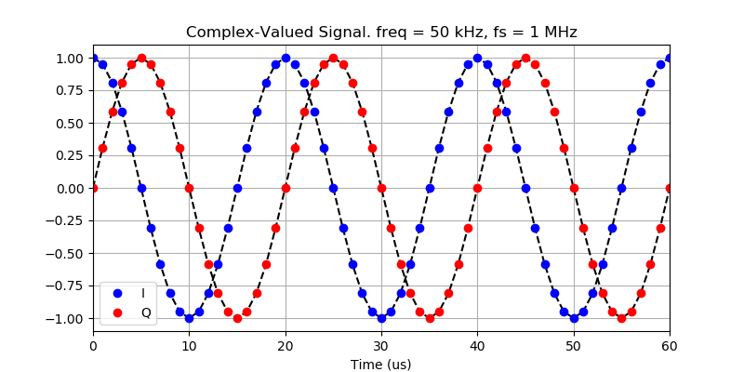
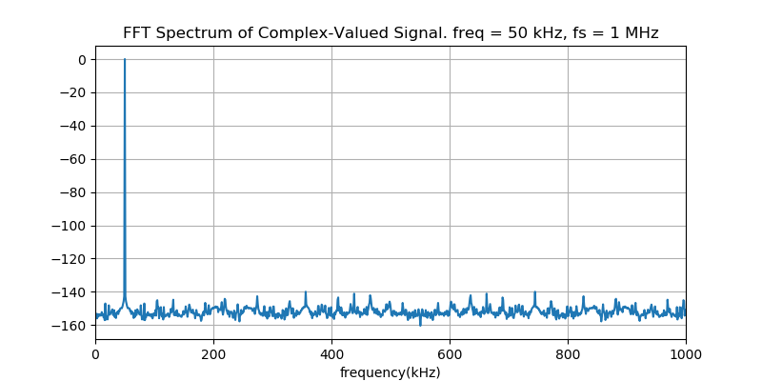
6. Convenience in Software
import numpy as np
fp = open('demo.iq','rb')
fp.seek(0,0)
dt = np.dtype([('i',np.float32),('q',np.float32)])
data = np.fromfile(fp,dtype=dt,count=nsamples)
sigt = data['i']+1j*data['q']

Slide 15
7. Software Implementation
Single-phase downconverter (not I/Q)
Same math from page 10-11 but remove hardware and data of Q channel
2
4
Assume 8-bit ADC
Channel I “in phase”
1
byte 0 | byte 1 | byte 2 | byte n
I[0] | I[1] | I[2] | I[n]
X
X
X
X
How to create the ‘Q’ component … ?

Slide 16
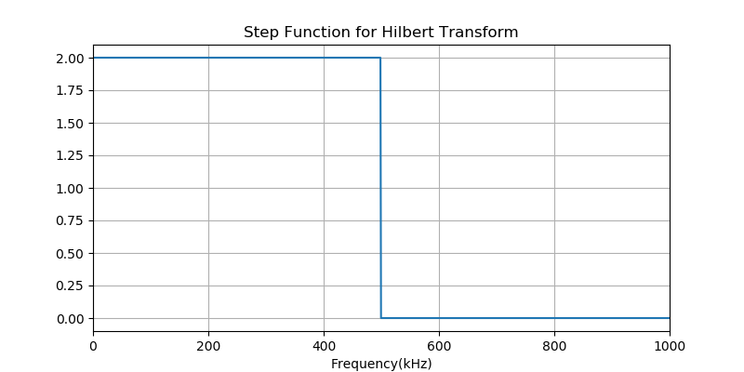
7. Hilbert Transform
Create the complex-valued analytic signal by Hilbert transform of the real-valued signal
Function is available in Python : scipy.signal.hilbert()
sig_r = np.cos(2*np.pi*freq*tt+phi0)
sig_h = scipy.signal.hilbert(sig_r)

Slide 17
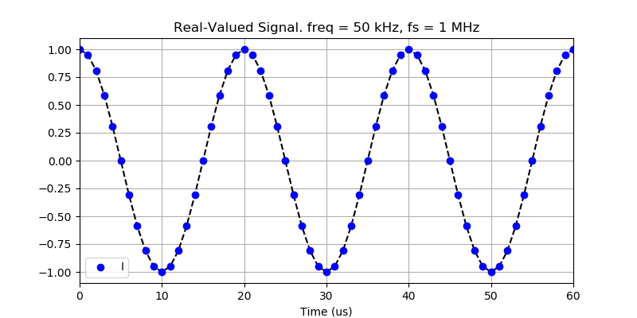
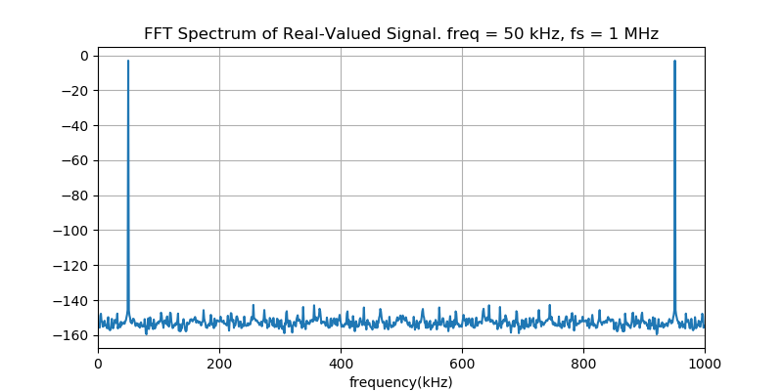
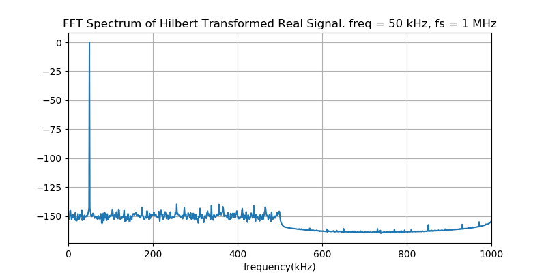
7. Hilbert Transform
FFT
(data bytes x 2)
Multiply step function (delete 2nd Nyquist zone)
IFFT

Slide 18
8. Tradeoff: Real-value vs I/Q sampling
If the required bandwidth for the system is small (low data rate, easy for ADC, CPU / GPU), we can implement a single-phase, real-value sampling receiver. Reduce design work in RX hardware. Reduce load on software and computer.
If the required bandwidth is big (high data rate, limit of CPU / GPU), we can implement the I/Q receiver design. Increase design work in RX hardware. Reduce load on software and computer.

