Slide 1
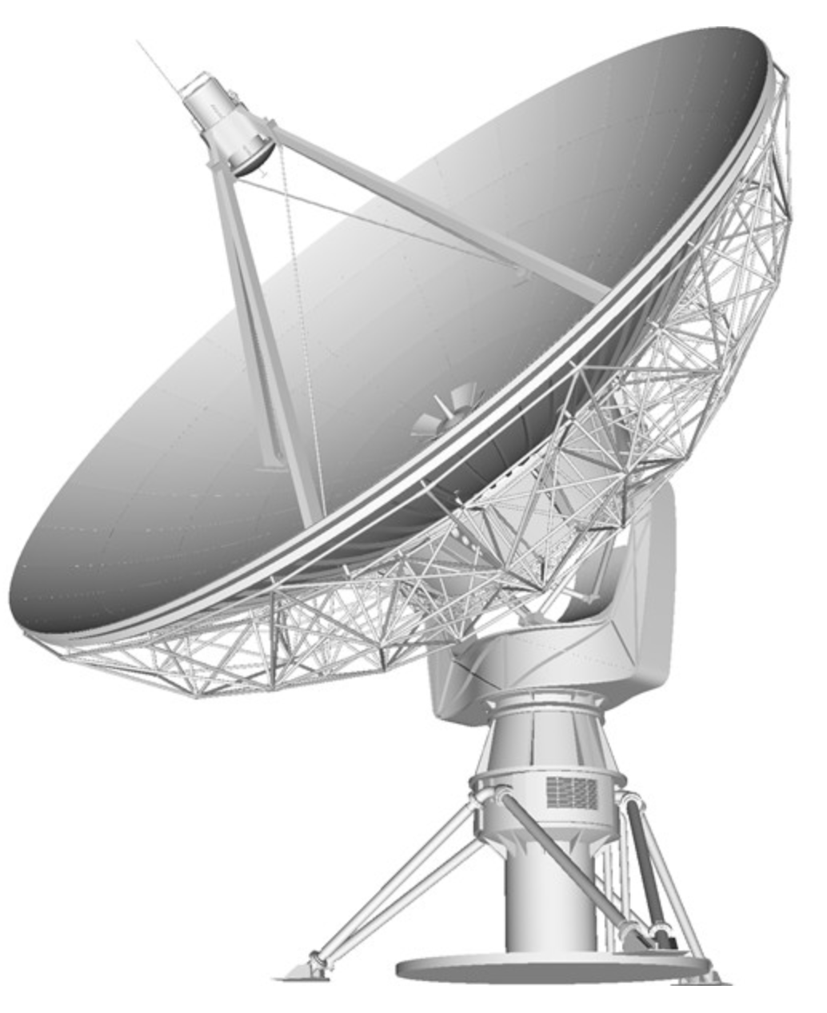
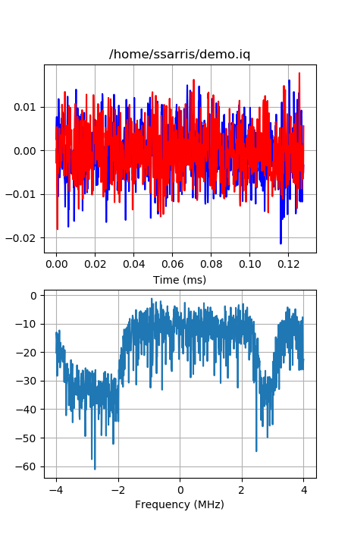
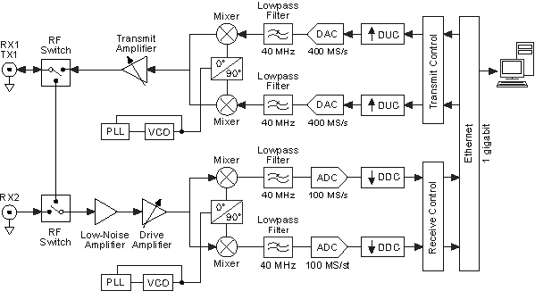

RF Quadrature (I/Q) Signals
Math Model
Implementation in Hardware
Structure of Digital Data
Implementation in Software
Spiro Sarris. 01 /2019

Slide 2
Links to Download
This Presentation
https://github.com/spiro-sarris/pres/blob/master/rf_iq.pdf
Python code - generate signals and display
https://github.com/spiro-sarris/utils/blob/master/iqdemo.py
Python code – read raw .iq file from GNUradio
https://github.com/spiro-sarris/utils/blob/master/iqstep.py

Slide 3
Outline
Amplitude, phase. Why is it interesting?
Euler’s formula
Math model of signal
Implementation of model in receiver hardware
Analog to digital conversion (ADC)
Convenience in software programming languages
Implementation of model in software
Compare I/Q sampling and real-value sampling

Slide 4
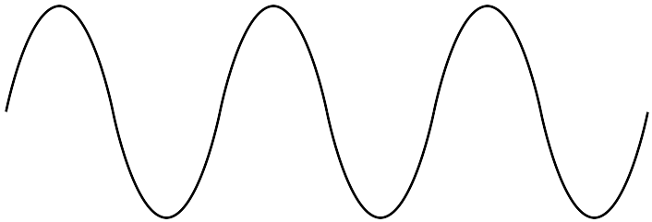

1. Amplitude, Phase
Amplitude, A
time
Phase, Φ
ΔΦ = 2π
ΔΦ = 2π radians for 1 cycle in time and for 1 wavelength (λ) [m] in space
Angular frequency (ω) [radians/sec] is the rate of change of phase vs. time
Temporal frequency (f) [Hz] is the number of cycles per second

Slide 5

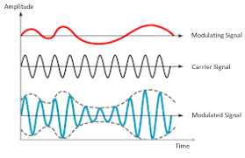
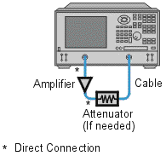
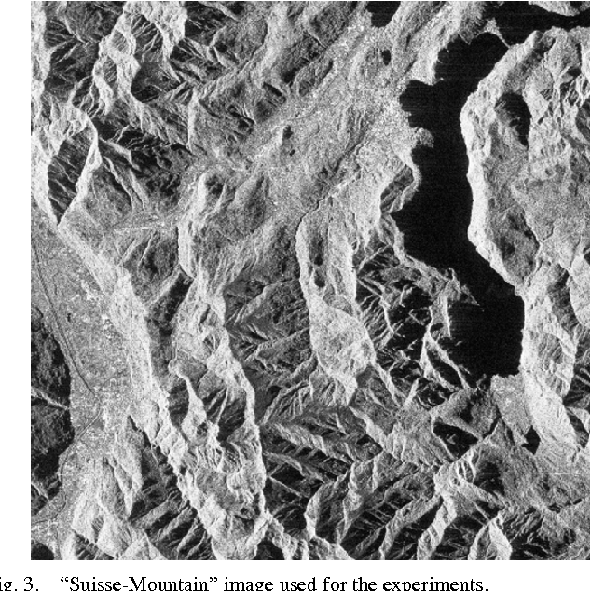
1. Amplitude
RSSI – Received Signal Strength Indicator
Communication Modulation
Component Gain / Loss
Synthetic Aperture Radar Image

Slide 6
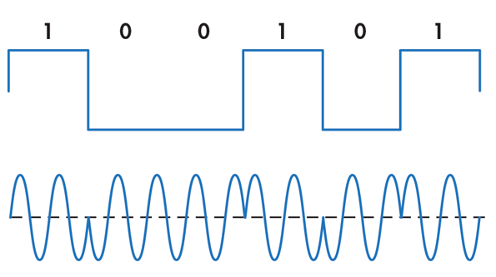
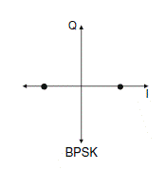
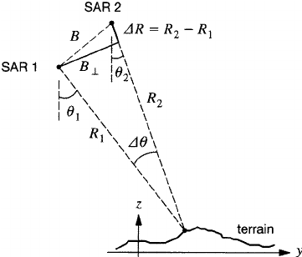
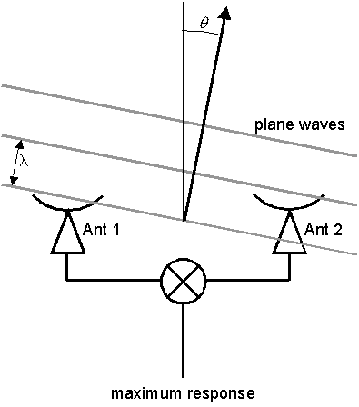
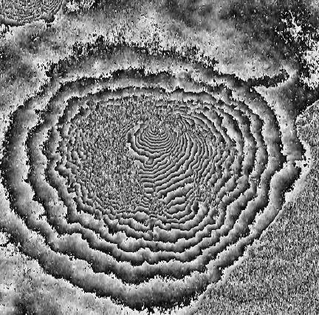
1. Phase
Length / Distance Measurement
Data Communication Modulation
Synthetic Aperture Radar Interferometer
Radio Interferometer

Slide 7

2. Euler’s Formula
Year 1748 - Mathematician Leonhard Euler published that periodic functions such as cosine and sine can be represented as complex exponentials of instantaneous phase (phasors)
This model simplifies math related to amplitude and phase

Slide 8
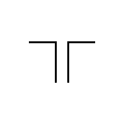

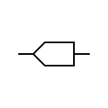
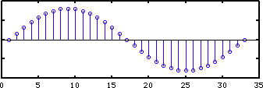
3. Math Model of Signal
Antenna
Balun
t in continuous time
n is integer index for discrete time
At any location, we can measure real-valued voltage and record with ADC. Recorded data includes only instantaneous amplitude. How do we find the phase information?

Slide 9
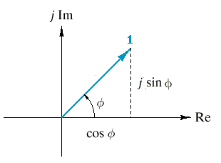

3. Math Model of Signal
Real-value cosine
Euler’s model of complex phasor
?
Receiver
How can we translate real-value voltage signal model (easy to understand in the physical world) to quadrature I/Q signal model (easy to process using DSP software)?

Slide 10
4. Implementation of Model in Hardware
I/Q Downconverter Receiver (example Ettus USRP N210+WBX)

Slide 11
4. Implementation of Model in Hardware
2
4
Use trig identity – product to sum
1
Lowpass filter removes
90 degree
phase delay
3
5
Lowpass filter removes

Slide 12
5. Analog to Digital Conversion (ADC)
2 ADCs with same sample clock and same length of cable / PCB trace
Example 8-bit = 1 byte per sample
4
I[n]
Channel I “in phase”
byte 0 | byte 1 | byte 2 | ...
I[0] | I[1] | I[2] | ...
byte 0 | byte 1 | byte 2 | ...
Q[0] | Q[1] | Q[2] | ...
Channel Q “quadrature phase”
(delay by π/2 radians = λ / 4)
5
How to combine … ?
NOTE: ‘I’ and ‘Q’ in this context are for 1 polarization. Not related to Stokes parameters {I, Q, U, V}

Slide 13
5. Analog to Digital Conversion (ADC)
Interleave the I and Q data buffers into 1 on synchronous system before sending out to file or asynchronous system (non-real-time Ethernet, etc.)
byte 0 | byte 1 | byte 2 | ...
I[0] | I[1] | I[2] | ...
file_name.iq
TCP socket
UDP socket
asyncio
byte 0 | Byte 1 | byte 2 | byte 3 | byte 4 | byte 5 | ...
I[0] | Q[0] | I[1] | Q[1] | I[2] | Q[2] | ...
byte 0 | byte 1 | byte 2 | ...
Q[0] | Q[1] | Q[2] | ...

Slide 14
6. Convenience in Software
Programming languages include support for complex/imaginary numbers and exponential function.
Many libraries of software are available to process data in this format
Language
Python | 1j | numpy.exp(x)
Matlab | J, j, I, i | exp(x)
C | <complex.h> I | <complex.h> cexp(x)
Octave | J, j, I, i | exp(x)

Slide 15
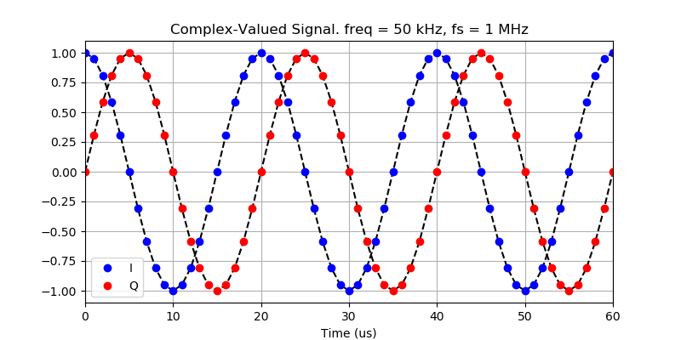
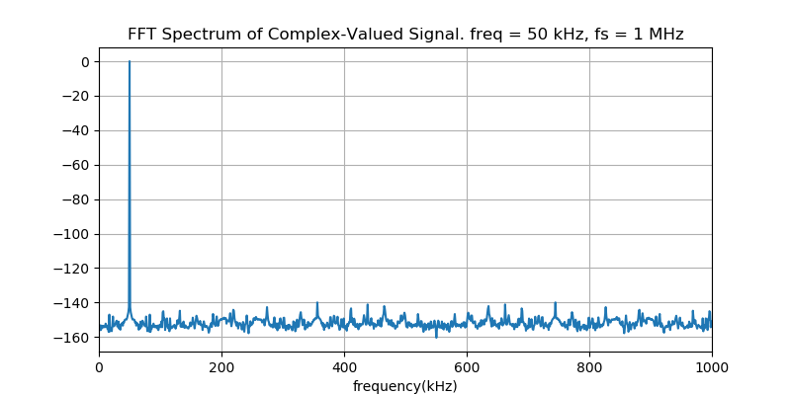
6. Convenience in Software
import numpy as np
fp = open('demo.iq','rb')
fp.seek(0,0)
dt = np.dtype([('i',np.float32),('q',np.float32)])
data = np.fromfile(fp,dtype=dt,count=nsamples)
sigt = data['i']+1j*data['q']

Slide 16
7. Implementation in Software
Single-phase downconverter (not I/Q)
Same math from page 10-11 but remove hardware and data of Q channel
Channel I “in phase”
2
4
I[n]
byte 0 | byte 1 | byte 2 | byte n
I[0] | I[1] | I[2] | I[n]
1
X
X
X
X
How to create the ‘Q’ component … ?

Slide 17
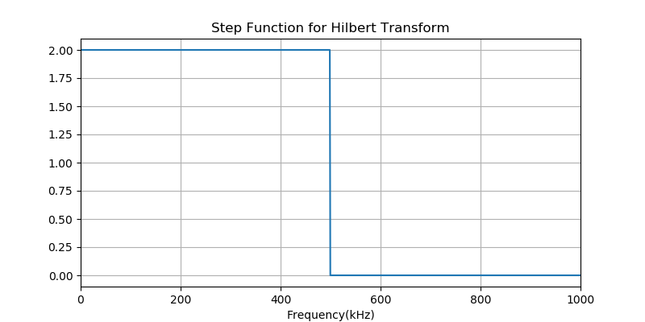
7. Implementation in Software
Create the complex-valued analytic signal by Hilbert transform of the real-valued signal
Function is available in Python : scipy.signal.hilbert()
sig_r = np.cos(2*np.pi*freq*tt+phi0)
sig_h = scipy.signal.hilbert(sig_r)

Slide 18
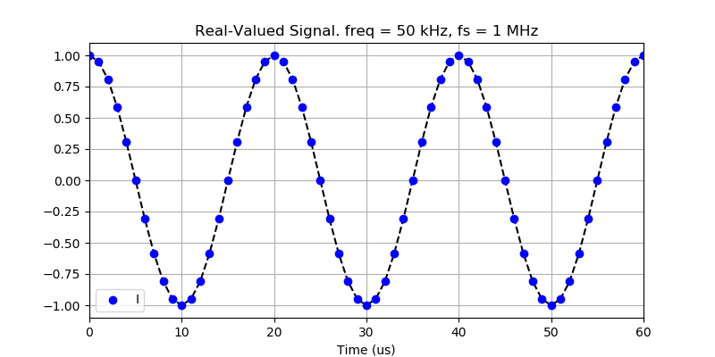
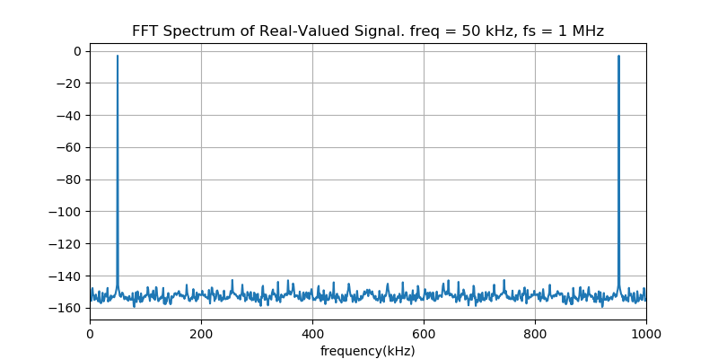
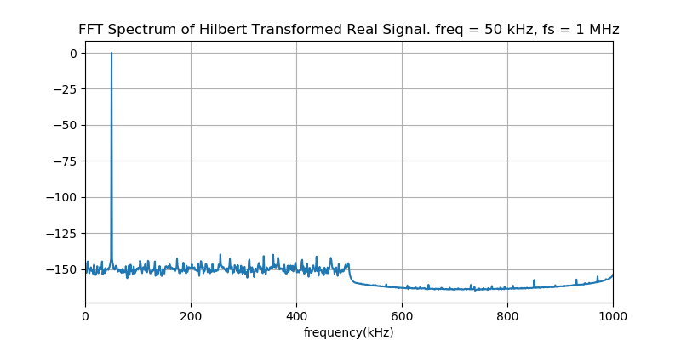
7. Implementation in Software
FFT
(data bytes x 2)
Multiply step function (delete 2nd Nyquist zone)
IFFT

Slide 19
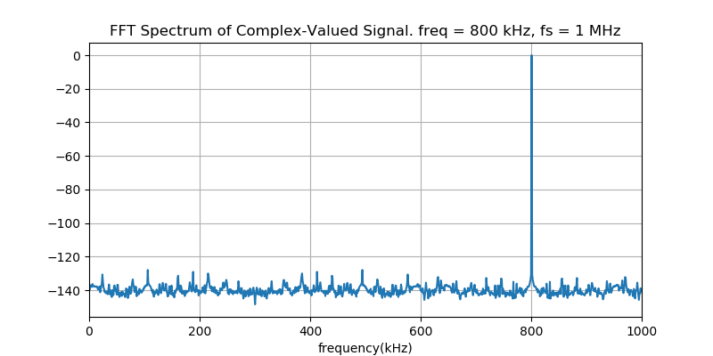
8. Compare: I/Q vs Real-Value Sampling
Example for I/Q Sampling:
Sample rate f_s = 1 MHz
RF signal frequency f_RF = 800 kHz
Both I and Q channels of receiver are sampled.
I and Q data arrays are combined in software to be complex samples
Signal appears at
800 kHz. Good!

Slide 20
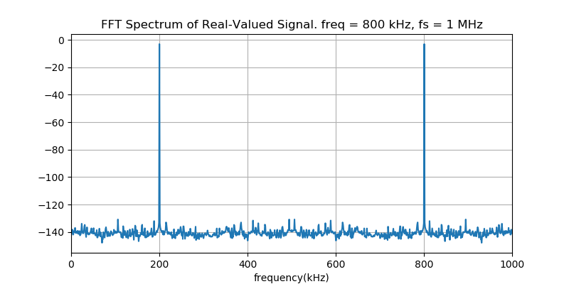
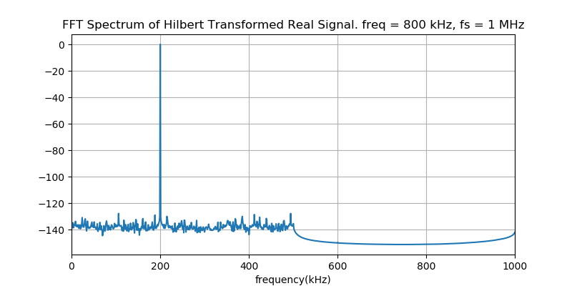
8. Compare: I/Q vs Real-Value Sampling
Example for Real-Value Sampling:
Sample rate f_s = 1 MHz
RF signal frequency f_RF = 800 kHz
Only “I” channel is sampled
“I” data array is converted to complex in software with Hilbert transform
Complex FFT creates a 2nd
signal at 200 Khz
Hilbert transform removes
the signal in 2nd Nyquist zone
Result signal is aliased at
(f_s - f_RF) = 200 kHz. NOT GOOD!

Slide 21
8. Compare: I/Q vs Real-Value Sampling
Conclusions for fixed sample rate:
I/Q complex sampler can record RF signal not more than 1 x sample rate
Real-value sampler can record RF signal not more than 0.5 x sample rate
Conclusions for fixed frequency and bandwidth
I/Q complex sampler must use sample rate >= 1 x RF bandwidth – but on 2 channels at the same time.
Real-value sampler must use sample rate >= 2 x RF bandwidth – only on 1 channel.
Final data rate is the same for both methods. But the work load is distributed in different ways.

Slide 22
8. Compare: I/Q vs Real-Value Sampling
If the required bandwidth for the system is small (low data rate, easy for ADC, CPU / GPU), we can implement a single-phase, real-value sampling receiver. Reduce design work in RX hardware. Reduce load on software and computer.
If the required bandwidth is big (high data rate, limit of CPU / GPU), we can implement the I/Q receiver design. Increase design work in RX hardware. Reduce load on software and computer.

