Slide 1
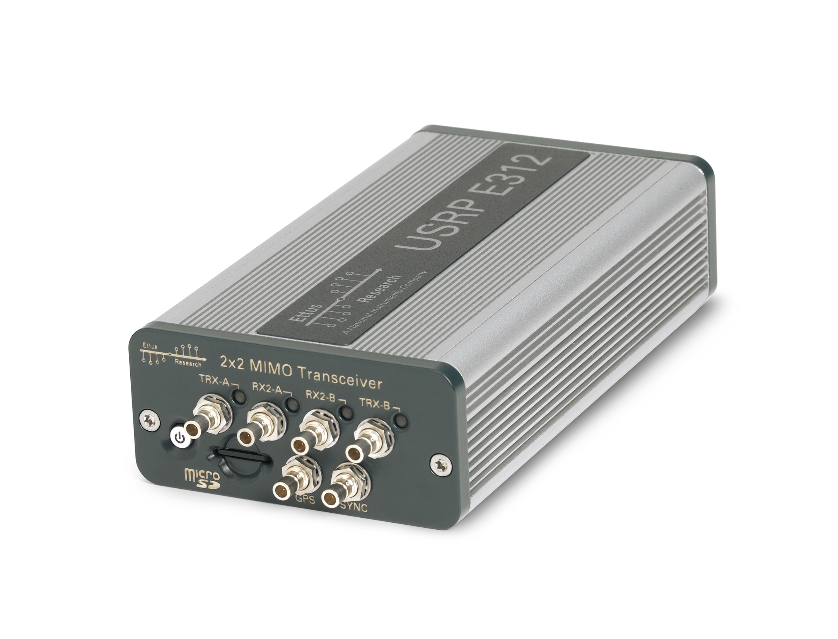
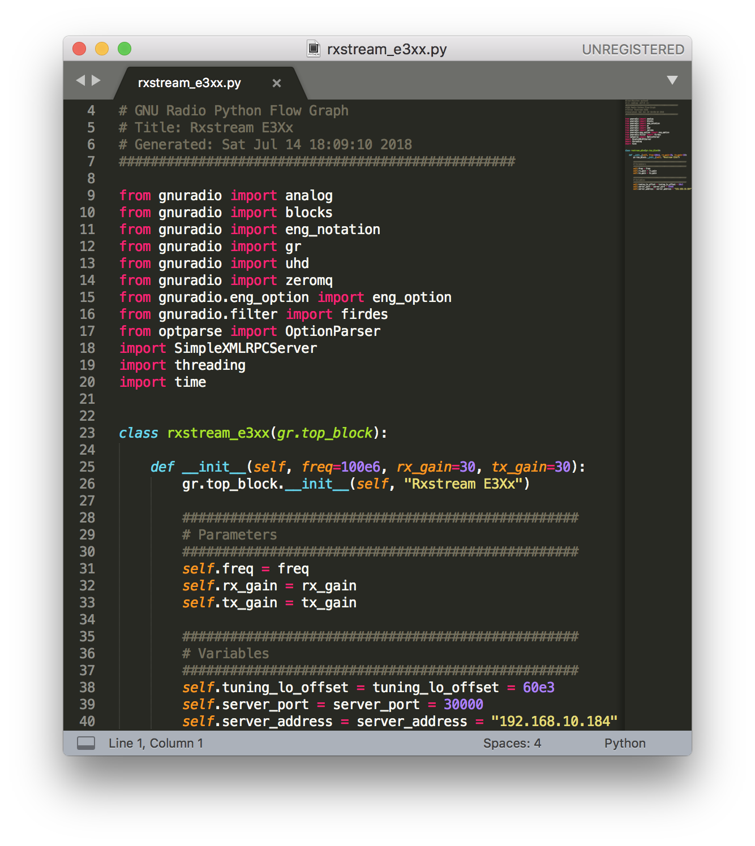
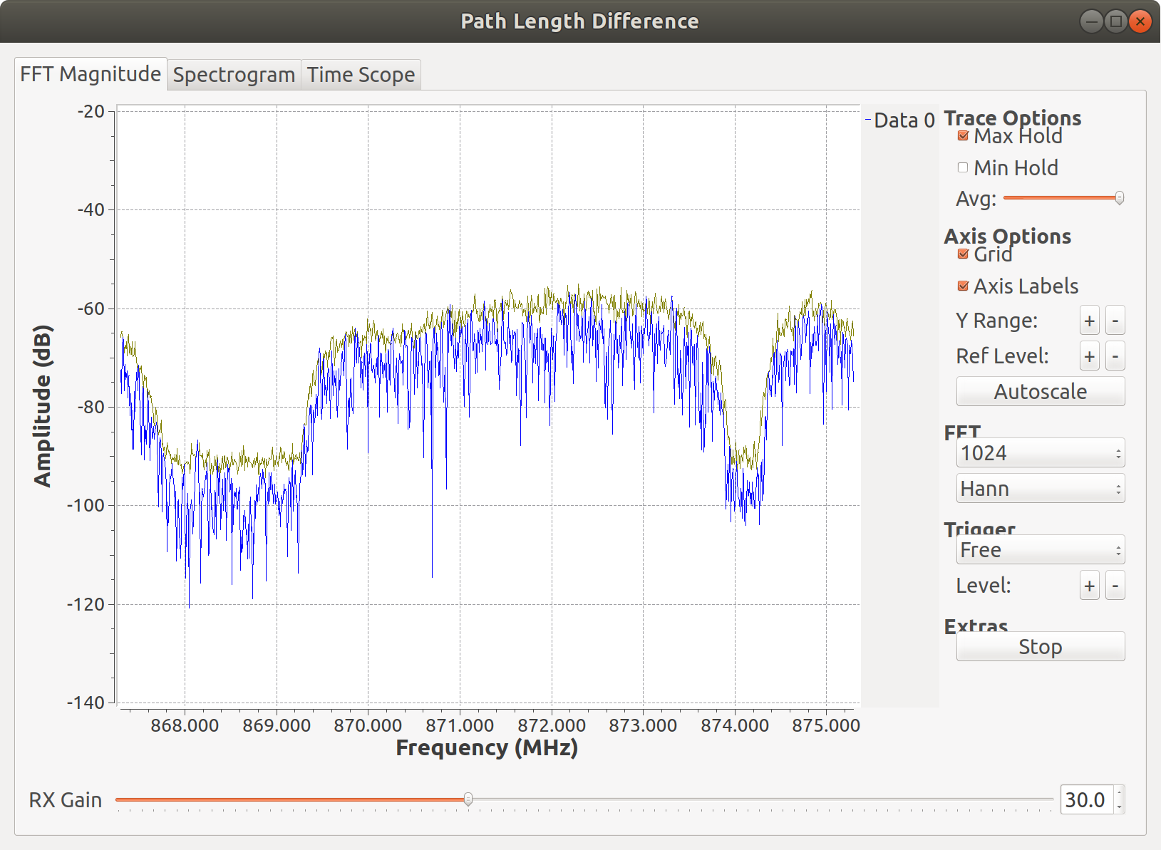
Software Defined Radio (SDR) Demonstration - Ettus USRP E312
Spiro Sarris. 07 / 2018
This presentation - https://github.com/spiro-sarris/pres/blob/master/sdrdemo.pdf
Download examples at https://github.com/spiro-sarris/sdr/

Slide 2
Outline
Equipment
System Overview
Example 1 – RX record, TX playback, post-process
Example 2 – Measure length of RG316 coaxial cable

Slide 3
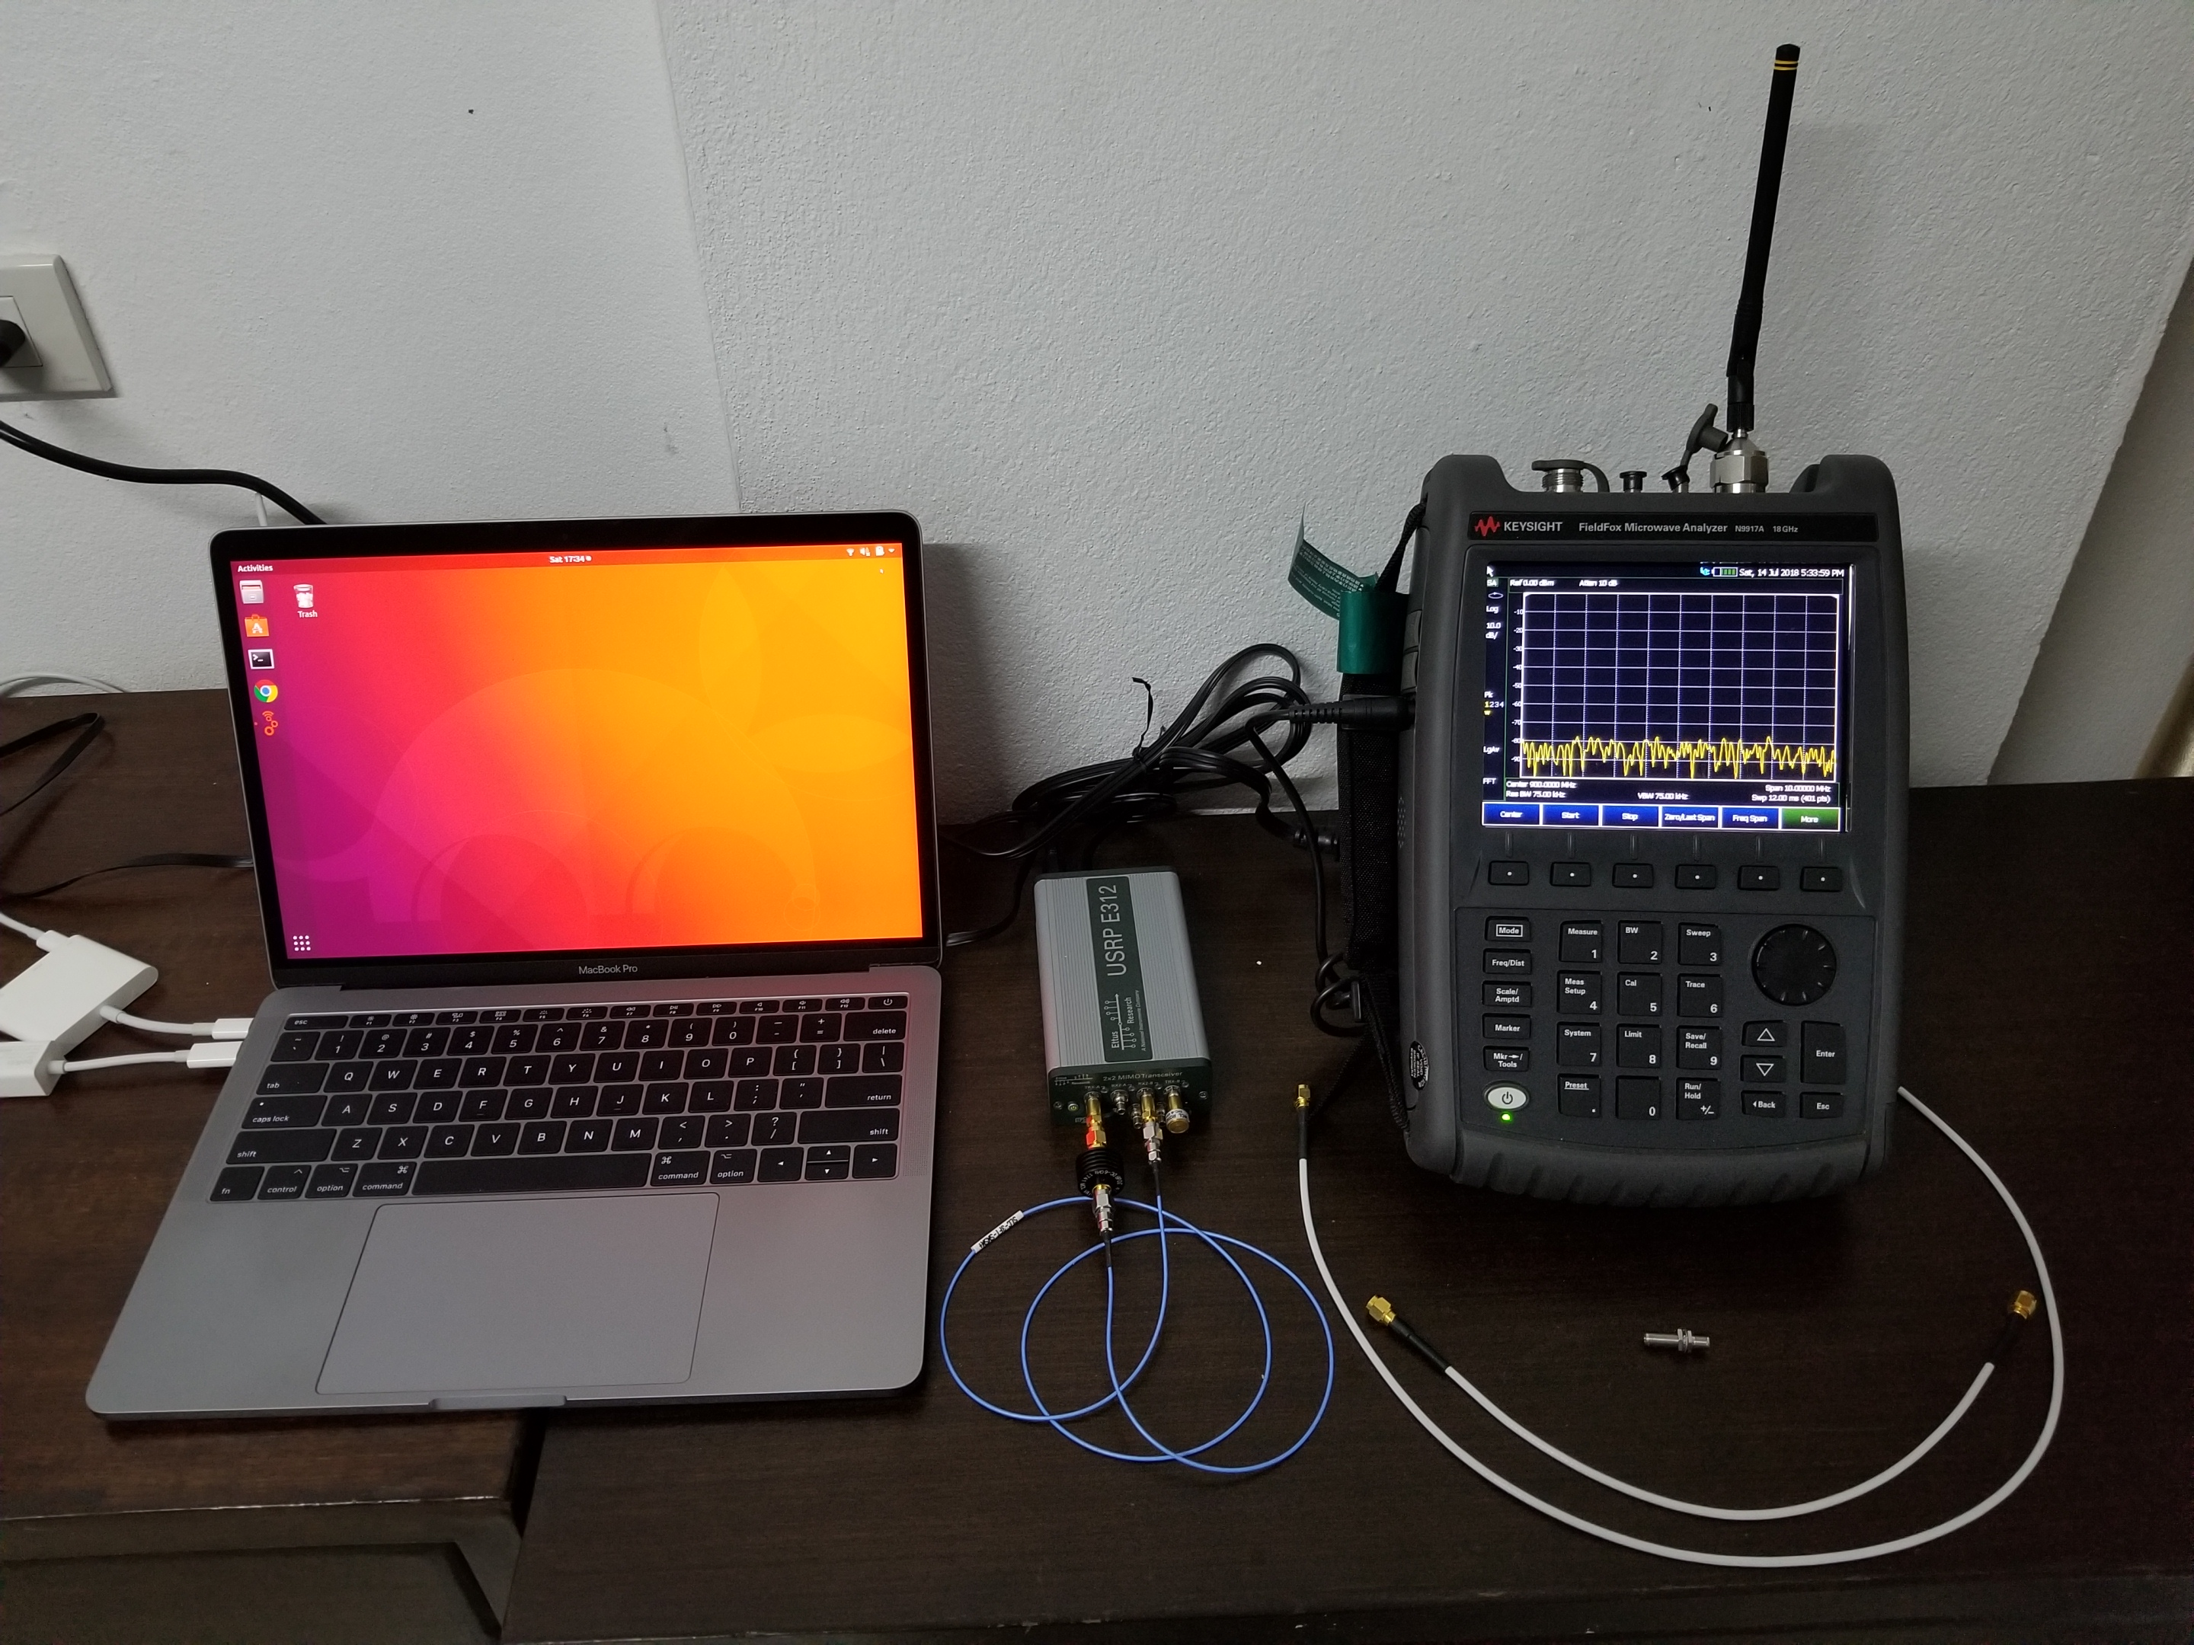
Equipment
SDR – Ettus USRP E312
Spectrum Analyzer
Antenna – 900 MHz dipole
Cables – coaxial with SMA
Computer – OS Ubuntu Linux
RF adapters

Slide 4
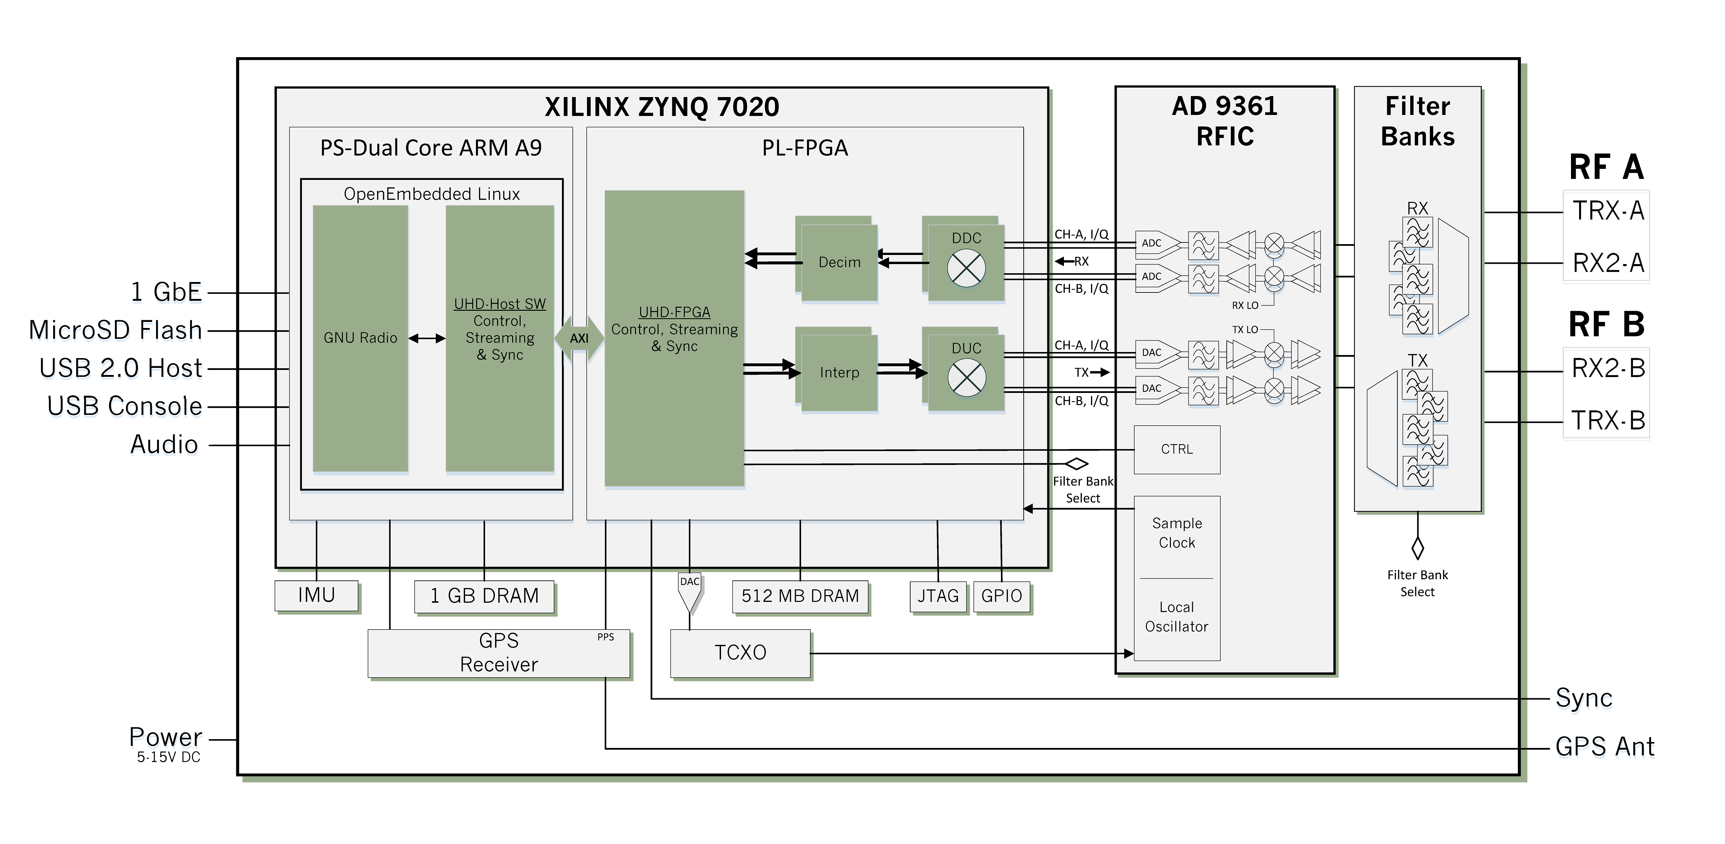
System Overview - E312
Digital data interfaces on the left side (back of box)
RF interfaces on the right side (front of box)

Slide 5
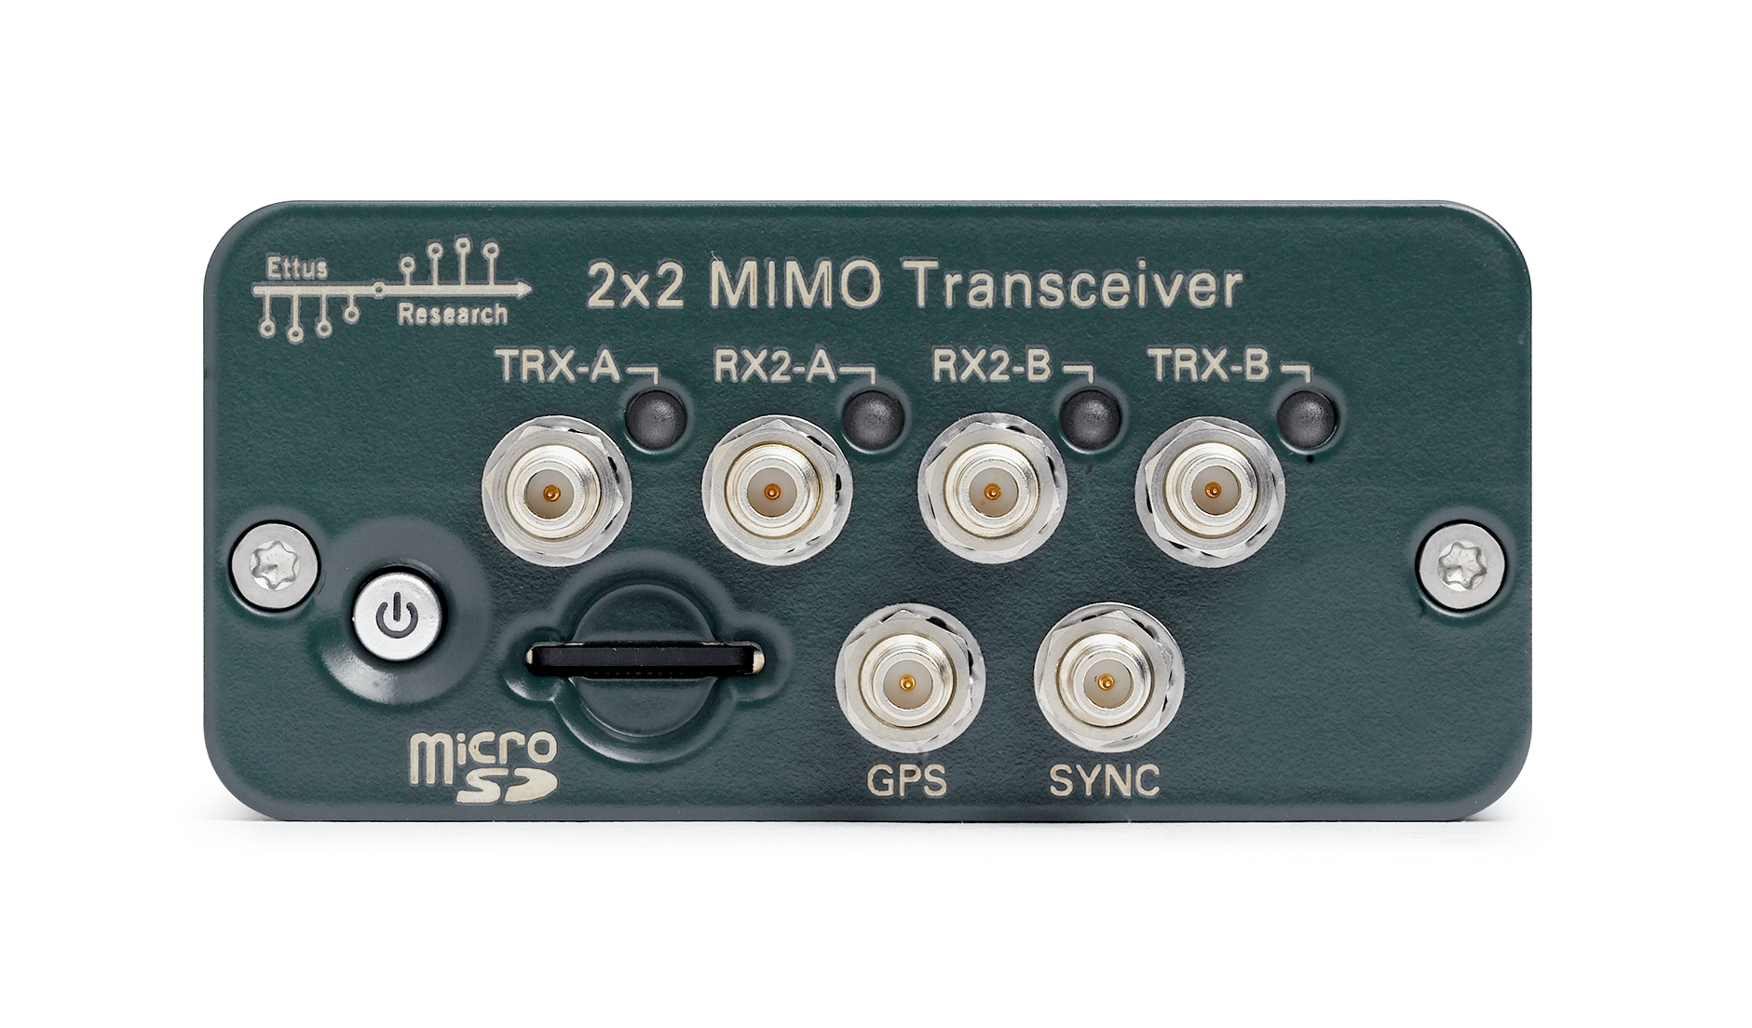
System Overview – RF
70 MHz – 6 GHz tuning range
Analog bandwidth 56 MHz
2 TX, maximum output power > +10 dBm (depends on frequency)
2 RX, noise figure < 8 dB. IIP3 = -20 dBm
Input and output filters automatic
Direct-conversion transceiver – Analog Devices AD9361

Slide 6
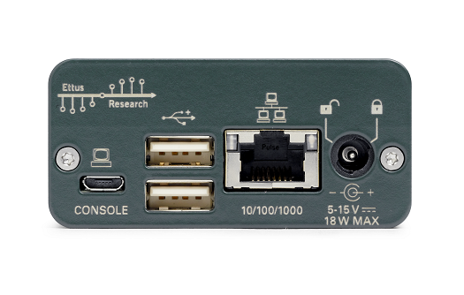
System Overview – Digital
Includes and Xilinx Zynq processor and Linux OS for stand-alone operation
USB-serial interface for configuration (FTDI standard)
Ethernet interface to connect to computer or network (SSH, TCP/UDP socket data)
10 Msamples/s data transfer on Zynq processor.

Slide 7
System Overview – Software
UHD is the device driver software required Ettus to control USRP hardware. Source code available at https://github.com/EttusResearch/uhd
GNURadio software provides many tools to create signal processing applications. Includes UHD classes to interface to Ettus USRP hardware. Source code available at https://github.com/gnuradio
GRC (GNU Radio Companion) is the graphical development environment to create GNU Radio apps quickly.
My example applications today are developed in GNURadio Companion and Python. Source code available at https://github.com/spiro-sarris

Slide 8
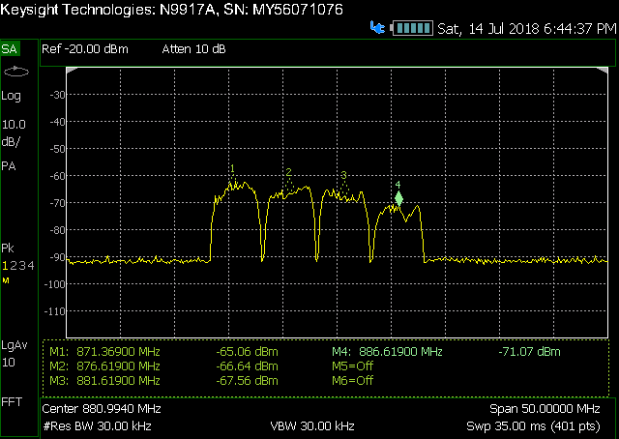
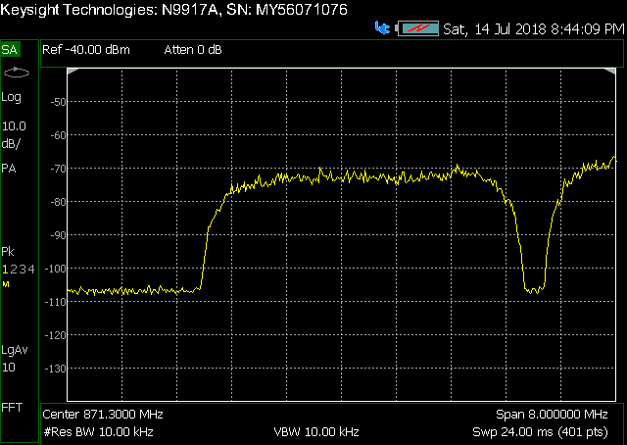
Example 1 – RX Record
Use spectrum analyzer with antenna to find something interesting near 900 MHz. Mobile wireless signal?

Slide 9
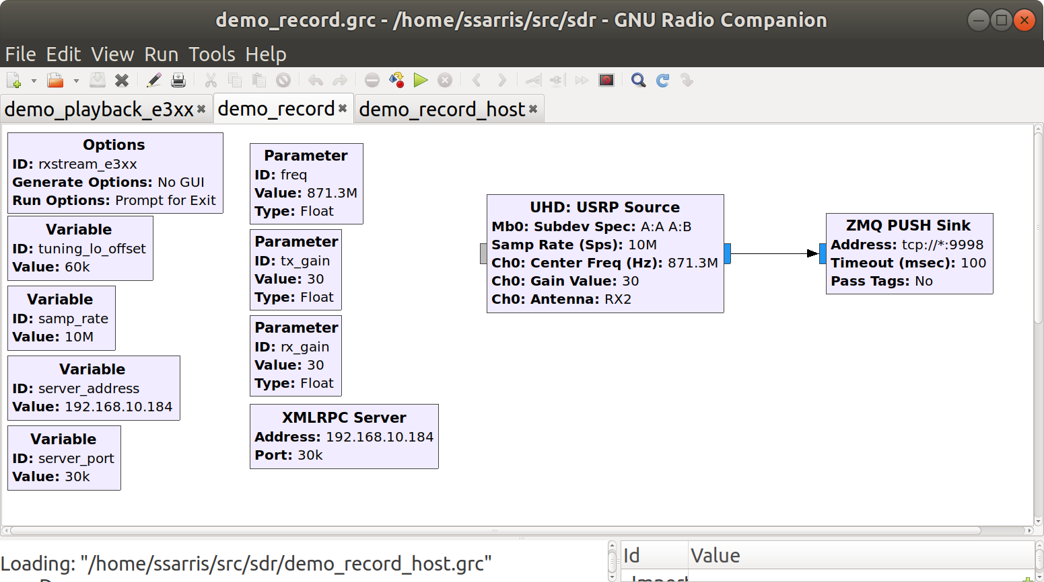
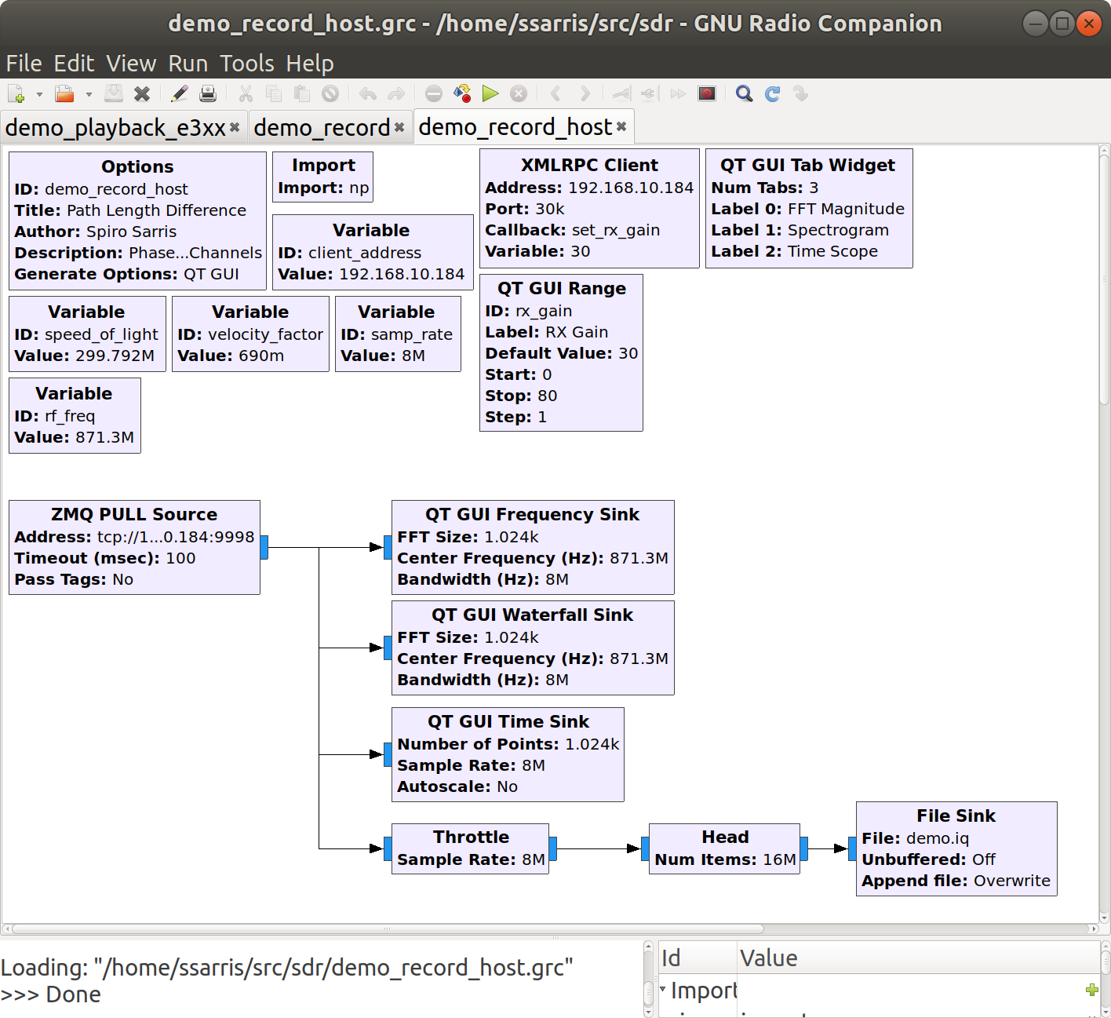
Example 1 – RX Record
Load software on SDR (stream data) and on host laptop (process and show GUI) TODO – add GUI of RXrecord

Slide 10
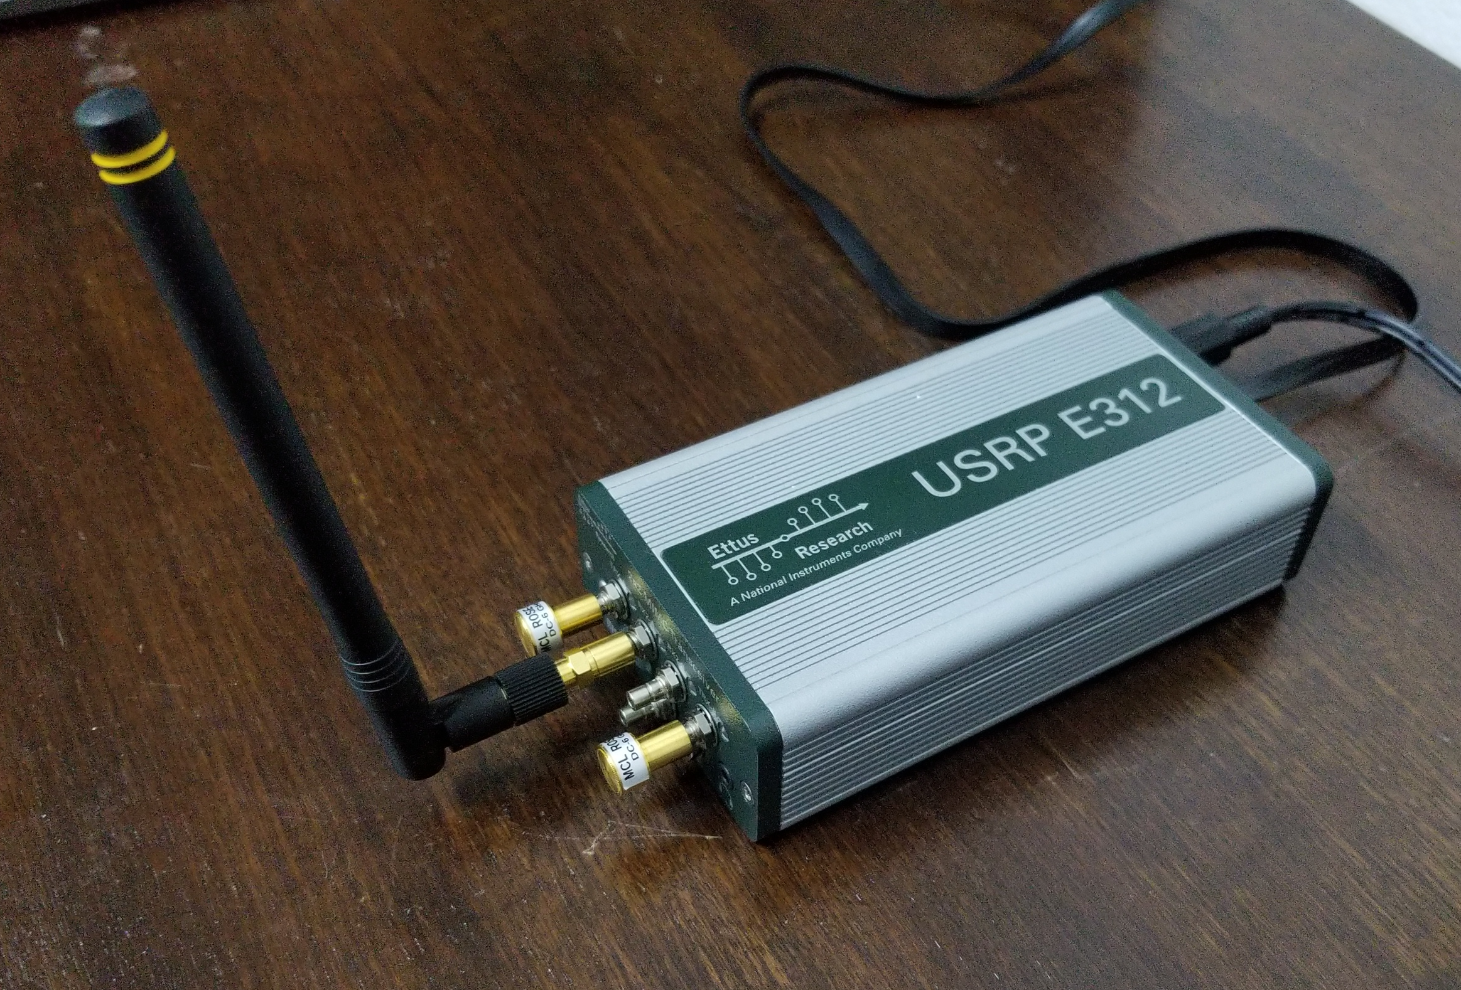
Example 1 – RX Record
Connect antenna to SDR. Observe GUI and record file

Slide 11
Example 1 – TX Playback
Transfer file from host computer to SDR local storage using scp over Ethernet.
  $ scp ./demo.iq root@192.168.10.198:/home/root/sdr/
SSH login to SDR. Locate playback python script.
  $ ssh root@192.168.10.198
  $ cd sdr/

Slide 12
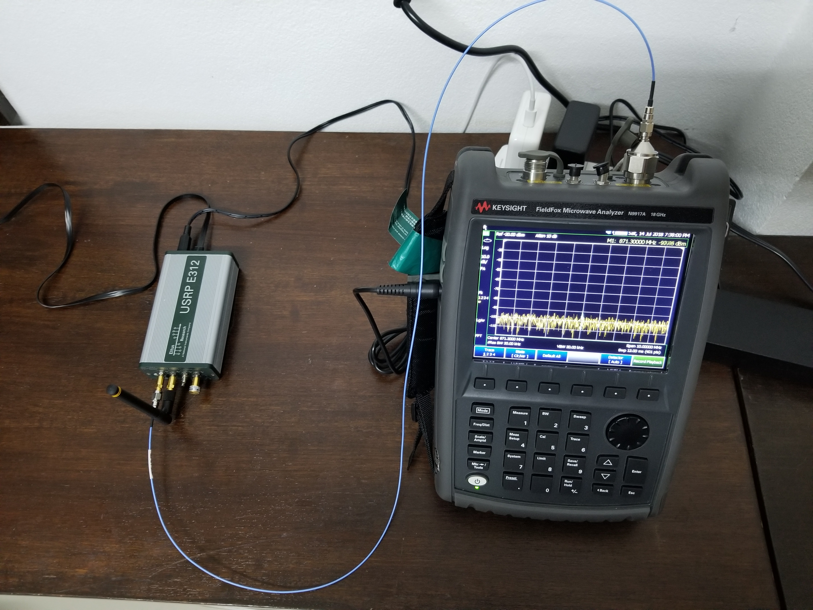
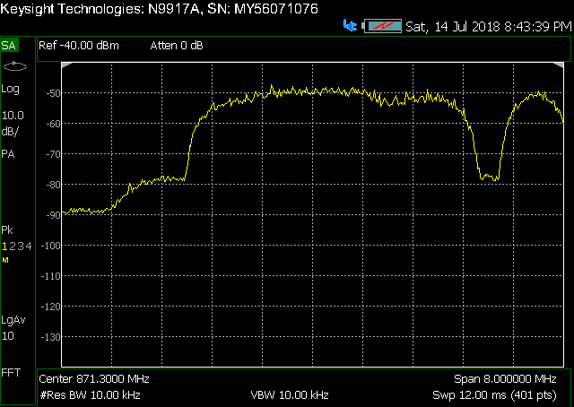
Example 1 – TX Playback
Connect TX-A to spectrum analyzer with 30 dB attenuator to guarantee safe power level at receiver.
  $ python ./demo_playback_e3xx.py

Slide 13
Example 1 – Post Process
File recorded from GNURadio “file sink” object is a binary file without header / meta data. If you want meta data, open a second file and write data of interest.
For each sample in time (example 8 MS/s), the complex-valued result is written sequentially as a pair of 32-bit (4-byte) float. “I” first, “Q” second. For each sample, the file size increases by 8 bytes. (write file 64 MB/s)
You can choose a programming language to read this file into native complex-valued data format. Python and Matlab are convenient.
Read file example Python code - https://github.com/spiro-sarris/utils/blob/master/iqstep.py
byte 0 | byte 4 | byte 8 | byte 12 | byte = 8*N | byte 8*N+4
I[0] | Q[0] | I[1] | Q[1] | I[N] | Q[N]

Slide 14
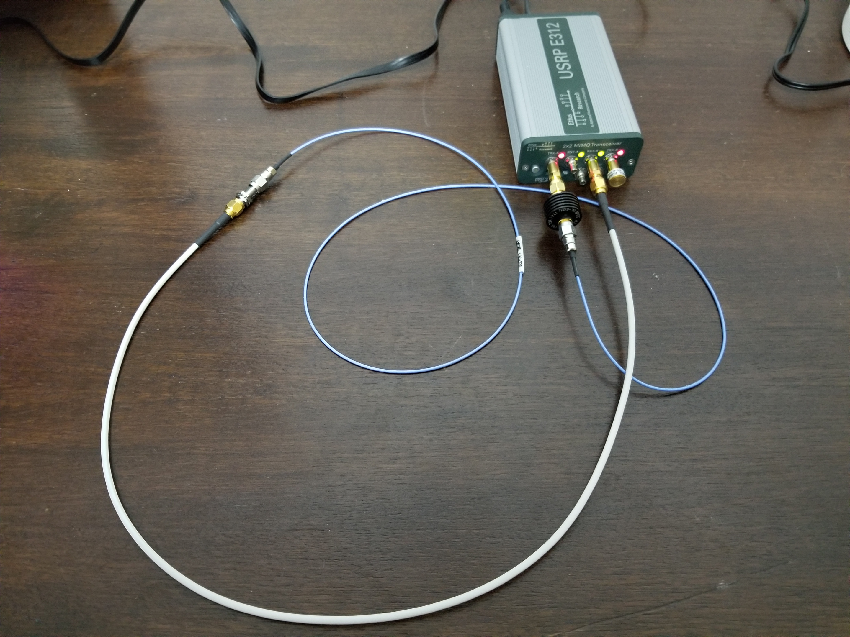
Example 2 – Cable Length

Slide 15
Example 2 – Cable Length
c = speed of light in free space = 299792458 [meters/second]
vf = velocity factor of cable. Speed reduced by dielectric material in cable [no unit]
λ = wavelength in cable [meters]
k = wave number [radians / meter]
L = cable length [meters]

Slide 16
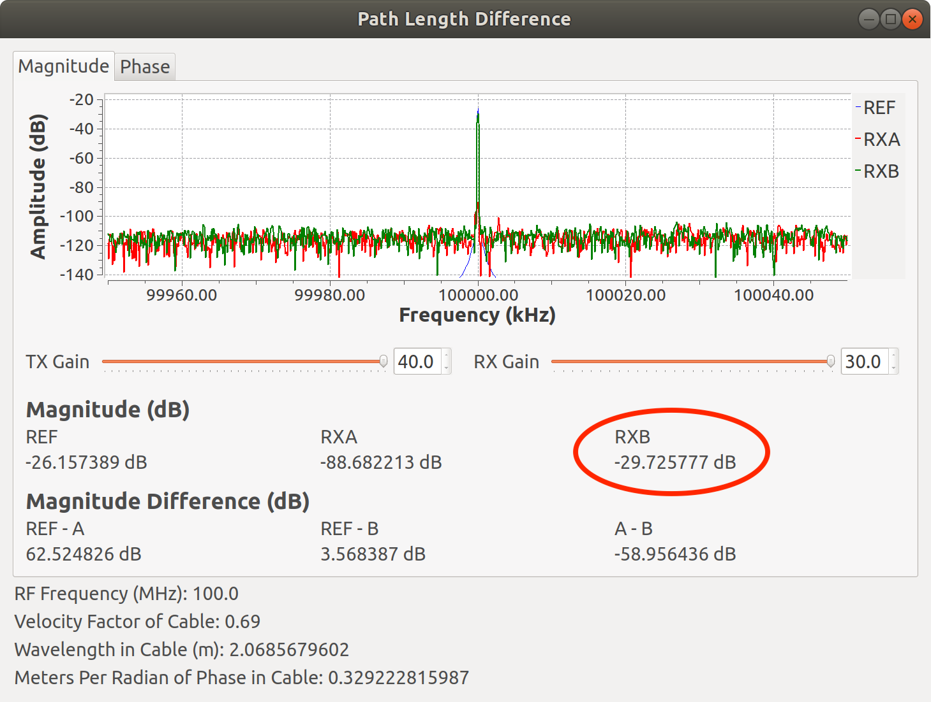
Example 2 – Cable Length
Relative amplitude of calibration cable = -29.73 dB

Slide 17
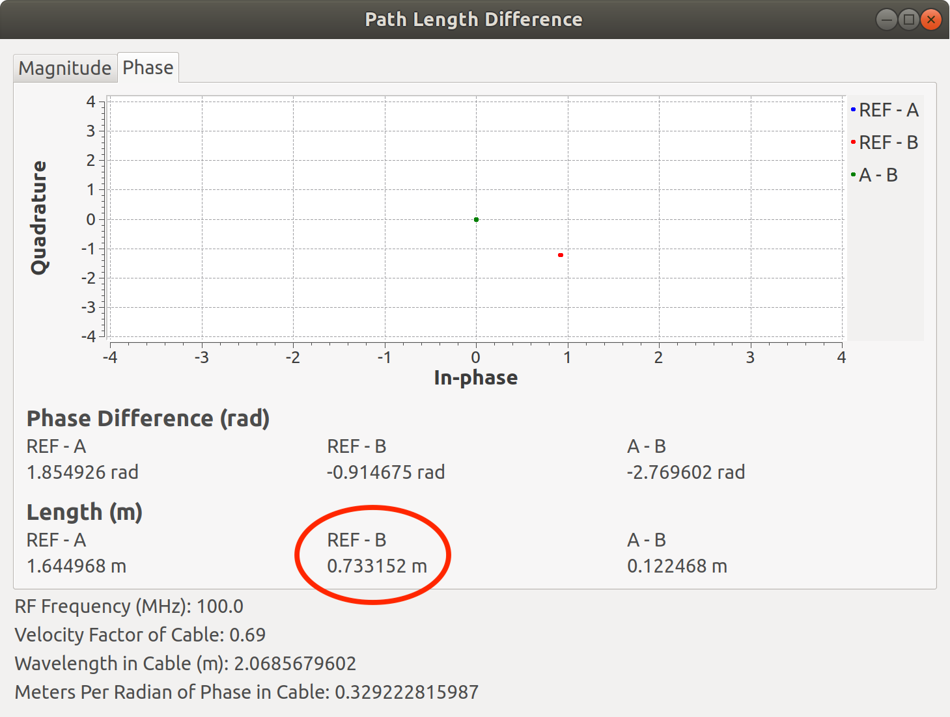
Example 2 – Cable Length
Relative phase and length of calibration cable. L = 73.3 cm

Slide 18
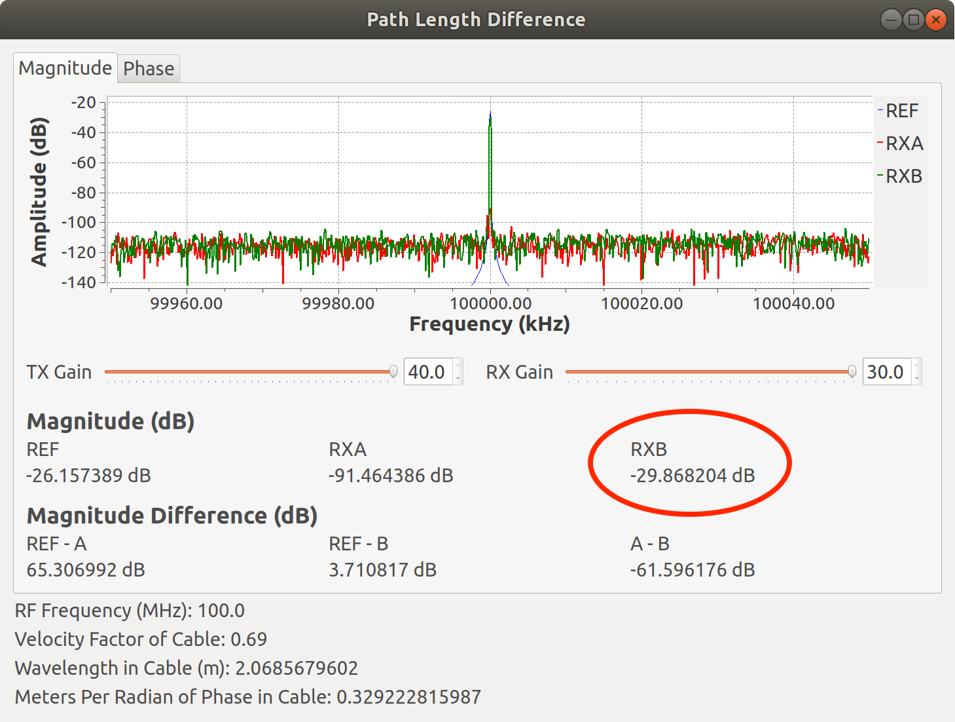
Example 2 – Cable Length
Add DUT cable. Observe reduced amplitude = -29.87 dB

Slide 19
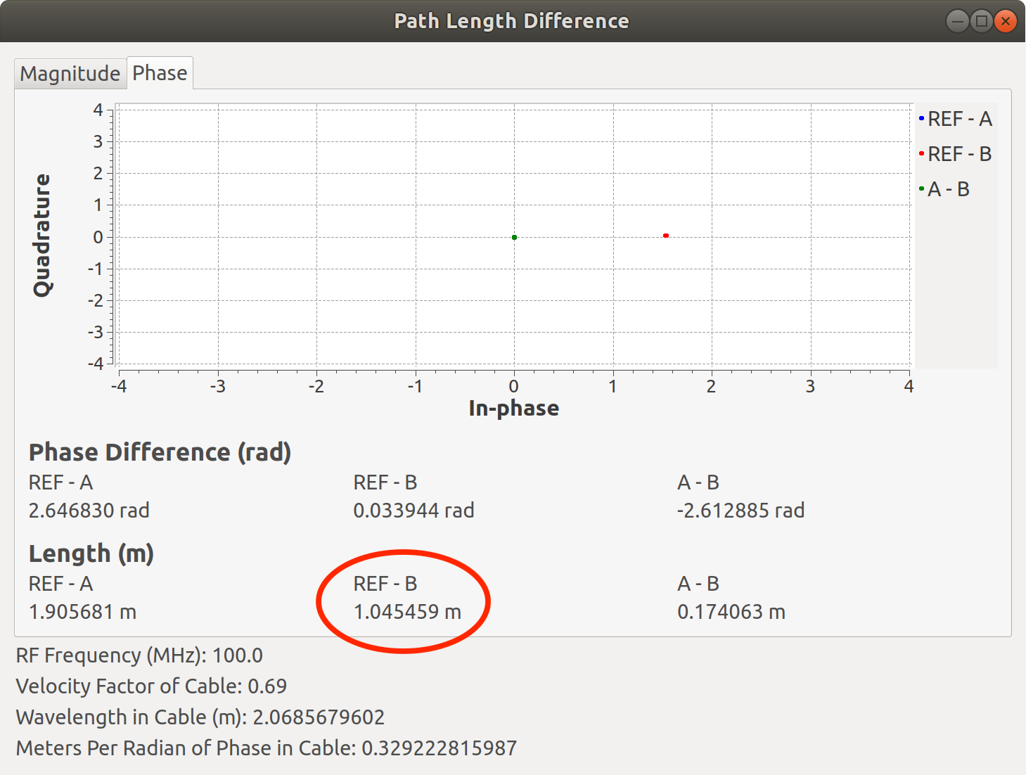
Example 2 – Cable Length
Observe additional phase and length of DUT cable. L = 104.5 cm

Slide 20
Example 2 – Cable Length
Amplitude reduced by DUT cable : (-29.87) - (-29.73) = -0.14 dB
Length increased by DUT cable: (104.5) – (73.3) = 31.2 cm
Real cable length is 30.48 cm + adapter (0.7 cm?)

