Slide 1

Blockchain Smart Contract Lab
Remix Ethereum Platform and UI
2-Hour Hands-On Workshop
Vangelis Malamas, Dimitris Koutras, Spiros Papagiannopoulos

Slide 2
Quick Overview
Blockchain is a distributed ledger technology that records transactions across multiple computers securely, immutably, and transparently.
Ethereum is a blockchain platform that allows developers to create and deploy decentralized applications (dApps) using smart contracts written in Solidity.
A Smart Contract is a self-executing digital agreement coded in Solidity. It enforces terms automatically without intermediaries.
Notes:
Explain that blockchain functions as a shared database maintained by a decentralized network of nodes. Highlight the concepts of immutability, consensus, and transparency.

Slide 3
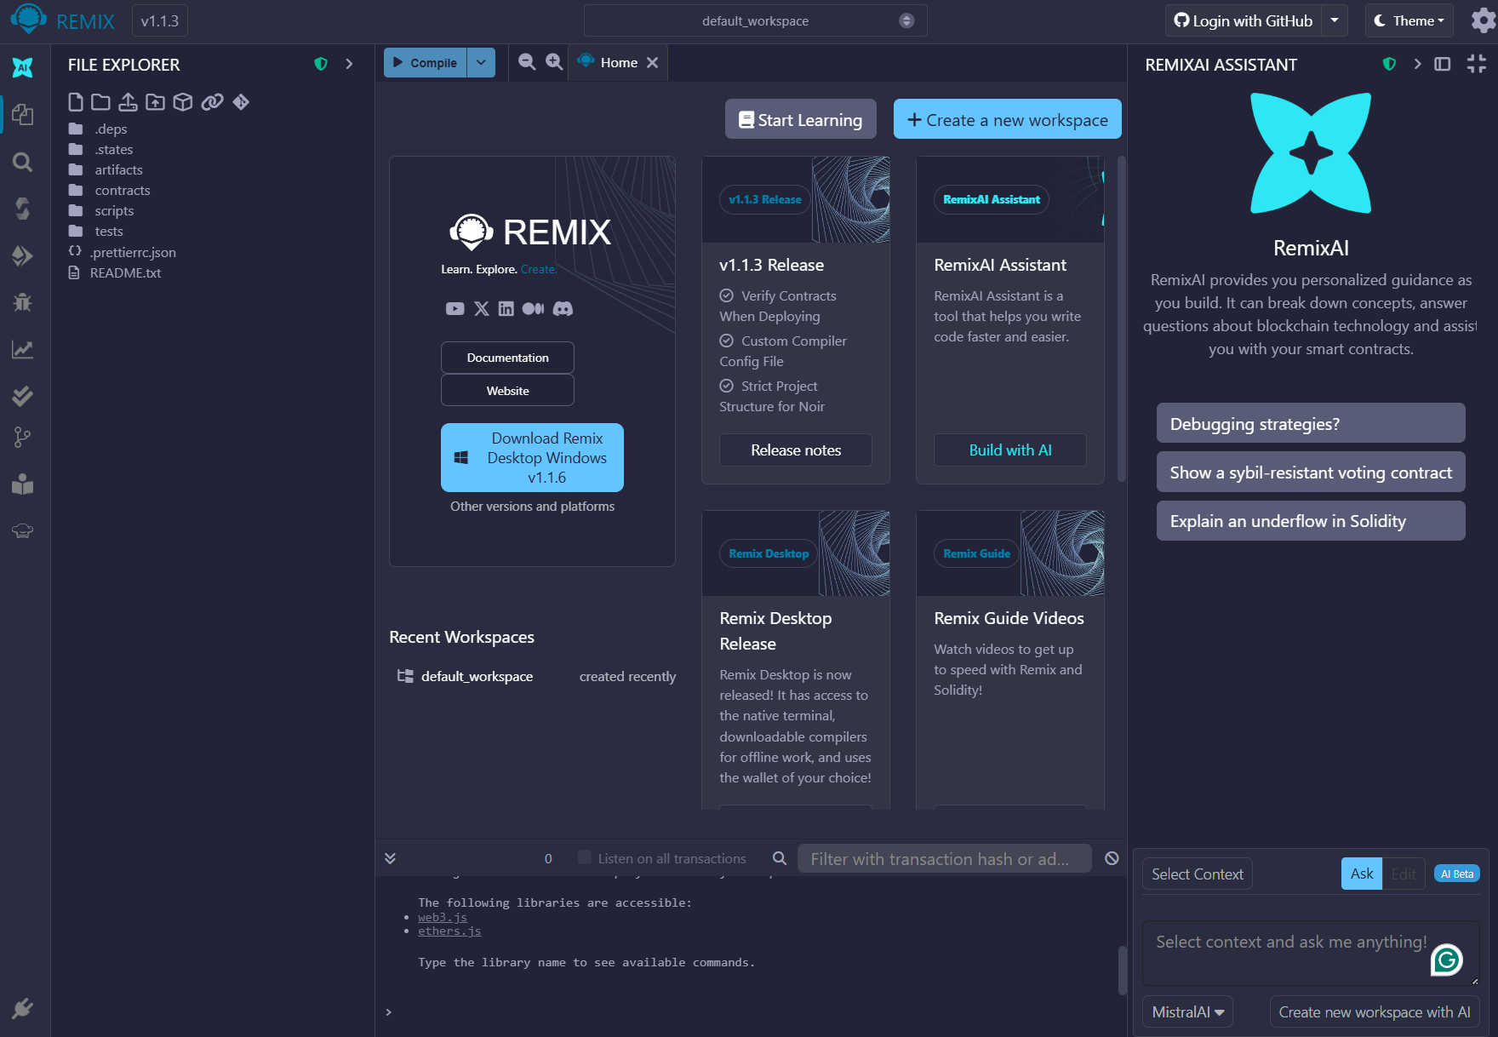
Remix IDE Introduction
Remix IDE is a browser-based development environment that supports writing, compiling, deploying, and debugging Solidity smart contracts.
Notes:
The Remix browser-based IDE is a great way to start your Ethereum development projects.
The main difference in developing a blockchain-based app is that its more difficult to fix errors after launching (it is plausible but costly, since you need to republish your app).
So it is important to make as many testing us you can before you launch your app.
Remix allows you to focus on developing and evolving your Smart Contract without having to worry about creating a middle layer or a User Interface. It provides a rudimentary UI for you to interact with your SC, allowing you to refactor and evolve it much faster

Slide 4
Remix IDE Interface Components
Begin by opening a browser and navigate to:
https://remix.ethereum.org
File Explorer
Code Editor
Compiler
Deploy & Run panel
Console.

Slide 5
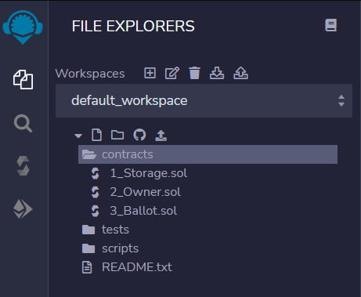
Remix IDE File Explorer
Create a new contract

Slide 6
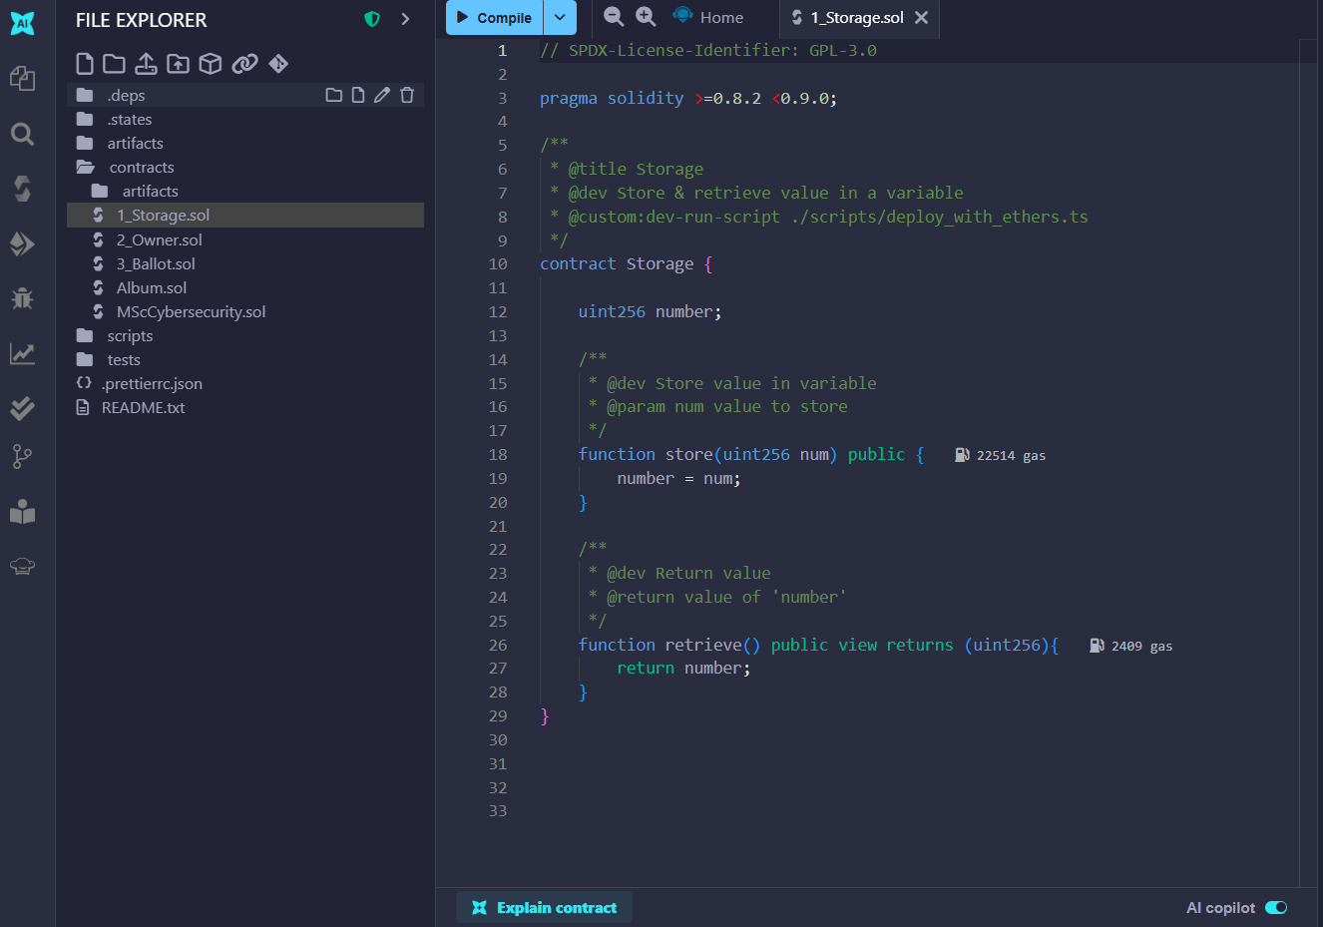
Remix IDE Code Editor
Write the SC

Slide 7
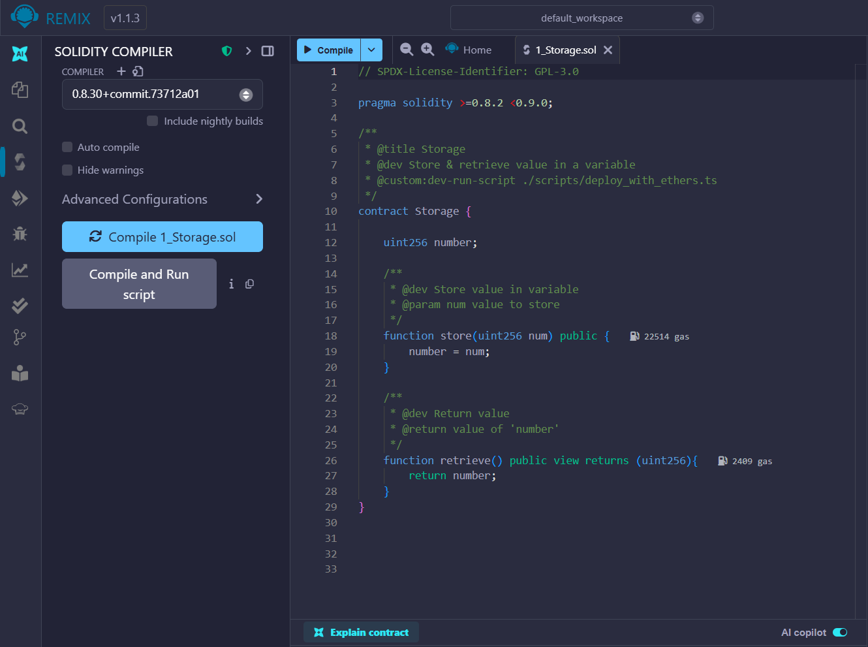
Remix IDE Compiler
Compile the SC

Slide 8
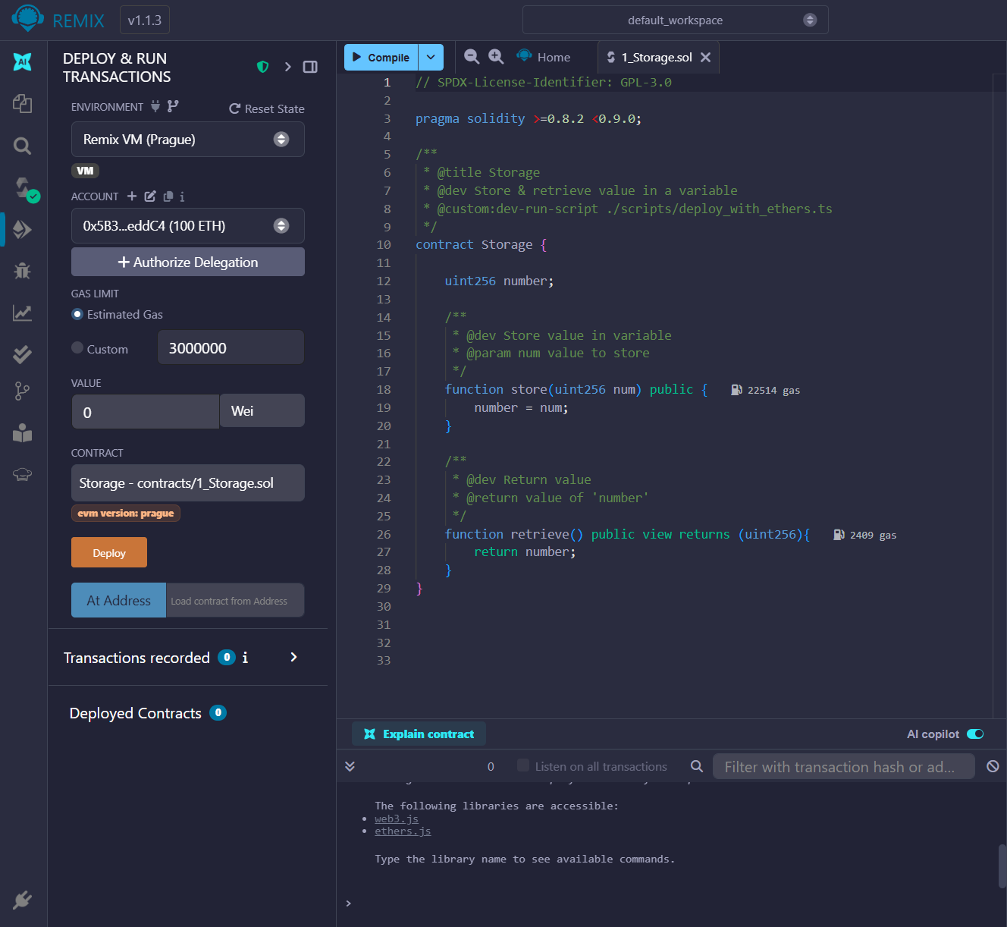
Remix IDE Deploy & Run
Deploy & Run the SC

Slide 9
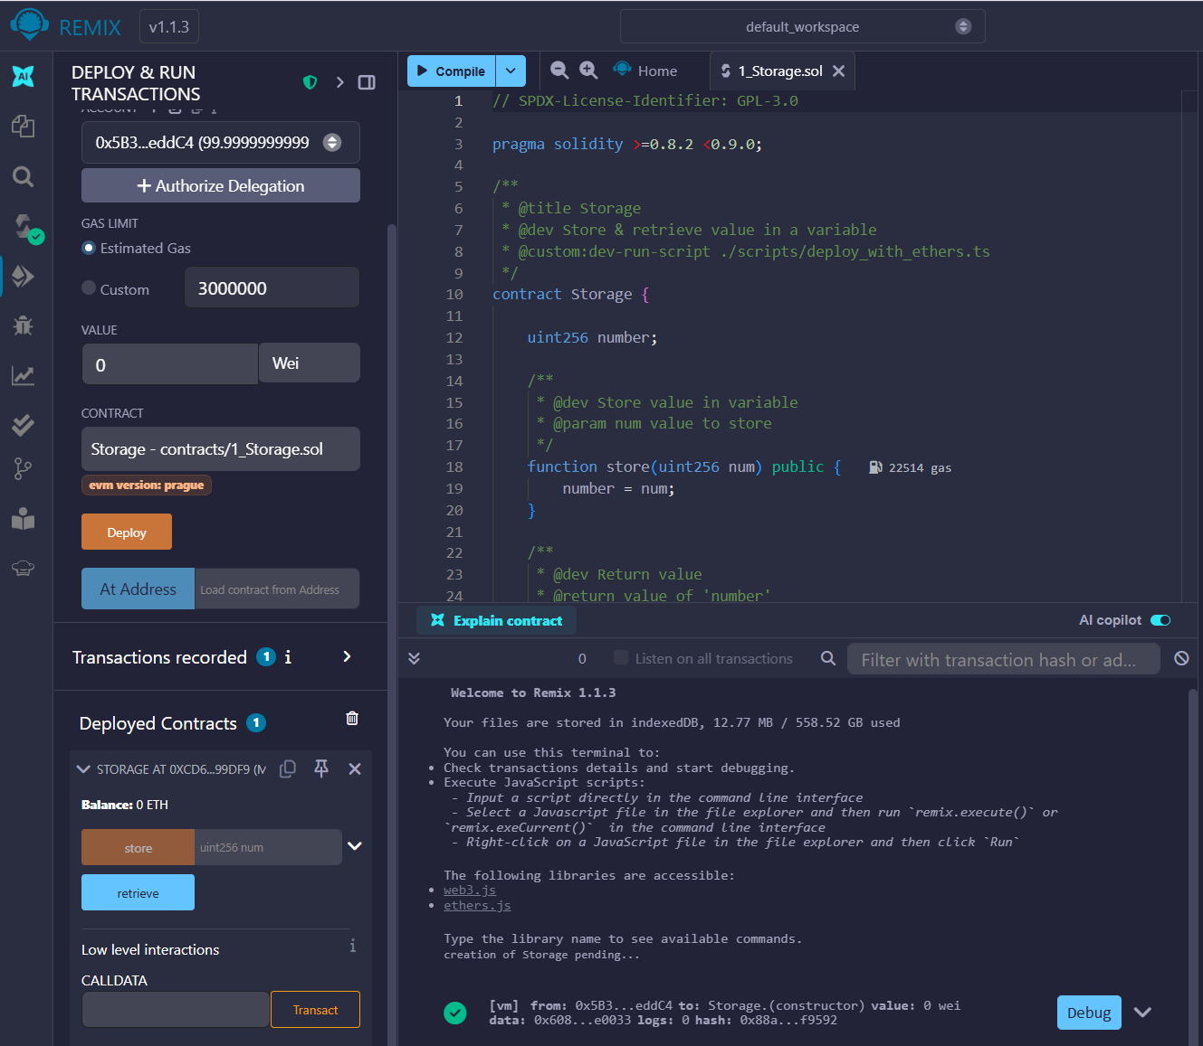
Remix IDE Console

Slide 10
Developing dApp
Use Case: Jukebox
General Description: Build an app which uses an Ethereum blockchain network to keep track of the albums our Jukebox device is playing. This Jukebox allows users to request not just a song but an entire album.
The decentralized, permanent ledger will serve as the official, trusted source of record for calculating royalty payments to the artists

Slide 11
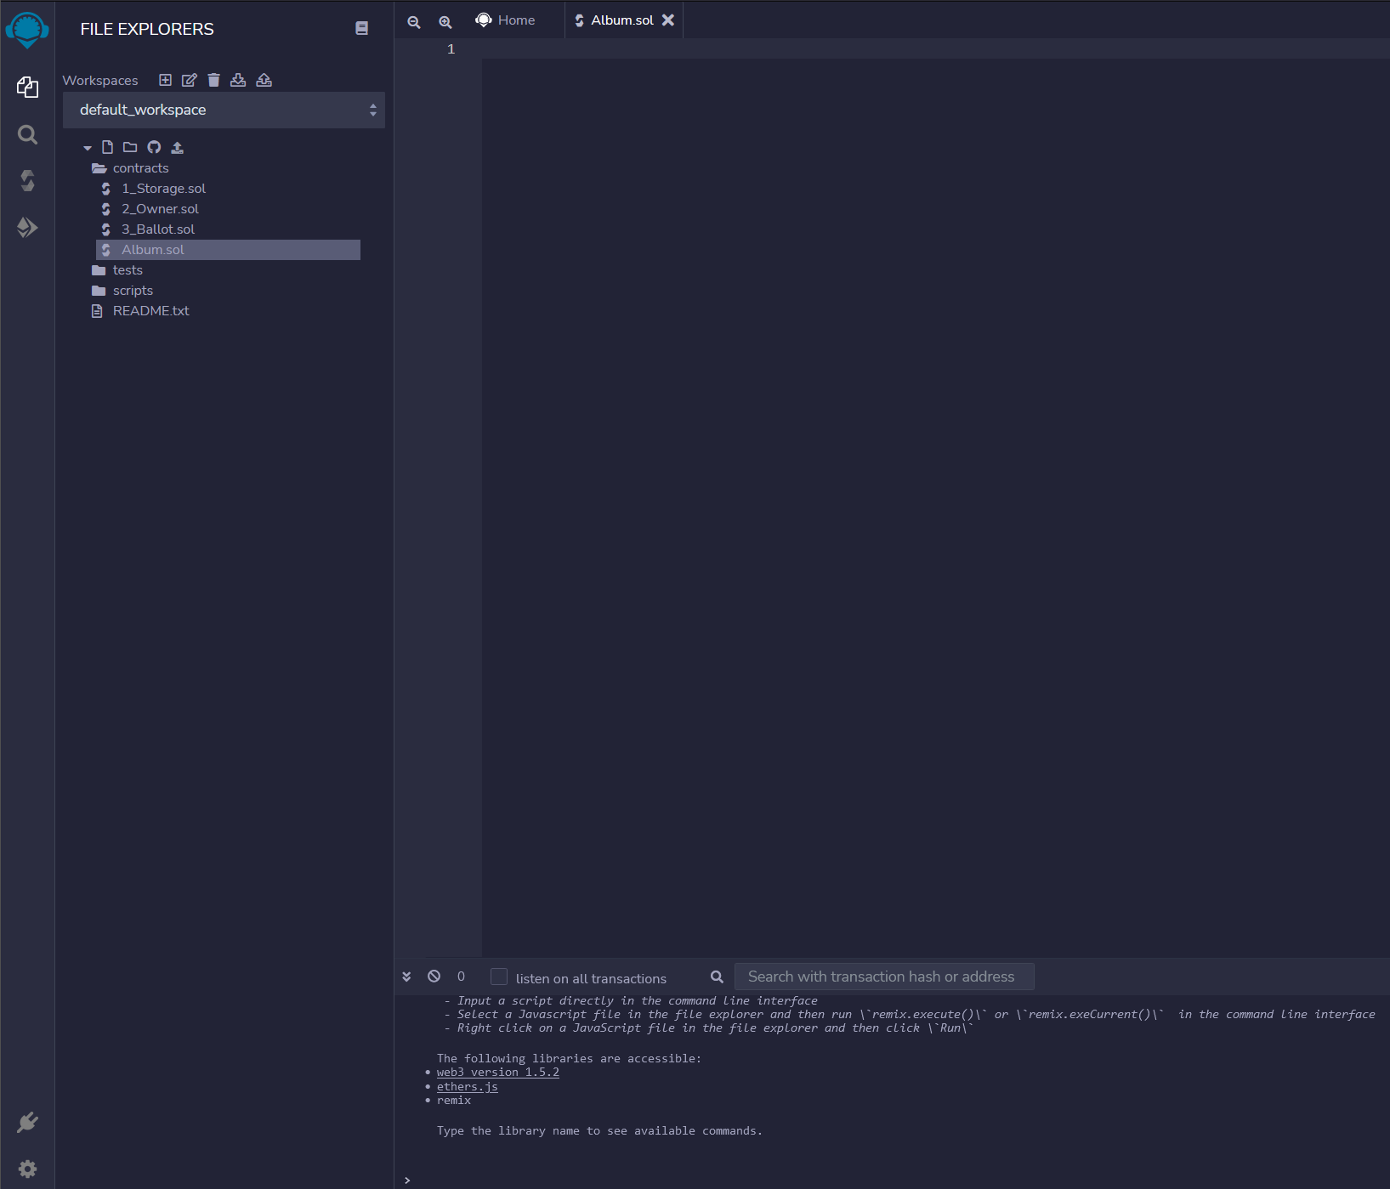
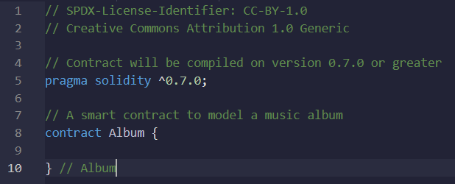
Writing the First Smart Contract
First, we create a new SC named “Album.sol” from the File Explorer tab
Notes:
Read the code line by line. Describe the pragma directive, variable declarations, and how public variables automatically create getter functions.

Slide 12
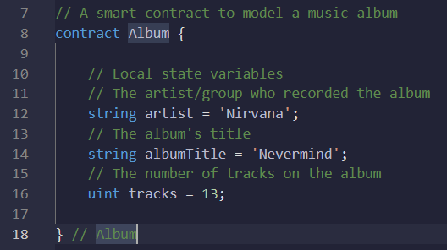
Writing the First Smart Contract
// SPDX-License-Identifier: MIT
pragma solidity ^0.7.0;
contract Album {
string public artist;
string public albumTitle;
uint public tracks;
}
First, we create a new SC named “Album.sol” from the File Explorer tab
Then we add variables. We assume there are three critical properties of an album that should be tracked:
The artist or group
The title of the album
The number of tracks on the album
Notes:
Read the code line by line. Describe the pragma directive, variable declarations, and how public variables automatically create getter functions.

Slide 13
Types of Variables in Solidity
We need to “characterize” each variable that we use depending on the use purpose:
bool: This is a Boolean type that returns True or False.
int/uint: Both int and uint represent integers or number values. The main difference is that integer can hold negative numbers as values.
address: The address type represents a 20byte value, which is meant to store an Ethereum address.
string: a dynamically signed string (alpha-numeric)
mapping: Hash tables with key types and values types.
struct: structs allows us to define new types (objects that contain multiple variables)
bytes: A dynamically-sixed array
Notes:
Explain what compilation does: it transforms Solidity code into bytecode and ABI for deployment.

Slide 14
Visibility Specifiers in Solidity
Solidity has four types of visibilities for both functions and variables:
public: This allows you to define functions or variables that can be called internally or through messages. [Visible to everyone]
private: private variables and functions are only available to the current contract and not the derived contracts. [Visible only inside the current contract]
internal: Functions and variables that can only be accessed internally (current contract and derived). [Visible only inside the current contract and the ones that inherit]
external: functions that can be called from other contracts and transactions. They cannot be called internally, except with “this.functionName()”
Notes:
Explain what compilation does: it transforms Solidity code into bytecode and ABI for deployment.

Slide 15
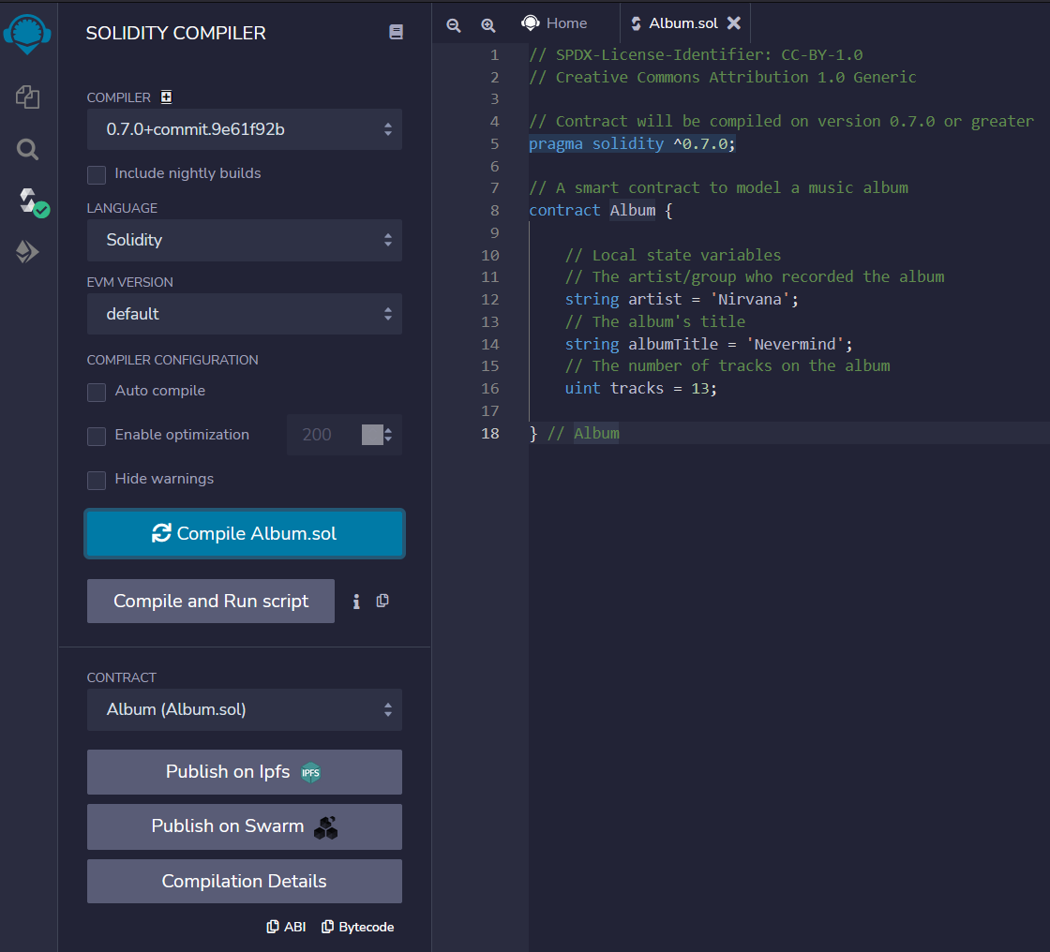
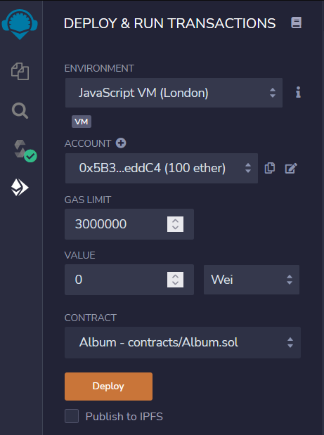
Compile & Deploy “Album.sol”
Notes:
Demonstrate the deployment process. Explain that each deployment creates a new instance of the contract on a local blockchain.

Slide 16
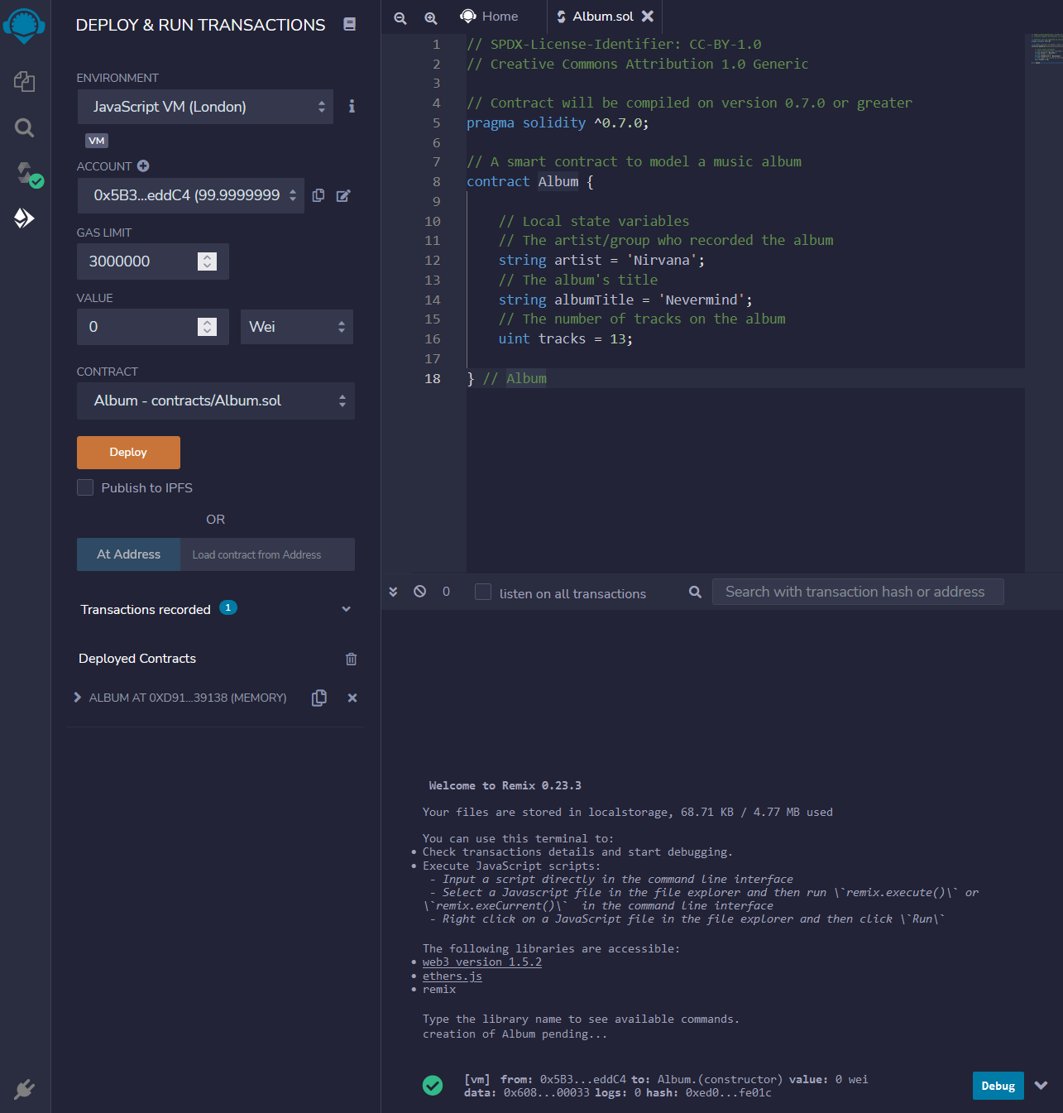
Compile & Deploy “Album.sol”
Notes:
Demonstrate the deployment process. Explain that each deployment creates a new instance of the contract on a local blockchain.

Slide 17
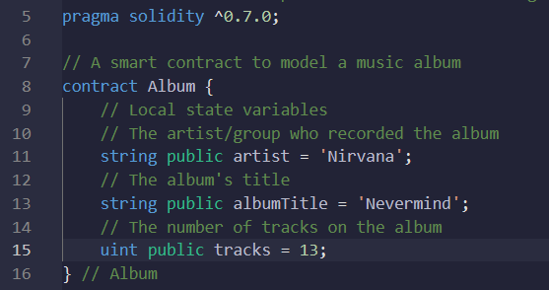
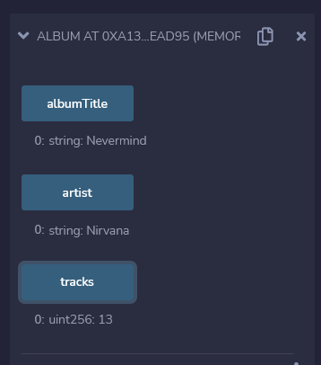
Change variable visibility
Append the “public” scope modifier to the artist, albumTitle and tracks variables
Notes:
We can view the properties of the album created in our contract by changing the scope of the internal state variables in our contract

Slide 18
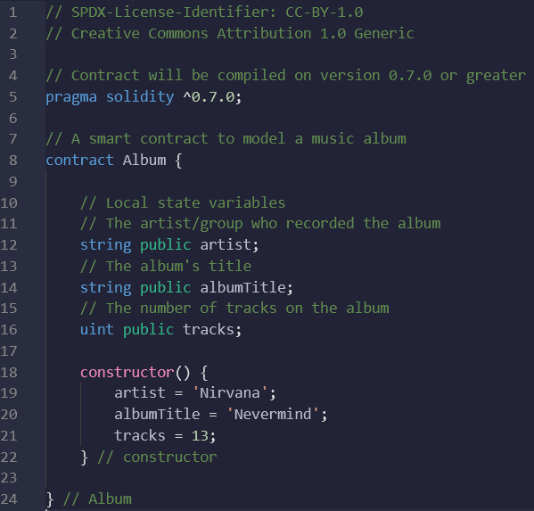
Adding a Constructor
Add a constructor to initialize the album data when the contract is deployed:
Constructors are intended to contain any logic that should be performed once initially to ready the application usage
Notes:
Many programming languages expose a constructor function, which is a special function that is called automatically when the program is deployed or invoked

Slide 19
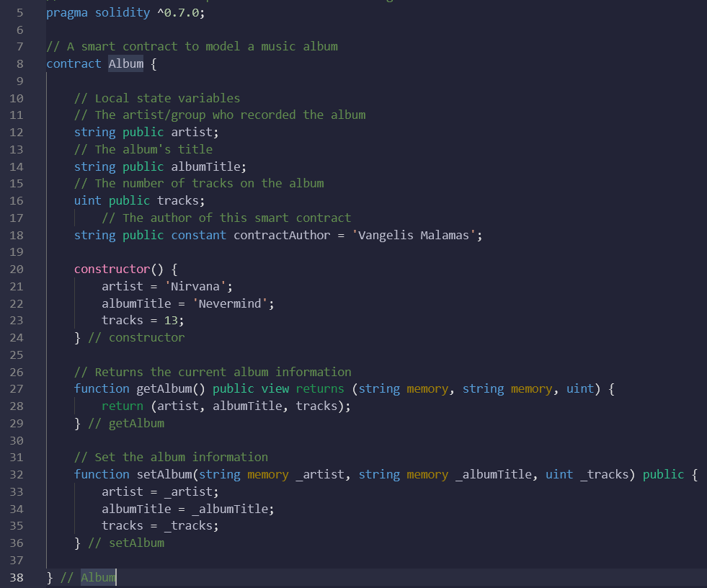
Adding Getter and Setter Functions
The get function (getAlbum) will return the current album information
The set function (setAlbum) will allow the user to change the current album information
Notes:
To make the contract more functional we add the following get and set functions

Slide 20
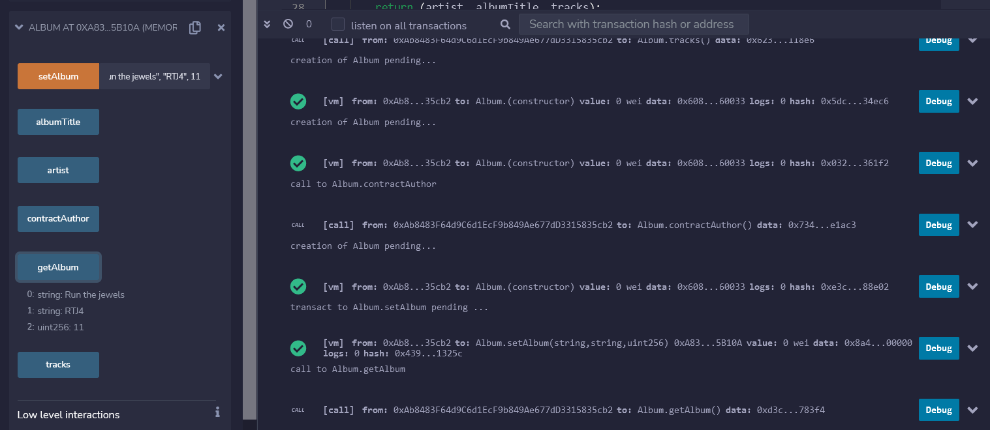
Recompile and Deploy
Recompile and redeploy the updated contract. Use the UI to call getAlbum() and setAlbum() to verify behavior.
Notes:
To make the contract more functional we add the following get and set functions

Slide 21
Adding and Raising an Event
Defining an Event
Begin by adding the following code to define your new event, albumEvent. Define the event after your local state variables but before your constructor.
// Event which will be raised anytime the current album information is updated.
event albumEvent(string albumEvent_Artist, string albumEvent_Title, uint albumEvent_Tracks);
Raising an Event
Add the following code to the setAlbum function. This will raise the event anytime the current album information is changed.
// Raise the albumEvent to let any event subscribers know the current album information has changed.
emit albumEvent(_artist, _albumTitle, _tracks);
Notes:
Ethereum contracts have the ability to define and raise events. Events are commonly used to integrate different applications or systems together.
We will be adding an event definition to your smart contract, and raising that event whenever the current album information is updated using the setAlbum method.

Slide 22
Adding Access Control
We will be adding function modifier to our SC which will only allow the contract's owner to update the currrent album information.
To start, we'll need a variable to store the account number of the contract's owner. Declare a new variable, owner, using the address data type using the code below.
// The owner of the current instance of this smart contract
address owner;
// Set the owner property of this contract instance to the constructor of this contract deployment
owner = msg.sender;
Notes:
In Solidity, Function Modifiers are used a special sub-functions that get executed prior to the main function they're attached to.
The purpose of a function modifier is to perform required checks, and only allow execution of the main function if all desired checks are passed.
Function Modifiers are commonly used to facilitate role-based access to certain features or abilities of a smart contract.
Remember, it IS possible to build permissioned solutions on permissionless platforms like Ethereum - function modifiers are a common way of doing so.

Slide 23
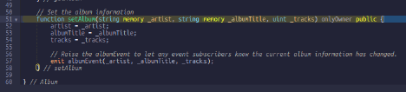
Modifier
// This function modifier ensures that the initiator of any transaction
// it is attached to matches the address of the contract's owner.
// Use this function modifier for functions that should only
// be performed by the owner of this contract instance.
modifier onlyOwner {
if (msg.sender != owner) {
// The initiator of this transaction is NOT the contract instance's owner!
} else {
_;
} // else
} // modifier onlyOwner
Notes:
Next, we'll create the function modifier, onlyOwner, to validate that the initiator (msg.sender) of any transaction our modifier is attached to matches the owner's address.
Add the following code under your constructor.
In the code, the underscore character "_" tells the Ethereum Virtual Machine that all checks in the modifier have been passed and the function this modifier is attached to should be executed.
If the msg.sender value does not match the owner address the underscore "_" line of code will never be reached, and the function this modifier is attached to will NOT be executed.
We can test the SC

Slide 24


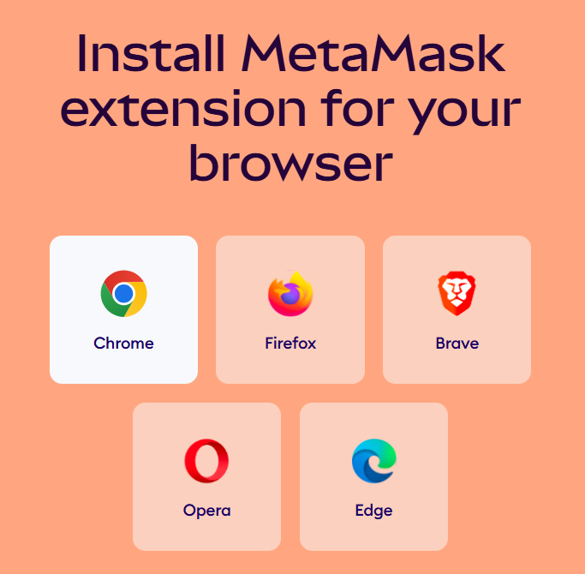
Connecting the digital wallet MetaMask
Begin by opening a browser and navigate to:
https://metamask.io/download
Notes:
Begin by opening a web browser and navigating to the MetaMask official website.
From there, select the correct browser (Chrome, Firefox, Brave, Opera, or Edge) and download the extension.
This will allow you to use MetaMask directly in your browser to manage Ethereum accounts.

Slide 25
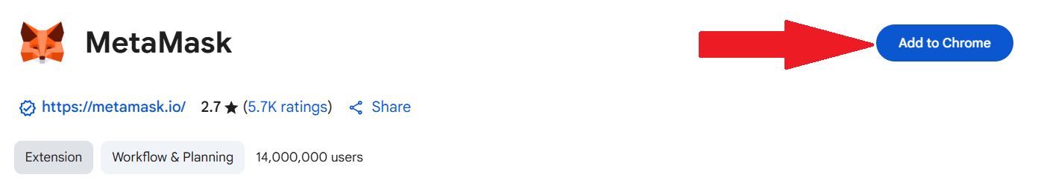
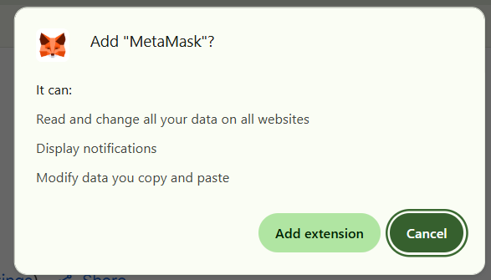
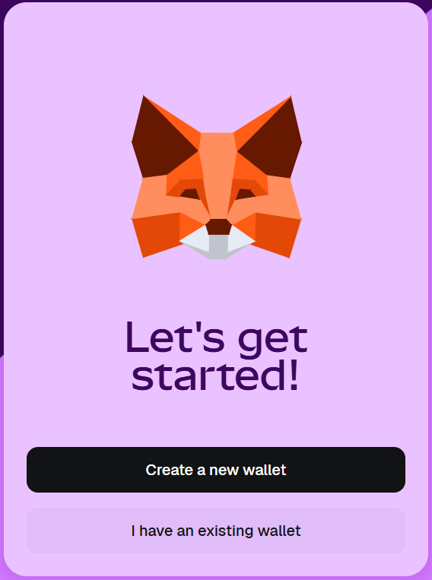
Installing and Setting up MetaMask
1.
Click “Add to Chrome” to install the MetaMask browser extension.
2. Confirm the installation by selecting “Add extension.”
3. Select “Create a new wallet.
Notes:
Click on “Add to Chrome” to install the MetaMask browser extension.
Confirm the installation by selecting “Add extension.”
Once installed, launch MetaMask and select “Create a new wallet” to begin setup.
Follow the on-screen instructions to create your password and backup your Secret Recovery Phrase.

Slide 26
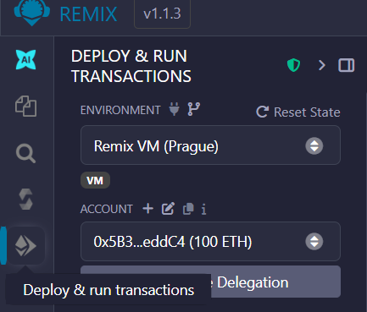
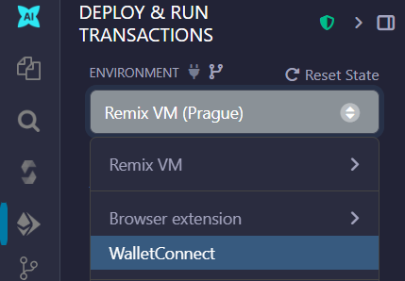
Connecting MetaMask to Remix IDE
1. Open Remix and navigate to the Deploy & Run Transactions panel.
2. Choose Injected Provider MetaMask or WalletConnect from the list.
Notes:
Open Remix and go to the “Deploy & Run Transactions” panel.
From the “Environment” dropdown, select either “Injected Provider – MetaMask” or “WalletConnect.”
This links Remix to your MetaMask wallet, allowing you to deploy and interact with smart contracts directly through your wallet.

Slide 27
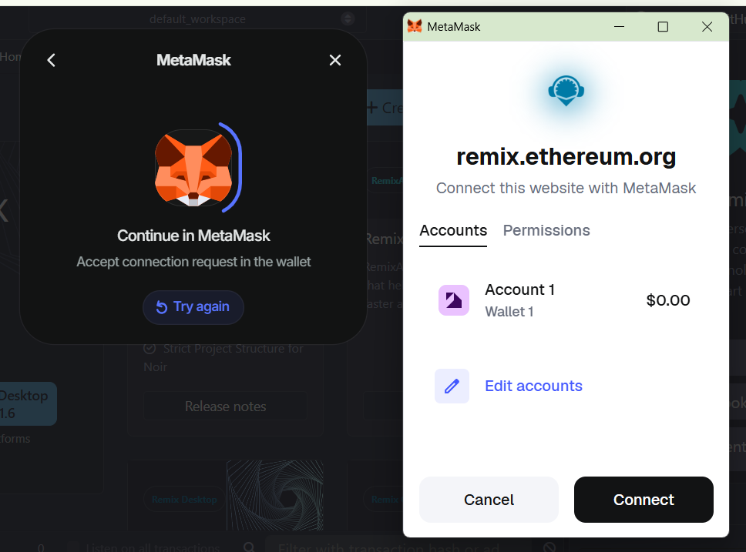
Signing Transactions with MetaMask
Confirm the wallet connection request that appears from remix.ethereum.org. Click Connect to authorize Remix to use your MetaMask account.
Notes:
When Remix tries to connect, a MetaMask pop-up from remix.ethereum.org will appear.
Click “Connect” to authorize Remix to access your wallet.
Always double-check the connected account and confirm that you’re on the correct network before approving any transaction.

Slide 28
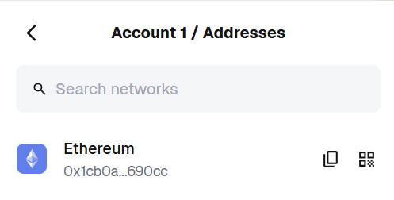
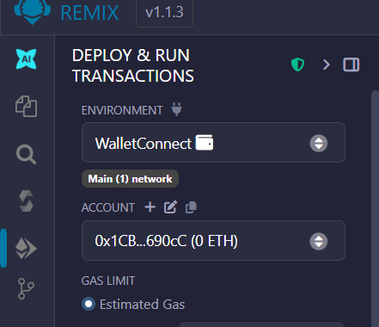
Confirming MetaMask Connection
Check your MetaMask
account address.
2. Verify the same address in Remix.
Notes:
Check your MetaMask account address under “Account 1 / Addresses.”
Then verify that the same address appears in Remix under “Account.”
If both addresses match, MetaMask is successfully connected to Remix.
You’re now ready to deploy and interact with smart contracts on the test network.

Slide 29


Installing Node.js and Web3.js on Windows
1. Right-click on the Start Menu → Windows PowerShell → Run as Administrator.
2. Install Node.js and npm (Node Package Manager)
3. Check Node.js and npm installation
4. Install Web3.js library:
Notes:
Start by opening PowerShell with administrator privileges to avoid permission errors.
Use the npm install -g node command to install Node.js globally.
Then verify that both Node.js and npm are correctly installed using node -v and npm -v.
Finally, install the Web3.js library with npm install web3, which allows JavaScript-based blockchain interaction.
Once installed, you’re ready to write and deploy smart contracts from your local machine.

Slide 30

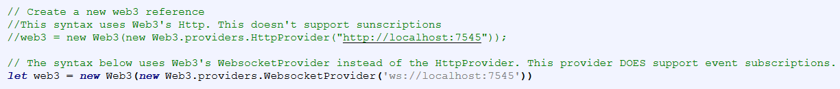
Connecting the SC with the UI
For the frontend we need an html and a css file
index.html

Slide 31
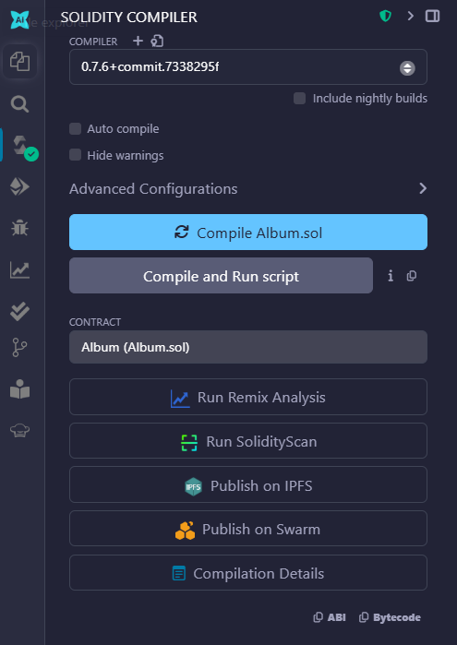
Inserting the ABI
Copy ABI from the compiler tab in Remix and paste it in the index.html file
Keep in mind that every time you recompile the SC you need to adjust the settings in the html file

Slide 32
Resources
Resources:
Solidity Documentation
Remix IDE Tutorials
Ethereum Developer Portal

