Slide 1
Git 101
Crash Course
Atlanta Session
Stefano Pirrello
spirrell@cisco.com
Systems Engineer GA-SC SLED

Slide 2
Agenda
Git?
Setup a Github Repo
Routine Tasks
File Restoration
Git Branches
Notes:
Create test branch
Make changes
Merge into Master

Slide 3
Why use Git?
Google says, “The purpose of Git is to manage a project, or a set of files, as they change over time. Git stores this information in a data structure called a repository. “
Versioning code as you make changes and rollback if the need arises
Network configuration templates
File restoration
Collaboration on projects
*******It is wise to commit often as you make changes

Slide 4
Setup a Repo
Browse to https://github.com and create an account
Start a project and give it a name
Public vs Private
Public everyone on the internet will have access for viewing and cloning
Private, you can setup access for who you wish to grant access to your project
Add python for .gitignore

Slide 5
Setup a Repo (cont.)
On your laptop
git remote add origin https://github.com/[username]/[repo].git
git remote –v to check we have the origin of the repo
git pull origin master
git push --set-upstream origin master
Start coding!

Slide 6
Routine Git Tasks
Once you make changes:
git add .
Adds all files you wish to track
git commit –m “Comments to describe your changes”
Point of reference of when changes were made. Think of commits as checkpoints.
git push
Push your changes to your upstream repo. In our case it will be the project we created earlier in Github.

Slide 7
Git Tasks (cont.)
git pull
Get the latest updates from the upstream repo, Github for example.
git status
Check the status of your repo. Will tell you if there are any pending changes ready to be committed in your local repo.

Slide 8
I deleted a file!!!!! OMG!!!!!
Never fear, Git always has your back.

Slide 9
Turn back time with Git
If you just ran a commit/push to your repo:
git revert HEAD
If you need to revert back to a specific commit:
git revert [insert commit here]

Slide 10
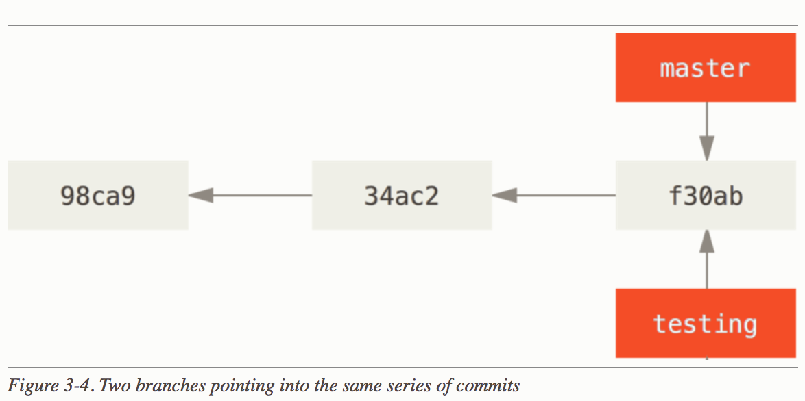
Git Branches
Branches are used to run tests, develop patches and try new features.
Reference:
https://git-scm.com/book/en/v2/Git-Branching-Branches-in-a-Nutshell

Slide 11
Examples
Notes:
Create test branch
Make changes
Merge into Master

Slide 12
Tips in using Git
DO NOT
Do This Often
git add.
git commit –m “useful information”

Slide 13
More Tips
Do NOT store passwords in git repos
Do NOT store certificates in git repos
https://github.com/spirrello/gitignore
Make sure you commit changes as you go to allow a safe rollback and to reduce risk on the number of changes.

