Slide 1
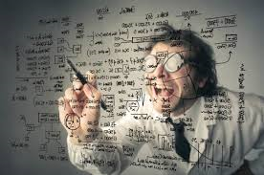
Most Valued DS Skills
R 607 Project 3
Fall 2016
10/2/2016
R 607 Project 3

Slide 2

The Team
Aaron Grzasko – Project Manager
Joseph Elikishvili – Web Scraping
Dhanajay Kumar – Web Scraping
Ahsanul Choudhury – Data Cleansing
Bruce Hao, Aaron Grzasko - Database
Andrew Carson – Analytics (graphs)
Daniel Thonn – Analytics (models)
10/2/2016
R 607 Project 3

Slide 3





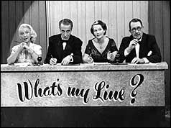
The Process
Obtain the data
  Jobs Site
Data Cleansing
  Fix anomalies
Database Import
  Web accessible data
Analytics
  Trends
  What am I ?
10/2/2016
R 607 Project 3

Slide 4

Team Collaboration
Tools used
  GitHub
  Slack
Meetings
  Every two days
  Meeting minutes posted
  Practice sessions
Project Management
  Task assignments
  Spinoff of sub-teams
10/2/2016
R 607 Project 3

Slide 5
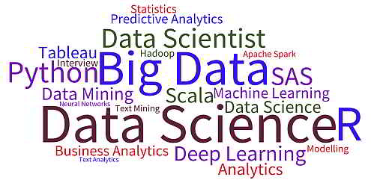
Goals
Work as a team
Project experience
Learn new Data Science techniques
Learn new tools
Learn more about the role of Data Scientist
10/2/2016
R 607 Project 3

Slide 6
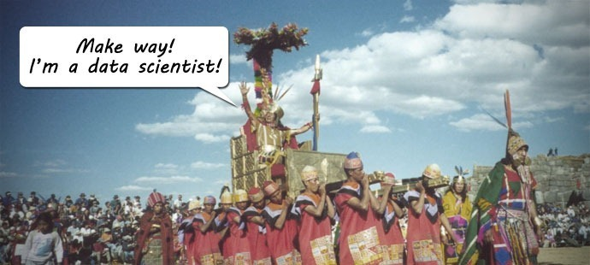
Mission
10/2/2016
R 607 Project 3

