Slide 1
ASP.NET Core 1.0 – Productivity with Templates
Vladislav Yurukov
SharePoint Developer; Painter;
Web and Middleware Team Lead; Web and Middleware Deep Technical Support; Web Administrator; Assistant Professor; Linux Administrator;

Slide 2
CONTENT
ASP.NET Core 1.0
Where is on the map?
Improvements
Middleware
Demo
Productivity
Blocked tasks
Test data
Integration tests coverage
Templates
Approaches
DNX
Demo

Slide 3
ASP.NET Core 1.0

Slide 4
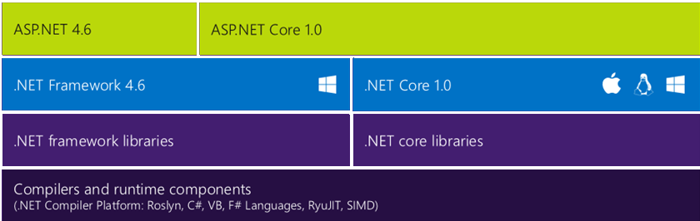
Where is on the map?
Choose different Section Slide for every new section.

Slide 5
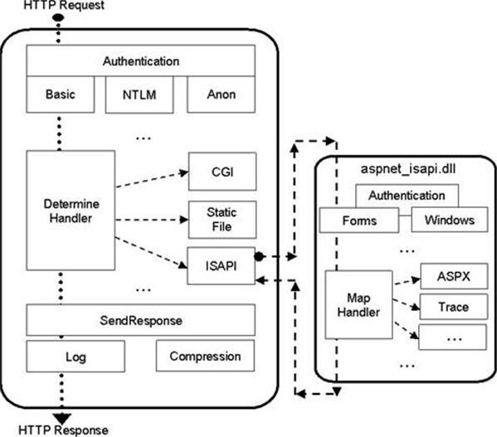
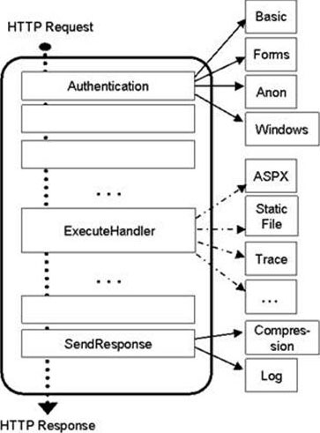
Middleware – the road for last decade
IIS 6.0 and ASP.NET pipelines
IIS 7 and above
OWIN

Slide 6

DEMO
ASP.NET Core 1.0 Middleware

Slide 7
Improvements
New light-weight and modular HTTP request pipeline
Ability to host on IIS or self-host in your own process
Single aligned web stack for Web UI and Web APIs
Cloud-ready environment-based configuration
Built-in support for dependency injection
Cross-platform
Ships entirely as NuGet packages
Open source and community focused

Slide 8
ASP.NET Core 1.0 Overview:
Project structure
Aligned Web UI and Web APIs
Environments
NuGet Packages
Tag Helpers
DEMO

Slide 9
Productivity

Slide 10
Problems to solve
Context: Building a modern SPA consuming JSON data from Web Api for Opportunity tracking. To be used by Sales Department.
Blocked tasks
Testing data
Integration tests coverage

Slide 11
Day 0 – kick of a new project. What happens next?

Slide 12
Seed Database
Seed with test data. Best to be done ASAP as it will speed up development by unblocking tasks:
CRUD operations in frontend.
Reports
Imports
Seed lookups. Seed with SQL script seems fine if lookup field values are defined in requirements. Otherwise made data up.
Seed configuration data. Best to be done with CRUD since the beginning. But could be hardcoded for a day or two if it is a blocker for other tasks.

Slide 13




Integration tests – at least cover CRUD
Create
Read
Update
Delete
Frontend new item
Imports
Frontend details and lists
Reports
Frontend update
Frontend delete

Slide 14
Templates

Slide 15
Existing Approaches
Command line code generation/scaffolding
T4
T4 Toolbox
T4MVC
TextTemplating
Gulp
LESS

Slide 16

Our Approach in a Nutshell
text.Replace(placeholder, value)
+
DNX project (project.json)

Slide 17
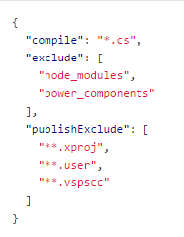
.NET Execution Environment (DNX)
SDK to build and run ASP.NET Core 1.0
Package ecosystem
Open source friendly
DNX project = folder with a project.json file
project.json

Slide 18
DEMO
Productivity areas:
Model
Repositories and Services
Controllers
Tests

Slide 19
Improved productivity for ASP.NET Core by Project Areas

Slide 20
CONTACTS
Contact
Contact Person: Vladislav Yurukov @ vladislav.yurukov@bulpros.com
GitHub
https://github.com/spiteos/TechTalksDemo

Slide 21
DISCUSSION

Slide 22
THANK YOU

