Slide 2
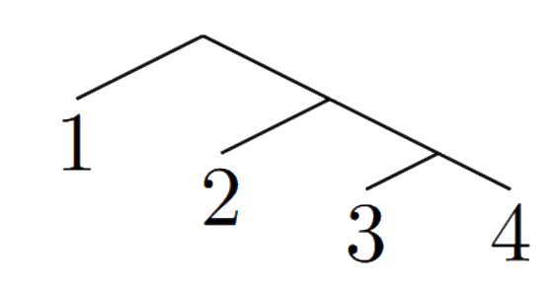
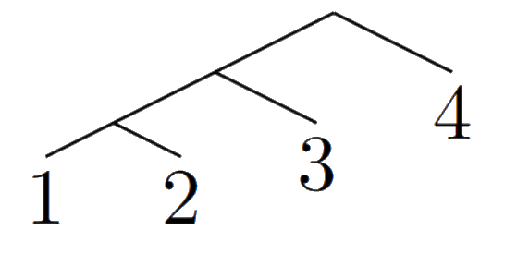
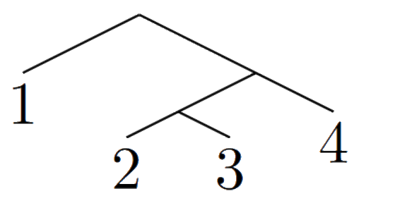
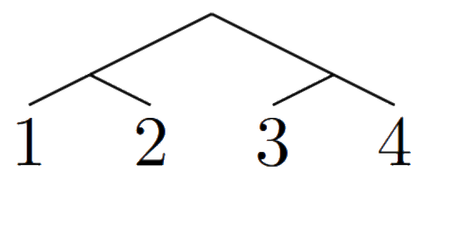
Trees With Labels
Notes:
This project was ultimately about measuring binary trees.
When dealing with binary trees there is a conflict, in that our concrete
representations, typically as a graph, contain extra information, which we
don't always want to measure.
For example (pictures of balanced and unbalanced 4-tree) the distinction
between a balanced tree, and an unbalanced tree, should not depend on the
content within the verteces of the tree.

Slide 3
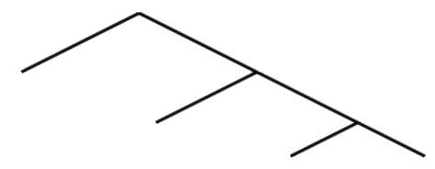
Trees Without Labels
Notes:
Conceptually we can 'remove' labels from a graph, by taking the set of trees
with the same label (picture from meeting, trees becoming the same shape)

Slide 4
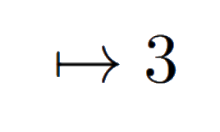
Measuring Shape
Notes:
So back to tree measurements, when we define a measurement of tree shape such
as balance, we typically define them as functions of a particular graph (tree
being mapped to a number /\/\ |-> 2), so the property that we want, "invariance
under relabelling", is that regardless of how you label the tree, you get the
same result.
Once you do this, your function can actually act on our unlabelled trees as
well. (again /\/\ |-> 2)

Slide 5
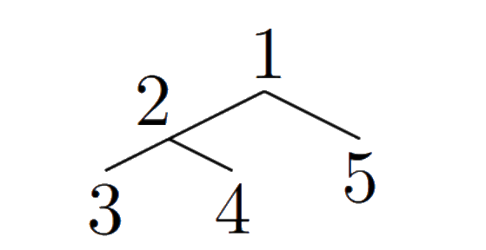
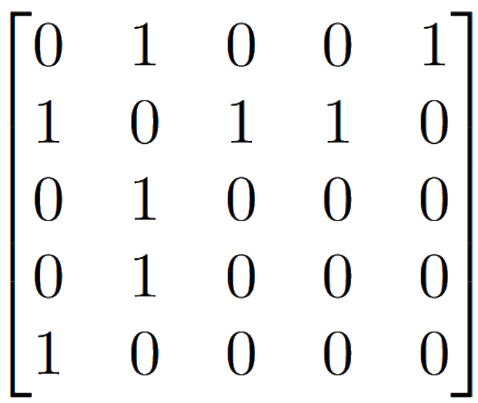
Ubiquity of Synonymity (1)
Notes:
The project was in large part following the model of a 2012 paper: "Ubiquity of
Synonymity: almost all large trees are not distinguished by theire spectra or
immanantal polynomials"
This paper was checking for an additional property of maps, that they are not
only invariant, but also were able to distinguish between trees.
It represented binary trees as matrices based on their graphs, and then took
measurements of those matrices. (Examples?)

Slide 6
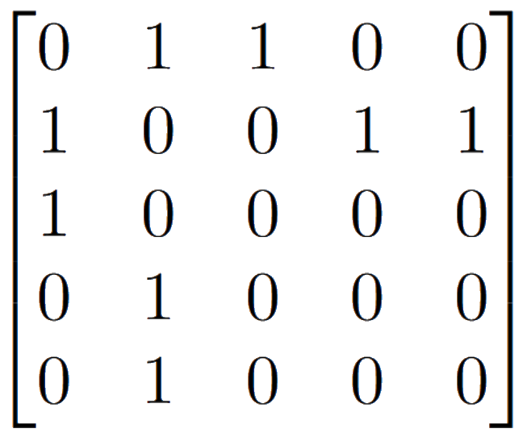
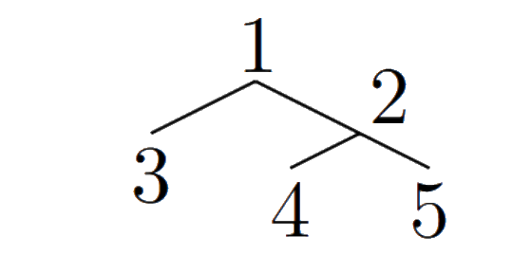
Covariance
Notes:
In these matrix representations, trees that have the same structure have similar matrix representations, similar by some simultaneous row/column permutation
We call this covariance: Changing the labels of the tree changes its representation in some predictable way.

Slide 7
Ubiquity of Synonymity (2)
(trees with the same spectrum)
Notes:
(picture of trees with same measurement?)
It found that the maps were so bad at distinguishing trees that the proportion
of trees with the same spectrum or immanantal polynomial approached 1!
We will follow this model by looking at trees as matrices that can be measured.

Slide 8
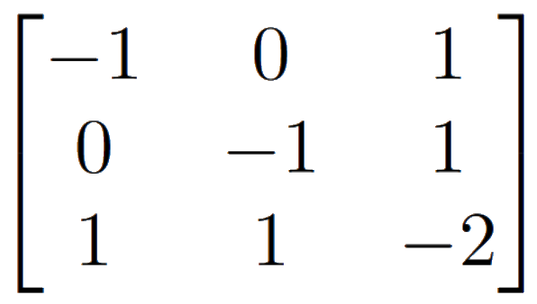
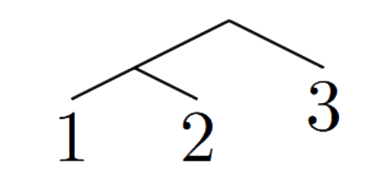
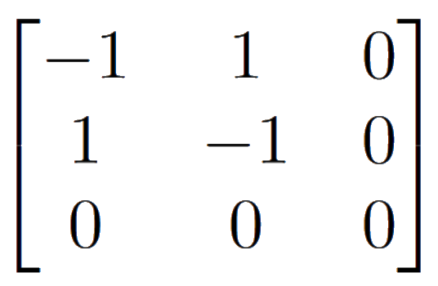
MRCA Algebra of a Tree (1)
Notes:
The other inspiration for this project was a small part of the work of
Tasmania's phylogenetics group. As such some of the people here will be
familiar with the representations used.
The representation we were using was an algebra of matrices that essentially
kept track of the pairs of leaves that had the same common ancestor. (3-tree
example?) (do they need this info?)

Slide 9
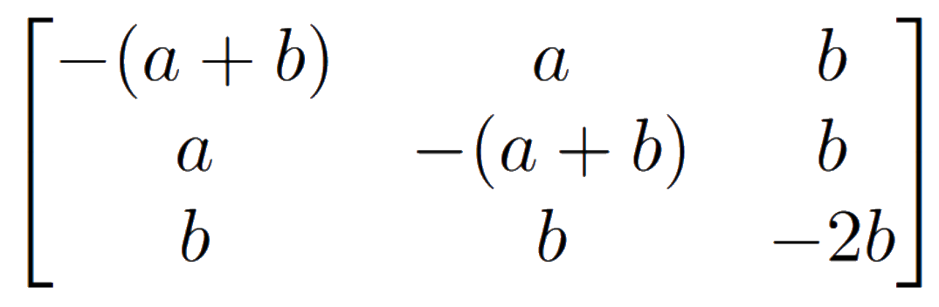
MRCA Algebra (2)

Slide 10
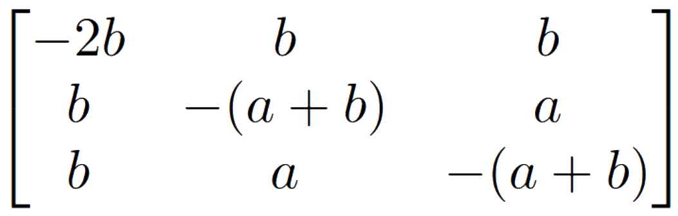
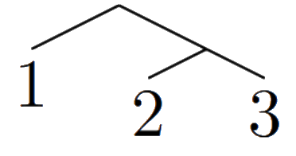
Covariance in MRCA Algebra
Notes:
In this representation, we still have label-like information, in that we can
swap the rows and columns to get trees that have the same structure but
different representations (3-tree example)
From an algebraic perspective though, these will be isomorphic, so that is
promising.
Ultimately what we want to do is remove this information somehow.
(this explanation is bad… focus on covariance, and how we know how to make this invariant, perhaps in the previous covariance slide talk about that actually)

Slide 11
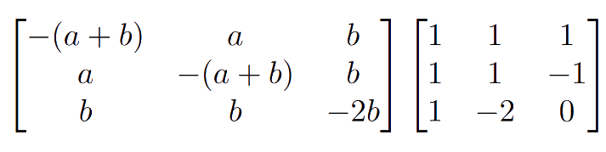
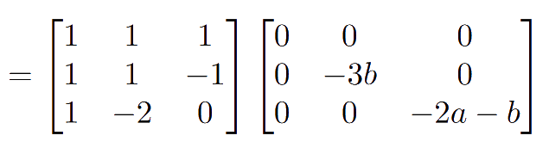
Commuting
Notes:
Additionally this algebra is commutative, which gives us a very interesting
property that when we take the eigenvalues of any matrix in the algebra, we can
do it with a consistent set of eigenvectors.
This is where the inspiration for the project came from, that by looking at the
spectrum of an algebra of matrices, we could get a new representation of binary
trees.
(diagonalization examples in algebra?)

Slide 12
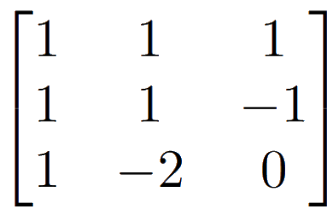
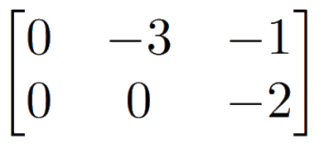
‘Eig’ Matrices
Notes:
The results of the project centred around this diagonalization, constructed as
2 matrices
(picture of matrices)
in this one each column is an eigenvector, in this one each row is the spectrum
of a basis matrix, and so each entry is an eigenvalue.

Slide 13
Results

Slide 14
Basis Fairness
Notes:
Any non-overlapping basis of the matrix algebra contains enough information to
recover the tree itself.
It's interesting that the algebra is virtually just as much of a binary tree as
a graph of connected points is.

Slide 15
Vertex Eigenvectors
Notes:
Each basis matrix has one simple eigenvalue, and so all of our eigenvectors
correspond to a vertex on the tree in some way
- requires explanation of simultaneous diag

Slide 16
Path Eigenvalues
Notes:
The eigenvalue of each matrix/vector pair correspond to the location of the
eigenvector relative to the matrix

Slide 17
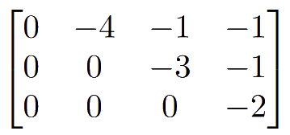
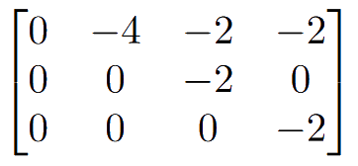
Triangular Eigenvalues
Notes:
Since we are representing the eigenvalues as a matrix, this structural
relation can be used to make the matrix upper triangular, without changing its
spectrum or determinant
once we do this its trace becomes the sackin index, a measurement of tree
balance
Unfortunately almost all large trees end up having the same spectrum

Slide 18
Orthogonal Eigenvectors
Notes:
the eigenvectors are orthogonal, so measurements such as angle between
vectors is trivial

Slide 19
Eig Fairness
Notes:
the eigenvalues and eigenvectors can each be used to reconstruct the tree
so we have an unexpected and very novel representation of a tree!

