Slide 1


Socio-economics of college education
Sarbottam Piya

Slide 2

Problem statement
n = 57,435
What determines the acceptance in Universities?
Economics of college education
Does college ranking matters?
Harvard University
Class of 2025

Slide 3
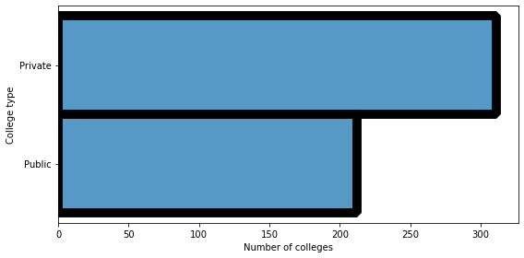
Data source and information
College ranking data from Forbes 2019
Ranking
Private/Public
Acceptance rate
Number of students
Total cost
Financial aid
Alumni salary
N=651

Slide 4
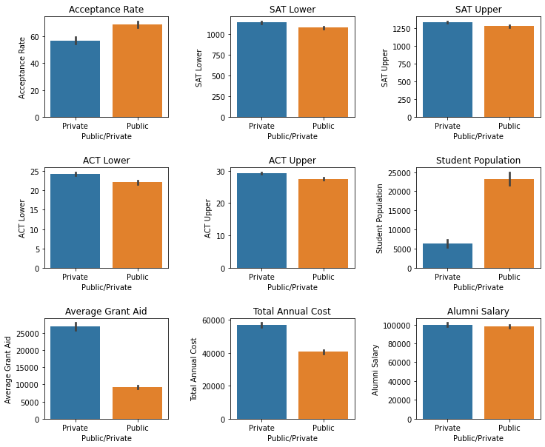
Private vs public university
Small class size
Expensive
Higher average grant aid

Slide 5
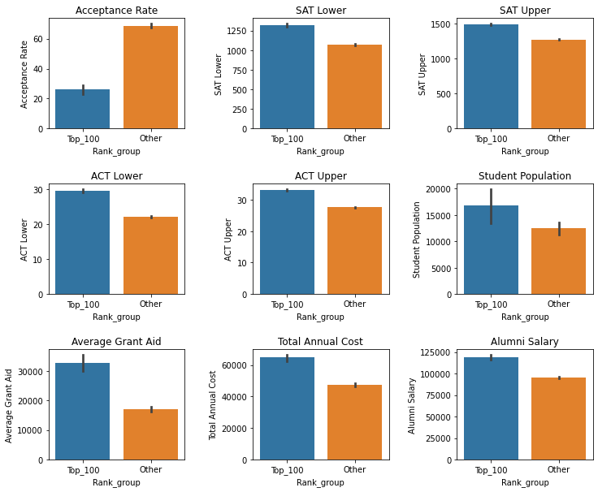
Top 100 university vs remaining university
Top 100 university
Low acceptance rate
High annual cost
High grant aid
High alumni salary

Slide 6
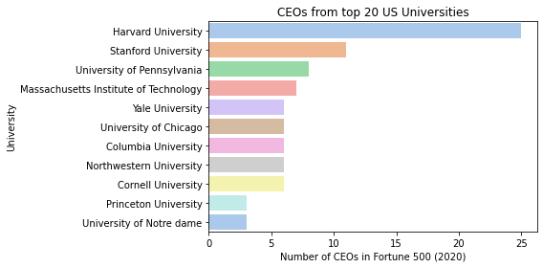
Socio-economic impact of graduating from top-tier universities
Data source: https://www.statista.com/
Notes:
When you apply for a job, the university from where you graduate play very important role. Here is an example,
Among the 500 CEOs of fortune 500 companies, 97 CEOs graduated from one of the top 20 Universities.

Slide 7
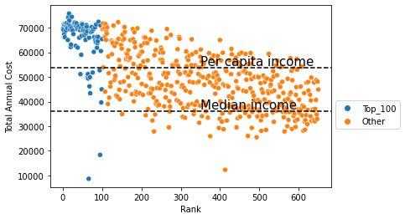
Is college education affordable?

Slide 8
Do university rankings matter?
Increase the opportunity to get high paying better jobs in top tier company
Expensive
But what if your goal is to be school teacher, police officer

Slide 9
Thank you

