Slide 1

Computer Architecture
Assignment #1: ARM Instruction Analysis
Gyu Dong Kim (gyudong_kim@korea.ac.kr)
Intelligent Computer Architecture & Systems Lab.

Slide 2
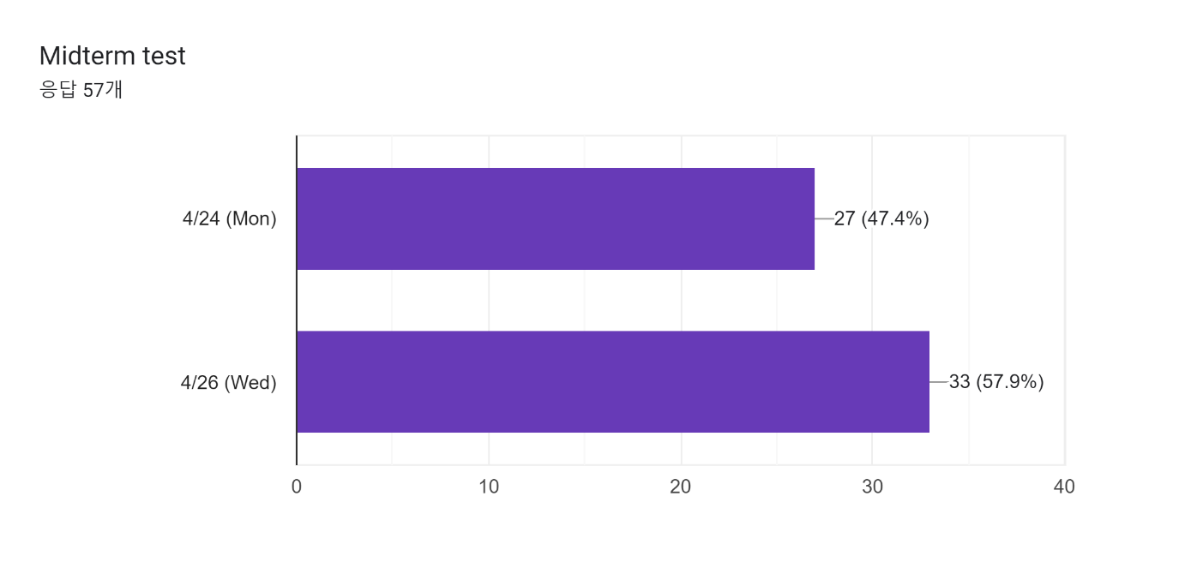
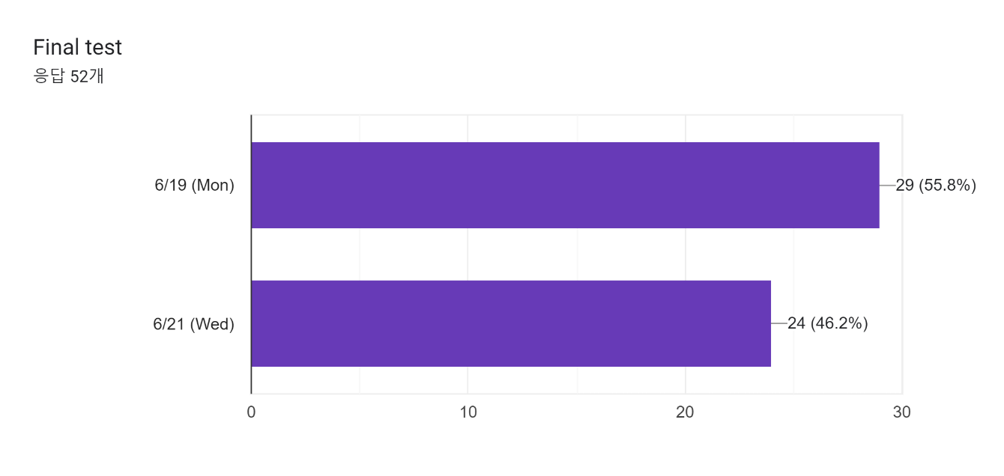
Survey Result

Slide 3
Purpose of Assignment #1
To understand hardware instructions and assembly language
To understand ARM instructions through the ARM reference manual
To understand how instructions are executed at the system and hardware level

Slide 4
About report
ARM instruction analysis report
Analyze instruction of address 000~024 in instruction file(inst_data.mif)
Change hex instructions to binary format and translate the binary instructions to assembly codes by referring to the ARM reference manual
Explain the meaning of each instruction
Explain the actual execution flow of the instructions
Explain where the execution ends (if it doesn’t end, explain the range of repetition in detail)
Instruction of addr. 000
Binary format result
Which instruction it is
Meaning
Actual Execution Sequence
. . .
Where the execution ends
(Or repetition range)
Instruction of addr. 024
Binary format result
Which instruction it is
Meaning
For each instruction
For the whole execution

Slide 5
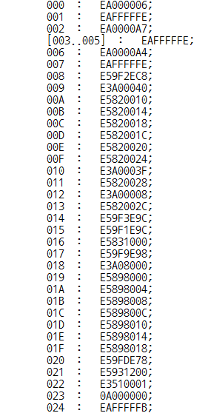
inst_data.mif
address
(HEX)
EA000006
instruction
(HEX)

Slide 6
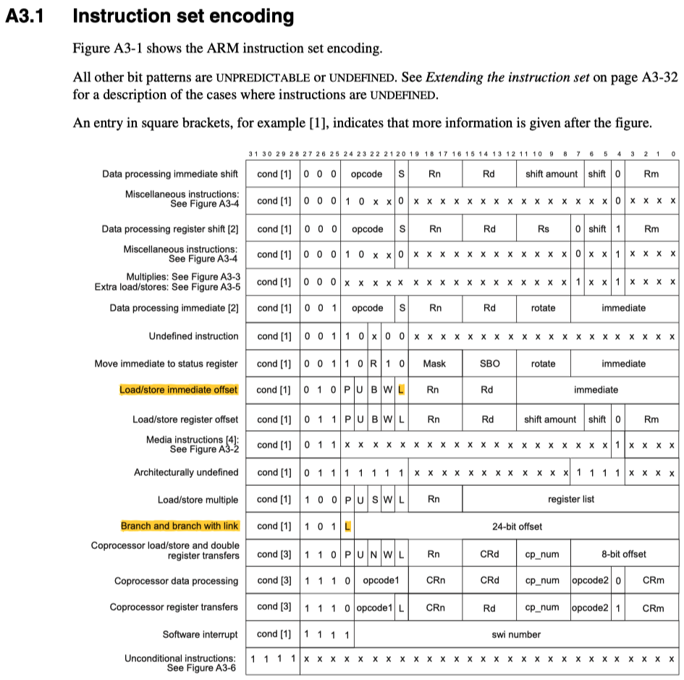
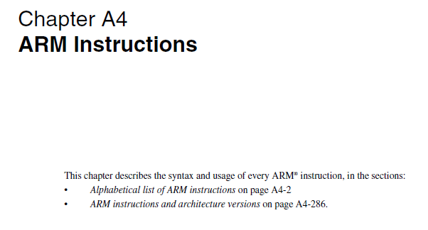
arm_architecture_reference_manual.pdf

Slide 7

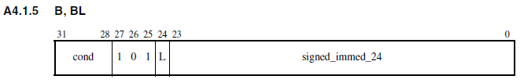
Example
EA000006
Change instructions to binary format
1110 1010 0000 0000 0000 0000 0000 0110 ₍₂₎
Translate the binary instructions to assembly codes by referring to the reference file
B #008;
Describe what instruction means
Move to the address current address*4+8+6x4 (In the case of RISC-V, add 4 to target address)
Because the address unit is 4 Byte (= 1 Word)
Therefore, move to the address (0 + 8 + 24) / 4 = 008
Next instruction will be E59F2EC8 at the address 008

Slide 8
Example
EAFFFFFE
Change instructions to binary format
1110 1010 1111 1111 1111 1111 1111 1110 ₍₂₎
Translate the binary instructions to assembly codes by referring to the reference file
B #001;
Describe what instruction means
Sign-extending the 24-bit signed(two’s complement) immediate to 30 bits
1111 1111 1111 1111 1111 1110 —> 11 1111 1111 1111 1111 1111 1111 1110
Shifting the result left two bits to form a 32-bit value
1111 1111 1111 1111 1111 1111 1111 1000 = -210 * 4 = -810
Adding this to the PC, which contains the address of the branch instruction(current address) plus 8 bytes
Make ‘4’ by adding the current instruction address ‘(1*4)+8’ and ‘-8’
Divide '4' into 4 so that it branches at first among the word-unit instructions : 4/4 = 1
Because it branches to the same instruction, the same instruction repeats indefinitely
Step 1: Switching 0 to 1, 1 to 0
0000 0000 0000 0000 0000 0010
1111 1111 1111 1111 1111 1101
Step 2: Add 1 to the result of 1st Step
1111 1111 1111 1111 1111 1101
1
1111 1111 1111 1111 1111 1110
cf. -2 = 1111 1111 1111 1111 1111 1110
= 2’s complement of 0000 0000 0000 0000 0000 0010

Slide 9
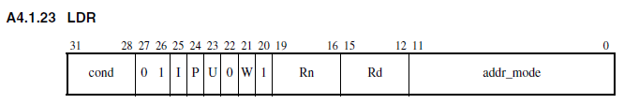
Example
E59FDE78
Change instruction to binary format
1110 0101 1001 1111 1101 1110 0111 1000 ₍₂₎
Translate the binary instructions to assembly codes by referring to the reference file
LDR $13, [$15, #0xE78];
Mark it as # because I bit, the 25th bit, is 0
Describe what instruction means
Calculate the address of memory by adding the value stored in the 15th register with #0xE78
Access to the calculated memory address and load the data into the 13th register
Read the value saved in address [$15 + #0xE78] of memory and store it $13

Slide 10
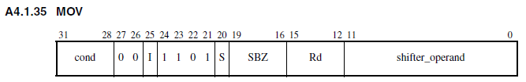
Example
E1A0F00E
Change instruction to binary format
1110 0001 1010 0000 1111 0000 0000 1110 ₍₂₎
Translate the binary instructions to assembly codes by referring to the reference file
MOV $15, $14;
Describe what instruction means
Store the value of the 14th register at the 15th register

Slide 11
Hint
Condition Code (e.g., 0(0000) = Equal, E(1110) = Always)
Refer to ARM Reference Manual p.112
Data Processing Instructions (e.g., MOV, CMP)
Opcode: Refer to Manual p.115
Instruction Encoding: Refer to Manual p.116
Load and Store Instructions (e.g., LDR, STR)
Address Mode: Refer to Manual p.129
Instruction Encoding: Refer to Manual p.130
Examples: Refer to Manual p.131
Branch Instructions (e.g., B, BL)
Instruction Encoding: Refer to Manual p.160
Examples: Refer to Manual p.114

Slide 12
Differences in the ARM and RISC-V instructions

Slide 13
Differences Between ARM and RISC-V
Different instruction field format is used
RISC-V (R-type)
ARM
31
25
24
20
19
15
14
12
11
7
6
0
func7
rs2
rs1
func3
rd
opcode
7 bits
5 bits
5 bits
3 bits
5 bits
7 bits
31
28
27
26
25
24
21
20
19
16
15
12
11
0
cond
0 0
I
opcode
S
Rn
Rd
operand
4 bits
2 bits
1
bit
4 bits
1
bit
4 bits
4 bits
12 bits
What is “cond” field?

Slide 14
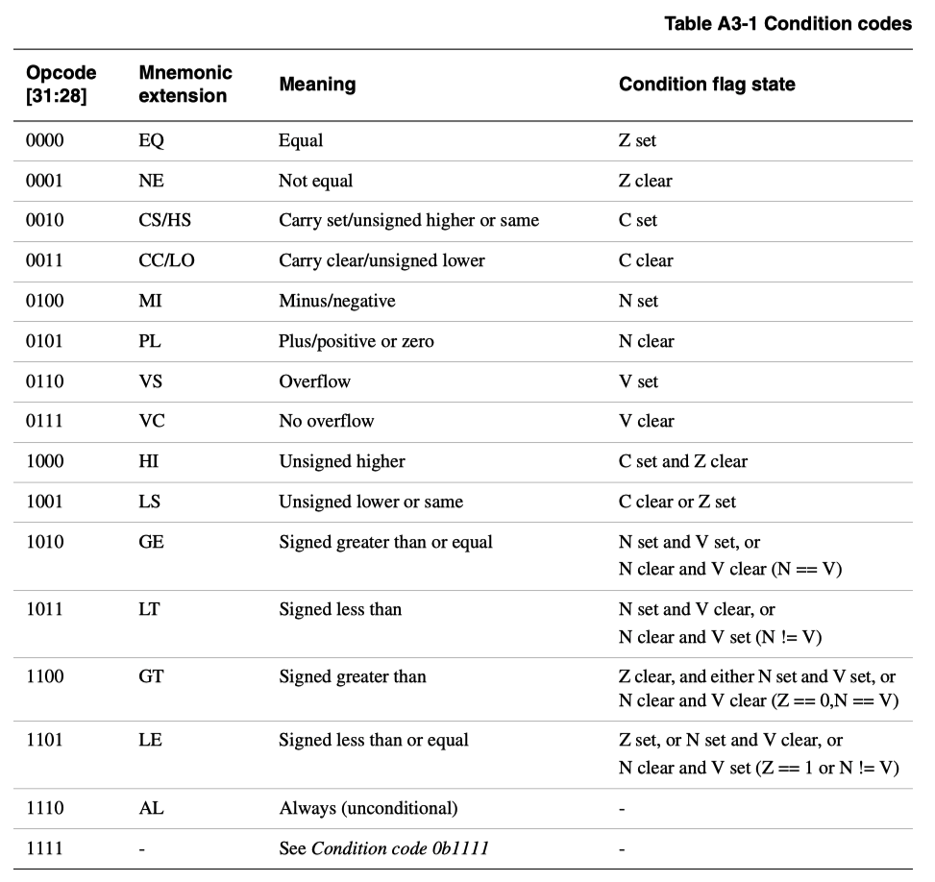
Differences Between ARM and RISC-V
Refer to ‘arm_architecture_reference_manual.pdf’ A3.2.1
Condition Field

Slide 15
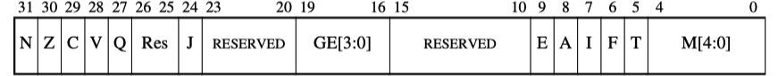
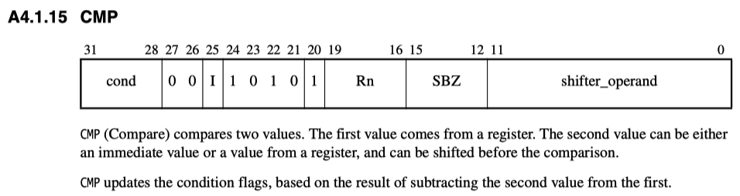
Differences Between ARM and RISC-V
Condition Code Flags
Condition Code Flag
Program Status Registers
SPSR(Saved Progam Status Register), CPSR(Current Program Status Register)*
N - set if the result is negative
Z - set if the result is zero
C - set if carry exists in the results of addition, subtraction, shift (unsigned operation)
V - set if the result overflows from addition or subtraction (signed operation)
Operation with “S” suffix
ADDS, SUBS (ADD, SUB doesn’t update flags)**
Format
*Refer to A2.5 in manual
**Refer to A4.1.3 in manual
The 1st value == The 2nd value
The 1st value - The 2nd value = 0
==> Z is set.

Slide 16
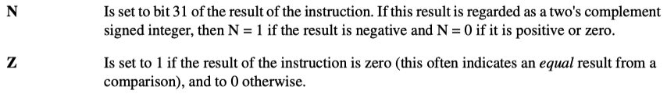
Execution Flow
Syntex
Example
Consider following ARM assembly
r0
N | Z | C | V
MOV
>> R0 is 2
CMP
>> ‘N’ is set after this instruction because ‘r0 - 3 < 0’ is true.
ADDLT
>> This line is executed because ‘cond’ field is met; r0 is now 3.
CMP
>> ‘Z’ is set because ‘r0 == 3’ is true
ADDLT
>> This line is not executed because the ‘cond’ field is not met.
BEQ
>> This line is executed because ‘Z’ is met.

Slide 17
Differences Between ARM and RISC-V
Branch instruction
RISC-V
Branching condition is tested and executed in one instruction
ARM
Branching condition is embedded in condition(cond) field
Branch is executed only if “cond” condition is met

Slide 18
Instruction Set Manual of ARM and RISC-V
ARM
https://iitd-plos.github.io/col718/ref/arm-instructionset.pdf
RISC-V
https://riscv.org/wp-content/uploads/2019/06/riscv-spec.pdf

Slide 19
Announcement

Slide 20
About Assignment #1
Report: 5 points
Analyzing instruction at 000~024 address in the instruction file (inst_data.mif)
Report should include the following
Student number and name
For each instruction,
Change the instruction from HEX to Binary (Score: 1)
Translate the binary instructions to assembly codes by referring to the ARM reference manual and explain the meaning of each instruction (Score: 2)
Explain the actual execution flow of the instructions (Score: 1)
Specify where the execution ends (if not, specify the range repeated in detail) (Score: 1)

Slide 21
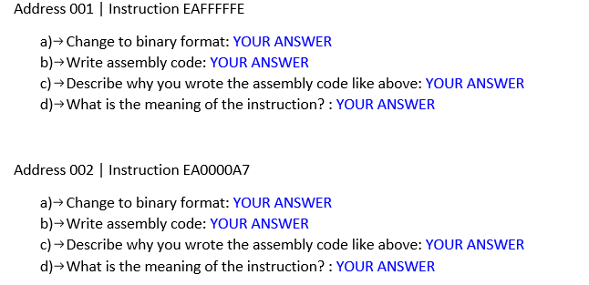
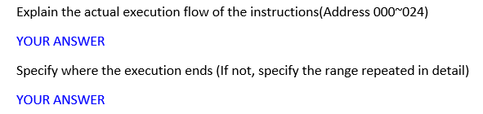
About Assignment #1
Write your answers by editing blue colored part.

Slide 22
About Execution Flow of Assignment #1
As you cannot know which value is stored in memory, you may need to assume arbitrary (or temporary) values for the data transfer instructions, such as STR and LDR.
Similarly, as you cannot know the exact value that may be stored in memory and/or registers, you may also need to consider both directions for conditional branch instructions, such as B and BL.
e.g., If the condition is satisfied, it may ~. Otherwise, it may ~. If branch will be executed, it may ~.

Slide 23
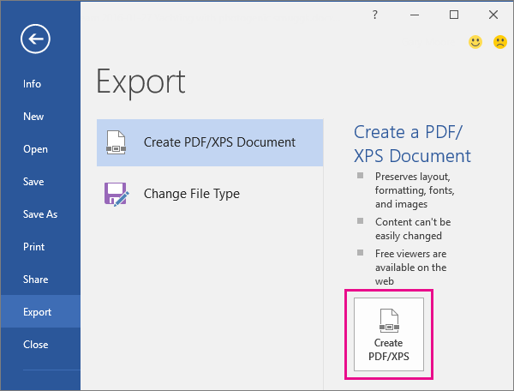
Submission
Due date
April 28 (Fri) 11:59 P.M.
How to submit
Through KULMS
Report
Submission format
Compress the file as ‘CA1_STUDENTNUMBER_NAME.pdf’
(Export to PDF file from .docx)

Slide 24
Q&A
If you have any questions about Assignment #1,
Email gyudong_kim@korea.ac.kr

