Slide 1

One of the world’s biggest banks
$2.5 trillion assets
$95 billion revenue
$25 billion profit
240,000 staff / 16,000 in UK

Slide 2
One of the world’s biggest tech companies
$9.5 billion annual investment in technology and innovation
18,000 developers

Slide 3
Python is used in every business
Trading systems
Risk management
Machine learning
Analytics

Slide 4
Python is used in every business
Trading systems
Risk management
Machine learning
Analytics
Our “Athena” platform is 150k Python modules

Slide 5
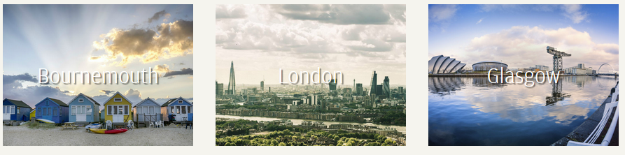
We are the UK’s biggest Python employer
London
Bournemouth
Glasgow
and now Dublin

Slide 6

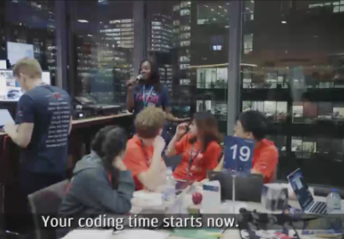
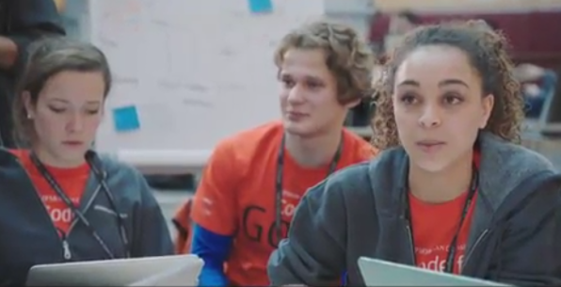
“Code for Good” hackathons to solve real problems for charities
Glasgow 4-5 November
Ask if interested (applications already closed)
London 17-18 November
Applications close 5 November

Slide 7
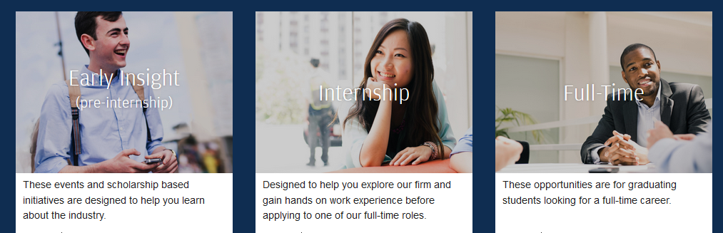
For more information
careers.jpmorgan.com
Here at PyCon:
- visit our recruiting stand
- 2017.pyconuk.org/sponsors/jp-morgan
2018 internship and graduate applications close on 26 November

