Slide 1
Pandas from the Inside Big Pandas PyCon UK tutorial, Friday 27 October 2017
Stephen Simmons
stephen.e.simmons@jpmorgan.com mail@stevesimmons.com
https://github.com/stevesimmons/pyconuk2017-pandas-and-dask
http://www.stevesimmons.com/pyconuk2017-pdfs.zip

Slide 2
Agenda
Welcome and introduction 5 mins
Pandas from the Inside 75 mins
Big Pandas (Dask and Parquet) 30 mins
Pandas 2.0 – where next? 10 mins

Slide 3
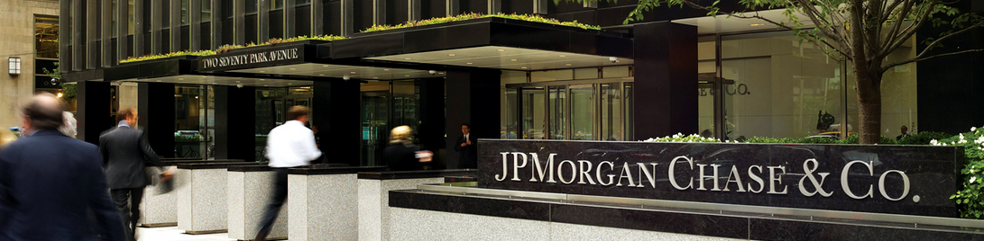
One of the world’s biggest banks
$2.5 trillion assets
$95 billion revenue
$25 billion profit
240,000 staff / 16,000 in UK

Slide 4
One of the world’s biggest tech companies
$9.5 billion annual investment in technology and innovation
18,000 developers

Slide 5
Python is used in every business
Trading systems
Risk management
Machine learning
Analytics
Our “Athena” platform is 150k Python modules

Slide 6
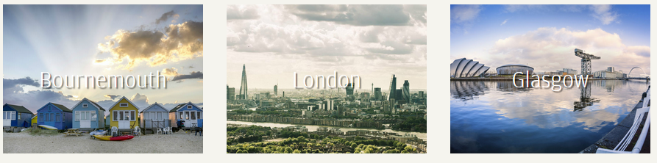
We are the UK’s biggest Python employer
London
Bournemouth
Glasgow
and now Dublin

Slide 7

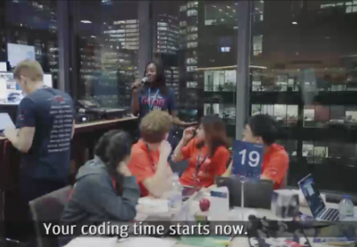
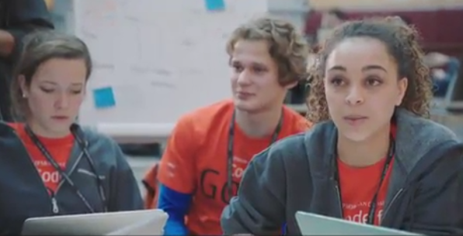
“Code for Good” hackathons to solve real problems for charities
Glasgow 4-5 November
Ask if interested (applications already closed)
London 17-18 November
Applications close 5 November

Slide 8
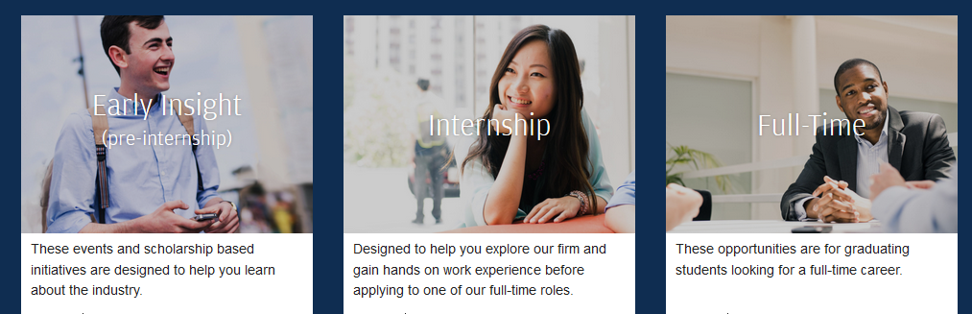
For more information
careers.jpmorgan.com
Here at PyCon:
- visit our recruiting stand
- 2017.pyconuk.org/sponsors/jp-morgan
2018 internship and graduate applications close on 26 November

