Slide 1
“Big Pandas” - Dask from the Inside PyCon UK tutorial, 27 October 2017
Stephen Simmons
mail@stevesimmons.com stephen.e.simmons@jpmorgan.com
https://github.com/stevesimmons/pyconuk-2017-pandas-and-dask

Slide 2
Goals for today…
Let’s try a much bigger data set – “BTS OTP” (172m records)
Try some simple analysis
DataFrames from dask rather than pandas
Efficient data storage
Calculating the dask dependency graph
(Note: Examples here all designed to run on a local machine)

Slide 3
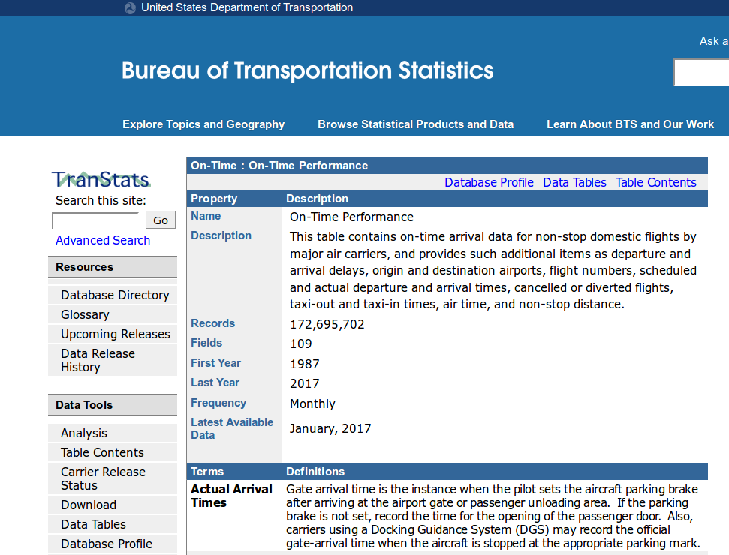
American “on-time performance” flight data
Monthly zipped csv files
Each file has 450,000 rows x 109 cols
220MB unzipped 22MB zipped 12MB with LZMA (.xz)
https://www.transtats.bts.gov/acTableInfo.asp?Table_ID=236

Slide 4
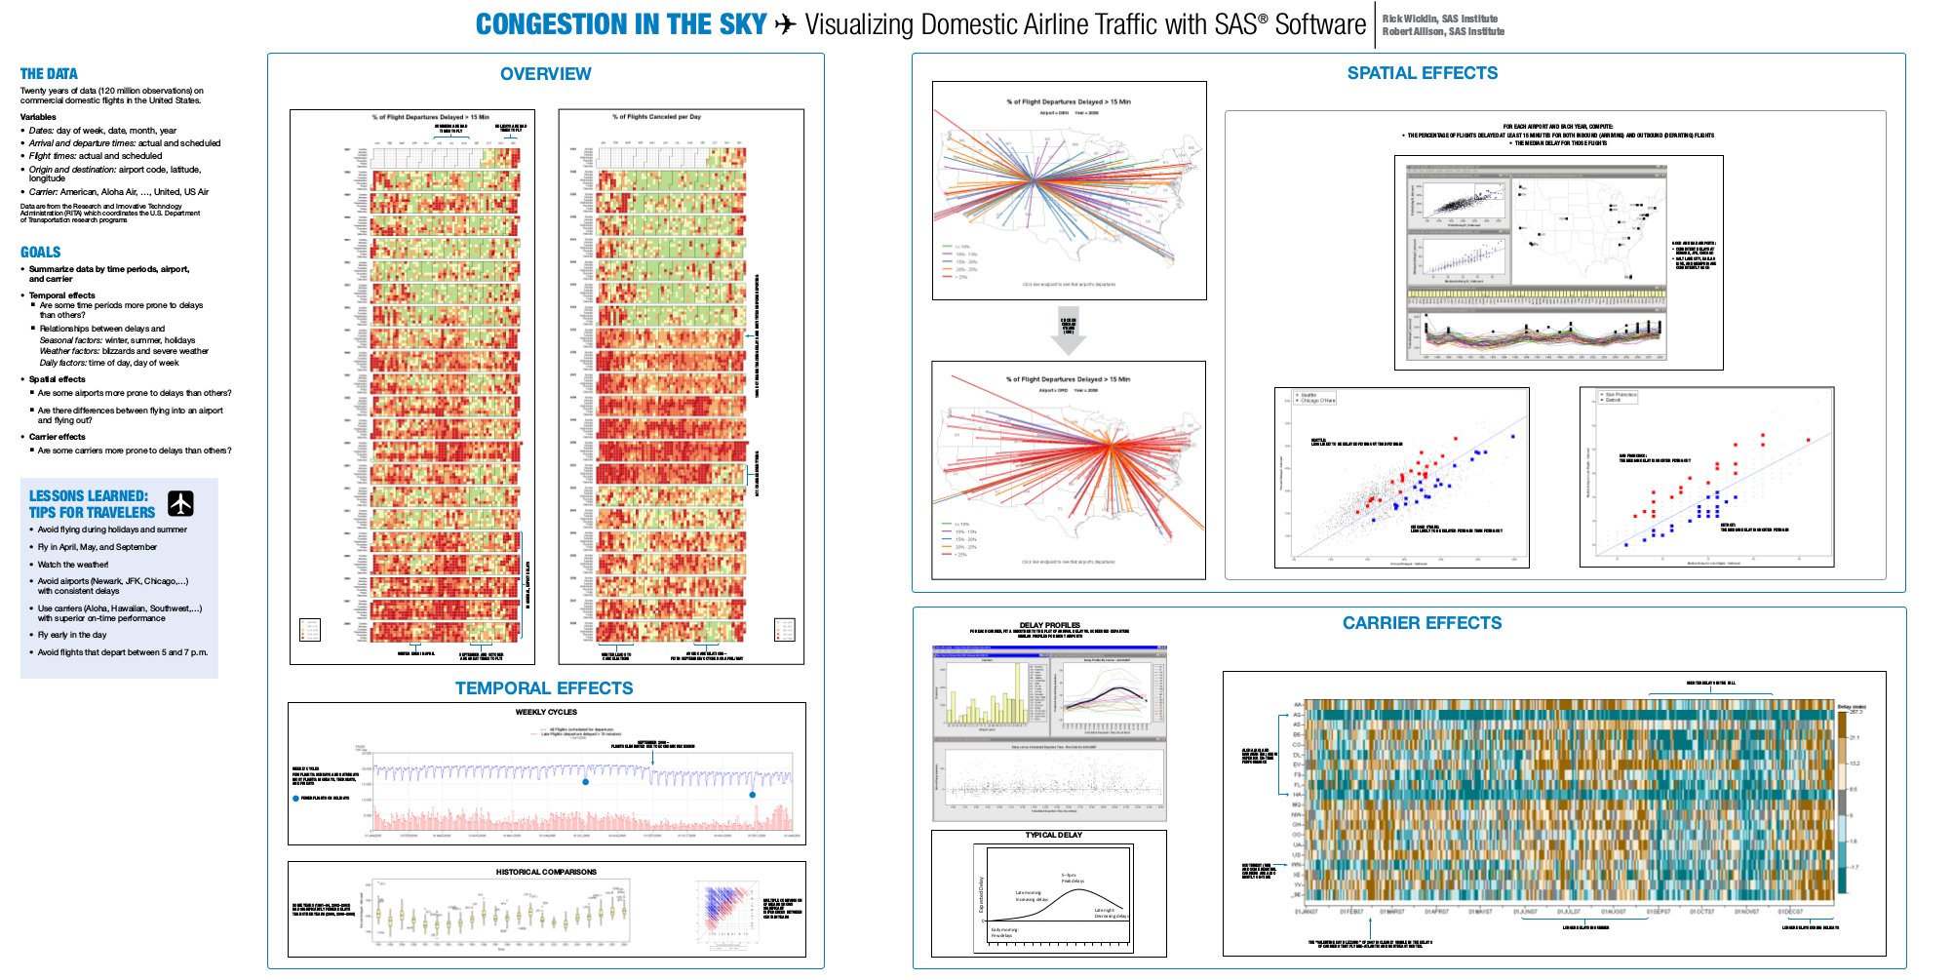
http://stat-computing.org/dataexpo/2009

Slide 5
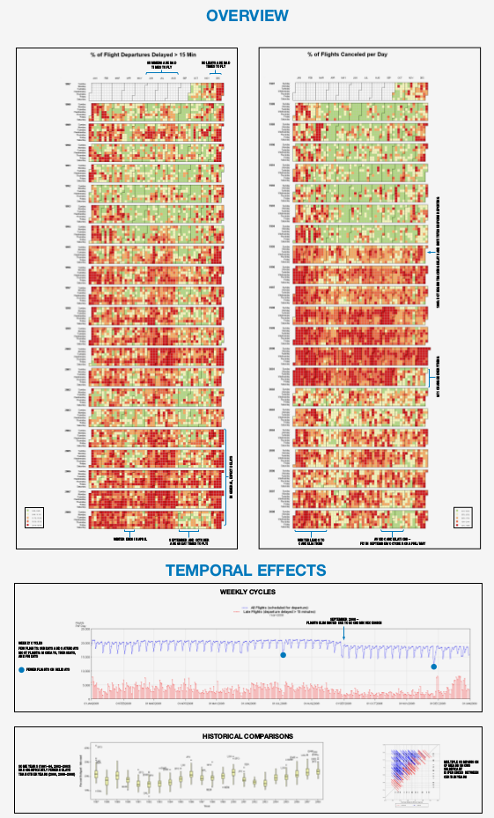
Our analysis goals…
Calculate % of flights cancelled per day
by date / date range
by origin / destination
by carrier
by state
http://stat-computing.org/dataexpo/2009

Slide 6
df = pd.read_csv('flights-2016-01.xz', nrows=4, dialect="excel")
> df.T
Year 2016 2016 2016 2016
Quarter 1 1 1 1
Month 1 1 1 1
DayofMonth 6 7 8 9
DayOfWeek 3 4 5 6
FlightDate 2016-01-06 2016-01-07 2016-01-08 2016-01-09
UniqueCarrier AA AA AA AA
AirlineID 19805 19805 19805 19805
Carrier AA AA AA AA
TailNum N4YBAA N434AA N541AA N489AA
FlightNum 43 43 43 43
...
Origin DFW DFW DFW DFW
...
Dest DTW DTW DTW DTW
...
CRSDepTime 1100 1100 1100 1100
DepTime 1057 1056 1055 1102
DepDelay -3 -4 -5 2
...
TaxiOut 15 14 21 13
WheelsOff 1112 1110 1116 1115
WheelsOn 1424 1416 1431 1424
TaxiIn 8 10 14 9
CRSArrTime 1438 1438 1438 1438
ArrTime 1432 1426 1445 1433
ArrDelay -6 -12 7 -5
...
Cancelled 0 0 0 0
CancellationCode NaN NaN NaN NaN
Diverted 0 0 0 0
CRSElapsedTime 158 158 158 158
ActualElapsedTime 155 150 170 151
AirTime 132 126 135 129
Flights 1 1 1 1
Distance 986 986 986 986
...
[110 rows x 4 columns]

Slide 7
Pandas DataFrames don’t scale well
> df = pd.read_csv('flights-2016-01.xz', dialect="excel")
DtypeWarning: Columns (77) have mixed types. Specify dtype option on import or set low_memory=False.
CPU times: user 5.48 s, sys: 1.36 s, total: 6.83 s
Wall time: 6.83 s
> df.info()
<class 'pandas.core.frame.DataFrame'>
RangeIndex: 445827 entries, 0 to 445826
Columns: 110 entries, Year to Unnamed: 109
dtypes: float64(71), int64(21), object(18)
memory usage: 374.2+ MB
> df.memory_usage(deep=True).sum() / 2**20
745.2

Slide 8
Pandas DataFrames don’t scale well
> df = pd.read_csv('flights-2016-01.xz', dialect="excel")
DtypeWarning: Columns (77) have mixed types. Specify dtype option on import or set low_memory=False.
CPU times: user 5.48 s, sys: 1.36 s, total: 6.83 s
Wall time: 6.83 s
> df.info()
<class 'pandas.core.frame.DataFrame'>
RangeIndex: 445827 entries, 0 to 445826
Columns: 110 entries, Year to Unnamed: 109
dtypes: float64(71), int64(21), object(18)
memory usage: 374.2+ MB
> df.memory_usage(deep=True).sum() / 2**20
745.2
> df = pd.concat([
pd.read_csv('flights-%s.xz' % m,
dialect="excel")
for m in ['2015-12','2016-01','2016-02']
])
DtypeWarning: Columns (48,76,77,84,85) have mixed types.
DtypeWarning: Columns (77) have mixed types. DtypeWarning: Columns (77,84) have mixed types.
Specify dtype option on import or set low_memory=False.
CPU times: user 18.4 s, sys: 6.66 s, total: 25.1 s
Wall time: 1min 26s
> df.info()
<class 'pandas.core.frame.DataFrame'>
Int64Index: 1348946 entries, 0 to 423888
Columns: 110 entries, Year to Unnamed: 109
dtypes: float64(69), int64(21), object(20)
memory usage: 1.1+ GB
> df.memory_usage(deep=True).sum() / 2**20
2326.9

Slide 9
Need to scale up in multiple places…
Data storage format
Load data in parallel
Parallelize intermediate calculations
Run on multiples core/machines
Effort required to write/optimize correct parallel code
And we still want to use Python and Pandas!

Slide 10
Dask is a ‘drop-in’ replacement for pandas*
> import dask.dataframe as dd
> paths = [ 'flights-%s.xz' % dt.strftime('%Y-%m')
for dt in pd.date_range('2015-12', '2016-03', freq='M') ]
> cols = ['FlightDate', 'Origin', 'Dest', 'OriginState', 'DestState',
'Carrier', 'FlightNum', 'TailNum', 'CRSDepTime', 'CRSArrTime',
'DepDelay', 'ArrDelay', 'Flights', 'Cancelled', 'Diverted', ]
> ddf = dd.read_csv(
paths,
dialect="excel", encoding='latin-1',
header=0, usecols=cols,
compression='xz', blocksize=None,
parse_dates=['FlightDate'],
dtype={'FlightNum': str}, )
* … for a subset of pandas DataFrame operations

Slide 11
Dask is a ‘drop-in’ replacement for pandas*
> import dask.dataframe as dd
> paths = [ 'flights-%s.xz' % dt.strftime('%Y-%m')
for dt in pd.date_range('2015-12', '2016-03', freq='M') ]
> cols = ['FlightDate', 'Origin', 'Dest', 'OriginState', 'DestState',
'Carrier', 'FlightNum', 'TailNum', 'CRSDepTime', 'CRSArrTime',
'DepDelay', 'ArrDelay', 'Flights', 'Cancelled', 'Diverted', ]
> ddf = dd.read_csv(
paths,
dialect="excel", encoding='latin-1',
header=0, usecols=cols,
compression='xz', blocksize=None,
parse_dates=['FlightDate'],
dtype={'FlightNum': str}, )
> ddf[['Carrier','Flights','Cancelled']].groupby('Carrier').sum()
CPU times: user 16 ms, sys: 0 ns, total: 16 ms
Wall time: 18.3 ms
* … for a subset of pandas DataFrame operations

Slide 12
Dask is a ‘drop-in’ replacement for pandas*
> import dask.dataframe as dd
> paths = [ 'flights-%s.xz' % dt.strftime('%Y-%m')
for dt in pd.date_range('2015-12', '2016-03', freq='M') ]
> cols = ['FlightDate', 'Origin', 'Dest', 'OriginState', 'DestState',
'Carrier', 'FlightNum', 'TailNum', 'CRSDepTime', 'CRSArrTime',
'DepDelay', 'ArrDelay', 'Flights', 'Cancelled', 'Diverted', ]
> ddf = dd.read_csv(
paths,
dialect="excel", encoding='latin-1',
header=0, usecols=cols,
compression='xz', blocksize=None,
parse_dates=['FlightDate'],
dtype={'FlightNum': str}, )
> ddf[['Carrier','Flights','Cancelled']].groupby('Carrier').sum()
CPU times: user 16 ms, sys: 0 ns, total: 16 ms
Wall time: 18.3 ms
> _.compute()
CPU times: user 13.9 s, sys: 2.22 s, total: 16.1 s
Wall time: 9.62 s
Flights Cancelled
Carrier
AA 223582.0 5001.0
AS 42063.0 311.0
B6 68137.0 1522.0
DL 208121.0 1472.0
EV 126036.0 4409.0
F9 21865.0 266.0
HA 18390.0 12.0
MQ 20993.0 805.0
NK 32072.0 894.0
OO 140825.0 3471.0
UA 122148.0 2470.0
VX 15859.0 241.0
WN 308855.0 5677.0
* … for a subset of pandas DataFrame operations

Slide 13
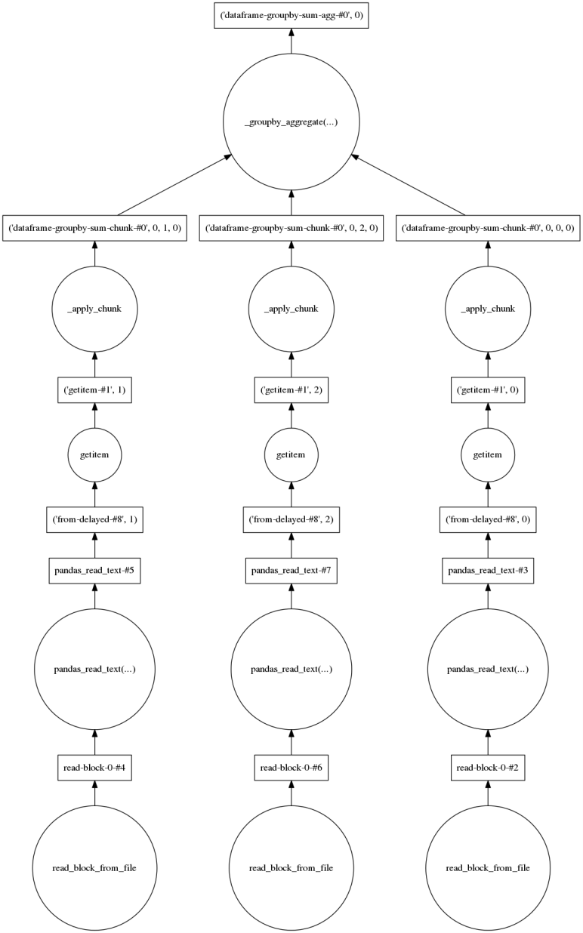
Expressions build a dependency graph…
> task = ddf[['Carrier', 'Flights','Cancelled']] .groupby('Carrier') .sum()
> task.compute()
CPU times: user 13.9 s, sys: 2.22 s, total: 16.1 s
Wall time: 9.62 s
> task.visualize()

Slide 14
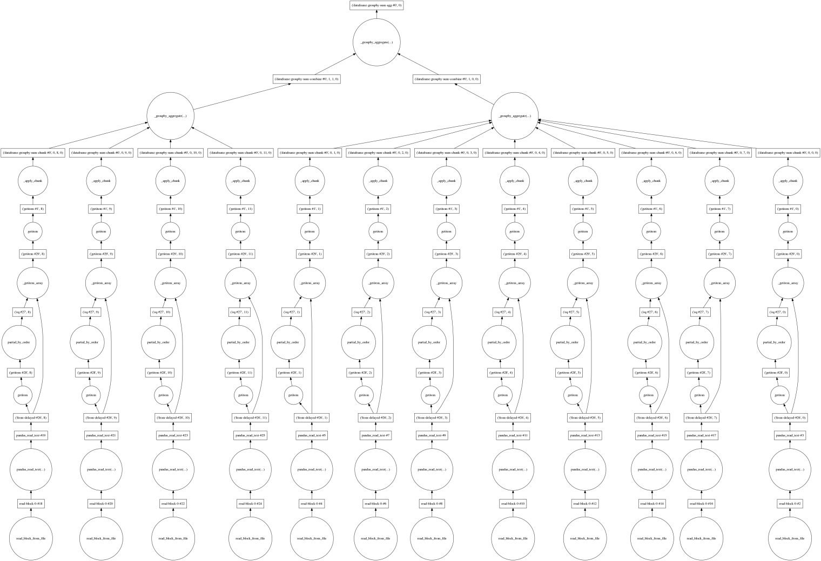
… that can get arbitrarily complex
> ddf = dd.read_csv('flights-*.xz', …)
> task = ddf[ddf.FlightDate=='2016-01-24'] [['Carrier', 'Flights','Cancelled']] .groupby('Carrier') .sum()
> task.visualize()

Slide 15
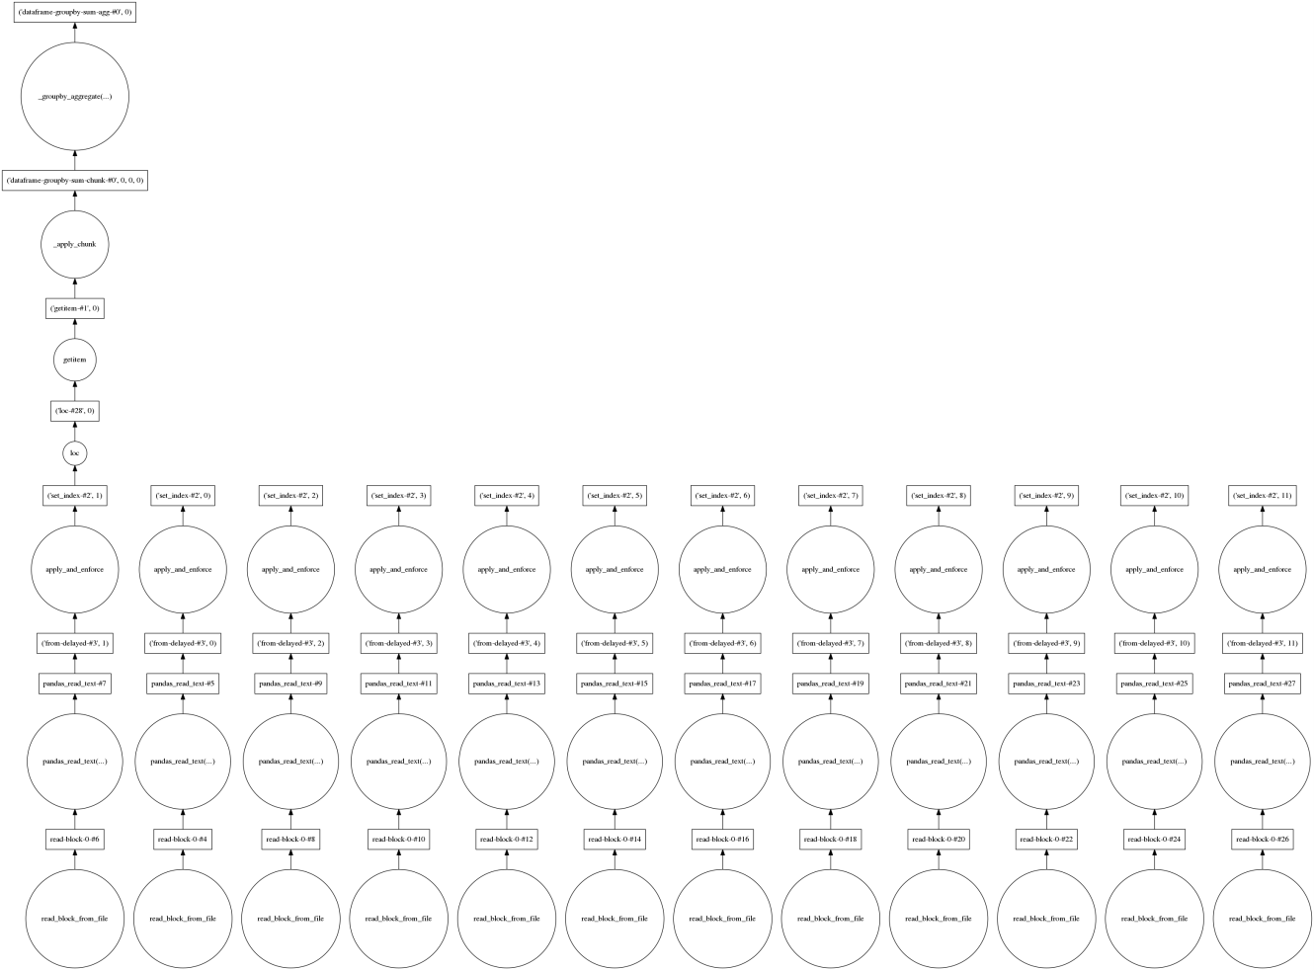
Dask prunes the graph where it can
> ddf = dd.read_csv('flights-*.xz', …)
> ddf = ddf.set_index('FlightDate')
> task = ddf['2016-01-24'] [['Carrier', 'Flights','Cancelled']] .groupby('Carrier') .sum()
> task.visualize()

Slide 16
Storage formats like parquet are faster than csv
ddf = load_data(start='2016-01', end='2017-02')
def sort_partition(df):
return df.set_index(df.FlightDate).sort_index()
task = ddf.map_partitions(func=sort_partition)
task.to_parquet('flights.parq', compression='SNAPPY')
$ ls -hs flights.parq/
total 100M
4.0K _common_metadata
20K _metadata
8.5M part.0.parquet
8.0M part.1.parquet
7.5M part.2.parquet
...
8.2M part.11.parquet
8.2M part.12.parquet

Slide 17
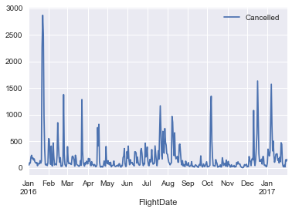
Storage formats like parquet are faster than csv
Parquet example 1 – whole dataset
ddf = load_data(start='2016-01', end='2017-02')
def sort_partition(df):
return df.set_index(df.FlightDate).sort_index()
task = ddf.map_partitions(func=sort_partition)
task.to_parquet('flights.parq', compression='SNAPPY')
$ ls -hs flights.parq/
total 100M
4.0K _common_metadata
20K _metadata
8.5M part.0.parquet
8.0M part.1.parquet
7.5M part.2.parquet
...
8.2M part.11.parquet
8.2M part.12.parquet
ddf = dd.read_parquet('flights.parq',
columns=['Cancelled']) # 50 ms
task = ddf.groupby(ddf.index).sum()
out = task.compute() # 313 ms
out.plot()

Slide 18
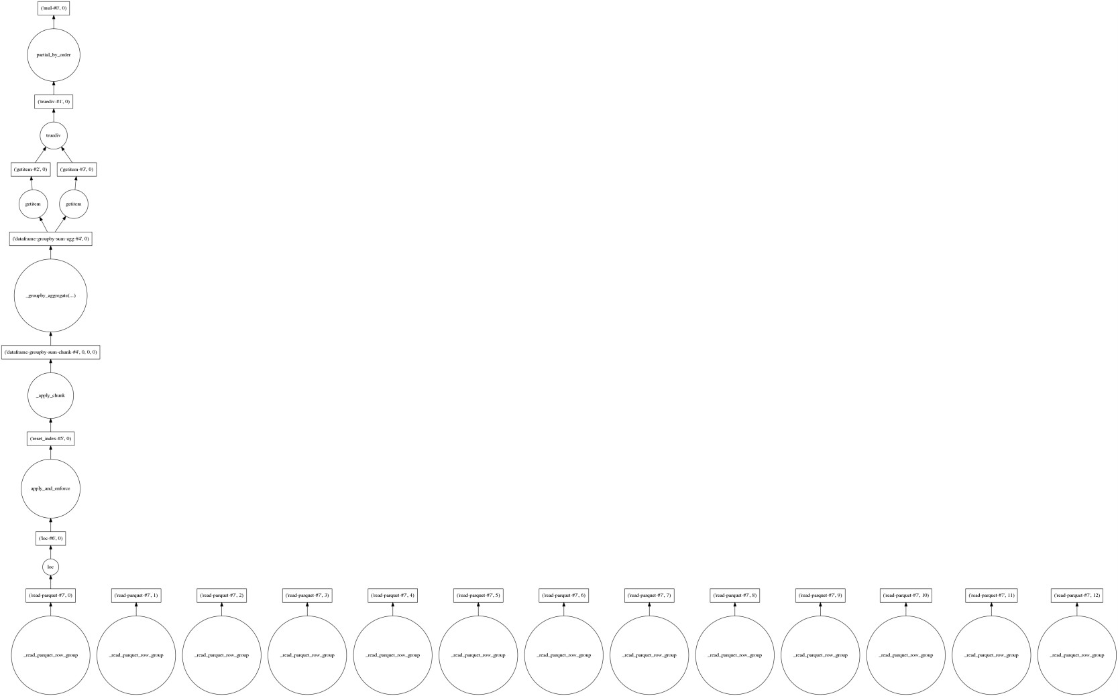
Parquet example 2: read a subset of the partitions
ddf = dd.read_parquet('flights.parq',
columns=['Carrier','Flights','Cancelled'])
x = (ddf.loc['2016-01-18':'2016-01-28']
.reset_index() # Move FlightDate from index to a column
.groupby(by=['Carrier','FlightDate'])
.sum()
)
y = x['Cancelled'] / x['Flights'] * 100
out = y.compute()
# 220 ms to read data, build graph and calculate
> out
Carrier FlightDate
AA 2016-01-19 0.339992
2016-01-20 0.160064
2016-01-21 1.327606
2016-01-22 30.712339
2016-01-23 36.307838
2016-01-24 25.588114
2016-01-25 8.853119
...
WN 2016-01-21 1.133787
2016-01-22 14.436219
2016-01-23 21.369961
2016-01-24 17.904074
2016-01-25 4.630682
2016-01-26 1.394422
2016-01-27 0.910643
2016-01-28 0.597610
dtype: float64

Slide 19
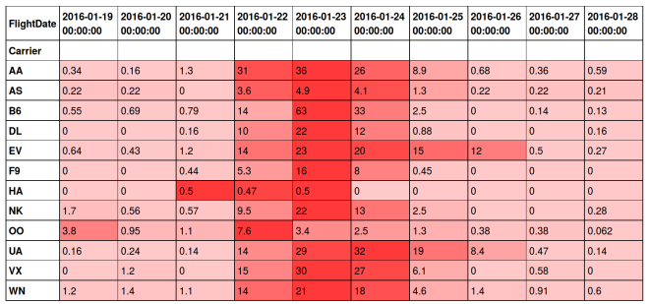
Parquet example 2: read a subset of the partitions
ddf = dd.read_parquet('flights.parq',
columns=['Carrier','Flights','Cancelled'])
x = (ddf.loc['2016-01-18':'2016-01-28']
.reset_index() # Move FlightDate from index to a column
.groupby(by=['Carrier','FlightDate'])
.sum()
)
y = x['Cancelled'] / x['Flights'] * 100
out = y.compute()
# 220 ms to read data, build graph and calculate
> ( out.unstack('FlightDate')
.style
.set_precision(2)
.background_gradient( cmap=sns.light_palette( "red", as_cmap=True),
high=0.4, low=0.2,
axis=1,)
)

Slide 20
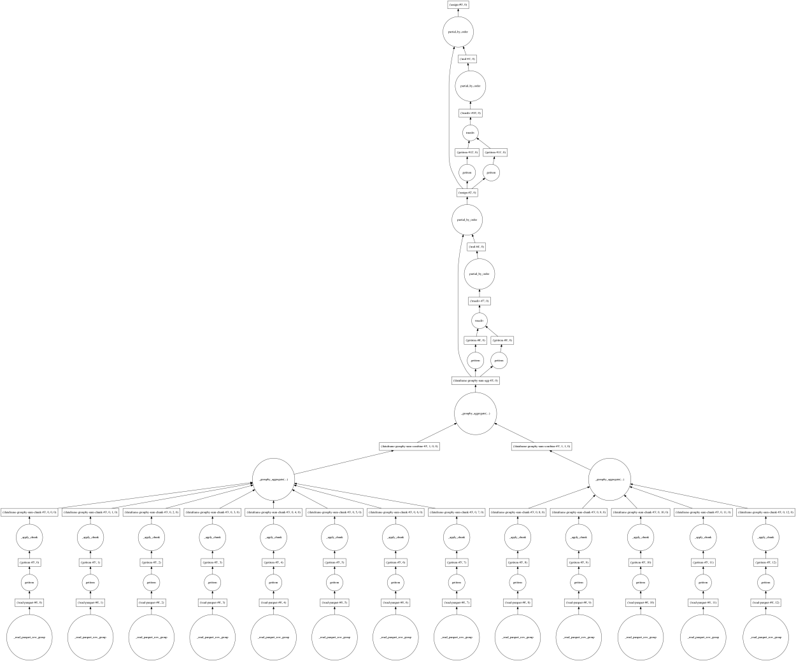
Monitoring progress of a Dask calculation
ddf = dd.read_parquet('flights.parq')
sum_cols = ['Carrier', 'Flights', 'Cancelled', 'Diverted']
task = ddf[sum_cols].groupby('Carrier').sum()
task['CancelledPct'] = task['Cancelled'] / task['Flights'] * 100
task['DivertedPct' ] = task['Diverted' ] / task['Flights'] * 100

Slide 21
Monitoring progress of a Dask calculation
ddf = dd.read_parquet('flights.parq')
sum_cols = ['Carrier', 'Flights', 'Cancelled', 'Diverted']
task = ddf[sum_cols].groupby('Carrier').sum()
task['CancelledPct'] = task['Cancelled'] / task['Flights'] * 100
task['DivertedPct' ] = task['Diverted' ] / task['Flights'] * 100
from dask.diagnostics import ProgressBar
with ProgressBar():
out = task.compute()
[ ] | 0% Completed | 0.0s
>

Slide 22
Monitoring progress of a Dask calculation
ddf = dd.read_parquet('flights.parq')
sum_cols = ['Carrier', 'Flights', 'Cancelled', 'Diverted']
task = ddf[sum_cols].groupby('Carrier').sum()
task['CancelledPct'] = task['Cancelled'] / task['Flights'] * 100
task['DivertedPct' ] = task['Diverted' ] / task['Flights'] * 100
from dask.diagnostics import ProgressBar
with ProgressBar():
out = task.compute()
[############################# ] | 87% Completed | 2.4s
>

Slide 23
Monitoring progress of a Dask calculation
ddf = dd.read_parquet('flights.parq')
sum_cols = ['Carrier', 'Flights', 'Cancelled', 'Diverted']
task = ddf[sum_cols].groupby('Carrier').sum()
task['CancelledPct'] = task['Cancelled'] / task['Flights'] * 100
task['DivertedPct' ] = task['Diverted' ] / task['Flights'] * 100
from dask.diagnostics import ProgressBar
with ProgressBar():
out = task.compute()
[##################################] |100% Completed | 2.6s
> print(out)
Flights Cancelled Diverted CancelledPct DivertedPct
Carrier
AA 987627.0 11847.0 2421.0 1.199542 0.245133
AS 191991.0 1072.0 520.0 0.558360 0.270846
B6 307075.0 4322.0 774.0 1.407474 0.252056
DL 992559.0 4898.0 1923.0 0.493472 0.193742
EV 526027.0 13048.0 1723.0 2.480481 0.327550
F9 102881.0 1341.0 169.0 1.303448 0.164267
HA 83065.0 136.0 91.0 0.163727 0.109553
NK 150769.0 3070.0 218.0 2.036228 0.144592
OO 656079.0 10326.0 2181.0 1.573896 0.332429
UA 587470.0 5702.0 1522.0 0.970603 0.259077
VX 74903.0 806.0 272.0 1.076058 0.363136
WN 1407229.0 18179.0 3324.0 1.291830 0.236209

Slide 24
Profiling a Dask calculation
ddf = dd.read_parquet('flights.parq')
sum_cols = ['Carrier', 'Flights', 'Cancelled', 'Diverted']
task = ddf[sum_cols].groupby('Carrier').sum()
task['CancelledPct'] = task['Cancelled'] / task['Flights'] * 100
task['DivertedPct' ] = task['Diverted' ] / task['Flights'] * 100
from dask.diagnostics import Profiler, ResourceProfiler, CacheProfiler
from cachey import nbytes
with (Profiler() as prof, ResourceProfiler(dt=0.25) as rprof,
CacheProfiler(metric=nbytes) as cprof):
df = task.compute()

Slide 25
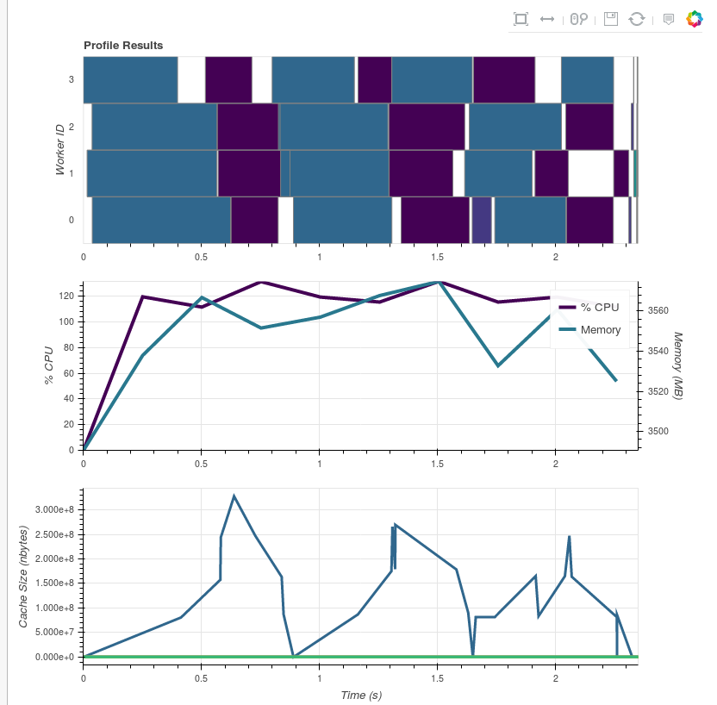
Profiling a Dask calculation
ddf = dd.read_parquet('flights.parq')
sum_cols = ['Carrier', 'Flights', 'Cancelled', 'Diverted']
task = ddf[sum_cols].groupby('Carrier').sum()
task['CancelledPct'] = task['Cancelled'] / task['Flights'] * 100
task['DivertedPct' ] = task['Diverted' ] / task['Flights'] * 100
from dask.diagnostics import Profiler, ResourceProfiler, CacheProfiler
from cachey import nbytes
with (Profiler() as prof, ResourceProfiler(dt=0.25) as rprof,
CacheProfiler(metric=nbytes) as cprof):
df = task.compute()
dask.diagnostics.visualize([prof, rprof, cprof], save=False, show=True)

Slide 26
So what exactly is a Dask DataFrame?
> print(dd.DataFrame.__doc__)
Implements out-of-core DataFrame as a sequence of pandas DataFrames
Parameters
----------
dask: dict
The dask graph to compute this DataFrame
name: str
The key prefix that specifies which keys in the dask
comprise this particular DataFrame
meta: pandas.DataFrame
An empty ``pandas.DataFrame`` with names, dtypes, and
index matching the expected output.
divisions: tuple of index values
Values along which we partition our blocks on the index
def from_pandas(data, npartitions=None, chunksize=None, sort=True, name=None):
"""
Construct a Dask DataFrame from a Pandas DataFrame
This splits an in-memory Pandas dataframe into several parts and constructs
a dask.dataframe from those parts on which Dask.dataframe can operate in
parallel.
Note that, despite parallelism, Dask.dataframe may not always be faster
than Pandas. We recommend that you stay with Pandas for as long as
possible before switching to Dask.dataframe.
Parameters
----------
data : pandas.DataFrame or pandas.Series
The DataFrame/Series with which to construct a Dask DataFrame/Series
npartitions : int, optional
The number of partitions of the index to create. Note that depending on
the size and index of the dataframe, the output may have fewer
partitions than requested.
chunksize : int, optional
The size of the partitions of the index.
sort: bool
Sort input first to obtain cleanly divided partitions or don't sort and
don't get cleanly divided partitions
name: string, optional
An optional keyname for the dataframe. Defaults to hashing the input
Returns
-------
dask.DataFrame or dask.Series
A dask DataFrame/Series partitioned along the index

Slide 27

The simplest Dask DataFrame
>>> df = pd.DataFrame([[1,2,3],[4,5,6],[7,8,9],
[10,11,12],[13,14,15]], columns=['a','b','c'])
a b c
0 1 2 3
1 4 5 6
2 7 8 9
3 10 11 12
4 13 14 15
>>> ddf = dd.from_pandas(df, npartitions=1)
a b c
npartitions=1 int64 int64 int64
0 ... ... ...
4 ... ... ...
Dask Name: from_pandas, 2 tasks
>>> ddf.divisions
(0, 4)
>>> ddf._meta
Empty DataFrame
Columns: [a, b, c]
Index: []
> print(dd.DataFrame.__doc__)
dask: dict
The dask graph to compute this DataFrame
name: str
The key prefix that specifies which keys in the dask
comprise this particular DataFrame
meta: pandas.DataFrame
An empty ``pandas.DataFrame`` with names, dtypes, and
index matching the expected output.
divisions: tuple of index values
Values along which we partition our blocks on the index
>>> ddf._name
'from_pandas-b71f6a90'
>>> ddf.dask
{
('from_pandas-b71f6a90', 0): df,
}
>>> ddf.visualize()

Slide 28

The next simplest Dask DataFrame
>>> df = pd.DataFrame([[1,2,3],[4,5,6],[7,8,9],
[10,11,12],[13,14,15]], columns=['a','b','c'])
a b c
0 1 2 3
1 4 5 6
2 7 8 9
3 10 11 12
4 13 14 15
>>> ddf = dd.from_pandas(df, npartitions=2)
a b c
npartitions=1 int64 int64 int64
0 ... ... ...
3 ... ... ...
4 ... ... ...
Dask Name: from_pandas, 2 tasks
>>> ddf.divisions
(0, 3, 4)
>>> ddf._meta
Empty DataFrame
Columns: [a, b, c]
Index: []
> print(dd.DataFrame.__doc__)
dask: dict
The dask graph to compute this DataFrame
name: str
The key prefix that specifies which keys in the dask
comprise this particular DataFrame
meta: pandas.DataFrame
An empty ``pandas.DataFrame`` with names, dtypes, and
index matching the expected output.
divisions: tuple of index values
Values along which we partition our blocks on the index
>>> ddf._name
'from_pandas-de36e0f9'
>>> ddf.dask
{
('from_pandas-de36e0f9', 0): df[0:3],
('from_pandas-de36e0f9', 1): df[3:],
}
>>> ddf.visualize()

Slide 29
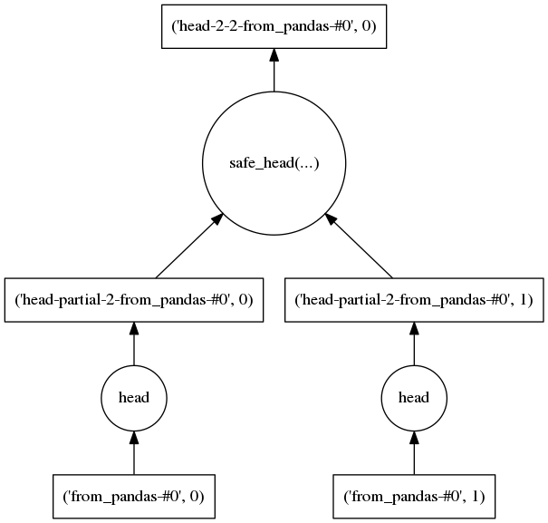
dd.DataFrame.dask
>>> ddf = dd.from_pandas(df, npartitions=2) .head(n=2, npartitions=2, compute=False)
>>> ddf._name
'head-2-2-from_pandas-de36e0f9b'
>>> ddf.dask
{
('head-2-2-from_pandas-de36e0f9b', 0):
( dask.dataframe.core.safe_head,
( function dask.dataframe.core._concat,
[('head-partial-2-from_pandas-de36e0f9b', 0),
('head-partial-2-from_pandas-de36e0f9b', 1)]
), 2
),
('head-partial-2-from_pandas-de36e0f9b', 0):
(<methodcaller: head>, ('from_pandas-de36e0f9b', 0), 2), ('head-partial-2-from_pandas-de36e0f9b', 1):
(<methodcaller: head>, ('from_pandas-de36e0f9b', 1), 2),
('from_pandas-de36e0f9b', 0): df[0:3],
('from_pandas-de36e0f9b', 1): df[3:],
}
>>> ddf._keys()
[('head-2-2-from_pandas-de36e0f9b', 0)]
>>> ddf.compute()

Slide 30
Reimplement pandas methods lazily
>>> ddf = dd.from_pandas(df, npartitions=2) .head(n=2, npartitions=2, compute=False)
>>> ddf._name
'head-2-2-from_pandas-de36e0f9b'
>>> ddf.dask
{
('head-2-2-from_pandas-de36e0f9b', 0):
( dask.dataframe.core.safe_head,
( function dask.dataframe.core._concat,
[('head-partial-2-from_pandas-de36e0f9b', 0),
('head-partial-2-from_pandas-de36e0f9b', 1)]
), 2
),
('head-partial-2-from_pandas-de36e0f9b', 0):
(<methodcaller: head>, ('from_pandas-de36e0f9b', 0), 2), ('head-partial-2-from_pandas-de36e0f9b', 1):
(<methodcaller: head>, ('from_pandas-de36e0f9b', 1), 2),
('from_pandas-de36e0f9b', 0): df[0:3],
('from_pandas-de36e0f9b', 1): df[3:],
}
>>> ddf._keys()
[('head-2-2-from_pandas-de36e0f9b', 0)]
>>> ddf.compute()
dask.dataframe.core._Frame (L758+):
def head(self, n=5, npartitions=1, compute=True):
""" First n rows of the dataset"""
if npartitions <= -1:
npartitions = self.npartitions
name = 'head-%d-%d-%s' % (npartitions, n, self._name)
if npartitions > 1:
name_p = 'head-partial-%d-%s' % (n, self._name)
dsk = {}
for i in range(npartitions):
dsk[(name_p, i)] = (M.head, (self._name, i), n)
concat = (_concat, [(name_p, i) for i in range(npartitions)])
dsk[(name, 0)] = (safe_head, concat, n)
else:
dsk = {(name, 0): (safe_head, (self._name, 0), n)}
result = new_dd_object(merge(self.dask, dsk), name, self._meta,
[self.divisions[0], self.divisions[npartitions]])
if compute:
result = result.compute()
return result

Slide 31
Now we execute the graph with ‘compute’
dask.dataframe.base (L139+):
def compute(*args, **kwargs):
"""Compute several dask collections at once.
args : Any dask objects are computed and the result is returned.
traverse : Set to False to not look for dask objects in Python collections.
get : An optional alternative scheduler ``get`` function to use.
optimize_graph : If True [default], optimize the graph before computation.
Otherwise run as is. This can be useful for debugging.
kwargs : Extra keywords to forward to the scheduler ``get`` function.
"""
from dask.delayed import delayed
traverse = kwargs.pop('traverse', True)
if traverse:
args = tuple(delayed(a) if isinstance(a,
(list, set, tuple, dict, Iterator))
else a for a in args)
optimize_graph = kwargs.pop('optimize_graph', True)
variables = [a for a in args if isinstance(a, Base)]
if not variables:
return args
get = kwargs.pop('get', None) or _globals['get']
dsk = collections_to_dsk(variables, optimize_graph, **kwargs)
keys = [var._keys() for var in variables]
results = get(dsk, keys, **kwargs)
results_iter = iter(results)
return tuple(a if not isinstance(a, Base)
else a._finalize(next(results_iter))
for a in args)
Optimize
Cull – remove unnecessary tasks
Fuse tasks – make parallelization less granular
Inline cheap functions
Get graphs keys to evaluate
Execute in parallel with scheduler
‘get’ function
Sort nodes
Balance work between threads, processes, cores, over a cluster
Optionally cache intermediate results
References in dask source code:
- optimize.py, order.py and async.py

Slide 32
Conclusions
Dask is neat!
Especially in combination with parquet and distributed schedulers
Rough edges where it isn’t quite pandas…
Distributed operations have very different costs than in-memory pandas
I’d like more time to experiment with distributed schedulers (dask/distributed, dask/dec2), and compare storage formats (csv, Parquet, HDF5, HDFS, etc)

Slide 33
Conclusions
Dask is neat!
Especially in combination with parquet and distributed schedulers
Rough edges where it isn’t quite pandas…
Distributed operations have very different costs than in-memory pandas
I’d like more time to experiment with distributed schedulers (dask/distributed, dask/dec2), and compare storage formats (csv, Parquet, HDF5, HDFS, etc)
… but is Dask really the future of ‘big pandas’?

