Slide 1
Pandas 2.0 – where next? PyCon UK tutorial, 27 October 2017
Stephen Simmons
mail@stevesimmons.com stephen.e.simmons@jpmorgan.com
https://github.com/stevesimmons/pyconuk-2017-pandas-and-dask

Slide 2
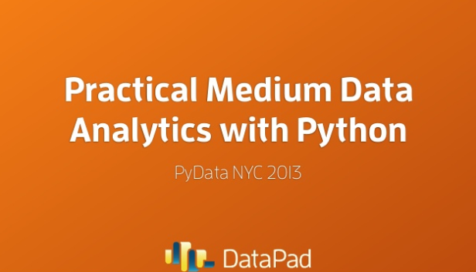
Wes McKinney’s talk at PyData NYC 2013
Source: https://www.slideshare.net/wesm/practical-medium-data-analytics-with-python

Slide 3
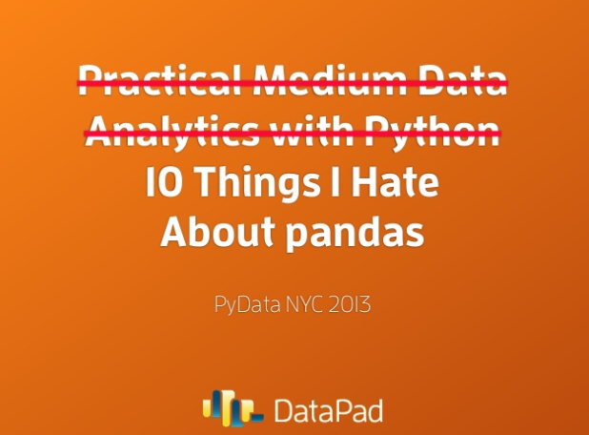
Wes McKinney’s talk at PyData NYC 2013

Slide 4
“10 Things I Hate About Pandas” (Wes McKinney, 2013)
Internals too far from "the metal"
No support for memory-mapped datasets
Poor performance in database and file ingest / export
Warty missing data support
Lack of transparency into memory use, RAM management
Weak support for categorical data
Complex groupby operations awkward and slow
Appending data to a DataFrame tedious and very costly
Limited, non-extensible type metadata
Eager evaluation model, no query planning
"Slow", limited multicore algorithms for large datasets
Source: http://wesmckinney.com/blog/apache-arrow-pandas-internals/

Slide 5
Way forward: Apache Arrow + “libpandas”
Apache Arrow
Columnar in-memory data format
Fast: C++, cache-locality, zero-copy reads
Aim is same memory format for Pandas, Spark, HBase, Parquet, …
libpandas
Use Arrow for in-memory data (no BlockManager)
More predictable memory usage
Simpler core API
“Deferred” pandas API
Expressions API for building calculation frameworks
Use for out-of-core and distributed execution (using simplified Dask?)
v 0.7.1, Oct 2017
Design phase
For the future

