Slide 1

Revolutionizing
Healthcare
Data Management
with
Blockchain

Slide 2
Problem Definition
Data Security
Untutored System
Administrative Costs
Redundancy
Current system involves huge monetary requirements for individual hospitals hence cost can be distributed evenly to manage database
Current practices of data storage is prone to data loss and leaks.
Docters and Medical partitionists are not updated of the latest advancements in the industry
The redundant data of several patients from the entire health care system.

Slide 3
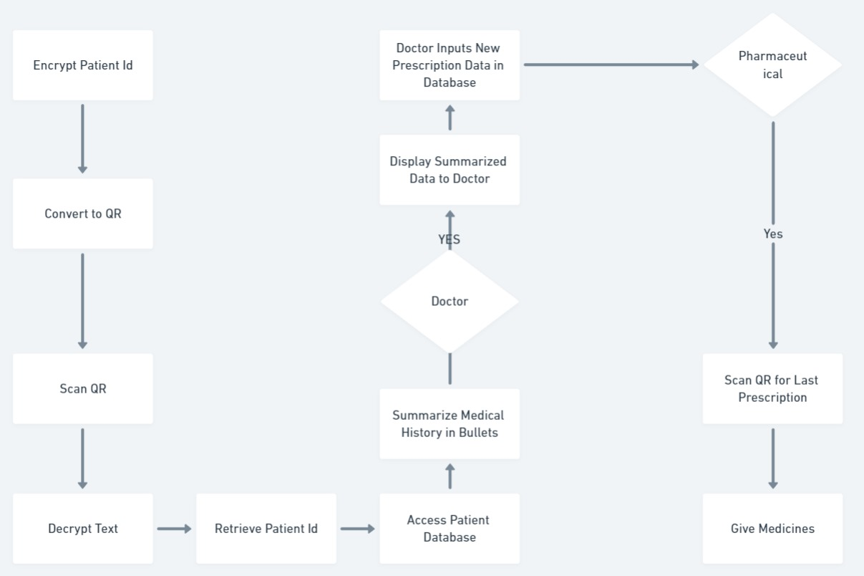
Architecture

Slide 4

Technologies Used
1
HTML and CSS
2
Ganache / Truffle
For creating and styling user interfaces that are accessible and responsive.
This is for demonstration of blockchain so no actual gas fees hence for testing environment
3
Node.js
4
Sanity
Enabling server-side functionality and seamless data integration.
Providing a structured and scalable content management system.
5
Python and Solidity
For building smart contracts and executing blockchain transactions.

Slide 5

Unique Aspects of Idea:
Security and Disaster Recovery
Reduced Administrative Costs
Immutable Audit Trails
Improved Data Integrity
The use of blockchain technology ensures the protection and privacy of patient data. Blockchain will help in data recovery since data isn’t available at a single database.
The use of smart contracts and automation significantly reduces administrative overhead by dividing it between multiple hospitals and medications.
The blockchain's immutable audit trails provide unprecedented transparency and accountability, a key differentiator from traditional databases.
Blockchain-based data management minimizes the risk of tampering or fraud.

Slide 6
Solution
Safe and Reliable non Redundant
Generative AI Suggestions
Administrative Costs
Scalability
Protecting patient information from unauthorized access and data breaches.
Docters and Medical partitionists are suggested latest and most accurate medicines acc. To patients’ history.
Reducing and distributing the financial burden of maintaining and transferring medical records among hospitals.
Data of patient of one country can be accessed by hospital of any country of the world.

