Slide 1
Scripting Languages for Interactive Fiction
Mike Gran
Los Angeles, California, USA
http://lonelycactus.com
gopher://spikycactus.dnsalias.com
https://github.com/spk121
spk121 at yahoo.com
Twitter @MikeSpike3

Slide 2
Agenda
About me
Interactive fiction and its sub-genres
Hypertext Interactive Fiction as an entry point
Helping underrepresented voices
Introducing Twine and Harlowe
That time I wrote an interactive fiction in Guile
Opinion: Your introductory language is too complicated
Conclusion: Minimalism is empowering

Slide 3
Who am I?
I neglectfully maintain
guile ncurses
guile curl
guile ispell
libzmodem: a ZModem library for BBSs
I am actively working
guile-gi: yet another GObject Introspection library
I can help you with
USA Gov’t standards for software and hardware procurement
real-time, embedded C/C++ for low size, weight and power systems
GPS

Slide 4
Various Semi-Legal Notices
The following presentation was created without recourse to equipment, premises, and resources of my employer. It was created wholly during unpaid time. It does not derive from the intellectual property of my employer.
Nothing in this presentation is a “joint work” or “made for hire” under California law.
No opinions expressed or implied therein should be considered to be the opinions of my employer, the United States government, or any of its departments.
This presentation is presented under a CC BY 4.0 license.

Slide 5
What is Interactive Fiction?
Interactive fiction is a type of game
Text-only or text-dominant
Focuses on story and puzzles
Not real time
Describes a situation then expects the user to make a choice or decision

Slide 6
Three sub-genres of interactive fiction
Classic Interactive Fiction
  Uses text parser for input
  Usually focuses on object or logic puzzles
Visual novels
  More graphical
  Typically presents pictures of characters with associated dialog
  Usually focuses on dialog and character relationships
  Uses hyperlinks or mouse interaction as input
Hypertext Interactive Fiction
  Uses hyperlinks as input
  More narrative in style

Slide 7
Classic Interactive Fiction
WEST OF HOUSE
This is an open field west of a white house, with a boarded front door.
There is a small mailbox here.
A rubber mat saying ‘Welcome to Zork!’ lies by the door.
> open door
The door cannot be opened.
> look under mat
There is nothing interesting there.

Slide 8
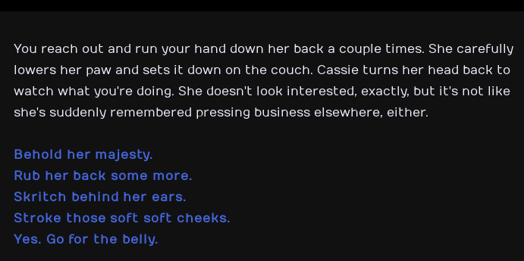
Hypertext Interactive Fiction
From “Cat Petting Simulator 2014”

Slide 9
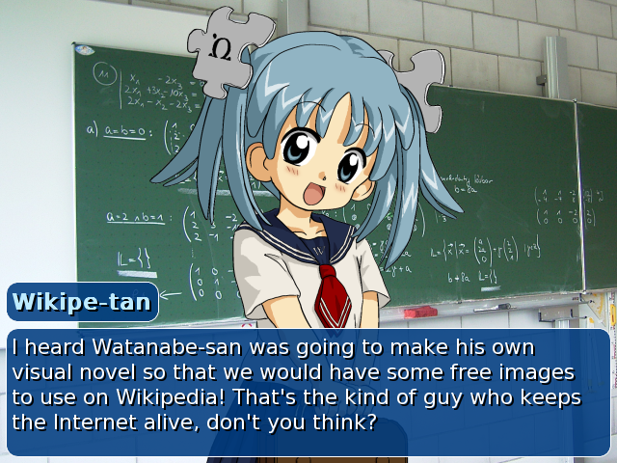
Visual Novels

Slide 10
Underrepresented Voices
The hypertext interactive fiction scene has a wide variety of authors and topics
Let’s look at four unusual games from underrepresented voices:
  Beneath Floes – addresses Nunavut culture
  Depression Quest – addresses depression
  Thread (Lucid Thread Games) – addresses veterans and PTSD
  As Cold as the Grave – queer romance

Slide 11

As Cold as the Grave
“Three times. As the heir to the throne, you have to visit the ruler of the Fae three times.
Unfortunately for you, you have to meet with the Queen of the Unseelie Fae.
No one has had to deal with her before.”
https://drazillion.itch.io/as-cold-as-the-grave

Slide 12

Beneath Floes
“Qikiqtaaluk, 1962. The sun falls below the horizon and won't return for months. You wander the broken shoreline, wary of your mother's stories about the qalupalik. Fish woman, stealer of wayward children: she dwells beneath the ice.”

Slide 13

Depression Quest
“Depression Quest is an interactive fiction game where you play as someone living with depression.
This game aims to show other sufferers of depression that they are not alone in their feelings, and to illustrate to people who may not understand the illness the depths of what it can do to people.”

Slide 14

Thread
“Thread is an interactive experience that puts you in the shoes of a person coping with PTSD.”
https://www.lucidthreadgames.com/

Slide 15
Importance of Hypertext Interactive Fiction for Underrepresented Voices
There are some easy to find academic studies on LGBTQ Twine games.
Of the 2000+ Twine games on itch.io, 100+ are tagged by their authors as LGBT+
Games commentators such as Feminist Frequency have highlighted the importance of Twine.

Slide 16
Digression: NaNoWriMo
National Novel Writing Month (NaNoWriMo) is an annual writing event. Thousands of amateur authors pledge to write 50,000 word novels during the month of November.
NaNoWriMo hosts group gatherings. Authors meet and write together.
TOP NANOWRIMO NOVEL TOPICS
1. Magick
2. Romance
3. Lesbians
4. Vampires
Most of these novels awful.
Who cares! You do you!
My “best” novel was about a college student who finds out he’s a robot, and then goes on a road trip of discovery. It was garbage.
When anyone can participate, you see different topics!

Slide 17
Who Makes Tiny, Personal Games
So you want to make a game?
It will never make any money.
Likely, only a couple of friends will play it.
Do it anyway.
The Enthalpy of Games
  I have the time and energy do hundreds of hours of free labor
  I have the skill
  I have the vision
  I have the dedication
H = time + skill + vision + dedication
Games that exist have H > H_min

Slide 18
Who Makes Tiny, Personal Games?
People with
coding skills
People with
a story to tell
Lost
voices
People with
time and energy
Indie
games
Lost
voices

Slide 19
Interactive Fiction’s Domain Specific Languages
There are many domain-specific languages created to write interactive fiction
The three sub-genres of interactive fiction have evolved separate creation tools
Classic Interactive Fiction
  Inform, ADRIFT, TADS
Hypertext Interactive Fiction
  Twine ft Harlowe, Twine ft Ice Cube
Visual Novels
  RenPy

Slide 20
Twine + Harlowe
I believe Twine + Harlowe is the simplest free tool to write hypertext interactive fiction
Harlowe is a templating language that converts Harlowe Script to HTML+JavaScript Bundles
Like HTML+PHP
  content is interrupted by delimited code
  each top-level page is an “experience”
  each top-level page is a closure and a scope
Simple Harlowe is simple for any skill level, but, complicated Harlowe is still complicated

Slide 21
Demos!
Demo’s never work live.
But, hey, let’s try!

Slide 22
Simplest Harlowe
A man is here. He is buried in the sand. Only his head is visible.
[[Continue on]]
[[Kick the head]]
Renders as text
Renders a hyperlink. On click, jumps to “Kick the Head” module.
Most Twine games use just this simple syntax

Slide 23
Styles
*emphasis*
**strong**
//italic//
Still simple.
<img src="http://example.org/image.png">
(text-colour:fuchsia)[Fuchsia text]
Uh oh.

Slide 24
Variables and scope
(set: $size to "giant")
Your stomach makes {
(if: $size is 'giant')[
an intimidating rumble!
](else:​)[
a faint gurgle
]}.
Our beautiful readability is already breaking down.
The sigils ‘$’ and ‘_’ on variables indicate local and global scope respectively

Slide 25
Control structures
(for: each _item, ...$arr) [You have the _item.]
prints "You have the " and the item, for each item in $arr.
(for: _ingredient where it contains "petal", ...$reagents) [Cook the _ingredient?]
prints "Cook the " and the string, for each string in $reagents which contains "petal".
Now we are in lambda territory.

Slide 26
Aside: The advantages and risks of Templating Languages
Rewards
Focus on the task
Avoid boilerplate
Simplify
Split up MVC or MVVM concerns
Risks
Because it is readable, you think you understand it
Leaky abstractions
Debugging experience may suffer
Often, makes simple simpler, but, make compex things even more complicated

Slide 27
That time I wrote an interactive fiction in Guile
Wanted to participate in Lisp Game Jam
Inspired by Twine & RenPy
Tried to make simple script
Eventually, newb-friendly readability of scheme is limited
  (((Scheme (is) (scheme))))
Other readers remix Scheme
  WISP is a Python-like syntax for Scheme
  Guile-Reader adds some flexibility to the reader

Slide 28
Code snippet from my Interactive Fiction
(define (Seventeen)
(You-speak-text
"Perhaps you " '(i "should") " say something about the hotel. It is…"
"\n⇒ "
`(a (@ (action ,EighteenA)) "elaborately furnished")
"\n⇒ "
`(a (@ (action ,EighteenB)) "exceedingly expensive")))
So reasonable readable for a Scheme hacker, but, quasiquote and SXML notation is not so friendly.

Slide 29
Publishing and Sharing my Guile Game
Getting my Guile/GTK3-based game as downloadable binaries for GNU/Linux and Windows was a brutal process
  Statically linked everything
  Installed Guile with relative, not absolute, paths
  GTK3 on Windows is poorly supported
  Guile on Windows (via MinGW) is 32-bit, single-threaded only

Slide 30
Minimalism for Newbs != Minimalism for Geeks
Minimalism for Newbs
  Easy to learn
  Easy to understand
  Easy to fix
  Easy to share
Minimalism for Geeks
  Easy to define
  Easy to explain
  Easy to parse
  Easy to run
I’m stereotyping and making overly broad statements.
Don’t @ me, bro.

Slide 31
Opinion: Your Language is too Complicated
I started on BASIC on the TRS-80
10 PRINT “POOPY ”
20 GOTO 10
… and hijinks ensue
You may recoil at old BASIC, but, it was the start of my journey
How should kids in 2019 start on their journey?

Slide 32
Simplicity in Sharing Cannot Be an Afterthough
Hey, wanna see my program?

Slide 33
Simplicity in Publishing and Sharing
Kids these days expect all games to be browser, app or Steam.
So (for free software) you have to target the browser.
There are several websites that will let you publish your Twine game.
Sharing your game with friends is fairly simple.
itch.io
philome.la
newgrouds.com

Slide 34
A Generic Publishing and Sharing Strategy
I wish other small languages had a simple way to share.
Possible paths for a sharing site for other console languages...
Path 1
  Compile to web assembly
Path 2
  Use JS term emulator
  Communicate websockets to language instance port
  Use CloudABI or containers to make safe interpreter instance

Slide 35
Conclusion: Minimalism is Empowering
Tools like Twine+Harlowe (and to a lesser extent, RenPy) have low barrier to entry
  The syntax is expressive for the problem set
  The development environment supports the syntax
  Sharing or rehosting a completed work is simple
  Online services exist to host and run completed works
When that barrier to entry is low enough, the created works can represent a broader range of voices
  In Twine’s simplest forms, any storyteller can approach it.

Slide 36
Thus endeth the lesson
Luke 24:10-12
It was Mary Magdalene and Joanna, and Mary the mother of James, and other women that were with them, which told these things unto the apostles. And their words seemed to them as idle tales, and they believed them not.

