Slide 1

WorkBench For HMI-Modelling

Slide 2
Introduction to HMI Development Workbench
1. How HMI Development work bench is useful?
HMI Development workbench provides the user to generate the metadata and render the screen of imported AI graphics.
It also provides the user, the visual editor to edit its graphic widgets attributes and provides the edit field to enter the Dynamic data values.
Graphic designer can use this workbench to check the screen rendering visually by importing the AI graphics.

Slide 3
Definition of CSV files used in workbench
1. csvfile.gnt = generated contract
2. csvfile.cnt = contract file
3. csvfile.dvs = data validation schema
4. csvfile.dut = dynamic update table
5. csvfile.dSEI = default screen element info
6. csvfile.mSEI = modified screen element info
7. csvfile.cSEI = contract screen element info

Slide 4
.gnt file:
The .gnt file is the extension of CSV file of the generated contract.
.cnt file:
The .cnt file is the extension of CSV file of the available contract file.
.dvs:
The .dvs file is the data validation schema which includes the value of dynamic data ids.
.DUT:
The .DUT file is the dynamic update file which includes the dynamic data ids with the values generated taking .dvs file has the input.

Slide 5
.dSEI:
Default screen element info file with CSV data thats generated directly from AI files without contract data association.
.mSEI:
Modified SEI for attribute values except contract data.
.cSEI:
Contract association done with graphic elements and screen element info.

Slide 6
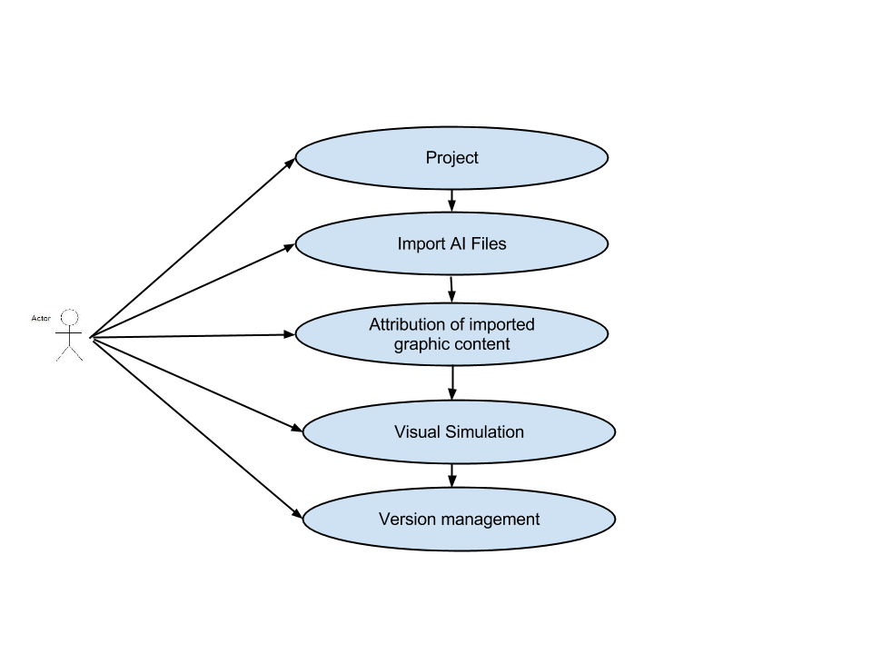
High-level Use-case of Workbench

Slide 7
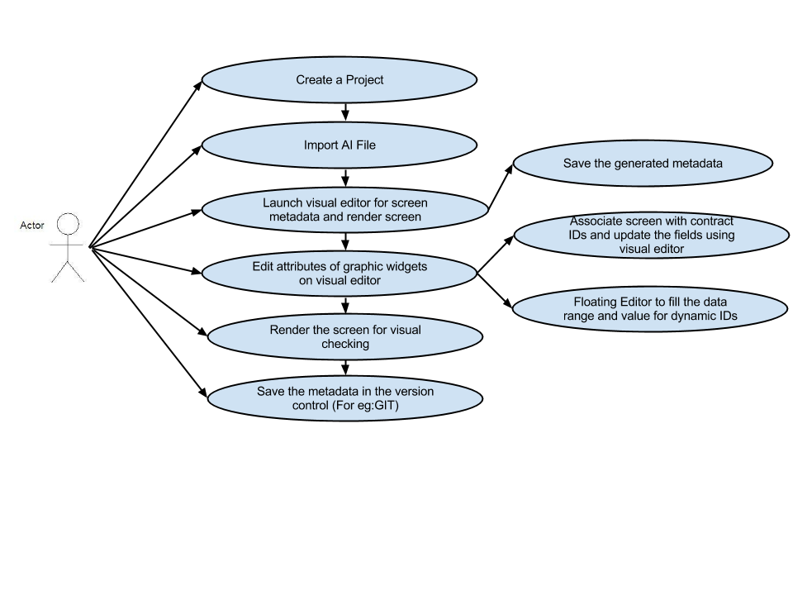
1.Project Creation
1.Create a new project.
2.Extract the AI graphics
by selecting and deselecting
the layers.Extraction
Process is explained in the next slide.
3.Import the extracted AI graphics.

Slide 8
Extraction of AI
Below are the guidelines to be followed for the extraction procedure:
1.Refer to “GIS-400_Uplevel_FBS” for look and appearance of the screens.
2.The file being extracted from Adobe Illustrator has to be checked with the screen shot provided in GIS document. The look of the screen in GIS and that of the extracted file from illustrator should exactly be the same.

Slide 9
Steps For extraction from Raw AI:
1.Anchor position:The anchor as shown should always be set to top left as the reference point for extraction of X, Y, W and H.
2.While extracting the required AI file from the raw file:
a)Open the required AI file in Adobe Illustrator.
b)Always uncheck the unwanted layers in the layers window
c)Select and copy the whole left over file or only the required button / image / label.
d)Open a new artboard from the File menu.
e)In the new artboard, go to Edit menu and click “Paste in place” option.
This gives us the original positioning of the layers as required.

Slide 10
2.Import AI
1.Extract the AI from Raw graphics by following the extraction procedure explained in the previous slides and Import the AI file.
2.User can save the extracted AI file imported in to the version control.
3.User can import single AI file or multiple AI files.
4.User can delete the AI file.

Slide 11
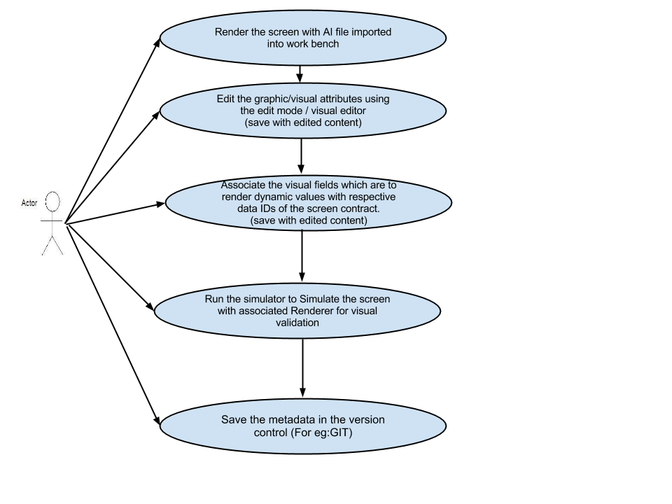
3.Attribution of imported graphic content
Visual editor provides the user
to edit the graphic widgets attributes
and the dynamic values.

Slide 12
Graphic widget attributes
Graphic widget attributes can be:
1.X,Y,Width and Height values
2.Font-type -for e.g. Can Regular,Bold or Italic
3.Font-color -for e.g. Can be RGB or CMYK format
4.Font-size
5.Font-family
6.Background color
7.column width ,column height and spacing attribute for the list screen.

Slide 13
Elements that are dynamic needs to be associated with the contract for Data Ids and Visual editor provides the edit field to enter the dynamic data values and render the screen for visual checking.
For e.g.-In AM_Now_playing screen has the element “frequency” dynamically changing which will have dynamic ID in the contract.User needs to associate the contract when importing AI graphics.
Workbench provides visual editor to the user to enter the value for the dynamic element “frequency” and check for visual validation.

Slide 14
4.Visual Simulation
Visual editor provides the user
to edit the attributes of graphic
Widgets and dynamic values.
User can check for visual
validation and save the data
into the version control.

Slide 15
Before importing of AI graphics ,workbench provides the user to configure its settings.The configuration settings includes:
1.Renderer
For visual validation of the graphic file imported.
XML-Renderer
Android Renderer
HTML Renderer(chrome)
2. UML-component
For testing the interaction validation.
Mock-UML
UML-tool from KPIT

Slide 16
3.Version control
To save the metadata generated in version control.
Clear case
GIT-Hub
4. configure path of the interim file generated of,
CSV
AI
XML

Slide 17
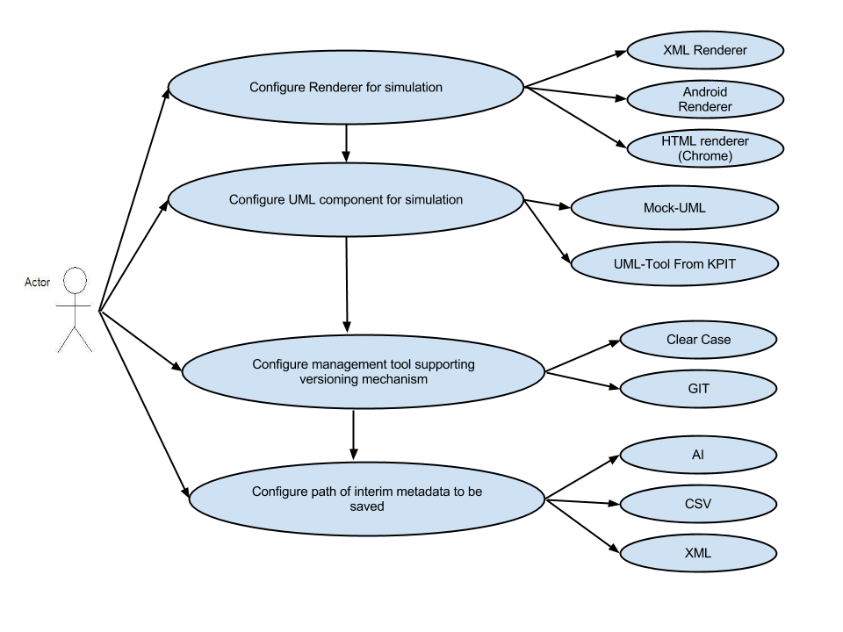
5.Version Management
Workbench provides the user to configure its settings before importing the AI graphics.

Slide 18
DEMO

Slide 19
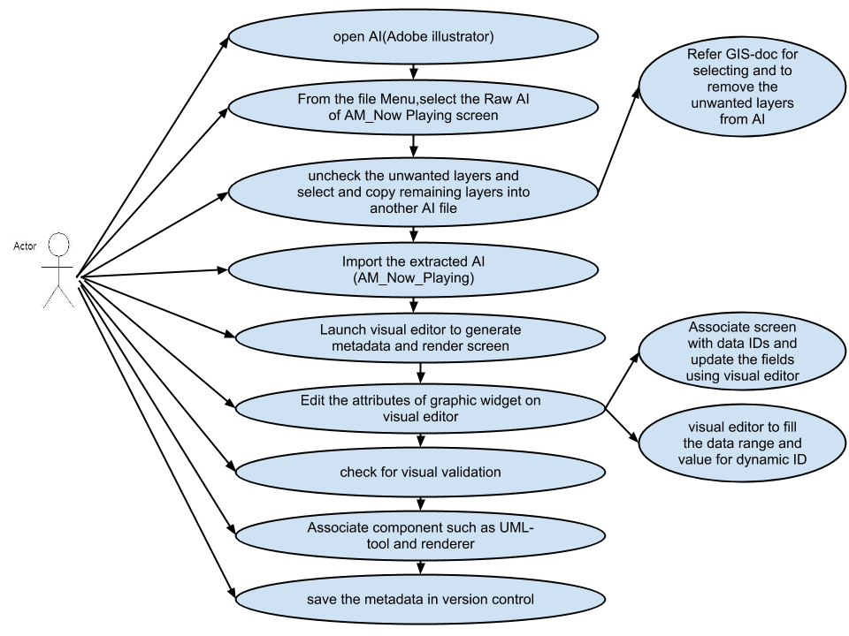

Slide 20
am_now_play AI screen has static and dynamic data present.
The static data in the screen are:
1.Background image
2.Browse label
3.Browse image
4.Gold-division line
5.AM tower image
The Dynamic data in the screen are:
1.Frequency
2.Short station name
3.HD Radio subscript which has states
4.Song-title name
5.Artist name

Slide 21
Elements with interaction function in the screen:
1.Browse label and image
When the user clicks on this element ,screen is transited to strong_station_list.
2.Dynamic text of label element song,artist and short-station name
When the user clicks on this element ,screen is transited to strong_station_list.
3.Image_metadata region
When the user clicks on this element ,screen is transited to strong_station_list.

Slide 22
Attributes of graphic widgets includes:
The attributes of static graphic widget for label includes:
1.font-family
2.font-name
3.font-color
4.font-size
5.font-type
6.text-align
7.truncation-type
8.truncation-suffix
9.rotation time
10.background color

Slide 23
The Dynamic Data values
Dynamic data can be presented by:
1.Associating the Contract for dynamic Ids before importing AI.
2.Providing the text field to enter the value for dynamic elements and check for visual validation.
Interaction elements for screen transition
Provide an edit field to enter the user-event attribute to the Browse element and metadata region which on click transit to strong station list.
Simulation
1.Run the visual editor to check for visual validation.
2.save the metadata in the version control.

