Slide 1

Java, J2EE and Spring MVC
WEBD 5201 Web Development Framework

Slide 2

Module Overview
Java + J2EE + Spring Framework (MVC) + Spring Boot (Microservice)
Spring MVC framework to develop an enterprise web application
2 Assignment and 1 Quiz

Slide 3
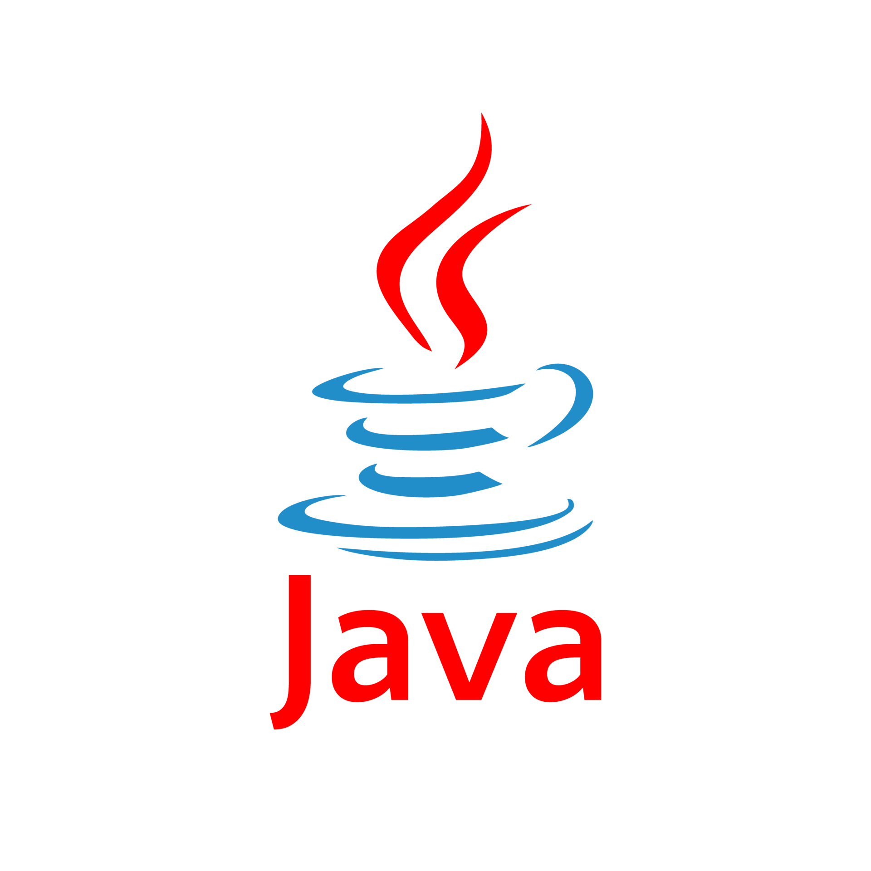
Java Programming Language
The Java programming language is an object-oriented, platform-independent, and versatile programming language created by James Gosling and his team at Sun Microsystems (now owned by Oracle Corporation).
Java is characterized by its write-once-run-anywhere capability, strong type system, and extensive standard library.

Slide 4

Java Use cases
Web Development
Mobile App Development
Enterprise Software
Desktop Development
Game Development
Automotive Industry – Navigation Components
Telecommunication

Slide 5
Java Characteristics
Purely Object-Oriented Programming Language
Platform Independent – Java Virtual Machine
Automatic Memory Management
Multi-Threading
Security
Community and Ecosystems

Slide 6
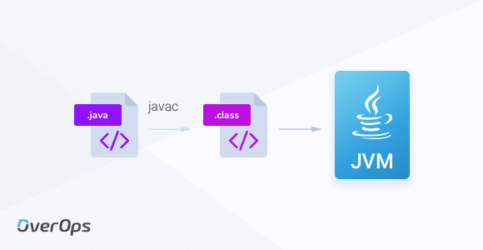
Java Virtual Machine - JVM
It is an integral part of the Java platform and plays a central role in executing Java applications
Execution of the Byte code.
Optimization
Multi Threading

Slide 7

Java Security
Automatic Memory Management
No Pointers
Code Verification – All the byte code will be scanned before execution
Strong Type Systems – All the variable types are enforced strict

Slide 8
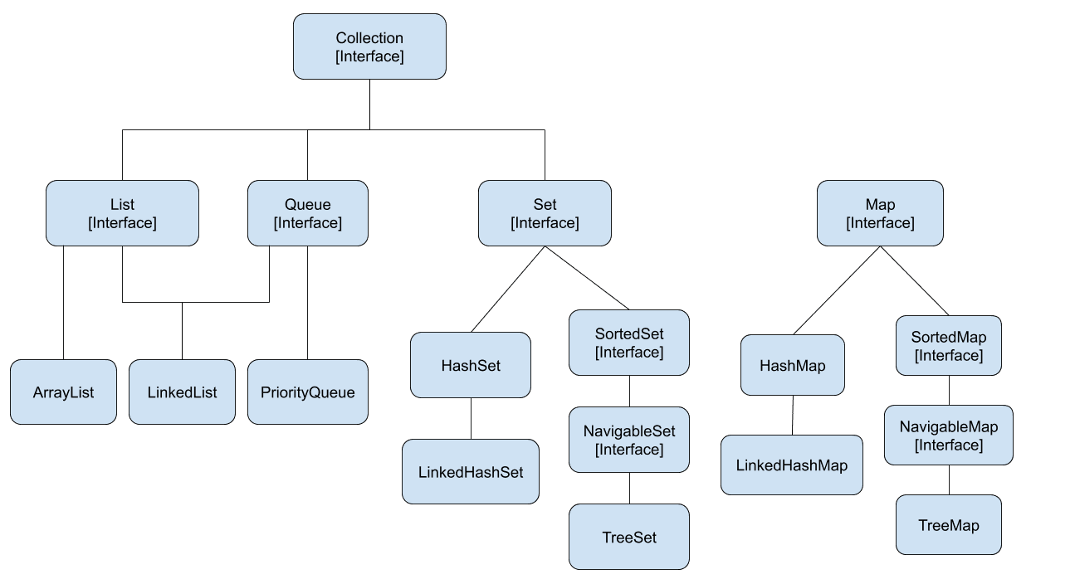
Java Collections
Collections is a framework that will provide set of interfaces and classes that can be used to manipulation of data or object (Example: Stack, Queue, ArrayList, HashSet Etc)

Slide 9
Java Setup - Activity 1 – 20 minutes
Java Basics - https://github.com/spkdroid/Java-Tutorial

Slide 10

J2EE – Java Enterprise Edition
Sun microsystem took the first step in assembling several Java component technology into integrated solution to develop web applications.
J2EE is a specification for a collection of software components to enable development of multitier web application – Paul Jensen, Oracle Cloud Infrastructure.
Suitable for building large-scale web applications

Slide 11
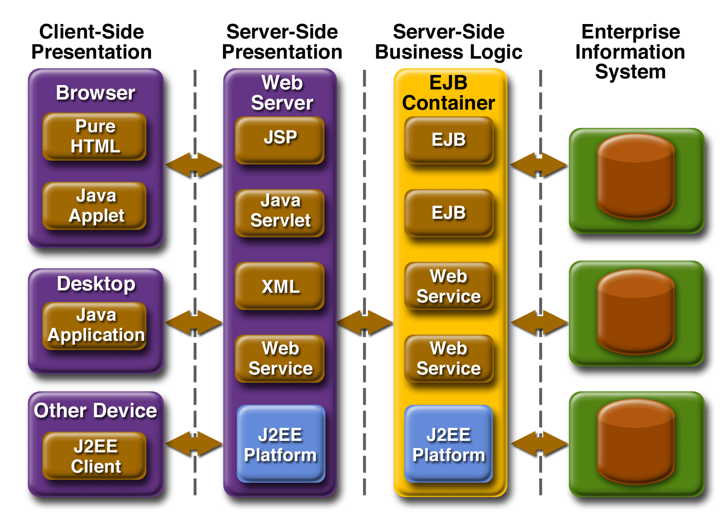
Eenterprose Application Model

Slide 12




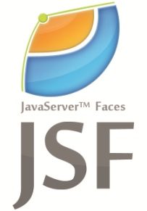
Framework

Slide 13
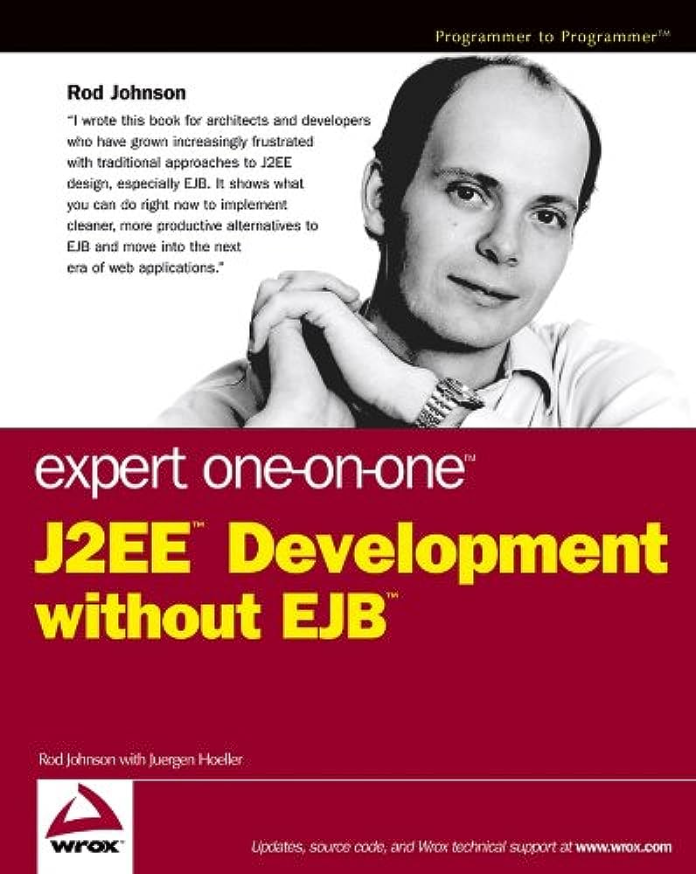
Spring Framework
The first version of the framework was written by Rod Johnson and was released by Apache 2.0 license in June 2003.
One of the most popular application development frameworks for enterprise Java.

Slide 14
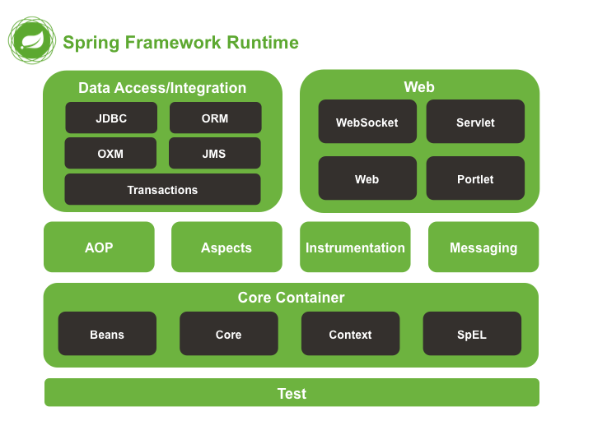

Slide 15
Extended Frameworks
Spring for Kafka – Message Queues
Spring Cloud Data Flow – Real-time data processing pipelines
Spring Apache Solr – Apache Solr search platform
Spring Hadoop – Provides integration with the Hadoop ecosystem.

Slide 16
Spring Boot - Microservice
A microservice is a software architectural style that structures an application as a collection of small, independent services that communicate with each other through well-defined APIs (typically over HTTP).
Each microservice is designed to perform a specific, well-defined function within the application.
https://spring.io/projects/spring-boot

Slide 17
Dependency Injection
Dependency Injection (DI) is a design pattern and a fundamental concept in software development that promotes loose coupling between components and helps manage the dependencies of a class or module.
@Inject is the annotation that is mainly used in different languages
https://github.com/spkdroid/DI

Slide 18
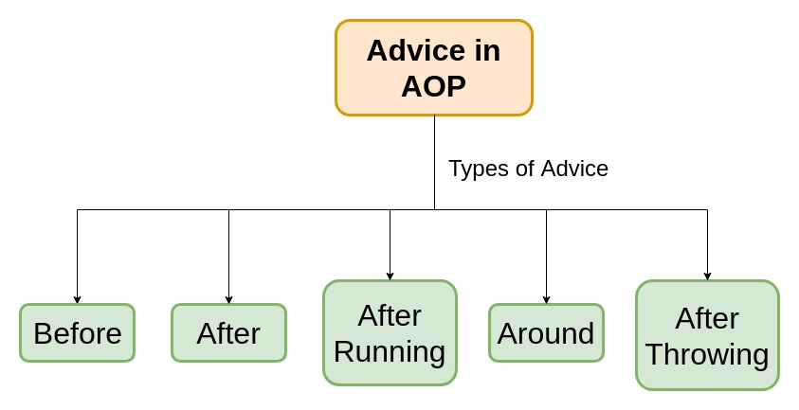
AOP – Aspect Oriented Programming

Slide 19
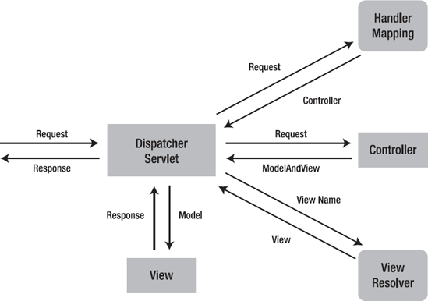
Spring MVC
Spring MVC (Model–view–controller) framework can be used to build web applications. The MVC design pattern separates different aspects of the application into modules and can enable loose coupling.
Dispatcher Servlet – The Dispatcher servlet dispatches requests to handlers
Acts as a front controller and provides a single entry point into the application

Slide 20
Spring MVC Annotation
Annotations | Actions
Controller | Used to make a class to act as a controller
Request Mapping | Used to map URL’s ( Get or Post )
Model Attribute | Used on methods to populate the model
Cookie Value | Used to bound the value to the HTTP cookie
Init Binder | Used for data binding inside the controller class

Slide 21
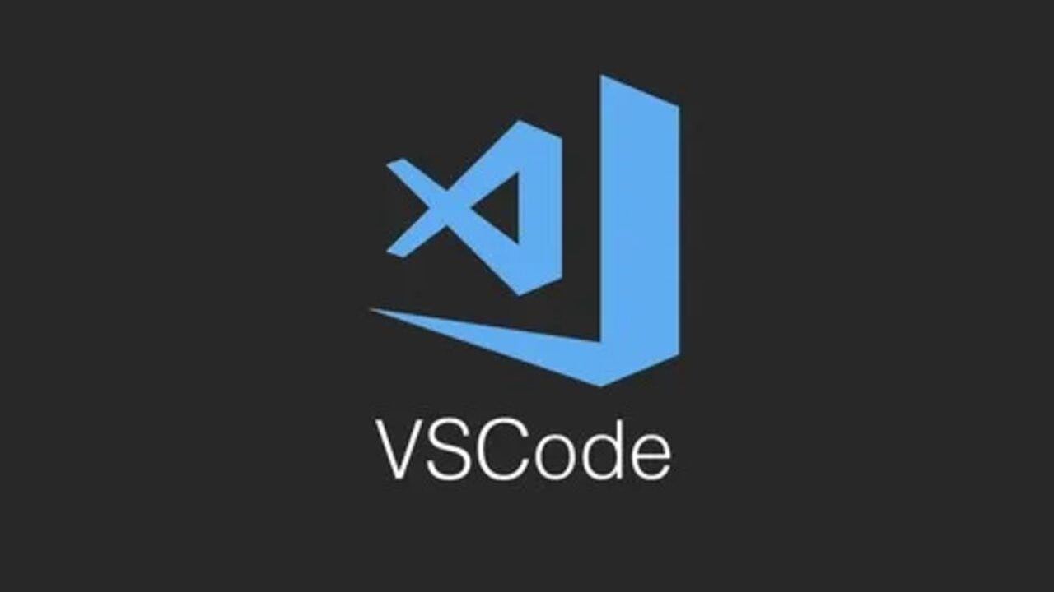

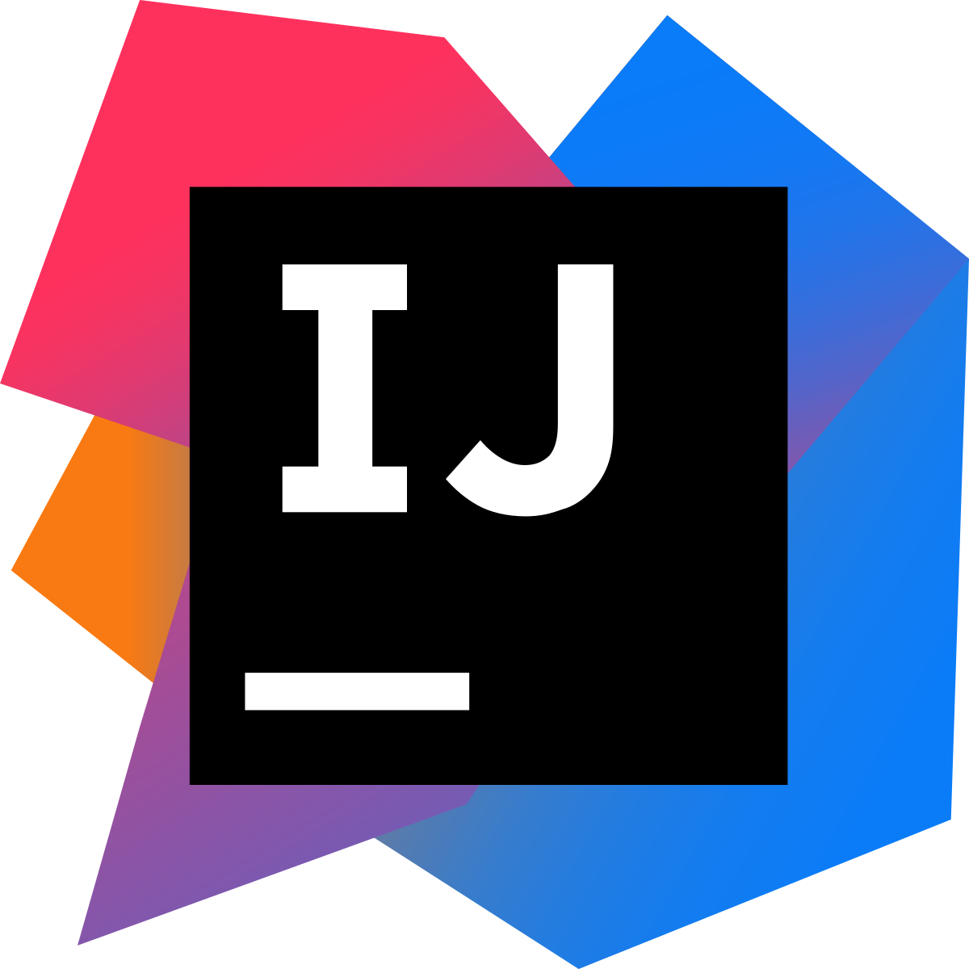
IDE
Integrated Development Environment
VSCode, Spring Tool Suite and Intellij

Slide 22

Questions?

Slide 23

Activity 2 – 30 Minutes
https://github.com/spkdroid/SpringMVC

