Slide 1

Course Retrospect
WEBD 5201 – WEB DEVELOPMENT FRAMEWORKS

Slide 2
Topics
PHP – Laravel framework
Ruby – Ruby on Rails
Java – SpringMVC
Basic System Design
Test Driven Development
CI/CD Pipelines
Web Security
Microservice
Practical Case Studies

Slide 3

Projects
1 PHP Project
1 Case Study
1 Ruby on Rails
1 SpringMVC - Try to complete the front-end part
Try publishing these projects in your Github profile with a suitable readme file.

Slide 4




Career Pathways
Full-stack web development
Associate Software Engineer positions (target one framework + Algorithms)
Database Developer (managing data in a distributed environment)
DevOps Developer ( CI/CD Pipelines, Infrastructure and Cloud)
Application Developer - Security

Slide 5

Quiz 3 Format
5 MCQ each two marks
5 Short answers, each two marks
4 case study questions, twenty marks

Slide 6

Quiz 3
Dispatcher Servlet
Microservice Architecture
SpringMVC– Web.xml
Annotations
Case Study

Slide 7
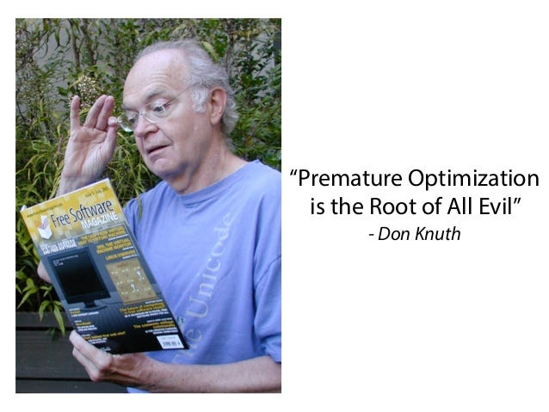
Case Study Format
Define the basic actions
Define the model attributes
Define the Restful Endpoints – pick the appropriate HTTP verbs, sample requests, and responses.
Complete with a proper conclusion.
https://github.com/spkdroid/Spring-CaseStudy

Slide 8

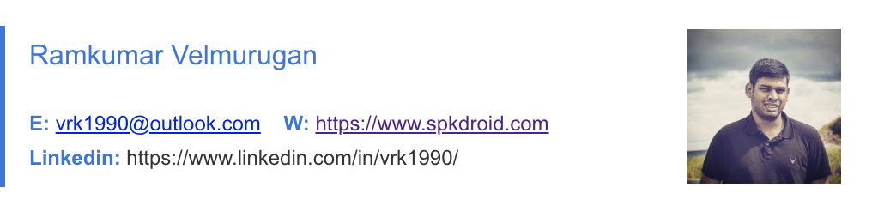
Contact

Slide 9

Questions?

