Slide 1
WEBD 5201 Web Development Frameworks
FALL 2023
Ramkumar Velmurugan

Slide 2
Course Outline
PHP – Larvel
Ruby on Rails
J2ME with Spring MVC

Slide 3

Evaluation Criteria
3 Term Tests – 40%
6 Assignments – 60%

Slide 4
PHP
A popular general-purpose scripting language that is especially suited to web development.
A web server can process PHP code

Slide 5
PHP Features
Open Source
Extensive Library
Community Support
Adaptable with multiple Technology

Slide 6

PHP Company Tech STACK
Facebook
Slack
Etsy
Tumblr

Slide 7



PHP FrameworkS
Laravel
Symfony
CakePHP
Slim
Drupal

Slide 8
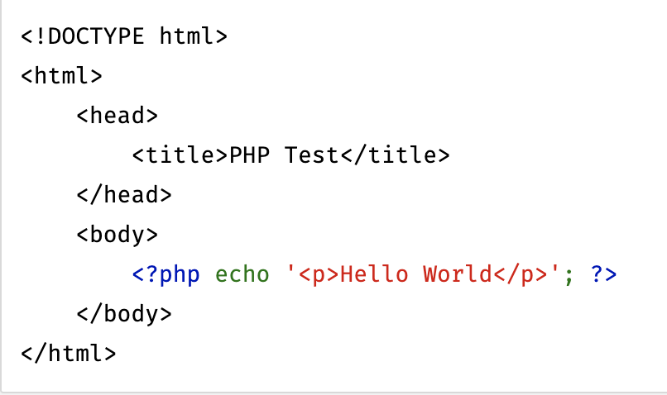
PHP Enabled Web Page

Slide 9
PHP Concepts
Variables – all the variables start with the $ sign, followed by the name
Print – echo command can be used to print on the screen
comments – supports both single-line and multiline comments inside the code
Arrays – indexed arrays, associative arrays and multidimensional arrays
Operators – All the essential arithmetic operators are supported
Conditional Statements – if-else and Switch are supported
Loops – while, do-while, for and foreach
Functions – Use both the built-in functions and allows user-defined functions

Slide 10
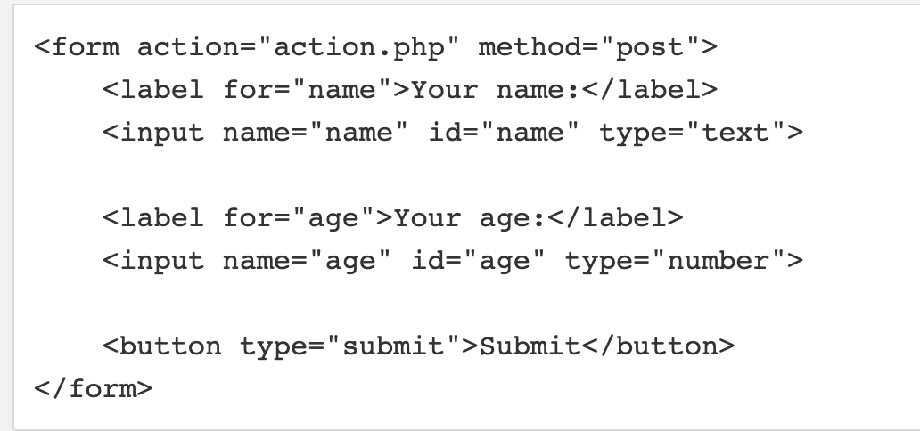
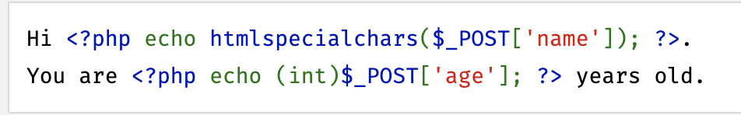
PHP Forms
Supports both $_GET and $_POST

Slide 11
PHP - OOP
Object oriented programming is a computer programming model that organize the software design around data or objects rather than the functions and logic
Classes - user-defined data types that act as the blueprint for individual objects, attributes and methods.
Objects - An instance of a class is called the object.
Methods - These are the functions that are inside the classes.
Attributes - Defined as the class templates.

Slide 12
Principles of OOP
Inheritance – classes can inherit behavior from the parent class
Encapsulation – Information inside an object, exposing the information outside
Abstraction – Expose only high-level public methods outside for accessing an object
Polymorphism – same method can be used for different purpose based on the context

Slide 13
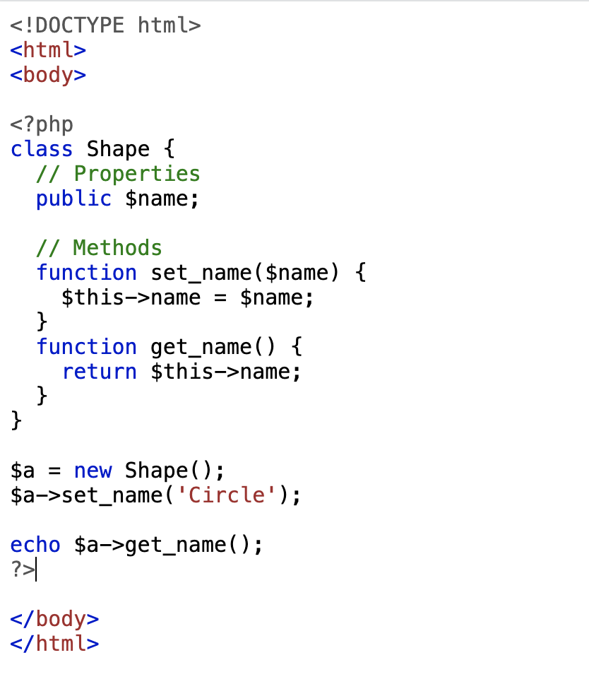
PHP - Class
The basic class definition begins with the keyword class
The name for the class should not be in the reserved word
A valid class name starts with a letter or underscore, followed by any number of letters, numbers, or underscores

Slide 14
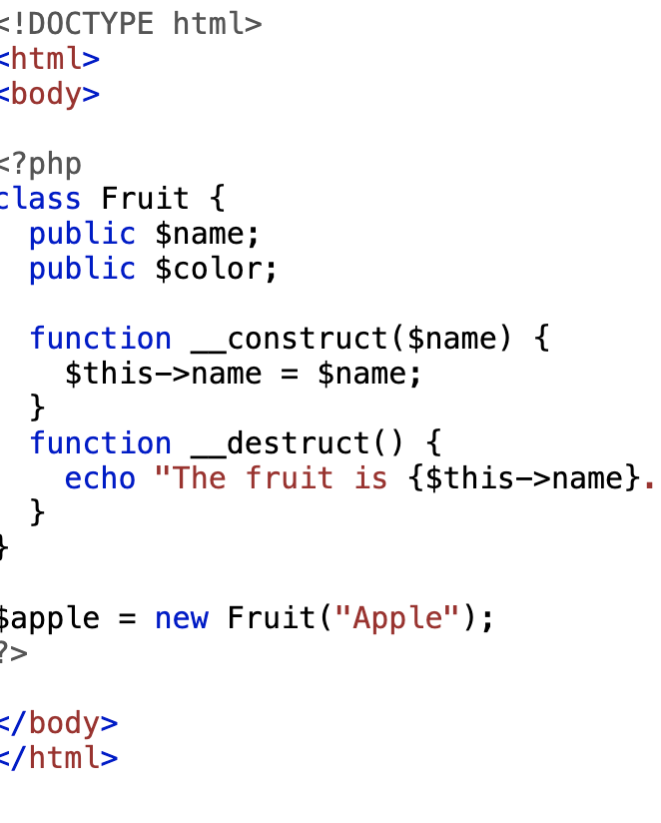
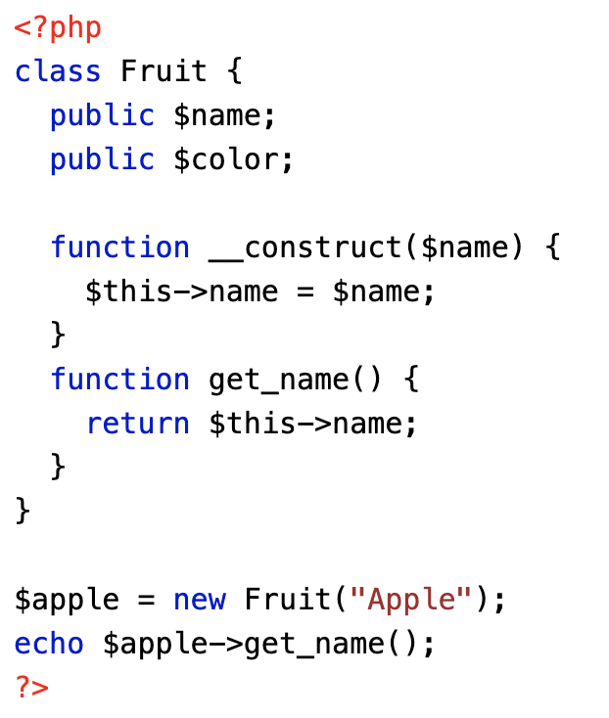
PHP – Constructor & Destructor
A constructor can be used to initialize an object properties upon creating the objects.
A destructor will be called when the object is destroyed, or the script ends.

Slide 15
PHP – Visibility
Properties and the methods visibility can be controlled by the access modifiers
Public – Accessed from anywhere
Protected – Accessed within the class and derived class
Private – Only inside the class

Slide 16
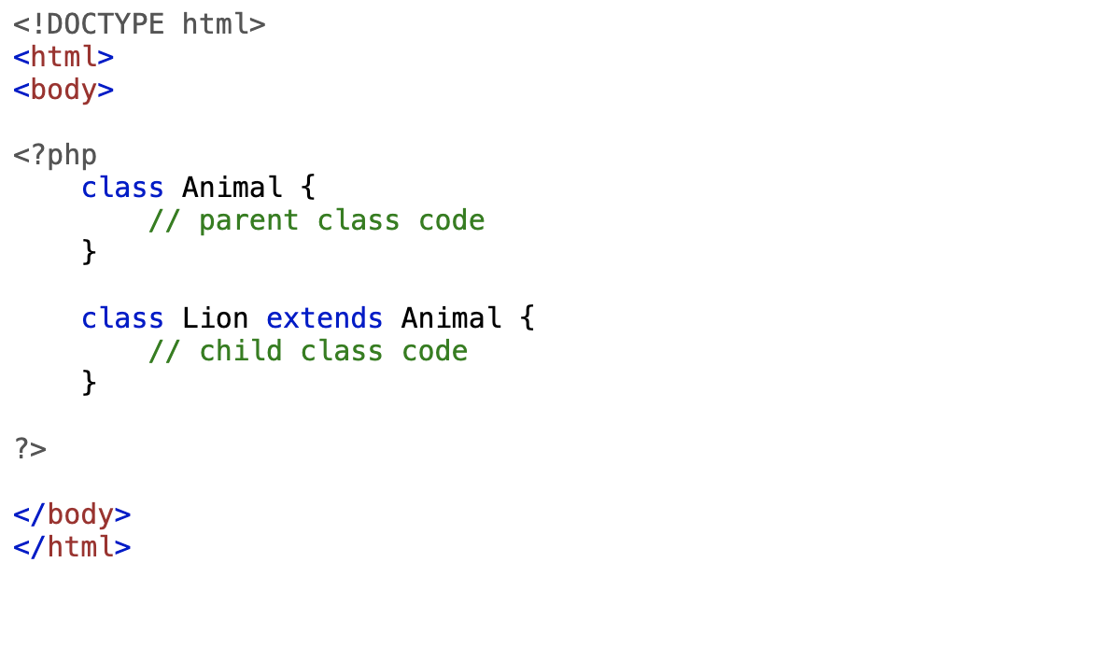
INHERITANCE
EXTENDS IS THE KEYWORD.
THE CHILD CLASS WILL INHERIT ALL THE PUBLIC AND PROTECTED METHODS FROM THE PARENT CLASS.

Slide 17
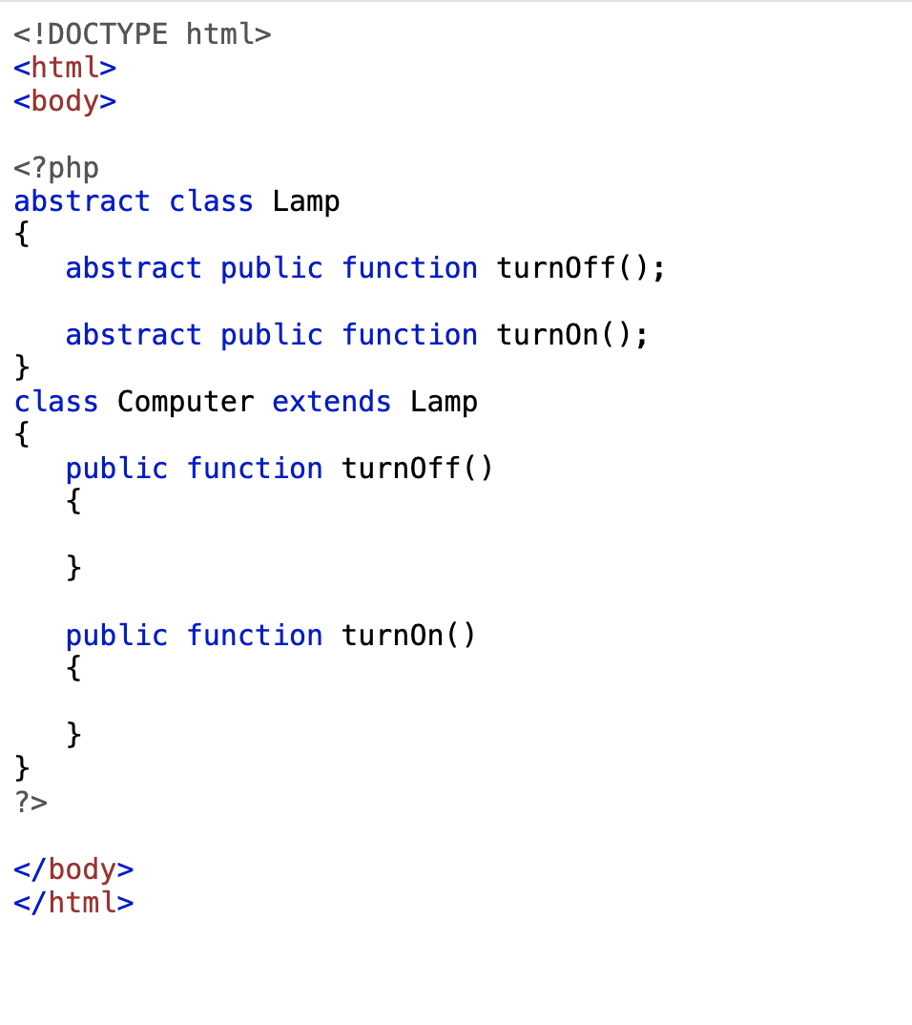
ABSTRACT classes
Abstract classes contain only the abstract methods but do not have any implementations.
Defined with the help of the Abstract keyword
Abstract classes cannot be instantiated

Slide 18
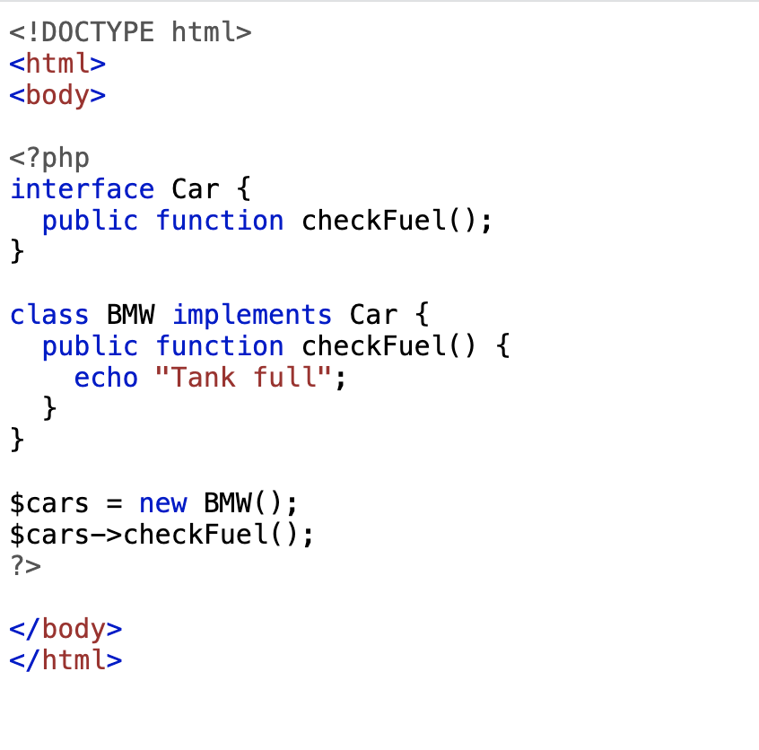
Interfaces
Interface allows you to create code which specifies which methods a class must implement
Implement is the keyword that needs to be used as an interface

Slide 19
overloading
Property Overloading
PHP property overloading is used to create dynamic properties on the object context. __set(), __get(), __usset() and __unset()
Method Overloading
Overloading dynamic methods that are not in the class scopre. __call() and __callStatic()

Slide 20
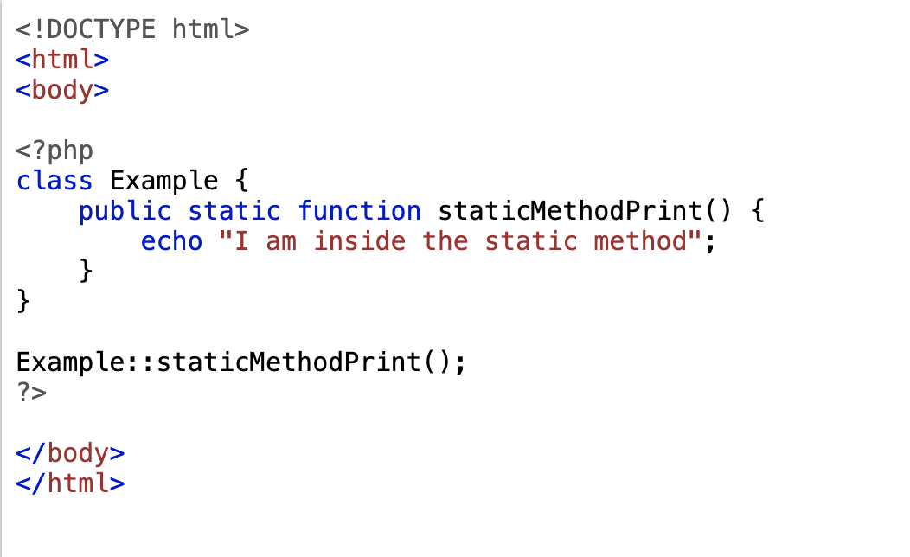
PHP Static Keyword
Declaring class properties or methods as static makes them accessible without needing an instantiation of the class. These can also be accessed statically within an instantiated class object.
A scope resolution operator must be used to access the static methods or properties inside the class.

Slide 21
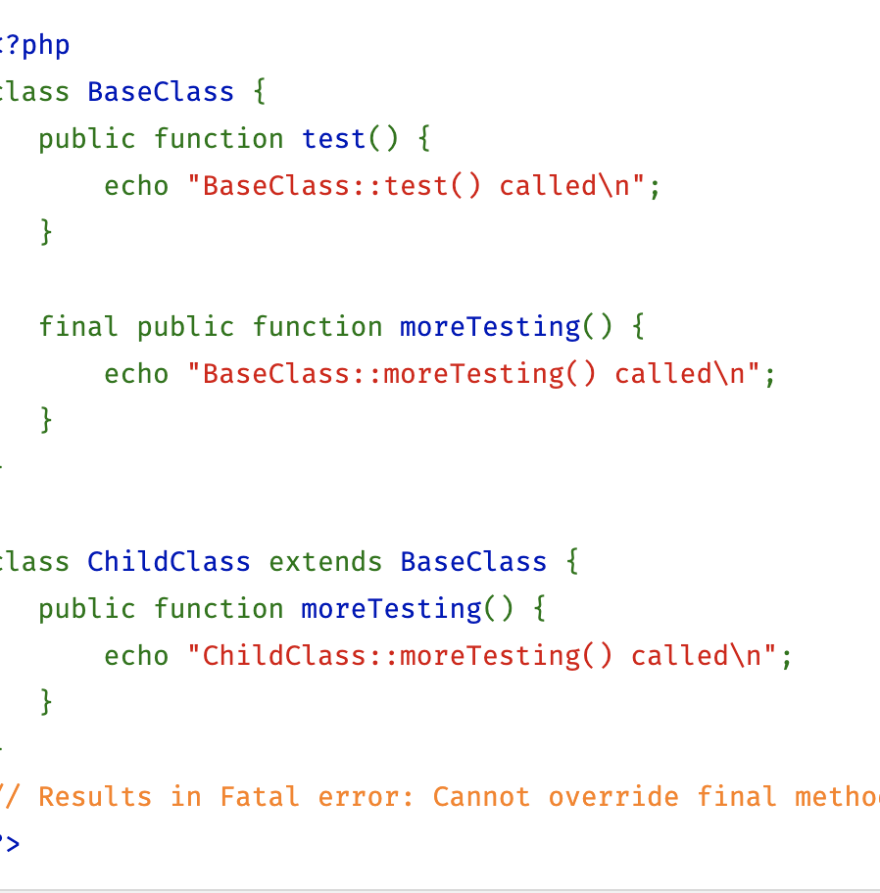
Final KeyWord
The final keyword prevent the child classes from overriding a method or constant.
When a class is defined as final it cannot be extended.

Slide 22
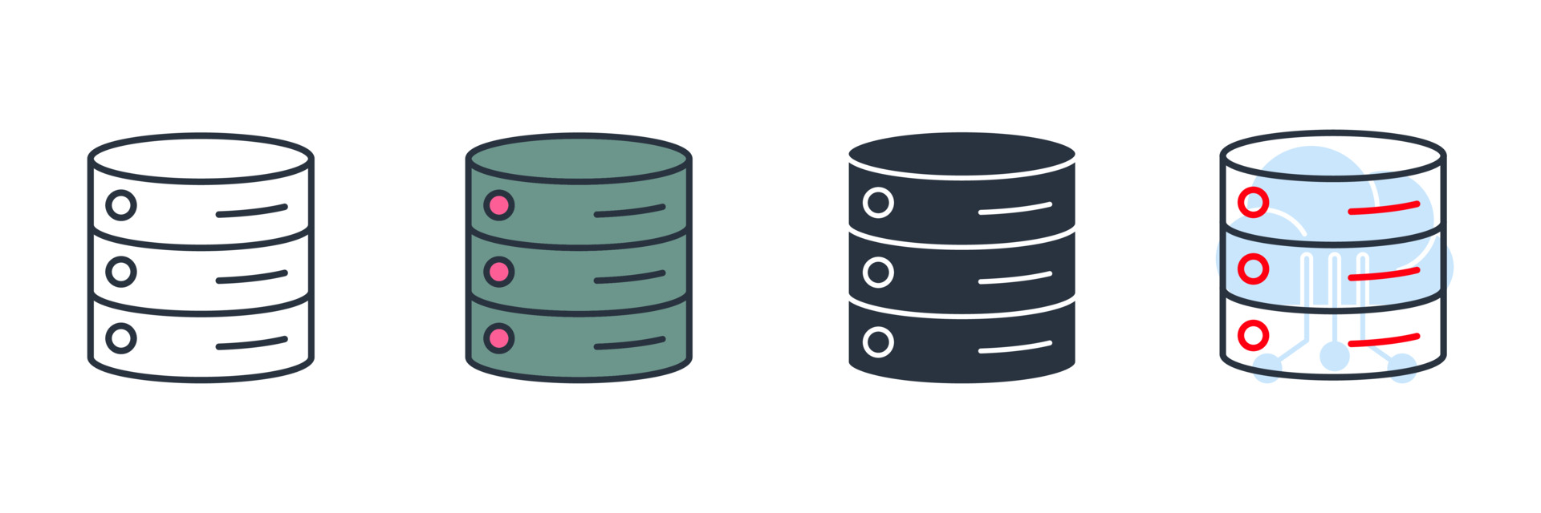
PHP Data OBJECTS (PDO)
The PHP Data Objects (PDO) extension defines a lightweight, consistent interface for accessing databases in PHP.
PDO provides a data-access abstraction layer, which means that, regardless of which database you're using, you use the same functions to issue queries and fetch data.

Slide 23
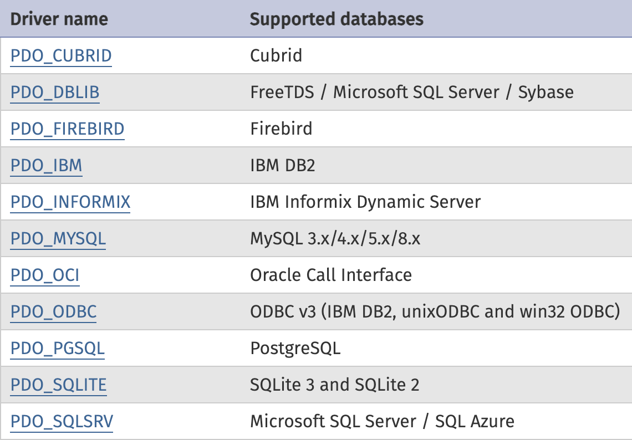
PDO Driver
PDO driver provides an interface that communicates with the database.

Slide 24
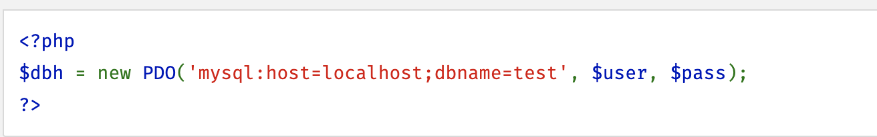
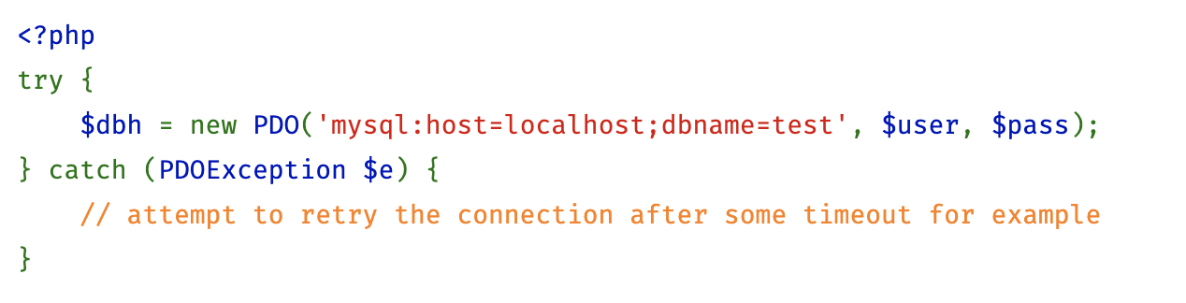
PDO Connections
Connections are established by creating instances of the PDO base class. It doesn't matter which driver you want to use; you always use the PDO class name
The connection can be disconnected by making the database variable to null
PDO:: ATTR_PERSISTENT needs to be set to true if a persistent connection required

Slide 25
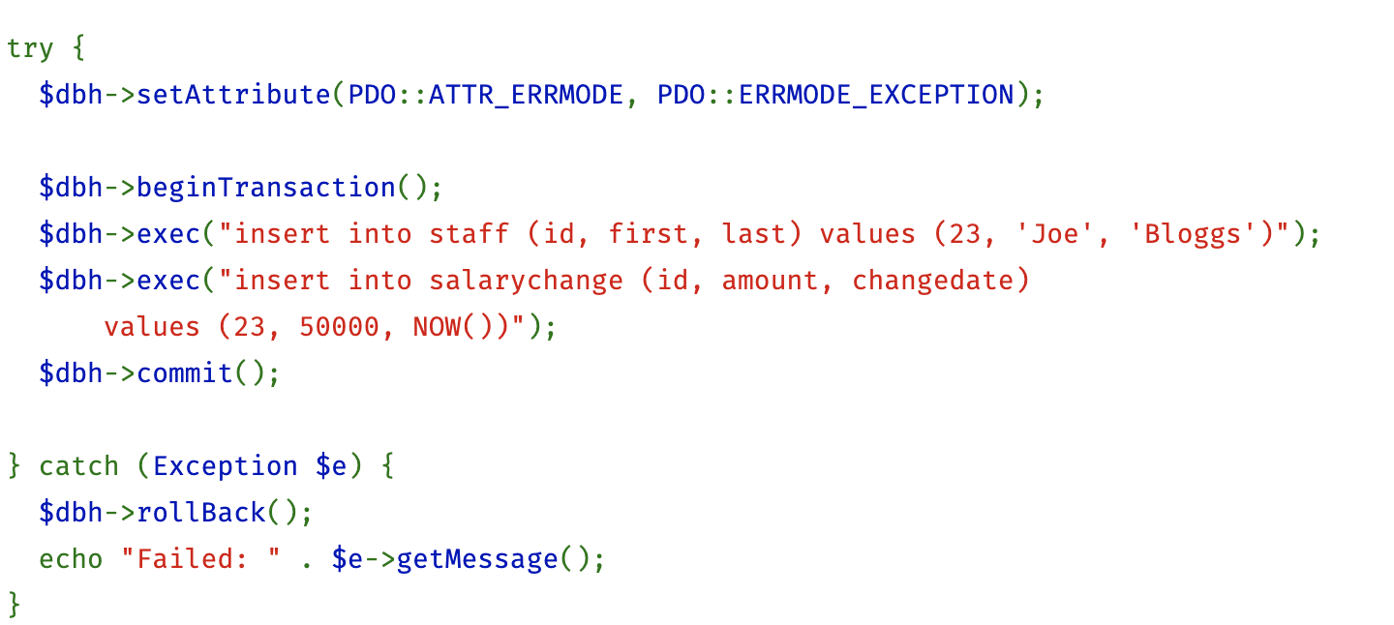
Transaction
A transaction is a set of inter-dependent SQL statements that needs to execute in all-or-nothing mode. A transaction is successful if all SQL statements are executed successfully.

Slide 26
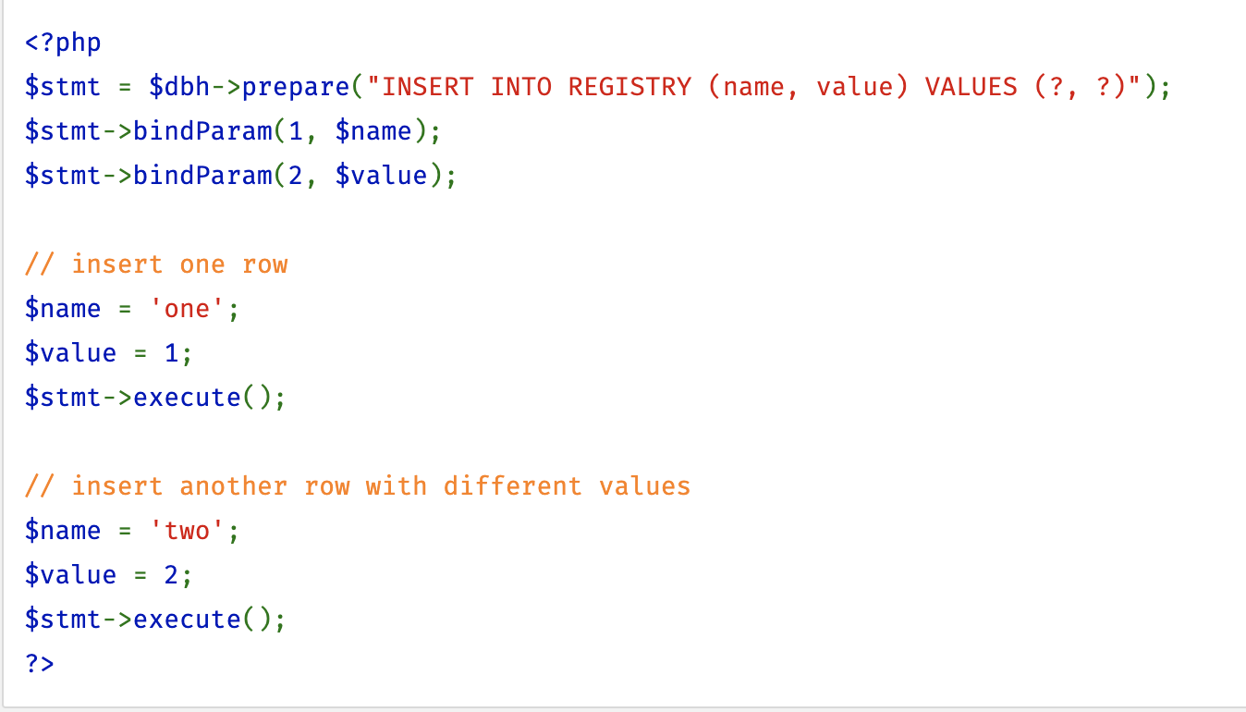
Prepared statement
A prepared statement can be used to create template SQL statements and send them to the databases.
Remote procedure could be called with this method.

Slide 27
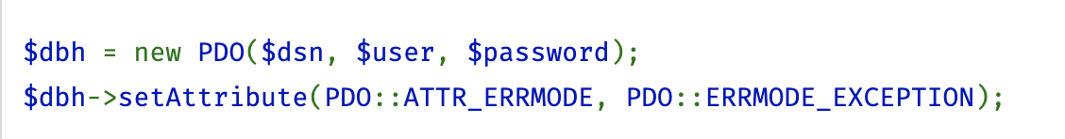
ERROR Handling
PDO::ERRMODE_SILENT – PDO set the ERROR code
PDO::ERRMODE_WARNING – PDO will emit the E_WARNING message
PDO::ERRMODE_EXCEPTION – PDO will throw a PDO exception

Slide 28
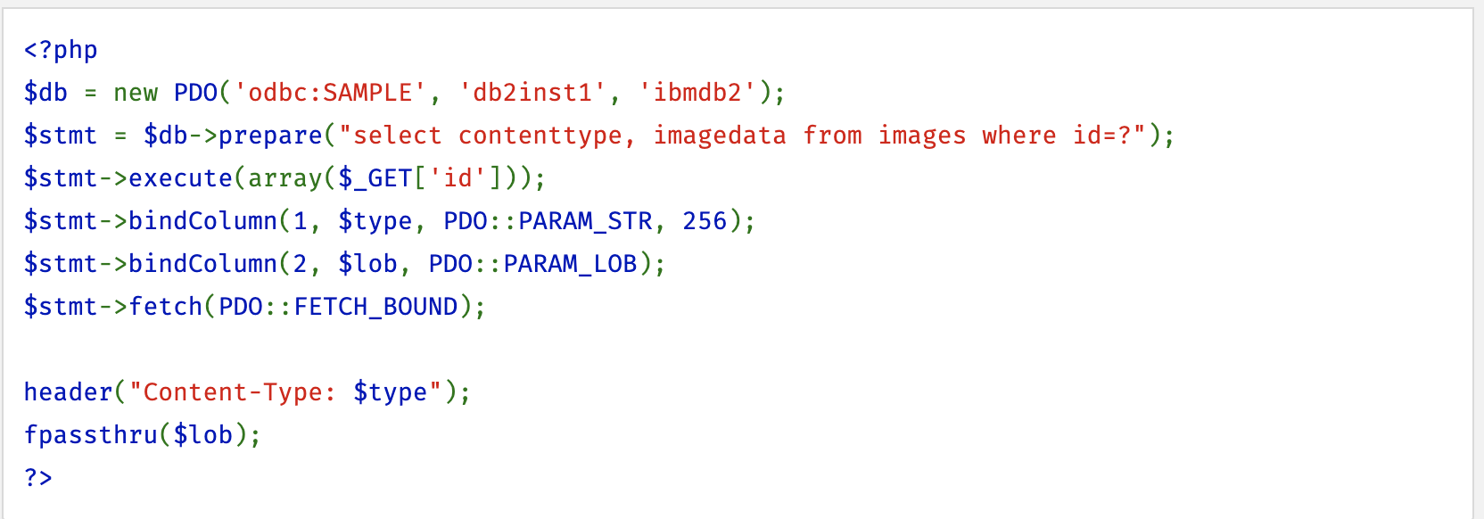
LOB – LARGE OBJECTS
LOB CAN BE USED TO STORE LARGE DATA INTO THE DATABASE.
LARGE OBJECTS CAN BE TEXTUAL OR BINARY IN NATURE

Slide 29

REFERENCE
http://php.net/manual/en/book.pdo.php
http://php.net/manual/en/language.oop5.php

Slide 30

QUESTIONS

