Slide 1
WEBD 5201 Web Development Frameworks
FALL 2023
Introduction to Software Development Framework

Slide 2
TOPICS
Introduction to Software development framework
Introduction to MVC - Model View Controller
Introduction to PHP - Laravel

Slide 3

Software Development Framework
A framework will act as the structure on which you can build software.
Using a framework will saves time and reduce the risk of errors.

Slide 4
Advantages of Frameworks
Clean and easily adaptable code
Increase in code re-usage
Simple testing and debugging
Reduced Duplicate code
Documentation support

Slide 5
Framework Types
Web Framework
Mobile Framework
Database Framework
Testing Framework

Slide 6

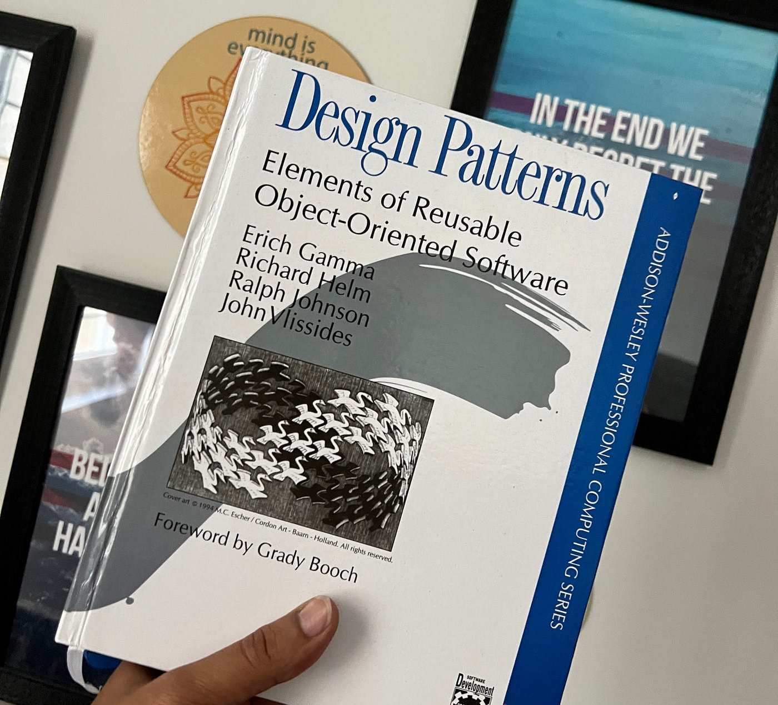
Design patterns
Design patterns are premade blueprints to solve design problems in the code.
Design patterns define a common language that software development teams can use to communicate efficiently

Slide 7
Classification of Design Patterns
Creational Pattern - Design pattern based on object creation
Structural Pattern – Design pattern-based assembly of object and class structures
Behavioral Pattern – Design pattern that identifies common communication patterns among objects

Slide 8

Architectural Design pattern
The architectural design pattern defines the high-level structure and organization of a software system.
The architectural design pattern guide decision in system scalability, performance and maintainability of the system.
MVC – MODEL VIEW CONTROLLER, MICROSERVICE PATTERN, SERVICE ORIENTER ARCHITECTURE (SOA), MONOLITHIC ARCHITECTURE ETC

Slide 9
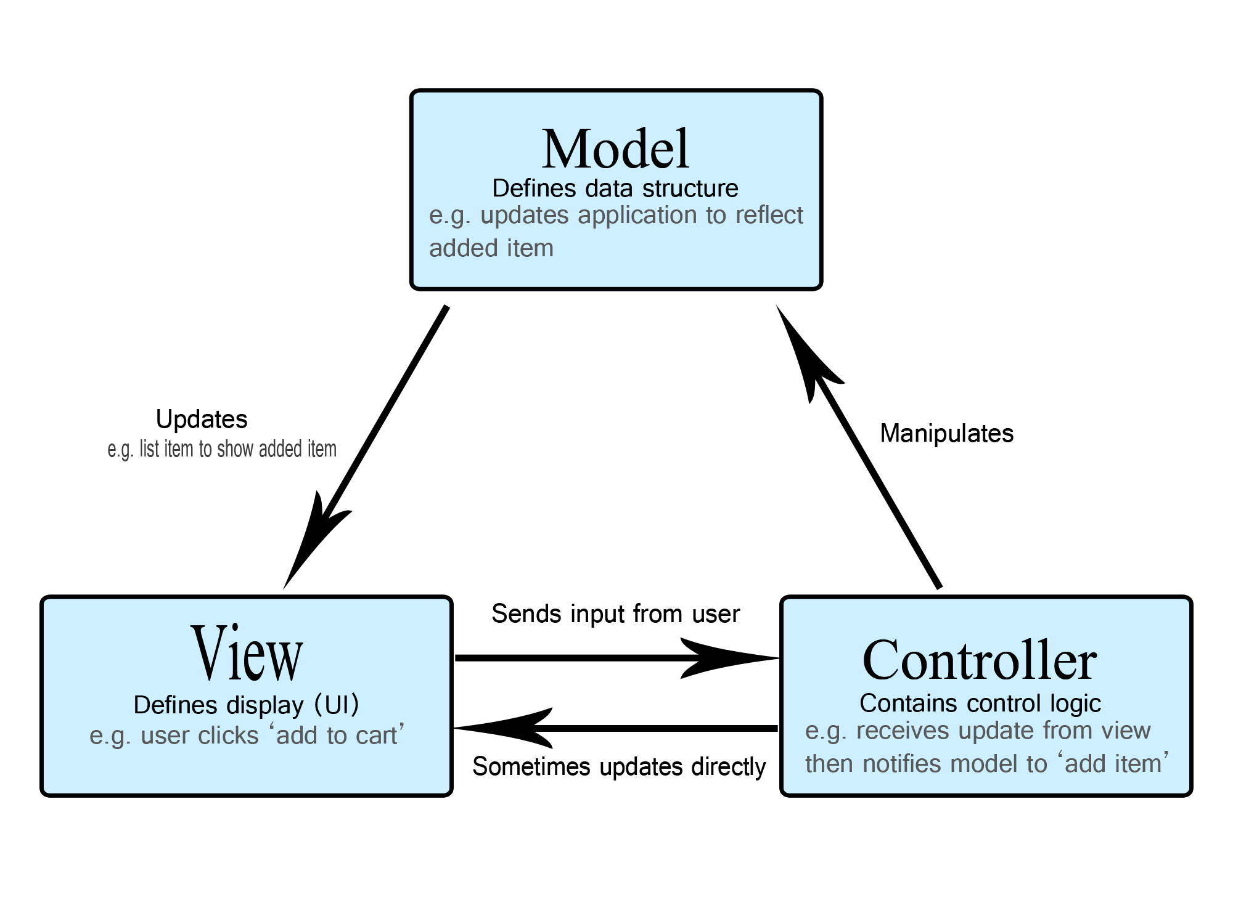
MVC – MODEL VIEW CONTROLLER
Architectural design pattern that will separates an application into three main logical components Model, View and Controller. Clear separation of Business logic, UI logic and Input logic.
Model – Model represent the application data and the business rules
View – Presentation logic
Controller – Controller will intercept the user request from the view and passes to the model

Slide 10

Laravel Framework
MVC PHP framework
Scalable Web Application
Component Reuse
Composer – Includes all the dependencies and libraries required for the project
Artisan – Built-in CLI

Slide 11
Features
Routing – Flexible approach for user to define routes in the web application
Query Builder and ORM Support
Template Engine – Blade Template Engine
Authentication
Email Support
Event Bus

Slide 12
Lab 1: Install Laravel Locally & Demo
Laracasts to watch and work through Lessons 1 through 16 tutorials
This lab will require configuring your laptop to run Apache and PHP with a MySQL server. This environment will be used to load Composer, which then will be used to load Laravel.
Assignment 1 Deadline: 22nd September, 2023.

Slide 13
Lab 2: Advanced Laravel Web Application
You are to to go to the Laracasts to watch and work through Lessons 17 through 32 tutorials (inclusive) in the Laravel 5.4 From Scratch series. NOTE: do not mistakenly work thought the `Laravel 4 From Scratch` or the `Laravel 5.2 From Scratch` series.
Assignment 2 Deadline: Oct 6th, 2023

Slide 14
Submission
Method 1: Provide a demo on your laptop and a zip file of your project
Method 2: Provide a video of your project, a single-page document with your project’s steps and a zip file.
Zip files could be sent directly in teams to me.

Slide 15

Test
Test – PHP Laravel
50 Points - Short Answers and multiple-choice questions
Oct 10th, 2023

Slide 16

Reference
https://developer.mozilla.org/en-US/docs/Glossary/MVC
https://www.turing.com/blog/software-architecture-patterns-types/
https://refactoring.guru/design-patterns

Slide 17
Activity
Install Laravel with the Composer
https://laracasts.com/series/laravel-from-scratch-2017

