Slide 1

Microservice
WEBD 5201 WEB DEVELOPMENT FRAMEWORKS

Slide 2
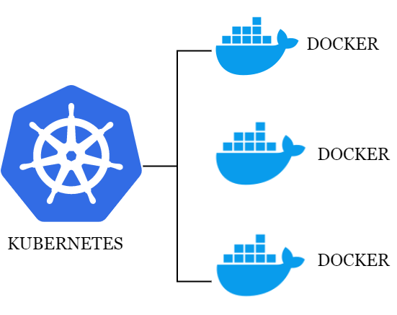

Assignment 5 Retrospect

Slide 3
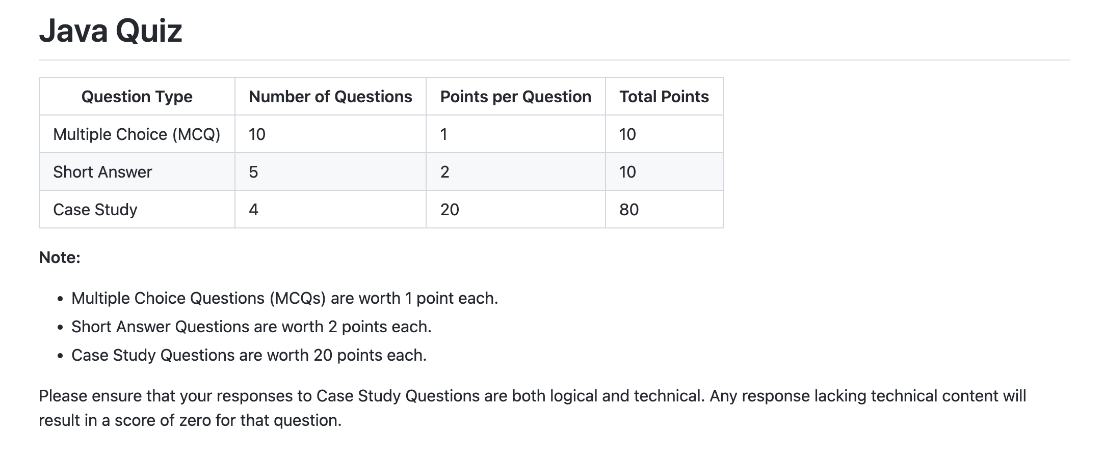

Slide 4
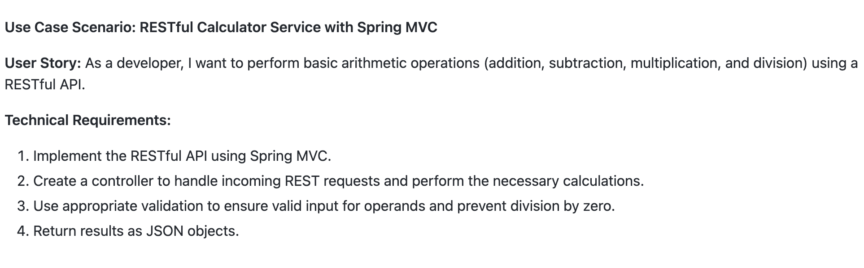
Sample Use case Question

Slide 5
Microservice Architecture
Microservices are an architectural approach where an application is composed of small, independent services, each encapsulating a specific business function. These services operate autonomously, communicate via well-defined APIs (e.g., HTTP/REST), and can be developed, deployed, and scaled independently.
Microservices enhance agility, scalability, and fault isolation by emphasizing decentralization and single responsibility. This approach allows diverse technologies, promotes resilience, and enables teams to work on distinct services concurrently. While offering flexibility, microservices also introduce challenges related to distributed systems and data consistency.

Slide 6
Characteristics of microservices
Decentralization
Single Responsibility
Autonomous
Data Management
Communication
Scalability
Technology Diversity

Slide 7
Decentralization
In a microservices architecture, each service operates as a separate and self-contained unit, possessing its own data storage, logic, and often its database. Decentralization contrasts with monolithic architectures, where a single, tightly integrated application handles all functionalities.

Slide 8
Single Responsibility
Single Responsibility in the context of microservices refers to the principle that each microservice should have a well-defined and narrowly focused purpose or business responsibility. In other words, a microservice should encapsulate a specific set of related functionalities, and it should excel at performing that particular task or solving a particular business problem.

Slide 9
Autonomous
The ability of each microservice to operate independently and make decisions related to its development, deployment, and scaling. Autonomy is one of the key principles in microservices architecture, and it implies that each service is a self-contained unit with its own set of responsibilities and resources.

Slide 10
Data Management
Data management in microservices refers to how data is handled, stored, and processed within the context of a microservices architecture. Microservices often emphasize autonomy, decentralization, and independent development, which can introduce data consistency, communication, and scalability challenges.

Slide 11
Communication
API
Sync – HTTP or REST
Async – RabbitMQ, Kafka or Message Queue
Event-Driven Architecture

Slide 12
Scalability
Scalability in microservices refers to the ability of a microservices-based architecture to handle increased workload or demand by efficiently adding or removing resources.
Horizontal vs Vertical Scaling
Load balancing
Auto Scaling

Slide 13
Technology Diversity
Technology diversity in microservices refers to using various programming languages, frameworks, and technologies across different microservices within a single application. Unlike monolithic architectures, where a single technology stack is often used for the entire application, microservices architectures embrace the idea that different services may have different requirements and may be best implemented using distinct technologies .

