Slide 1

Spring MVC & Java Server’s
WEBD 5201 – WEB DEVELOPMENT FRAMEWORKS

Slide 2
Topics
Spring MVC
Java Server’s
CI/CD and TDD
Spring Boot ( Microservice)

Slide 3
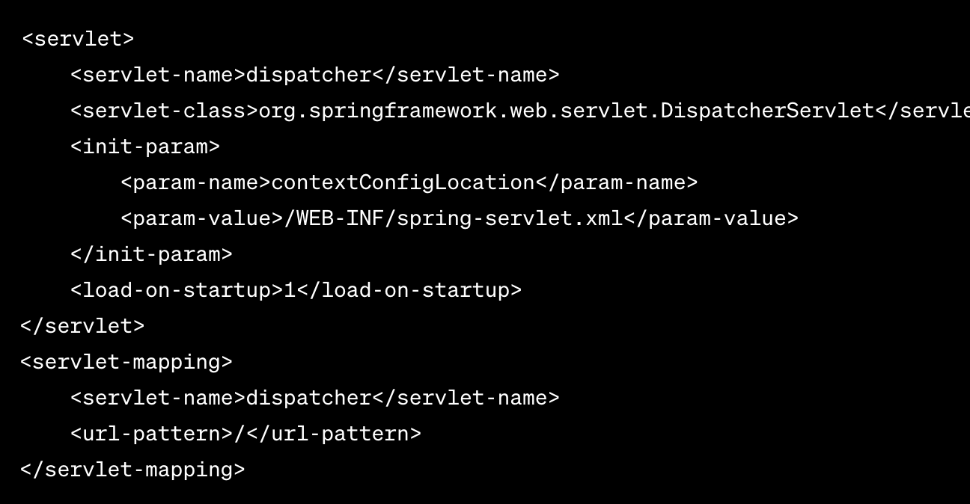
Dispatcher Servlet
The DispatcherServlet is a front controller in the Spring MVC framework. It is the central hub for HTTP requests in a Spring-based web application.
When a user makes an HTTP request, it is first intercepted by the web server (e.g., Apache, Tomcat), which then forwards the request to the DispatcherServlet.

Slide 4
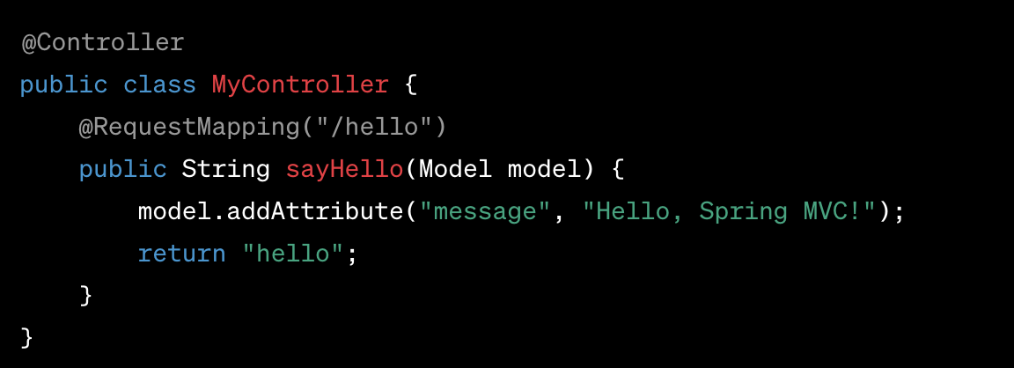
Controller
A controller in Spring MVC is responsible for processing HTTP requests, performing application-specific logic, and returning an appropriate response to the client.
It is an intermediary between the client (usually a web browser) and the application’s business logic.
Controllers receive requests from the DispatcherServlet and are responsible for invoking the corresponding methods to handle those requests.

Slide 5
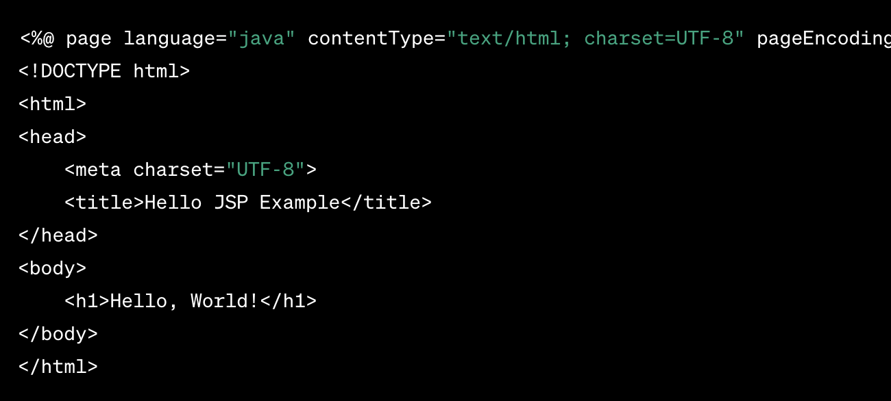
JSP – Java Server Pages
JSP pages have a ".jsp" file extension and are typically stored in the web application's "WEB-INF" or "WebContent" directory.
A JSP page consists of a mix of HTML and Java code. Java code is enclosed within special tags, such as <% ... %> for scriptlets, <%= ... %> for expressions, and <%! ... %> for declarations.
JSP pages are processed on the server-side, where the embedded Java code is executed. The generated HTML is then sent to the client's web browser.

Slide 6
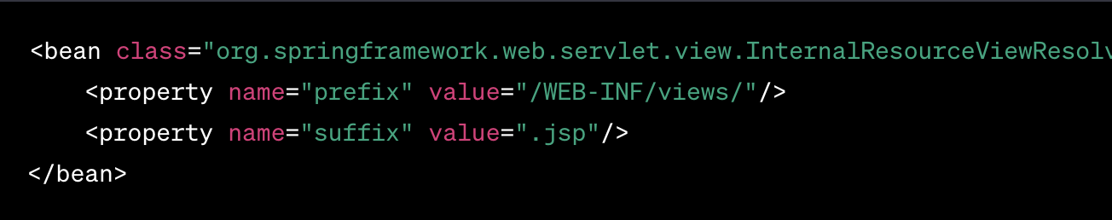
View Resolver
View Resolver is a component responsible for mapping the logical view names returned by the controller to actual views that should be rendered and returned to the client.
After resolving the logical view name, the View Resolver identifies and renders the corresponding view template. It might use a template engine like JSP, Thymeleaf, FreeMarker, or another view technology to generate the HTML sent to the client.

Slide 7

Discussion
Decline of Java Server Page?

Slide 8
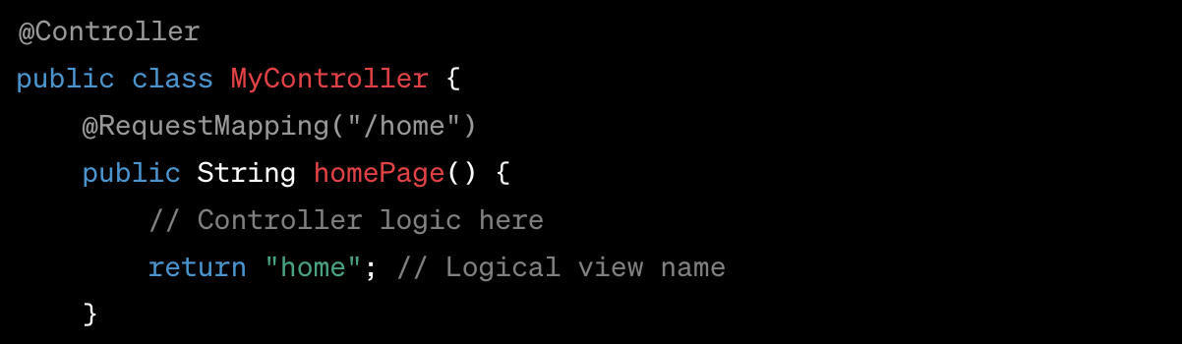
Request Mapping
Request Mapping is a fundamental concept that helps you map incoming HTTP requests to specific controller methods

Slide 9
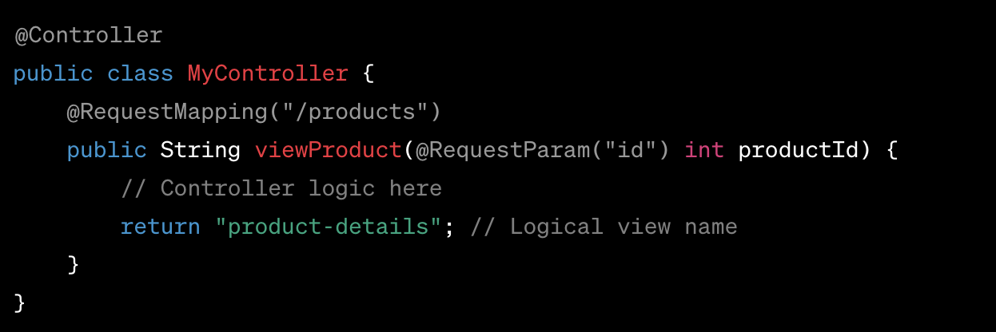
Request Parameters

Slide 10
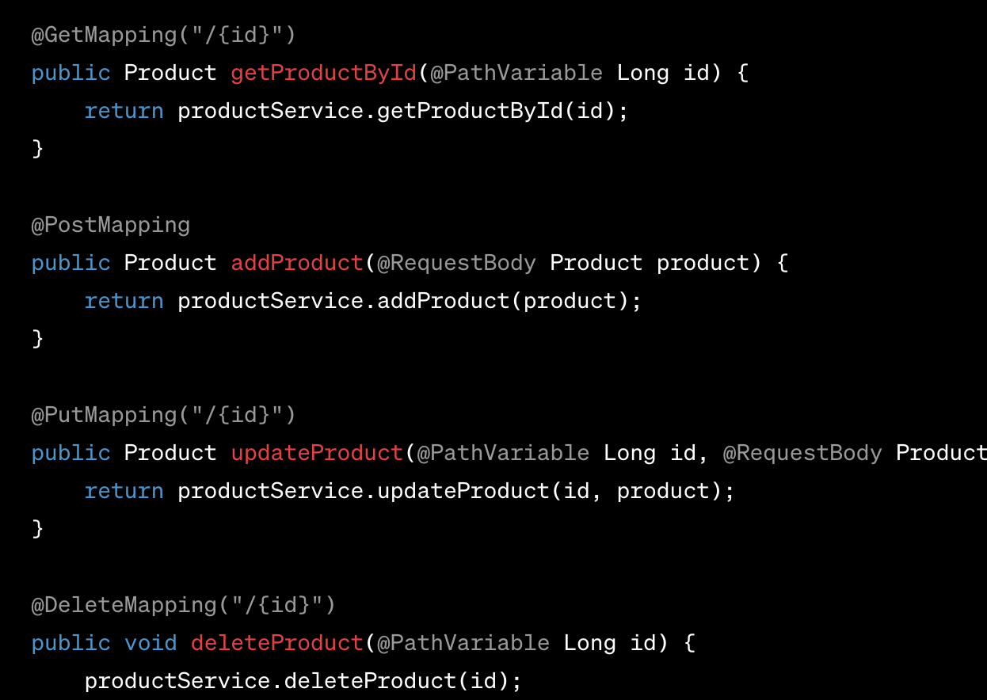
Restful Services

Slide 11
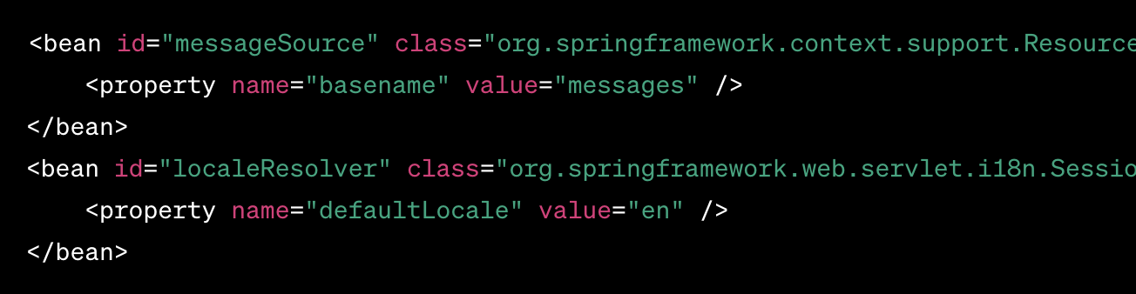
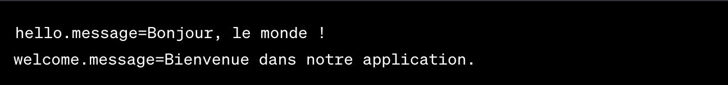
Internationalization
Internationalization in Spring MVC allows you to build web applications that can be displayed in multiple languages and regions.

Slide 12
Activity 1 (30 minutes)
https://github.com/spkdroid/SpringMVC-WEB

Slide 13
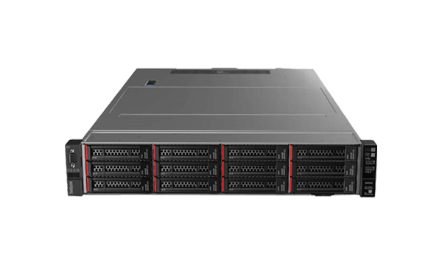
Java Server’s
Java is a popular programming language for building server-side applications, and there are several servers and frameworks available that facilitate the development and deployment of Java-based server applications.

Slide 14




Web Application Servers
Use Case: Hosting and serving web applications.
Example Server: Apache Tomcat, Jetty, WildFly, GlassFish.

Slide 15
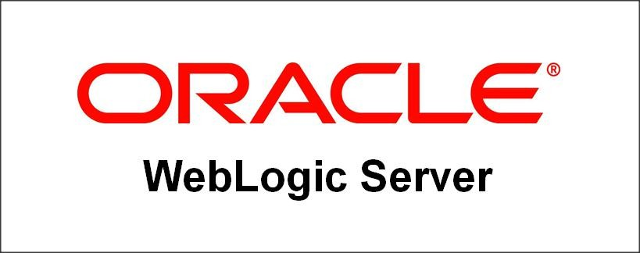
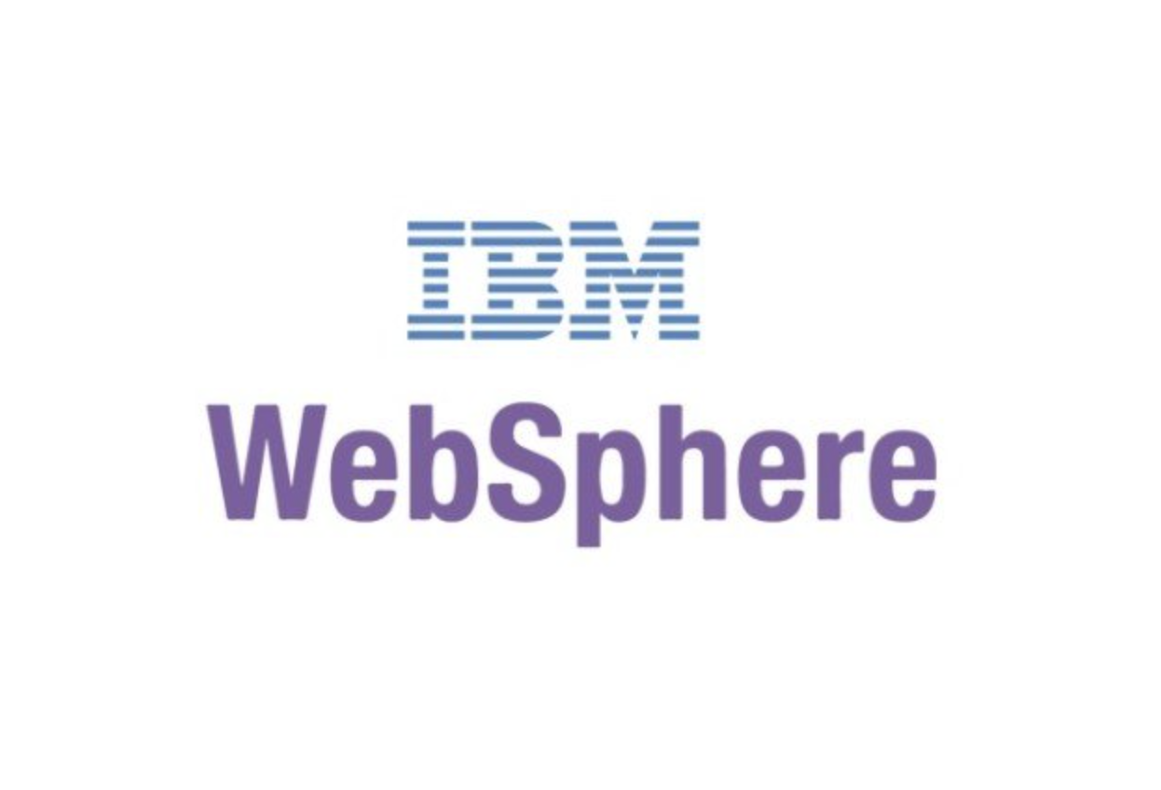
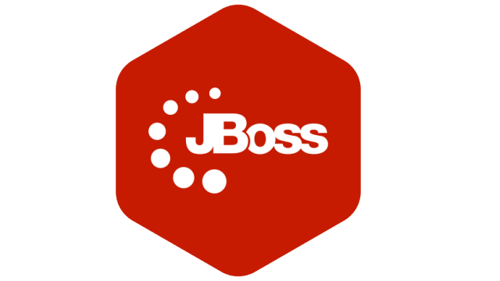
Enterprise Application
Use Case: Large-scale, distributed, and mission-critical enterprise applications.
Example Server: Java EE servers like WildFly, GlassFish, IBM WebSphere, Oracle WebLogic, JBoss

Slide 16

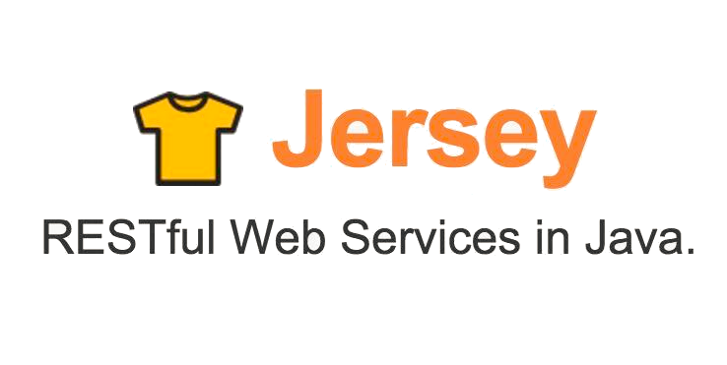
API Servers
Use Case: Serving APIs for communication between software components or third-party integrations.
Example Server: Spring Boot, Apache CXF, Jersey.

Slide 17


Database Servers
Use Case: Connecting to databases and executing SQL queries.
Example Server: Apache Derby, HSQLDB.

Slide 18

Messaging Servers
Use Case: Facilitating communication between distributed components using messaging protocols.
Example Server: Apache ActiveMQ, RabbitMQ.

Slide 19

Content Management Systems
Use Case: Real-time streaming of data, audio, or video content.
Example Server: Red5, Wowza Streaming Engine.

Slide 20

Collaboration Servers
Use Case: Supporting collaborative work environments with features like messaging, file sharing, and collaborative editing.
Example Server: Apache OpenMeetings, Jitsi.

Slide 21
Assignment 5
Application Features:
Implement a single-page web application that allows users to manage a list of items.
The items should have the following attributes: id, name, description.
Include functionality for adding, updating, deleting, and viewing items.
Backend (Spring MVC):
Use Spring MVC to create RESTful API endpoints for managing items.
Implement service and repository layers for interacting with the database.
Frontend:
Use HTML to create the structure of the single-page application.
Use CSS for styling to enhance the user interface.
Implement JavaScript (with or without a framework) to interact with the backend API asynchronously.

Slide 22

Questions

Slide 23

Thank you

