Slide 1


DATA VISUALIZATION OF GLOBAL CLIMATIC CHANGES USING JUPYTER NOTEBOOK
PRESENTED BY
JAYARISHA V 927621BEC068
KEERTHANA S P 927621BEC084 GUIDED BY
MADHUSRI J 927621BEC109 DR.C. NADAGOPAL
RANJANAPRIYA 21LEC011

Slide 2
INTRODUCTION
In this project we are going to explain that how the weather climatic changes are visualized by collecting the data of separate region like humidity, temperature and air pollution
In this let’s we discuss about the data visualization.

Slide 3

DATA VISUALIZATION
A key technology for analysing and presenting climate changes.
Graphical representation of information.
Analysing massive amounts of information.

Slide 4
Why visualize data
Major task for future developments is to further bridge the gap between climate and visualization expertise, exploiting the
Chances arising from sophisticated visualization approaches, smoothly supporting.

Slide 5
TOOL USED – CONDA SOFTWARE
CONDA is an open-source, cross-platform, language-agnostic package manager and environment management system.
It was originally developed to solve difficult package management challenges faced by Python data scientists.
Today is a popular package manager for Python

Slide 6
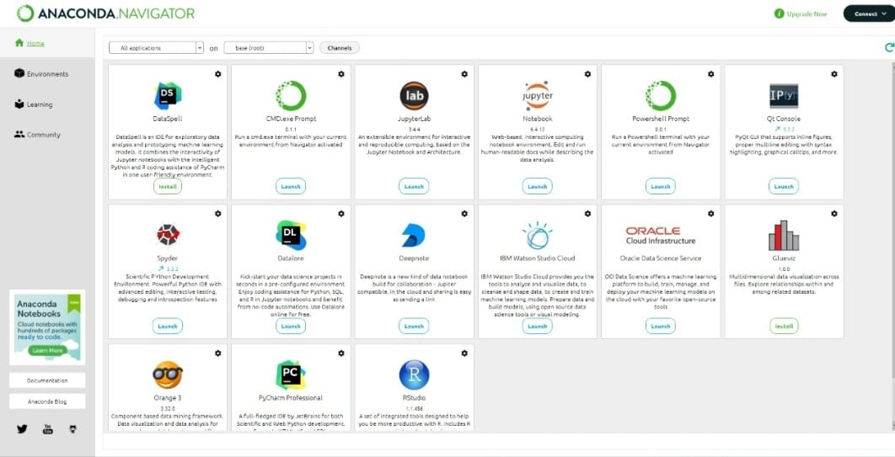

Slide 7
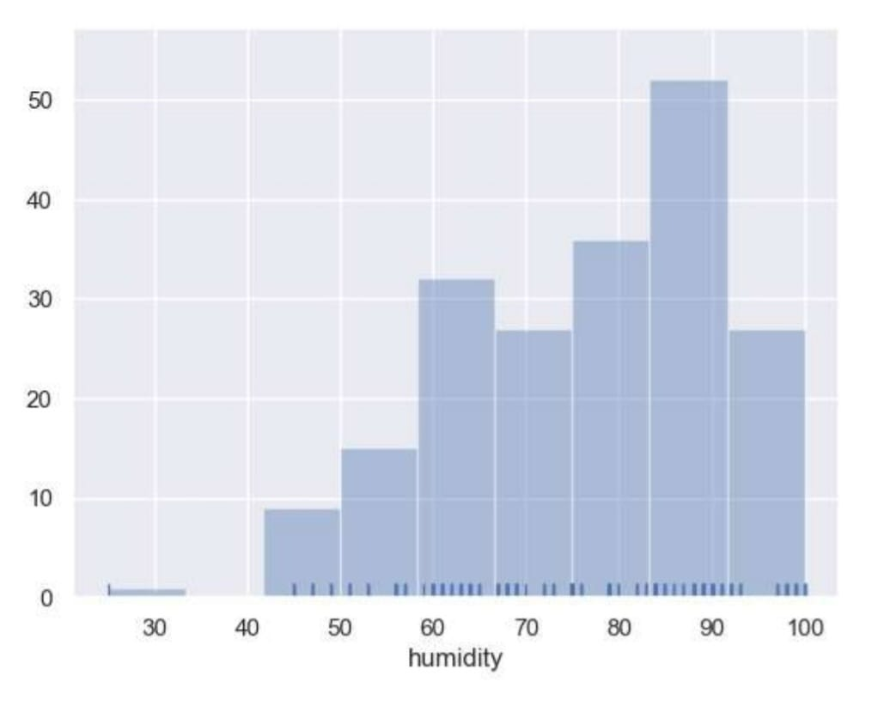
JUPYTER NOTEBBOOK
To create plots with Matplotlib and use the Jupyter notebook as our environment setting.
It’s an open source web application that allows you to create
and exchange documents with live code views and some
informative texts.

Slide 8
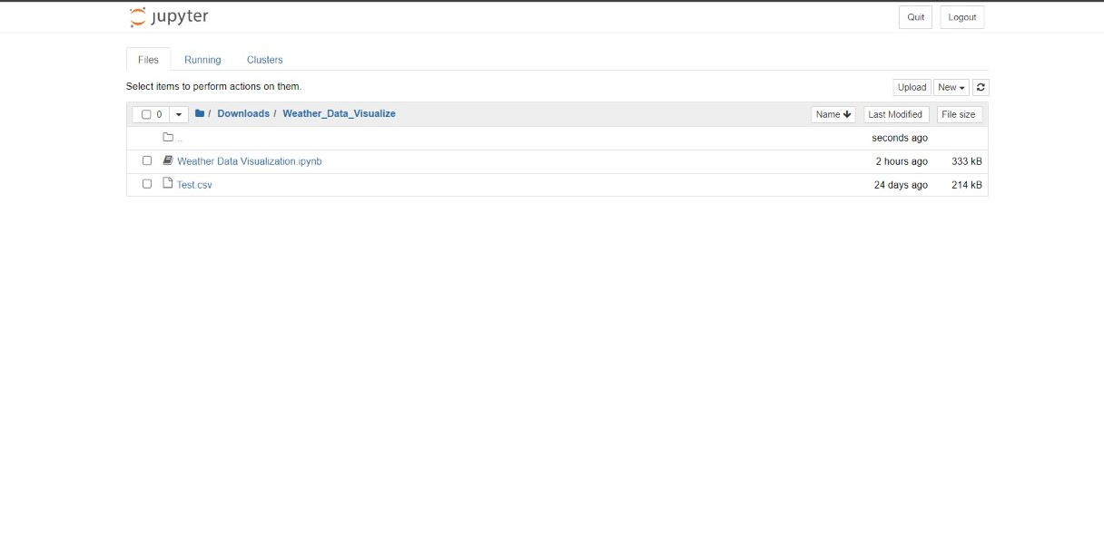

Slide 9
DATASET
We have taken the data from the Kaggle website as a reference.
We will be using the dataset throughout the section is weather climatic change.
In this we obtained data such as temperature, humidity, air pollution.

Slide 10
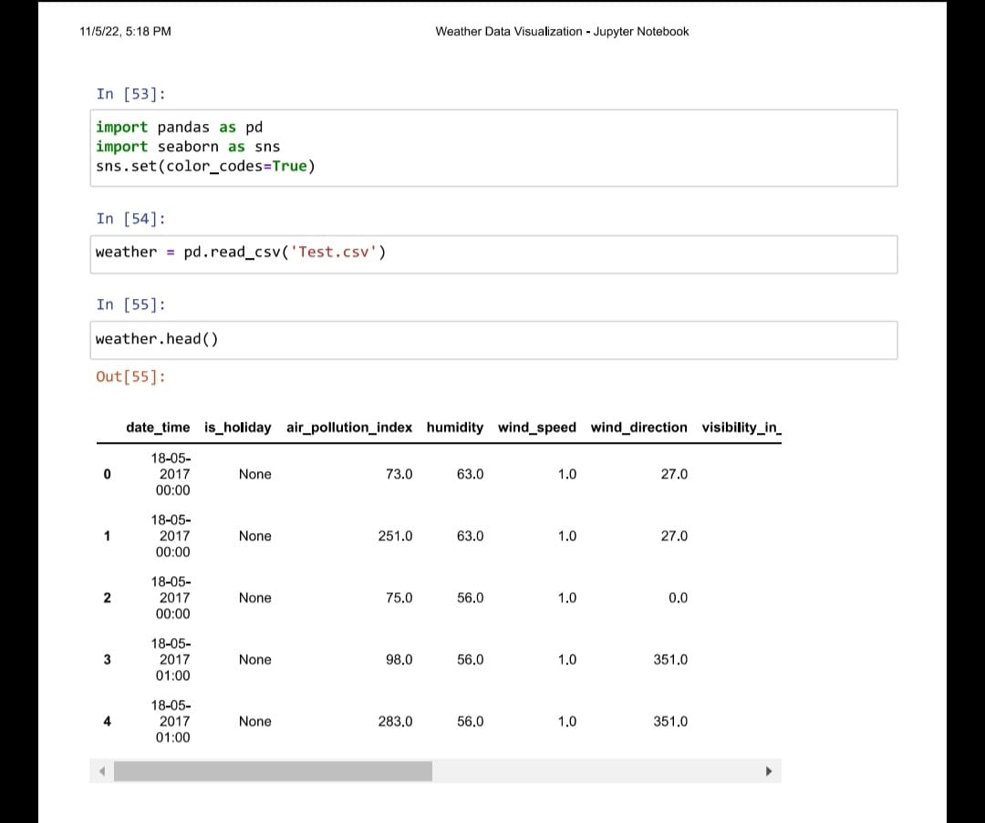

Slide 11
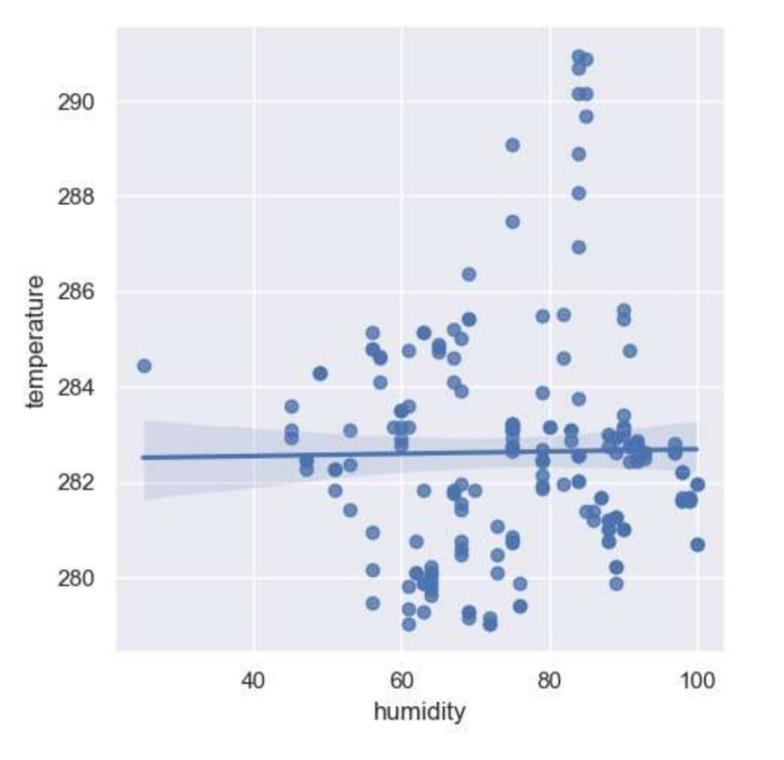

Slide 12
BENEFITS OF DATA VISUALIZATION
Data visualization tools make it quick and easy to create charts and graphs which can be added to a customizable dashboard.
Besides looking , data visualization tools give us the ability to process information faster and to use that information to boost productivity and results. Because of the graphic representations, it’s easy to see where action can be taken to improve.

Slide 13
APPILICATIONS OF DATA VISUALIZATION
Data visualization is essential to assist quickly identifying data trends, which would otherwise be a hassle.
The pictorial representation of data sets allows analysts to visualize concepts and new patterns.

Slide 14
OUTPUT
Then the output will be in the form of graphical or in chart form.
Our project is useful to visualize the data in a graphical form because as we cannot store more data in an Excel sheet.
By having this we can visualize some more data like stock market, Industrial profit, television TRP and etc…

Slide 15
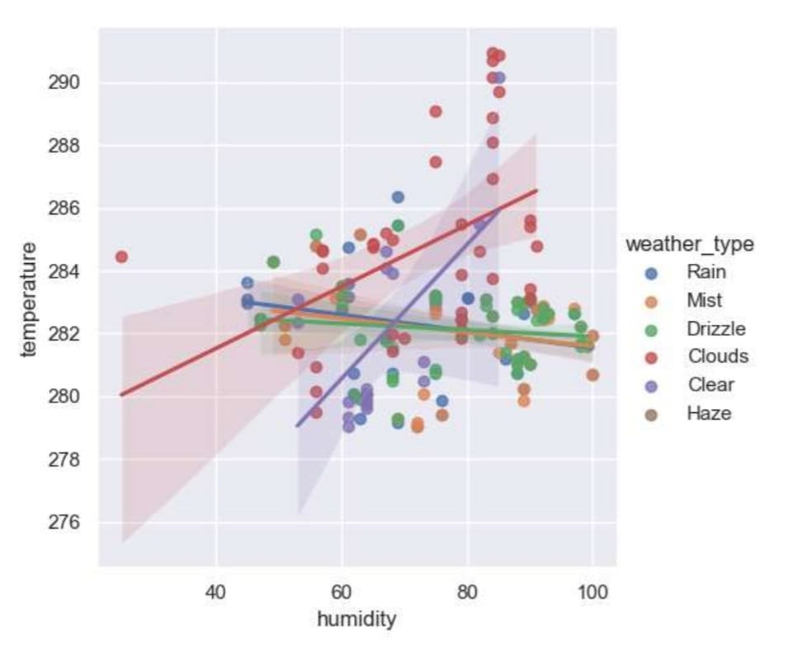
OUTPUT

Slide 16
CONCLUSION
Good data visualization should communicate a data set clearly and effectively by using graphics.
The best visualizations make it easy to comprehend data at a glance.

