Slide 1

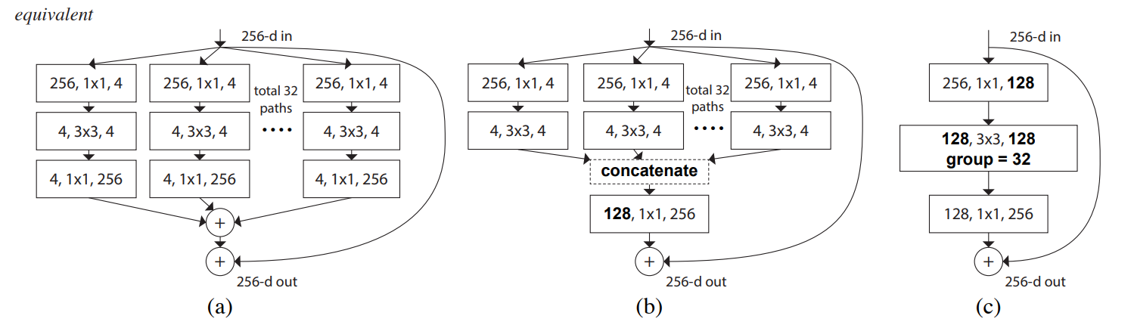
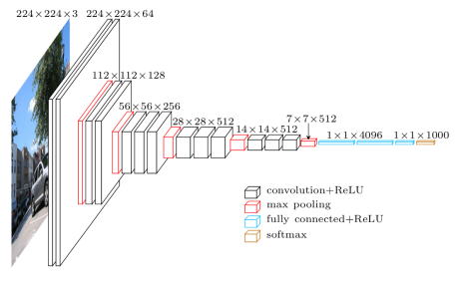
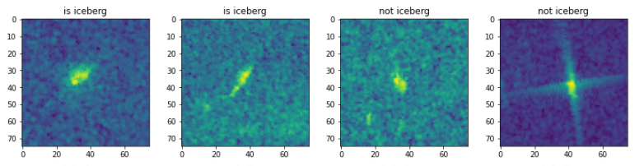
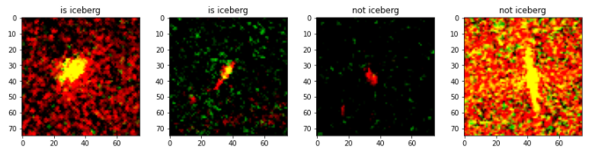
Statoil/C-CORE Iceberg Classifier Challenge
Tee Kah Hui, Kalkidan Fekadu, Samuel Pegg
Problem Statement
Image Augmentation
Drifting icebergs present threats to navigation and activities in areas such as offshore of the East Coast of Canada. Currently, many institutions and companies use aerial reconnaissance and shore-based support to monitor environmental conditions and assess risks from icebergs. However, in remote areas with harsh weather these methods are not feasible, and the only viable monitoring option is via satellite. The task is to build an algorithm that automatically identifies if a remotely sensed target is a ship or iceberg. Submissions are evaluated on the log loss between the predicted values and the ground truth.
Data augmentation is a popular technique to increase the variation of training data. Due to the limited amount of labelled data in this competition, we performed data augmentation on the training data. We did width & height shift and rotation. Below is an example of augmentation parameter we used.
Rotation_range: 40
Width_shift_range: 0.1
Height_shift_range: 0.1
Shear_range: 0
Zoom_range: 0.1
Horizontal_flip: True
Vertical_flip: True
Figure 3: ResNext Architecture
VGG-16
This network is characterized by its simplicity, using only 3×3 convolutional layers stacked on top of each other in increasing depth. Reducing volume size is handled by max pooling. Two fully-connected layers, each with 4,096 nodes are then followed by a softmax classifier. The architecture is shown below in figure 4.
Data and Preprocessing
Each observation in the data corresponds to two flattened images of the ship/iceberg using different light polarisations, and the incidence angle at which the photo was taken. We also get the binary ground truth - 1 is an iceberg. Some example images from band_1 data can be seen below in figure 1.
ResNeXt-29
Resnext, created by facebook, is a highly modularised architecture for image classification. he ResNeXt architecture is shown in figure 3.
We implemented ResNeXt-29 using Keras on the iceberg data and managed to achieve a log loss of 0.16965. This managed us to get in the top 1000 submissions. The ResNeXt architecture is shown in figure 3. Below is the configuration of our model.
Depth: 29
Cardinality: 4
Number of filter: 8
Regularization: None
As the labelled data is relatively small, we used 5-fold cross-validation to achieve better performance. For the training, we are using 1000 epochs and 10 steps per epoch. However too many epochs could lead to overfitting. We used callbacks API from Keras to perform early stopping when the valuation loss has stopped decreasing. Below is the parameters for callbacks.
Minimum change: 0.001
Patience: 45
Figure 4: VGGNet
For this task, we used 16 layers VGGNet to perform the classification. We selected the pre-trained weight from ImageNet as our base model. Similar to ResNext, k-fold cross-validation and early stopping are used improve performance and prevent overfitting. In the final layer, we chose Sigmoid activation function and binary cross entropy loss is our metric. Besides we used Adam optimizer with learning rate of 1e-5. Our VGGNet model achieved a log loss of 0.17109.
Figure 1: Image from band_1 data
We converted the data into 75x75x3 matrices for training. The three channels are band_1, band_2 and inc_angle respectively. Figure 2 shows the transformed image data.
Ensemble Learning
We next used ensemble learning to increase performance further by combining the prediction result from ResNeXt-29 and VGG-16. The stacked model result are manually submitted to Kaggle. This approach decreased our log loss to 0.15152 and placed us in the 700th position out of 3300 teams.
Figure 2: Preprocessed Image

