Slide 1

PREDICTON OF SOH OF EV BATTERY

Slide 2
PROBLEM STATEMENT
Electric vehicles depend heavily on battery performance and reliability.
Over time, batteries degrade due to repeated charging and discharging cycles.
Accurate prediction of battery State of Health (SoH) helps in improving safety, maintenance planning, and battery life management.
Our project aims to build a machine learning based predictive system that estimates battery health using parameters such as:
Anomalies Detection
State of Charge (SoC)
Remaining Useful Life(RUL)
Voltage
Temperature
Capacity
Cycles

Slide 3
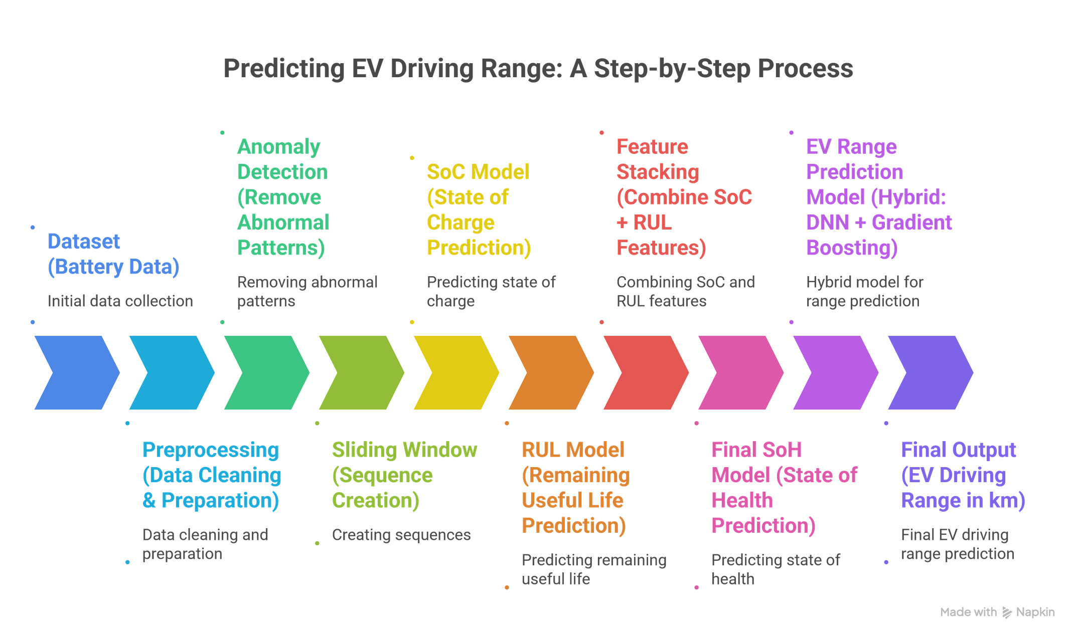
OVERVIEW

Slide 4
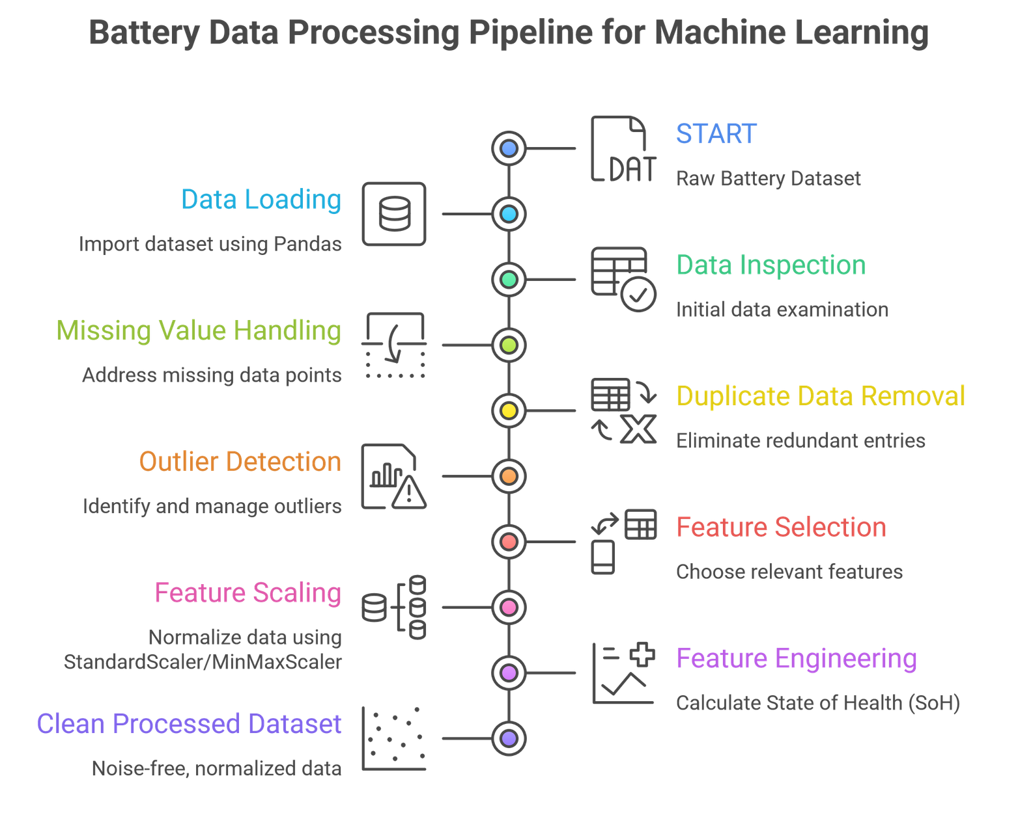

Slide 5
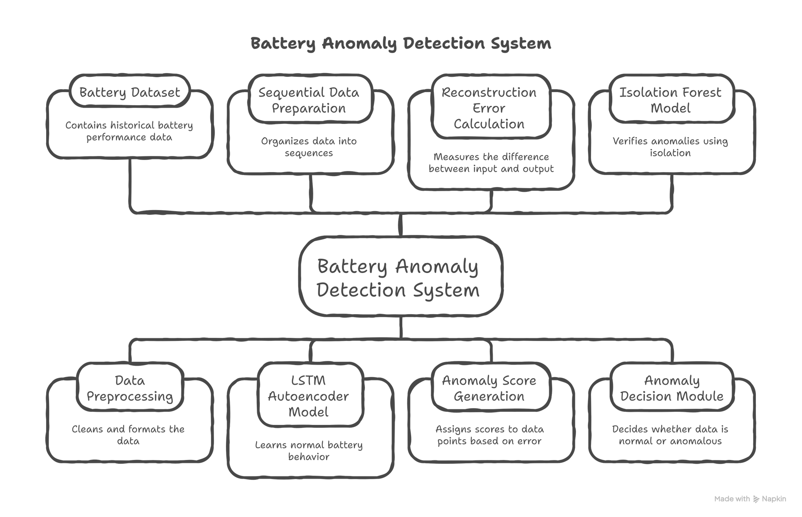

Slide 6
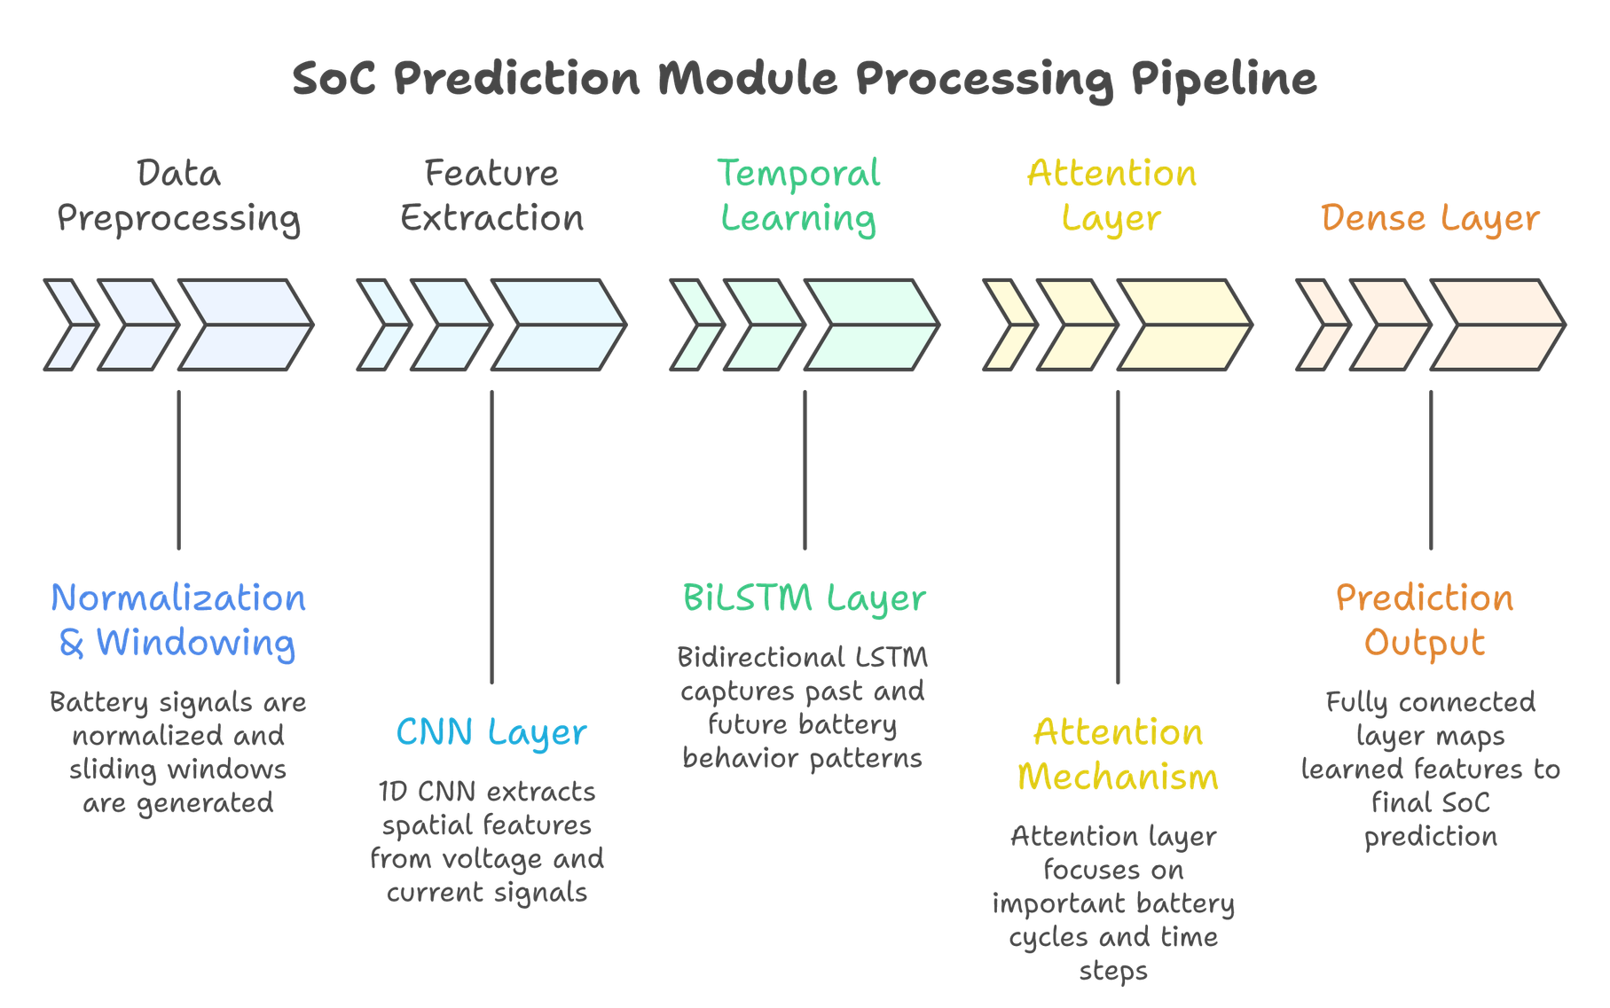

Slide 7
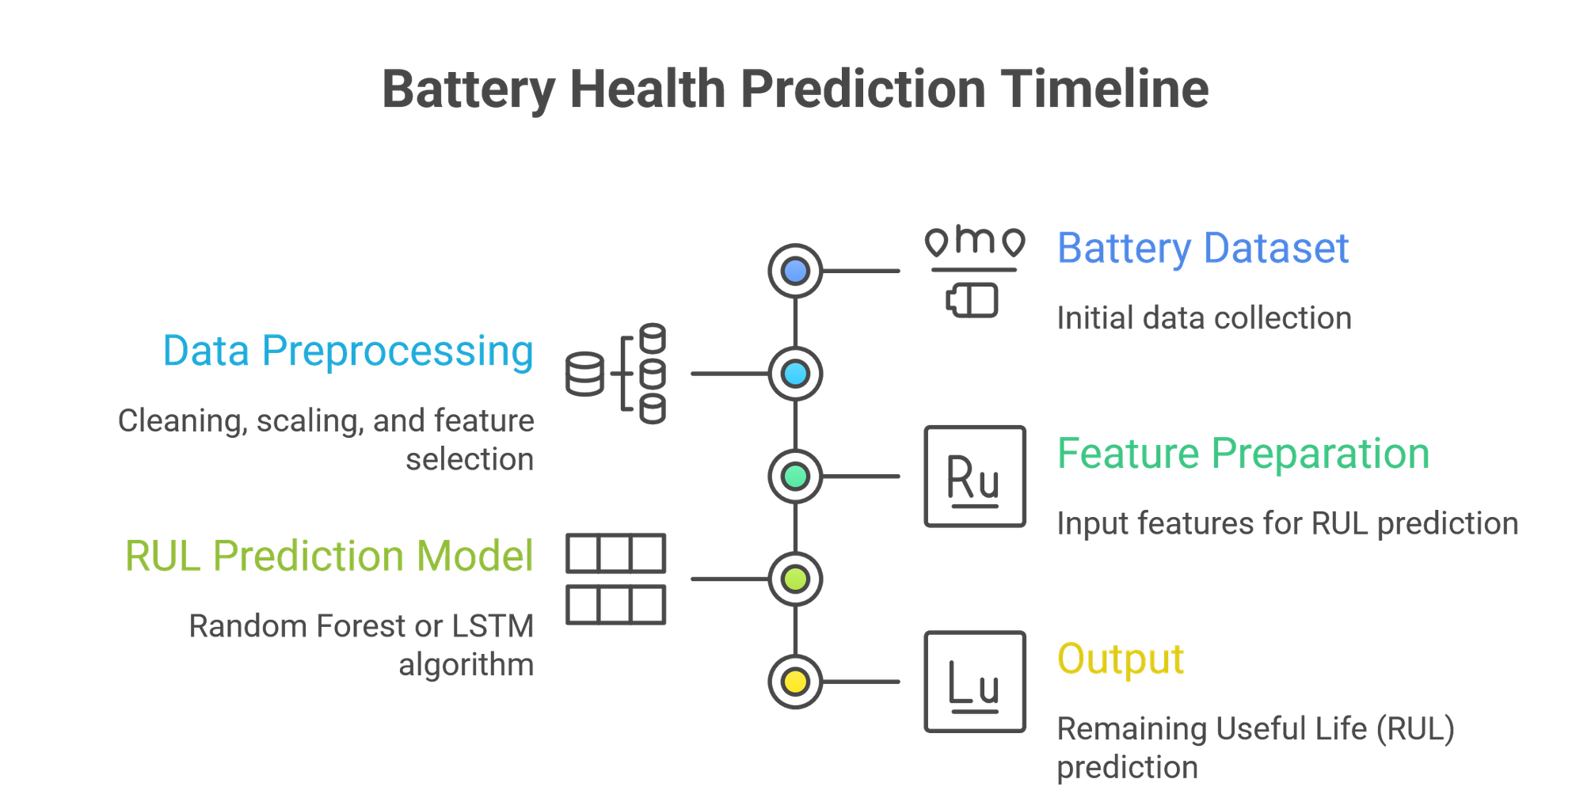
RUL (REMAINING USEFUL LIFE)

Slide 8
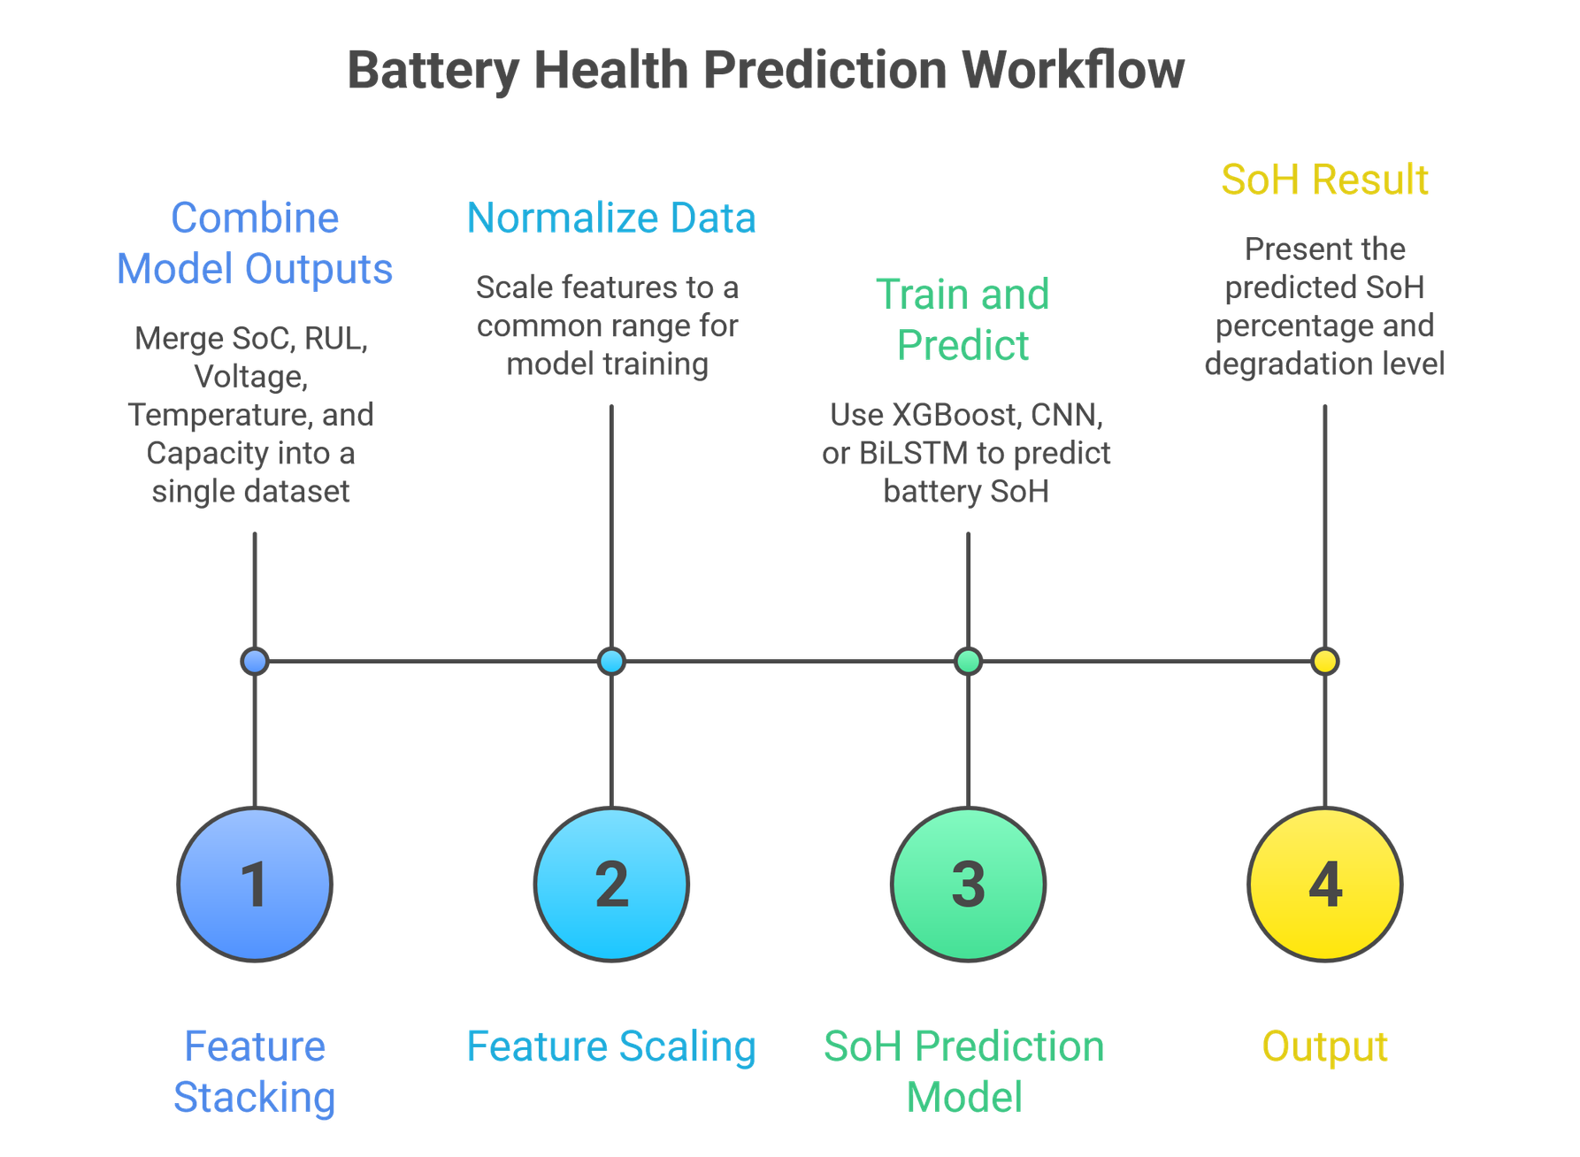

Slide 9
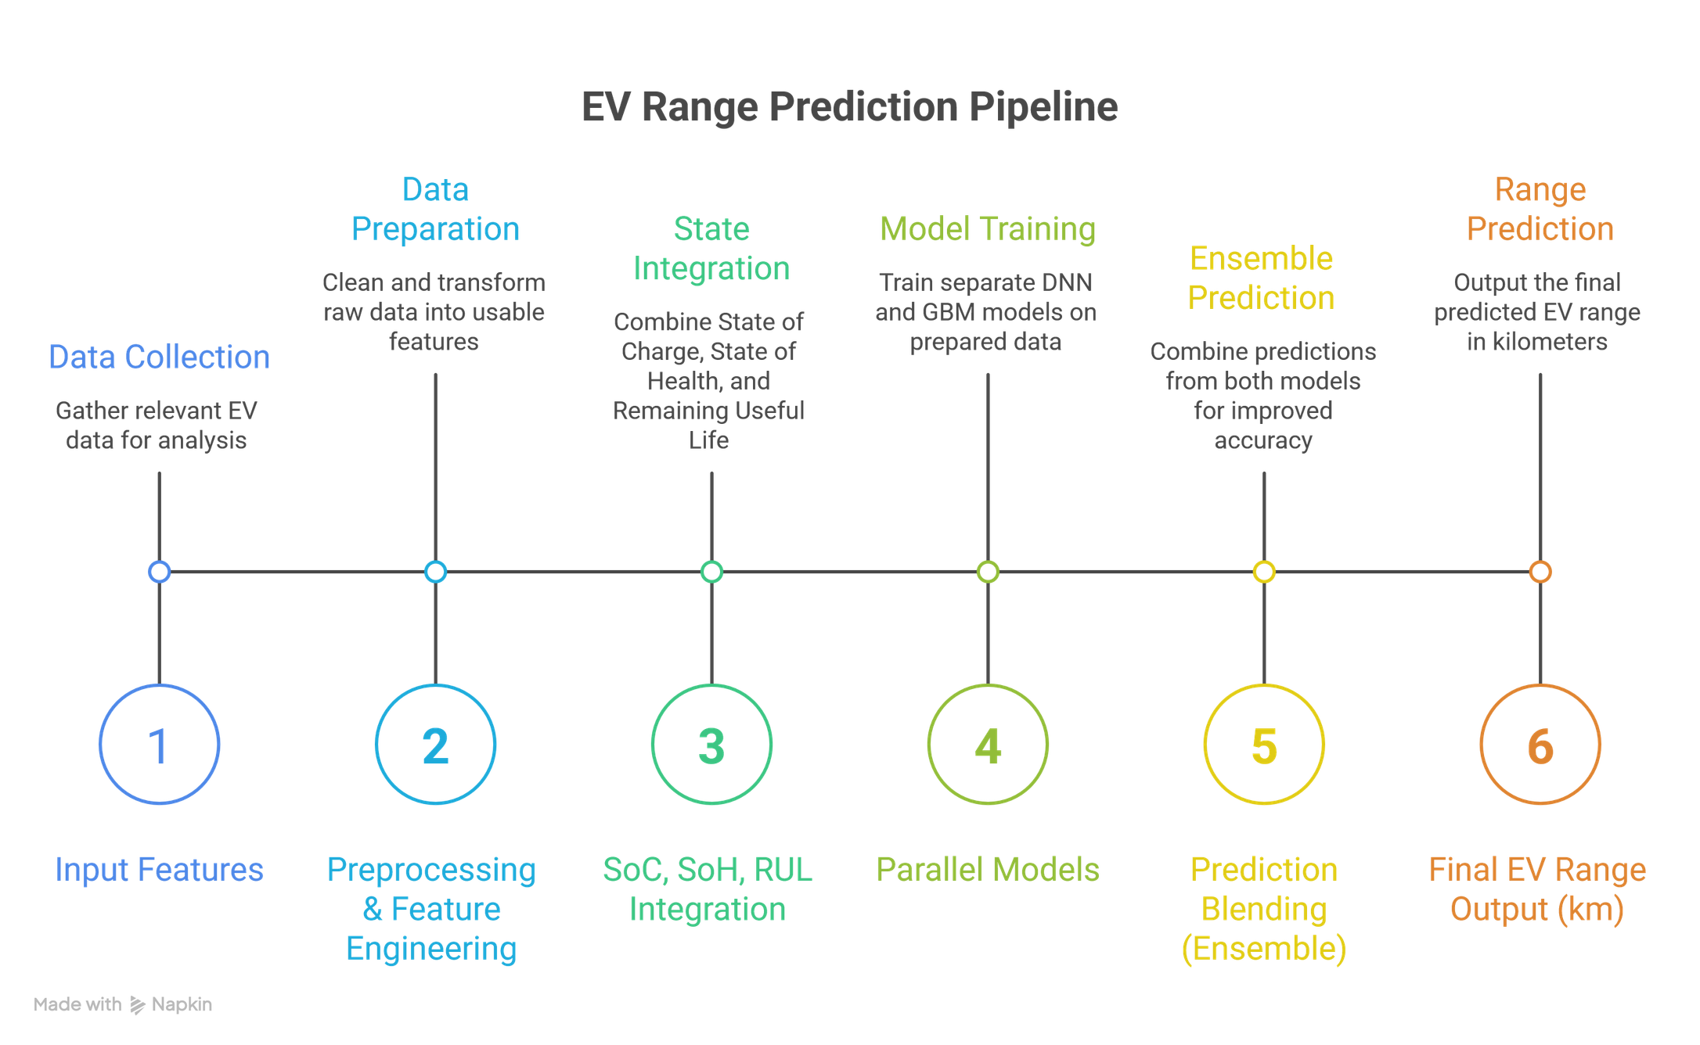
Range Prediction

Slide 10

Thank You
For your attention

