Slide 1
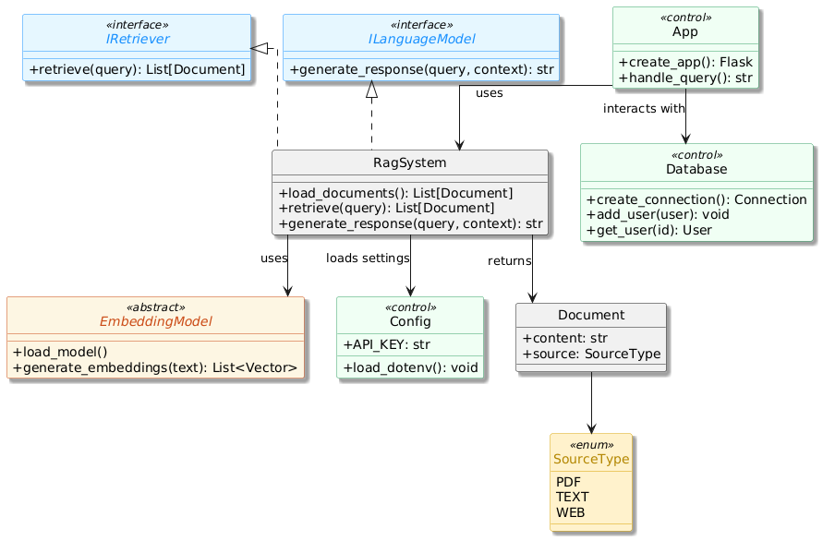
RAG BASED CHATBOT

