Slide 1
Guided Capstone Project
Big Mountain Resort

Slide 2
Problem Identification
Big Mountain Resort, a ski resort located in Montana. There has been a recent installation of additional chair lift this has caused a rise of $1,540,000 in operational cost for this season.
With the new installation of additional chair lift and facilities present, Big Mountain resort seeks to increase revenue to prevent any loss.
Therefore, investigation is done on ways to increase annual revenue by $2M through capitalizing on it facilities and having better values for ticket pricing.

Slide 3
Recommendation and Key findings
From this project it is recommended that:
Ticket Prices should be increased
The vast majority of resorts, such as Big Mountain, have no trams. It is recommended Big Mountain get some
Increasing the vertical drop by adding a run to a point 150 feet lower down but requiring the installation of an additional chair lift will help increase revenue

Slide 4
Model Results
Big Mountain Resort modelled price is $95.87, actual price is $81.00. Even with the expected mean absolute error of $10.39, this suggests there is room for an increase.
Generally, in Market Context Big Mountain above average, this was obtain using features that was important to the model.
For an expected number of visitors over 350,000, it was observed that increasing vertical drop requiring the installation of an additional chair lift to bring skiers back up, increases support for ticket price by $1.99. Over the season, this could be expected to amount to $3,474,638.

Slide 5
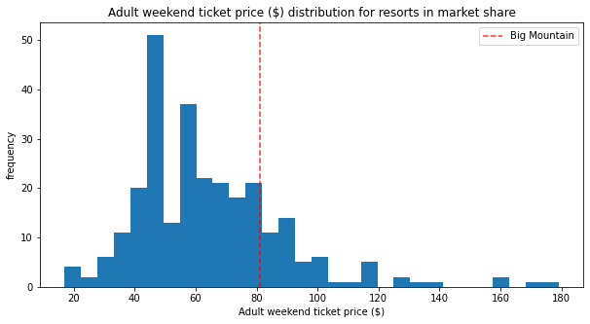
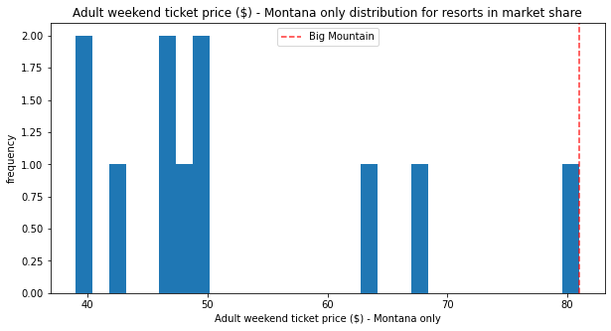
Comparing Ticket Prices.
The red vertical dash line represent Big Mountain

Slide 6
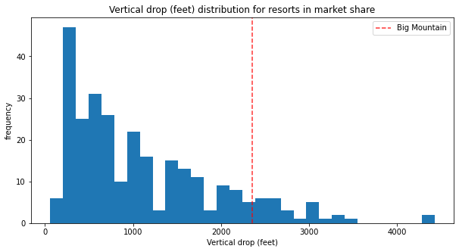
Comparing Vertical Drop
Big Mountain is doing well for vertical drop, but there are still quite a few resorts with a greater drop.

Slide 7
Summary and Conclusion
The outcomes and finding in this project are limited to the data obtained,
To achieve the goals stated in this project, ticket prices must be increased.

